Slide 1
Estimating resource availability in the power5 processor
^{20th} May 2008
Presented by Mitesh Meswani

Slide 2
Outline
Problem Description
FPU Availability
FXU Availability

Slide 3
How do we know if a resource is available for another thread to use?
Ideally, we want to pair a thread with low resource usage with a high resource usage
In a perfect world we know in every cycle:
For each functional unit
Busy or free state of the functional unit
Number of free entries in the issue queues
Number of free renaming registers
Available entries in branch history table
Number of free TLB entries
Number of free cache lines

Slide 4
Continued
We have the following metrics:
Number of cycles stalled for a unit
Number of events of a particular type, e.g., number of floating-point events
What does Stall tell us
Unit is not available
If no stall, we don’t know how many entries are free
What does event count give us
Compare the maximum computation rate for the event with observed event rate
We need to combine the above to estimate resource availability

Slide 5
Steps to Estimate Resource Availability
Step 1:
Identify stall counters
Identify event counters
For each event determine maximum supported rate
Step 2: for a given resource, set thresholds for the counters to map to high and low usage

Slide 6
POWER5 Architecture

Slide 7
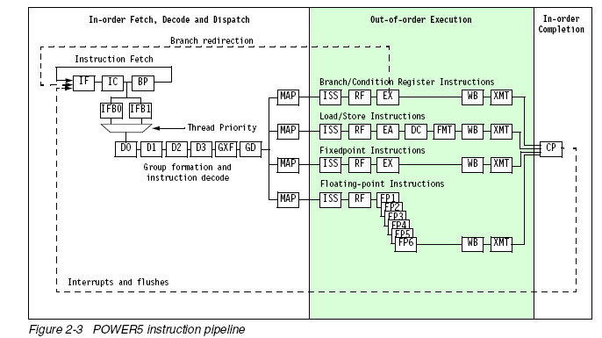
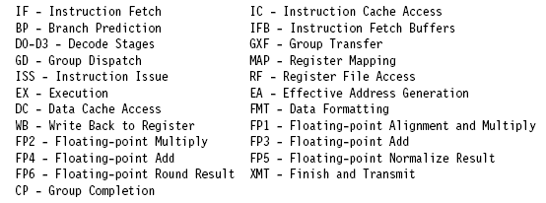
POWER5 Instruction Flow

Slide 8
POWER5 PMU
Six groups of events can be counted per thread
900 total events
Events are tracked by groups
Monitoring is complex: have 20 groups past dispatch, 32 outstanding loads, 16 outstanding misses, speculative execution
Upon group completion, the counters will report the last condition that stalled completion, cache misses are favored over function unit stalls

Slide 9
FPU Availability
FPU Resources:
Two FPUs (six cycle pipe)
Two 12-entry issue queues
120 renaming registers
Stall Counters:
Cycles FPR mapper was full
Issue queue stalls:
Cycles FPU0 full
Cycles FPU1 full
Completion Stalls:
Cycles stalled for FDIV/FSQRT
Cycles stalled for FPU instructions

Slide 10
FPU Event Counts for each FPU (0/1)
Instructions:
FSQRT
FEST
DENORM
FMOV_FEST
FDIV
FRSP_FCONV
FMA
STF
FPSCR
Groups:
SINGLE: Single precision instructions
1FLOP: 1FLOP instruction excludes FMA
Other events:
STALL3: stalled in pipe3
FIN: unit produced a result

Slide 11
FXU Availability
FPU Resources:
Two integer units
Two 18-entry issue queue shared with load-store unit
120 renaming registers
Stall Counters:
Cycles GPR mapper was full
Issue queue stalls:
Cycles for FXLSO stall
Cycles for FXLS1 stall
Completion Stalls:
Cycles stalled for FXU instructions
Cycles stalled for DIV instruction
Cycles FXU0 busy and FXU1 idle
Cycles FXU1 busy and FXU0 idle
Cycles FXU idle
Cycles FXU busy

Slide 12
FXU Event Counts for each FPU (0/1)
Instructions: None!
Other events:
FIN (produced result)

Slide 13
Branch Prediction Hardware Availability
Branch Prediction Hardware:
Shared three branch history tables: Two tables for two algorithms (bimodal, path correlated), one to predict the algorithm to use
One shared 32-entry target cache to predict branch conditional to address in count register
One 8-entry return stack per thread to predict return address of subroutine

Slide 14
Counters for branches
Stall Counters:
GCT_NOSLOT_BR_MPRED (Pipe is empty due to misspredictions)
Event Counters
FLUSH_BR_MPRED
Branch Issued
Unconditional branch
Predicted conditional branch with CR prediction and/or branch target prediction
Branch Misspredicts due to target address and/or CR prediction

