Slide 1
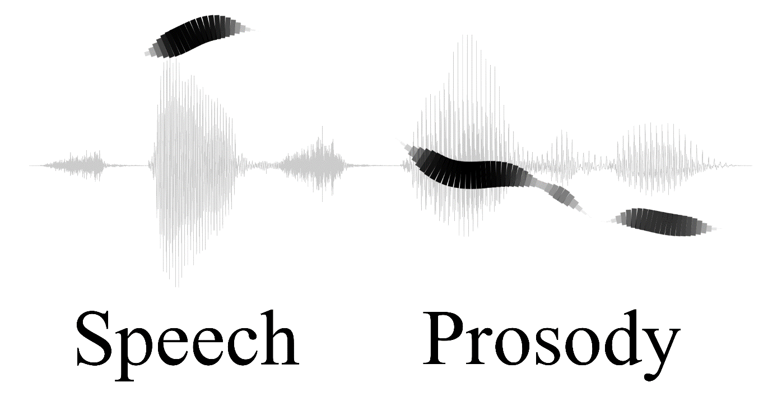
Two Pragmatic Functions of Breathy Voice
In American English Conversation
Nigel G. Ward, Ambika Kirkland, Marcin Wlodarczak, Eva Szekely
University of Texas at El Paso, KTH, Stockholm University
Speech Prosody 2022, to appear
Notes:
Please help me debug my presentation

Slide 2
Language = words + prosody …
intonation + intensity + timing + voicing …
modal + harmonic + falsetto + creaky + whispered + breathy …
https://www.ims.uni-stuttgart.de/institut/arbeitsgruppen/ehemalig/ep-dogil/EGG/page10.htm#modal

Slide 3

Language = words + prosody …
intonation + intensity + timing + voicing …
modal + harmonic + falsetto + creaky + whispered + breathy …
Give it a try!
https://www.ims.uni-stuttgart.de/institut/arbeitsgruppen/ehemalig/ep-dogil/EGG/page10.htm#modal

Slide 4
So, what does breathy voice do in English?

Slide 5
Outline
Articulatory and acoustic aspects,
previous work
Discovery method
Functions found:
self-directed speech, grounding
Experimental verification

Slide 6
Functions of Prosody
paralinguistic
phonological
pragmatic

Slide 7
Functions of Prosody
phonological
Breathy voice is phonemic in Gujarati, but not English

Slide 8
Functions of Prosody
paralinguistic
“seductiveness” (acted)
pragmatic

Slide 9
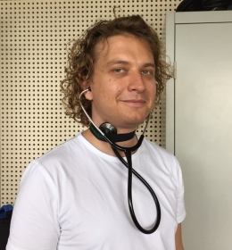
Functions of Prosody
So, what does breathy voice do in English,
in terms of pragmatic functions?
pragmatic
Marcin Wlodarczak
Stockholm University

Slide 10
Problem: breathy voice is an elusive percept
So we need
A feature detector
A corpus
A workflow

Slide 11
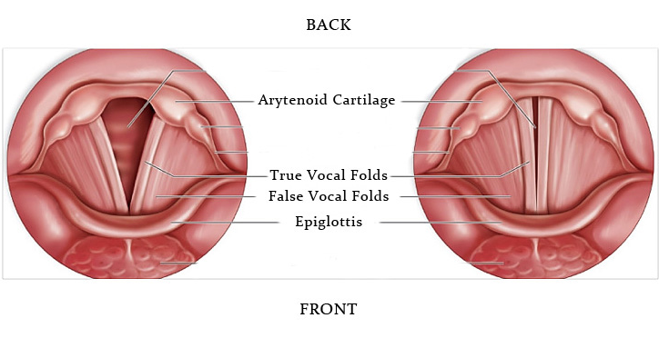
https://www.phon.ucl.ac.uk/courses/plin0065/week4.php

Slide 12
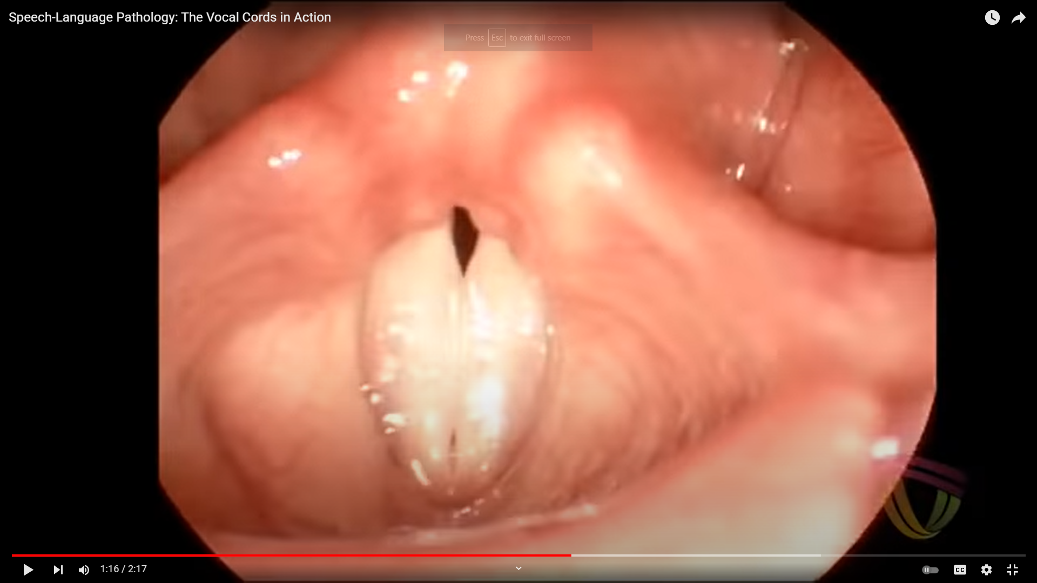
https://www.youtube.com/watch?v=y2okeYVclQo 1:45 – 2:05

Slide 13
Acoustic correlates of breathy vocal quality: dysphonic voices and continuous speech
J Hillenbrand, R A Houde JHSR 1996

Slide 14
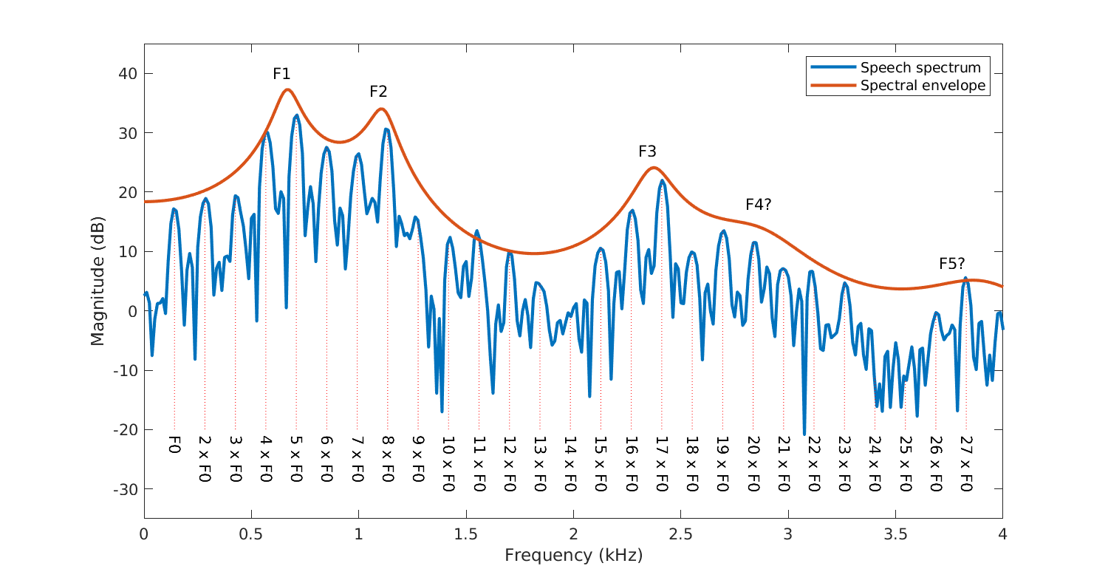
https://wiki.aalto.fi/pages/viewpage.action?pageId=149890776

Slide 15
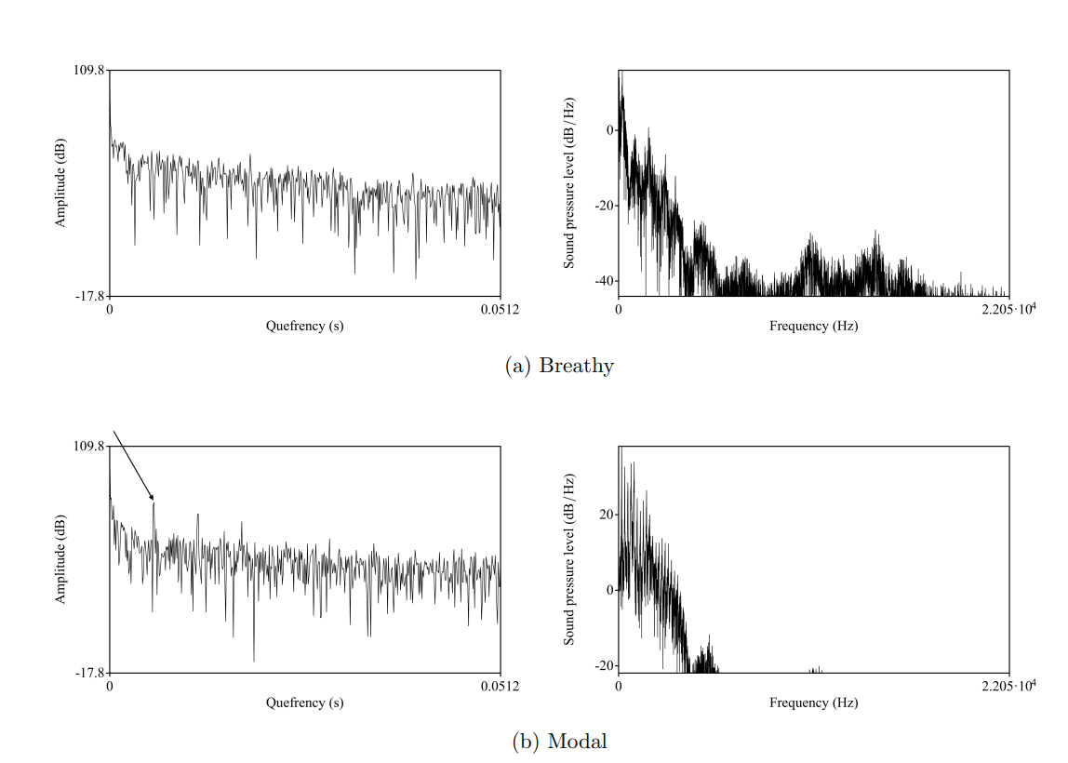
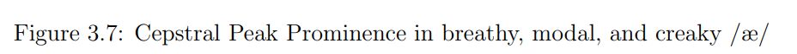
A cepstral peak
Laura Panfili, 2018

Slide 16
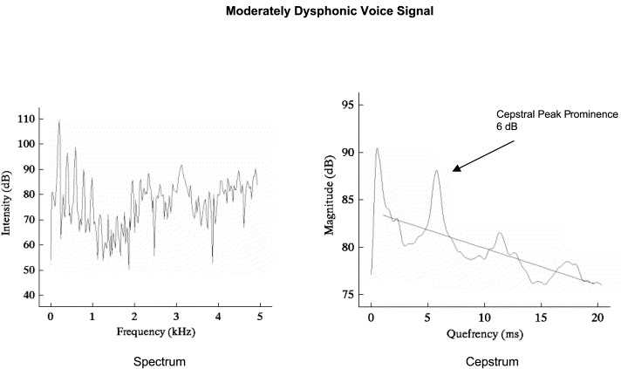
Yolanda D Heman-Ackah, et al., Journal of Voice, 16, 2002
inverseFourierTransform(log(signal spectrum)) = cepstrum

Slide 17
CPPS (Cepstral Peak Prominence Smoothed)
Medically, low CPPS indicates breathy voice
What about in conversation?
Laura Panfili, 2018

Slide 18
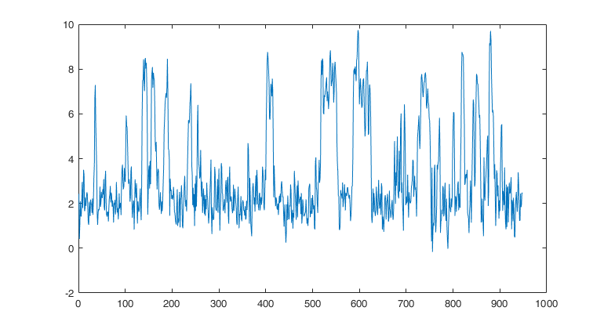
n
uh so
In conversation, CPPS correlates -0.363 with breathy voice, (Panfili 2018)
in part due to local phonetic effects
but this is still better than NHR, etc.

Slide 19
Problem: breathy voice is an elusive percept
So we need
A feature detector
A corpus
A workflow
to overcome pervasive confounds
via a “big data” approach
using the UTEP Social Speech Corpus

Slide 20
Problem: breathy voice is an elusive percept
So we need
A feature detector
A corpus
A workflow

Slide 21
Analysis Strategy
Problem: breathiness by itself means nothing
(in general, prosodic features work together
i.e., they rarely have meaning in isolation)
∴ We use Prosodic Constructions, which are
form-function mappings, between
- temporal configurations of prosodic features
- pragmatic and interactional functions
--- our theoretical framework ---
c.f. Construction Grammar

Slide 22
Workflow
1. Discover configurations of
frequently co-occurring features
by Principal Component Analysis (PCA)
over 200+ prosodic features
at each of 400,000+ samples over dialog data
2. Seek meanings for these configurationswi

Slide 23
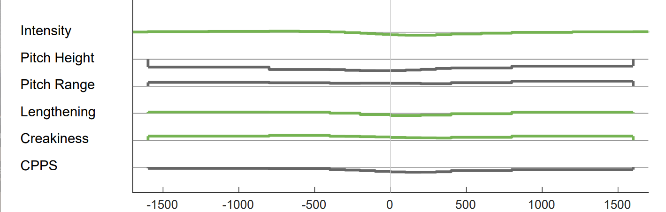
PCA Dimension 5
milliseconds
low pitch
slightly wide pitch range over about 3 seconds
creaky voice
breathiness over about 1 second

Slide 24
PCA Dimension 5
… need to think about, so I can write it up in the document, to where we’re gonna give to the taggers
and like, I could just imagine being part of something like that
low pitch
slightly wide pitch range over about 3 seconds
creaky voice
breathiness over about 1 second
utep-social00@9:26, utep-social04@5:43

Slide 25
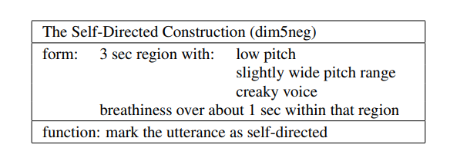
Common Uses of Dimension 5
musings …
not intended to affect the hearer nor evoke a reaction …
temporarily disengaging from the interaction

Slide 26
Try it with a neighbor
Hello, (to self: wow it’s warm today). How are you?
working a company really making a difference …
I could just imagine being part of something like that

Slide 27
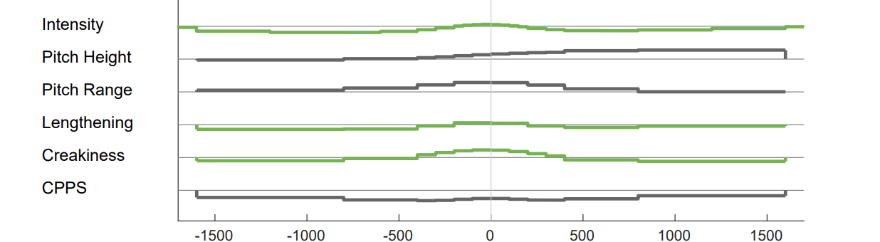
PCA Dimension 10
milliseconds
breathy voice over about 3 seconds
creaky voice
wide pitch
pitch rise after that region
over about 1 second

Slide 28
PCA Dimension 10
um, I’m a transfer student, from EPCC ↑
They’re searching for content? they’re searching for↑ . . . // yeah⇑, content, um↑ // a feeling↑
breathy voice over about 3 seconds
creaky voice
wide pitch
pitch rise after that region
over about 1 second
utepsocial04@1:00, utepsocial00@9:12

Slide 29

Common Uses of Dimension 10
shared laughter …
trying to establish the context …
preliminary to a deeper discussion …
trying to reach agreement …
trying to name something …

Slide 30
Try it!
Me? Well, I’m from El Paso (out in Texas) …
first imagining talking to a stranger you’ve met in Paris…
then imagining you’re talking to someone in Dallas

Slide 31
Experiment
Hypothesis: Native speakers will judge stimuli that exemplify these constructions to have the claimed meanings more often than controls
Participants: 99 crowdworkers, native speakers of English
Stimuli: 47 clips, 7 or 8 exemplifying each pattern or the opposite

Slide 32
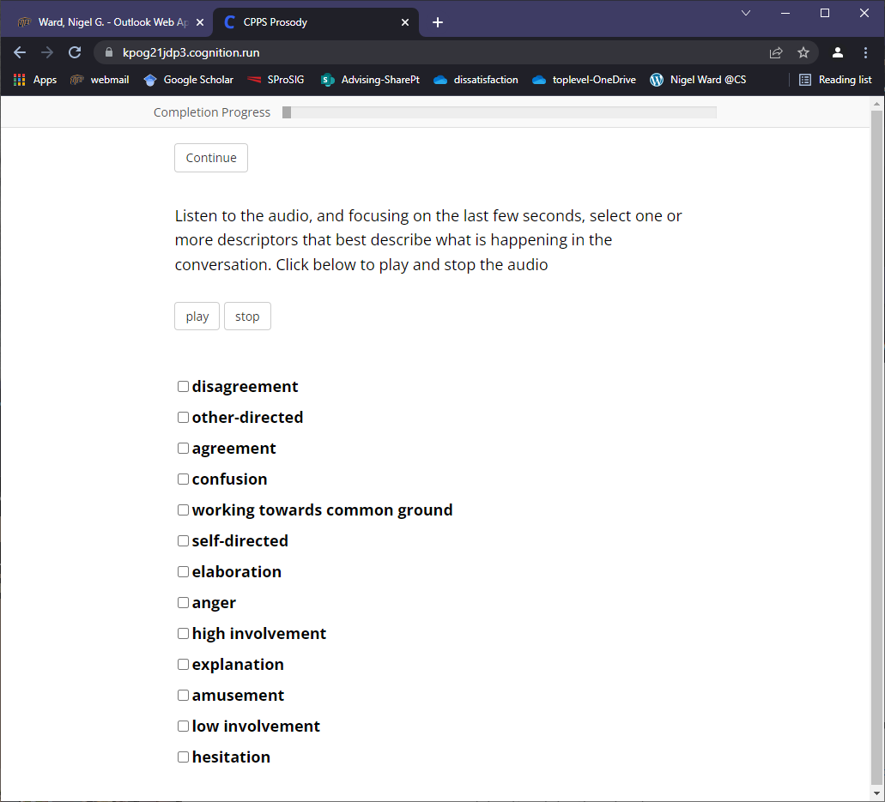

Slide 33
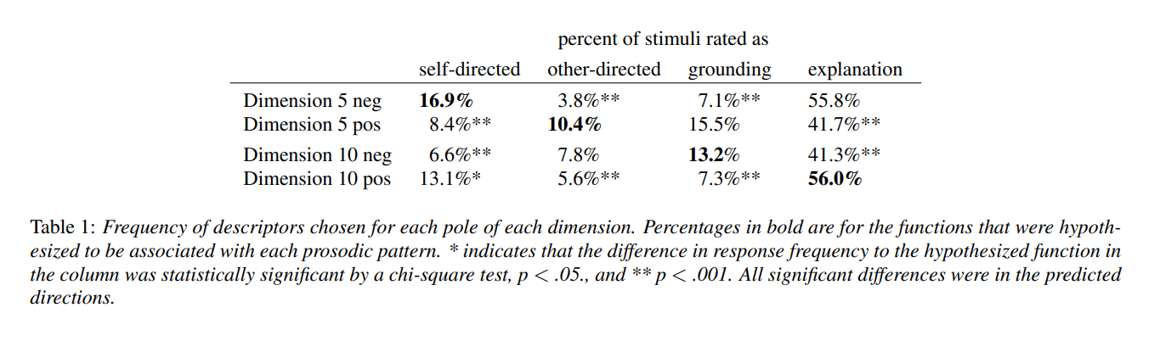
significance at p < .002, χ2

Slide 34
Summary
Breathy voice conveys
self-directed talk
when brief and in the vicinity of
low, wide pitch, and creaky voice
grounding attempts
when longer and surrounding brief
creaky voice leading to a pitch rise
Value: for learners of English, for Alexa and friends,
for robots …

Slide 35
Open Questions
What about other languages?

Slide 37
The Opposite Patterns
Dimension 5 high:
Form: briefly modal or harmonic voice, in the midst of high narrow pitch
Function: other-directed
oh really, that’s horrible
Dimension 10 high:
Form: modal or harmonic voice, and ending lower in pitch
Function: explanation
we haven’t done anything, and the
only reason I like is that we haven’t
done anything

Slide 38
Extra Examples
Dimension 5 low (self-directed)
Dimension 10 low (grounding)
I didn’t see the stop sign
okay, so it’s been a little while since you’ve been programming⇑, or // no↑, it, um, it’s actually been really quick; I’ve only had a summer off.

Slide 39
Myths about Prosody
Myth
It’s mostly lexical and syntactic
Pragmatics is found at turn ends
It’s mostly about pitch
It’s symbolic
It’s concatenative
It’s localized
Reality*
It’s mostly pragmatic
Speakers signal ahead
It’s also rate, energy, creakiness …
It’s gradient
It’s superpositional
It’s patterns over several seconds
*at least for dialog, at least for English, at least mostly

Slide 40
Other possible functions
Marking priority and off-topic utterances
(Ward 2019)
Marking exasperation

Slide 41

Much More than Just intonation!
Meaning in multistream configurations of prosodic features
plus action, posture, gesture, gaze …

Slide 42
Prosody, Classic-ish Definition
The musical aspects of speech
Pitch … loudness, timing properties
and things that pattern with them:
Voicing present (binary) or periodicity
Phonation type: creaky / breathy / falsetto, nasal …
Reduction / enunciation
Rate features
Glottal pulse shape features
…
Thousands of derived features
+ movement
breathing
gesture
gaze
…
There exist engineered feature sets (feature salads)

Slide 43
Properties of Prosodic Constructions
Form
  pitch, plus energy, rate, creakiness … … …
  patterns in time
  may have contributions by both interlocutors
Function
Flexibility in Use
  Different strengths
  Superimposable
Related Constructions

Slide 44
morn
good
ing
Prosody has the power to evoke action

Slide 45
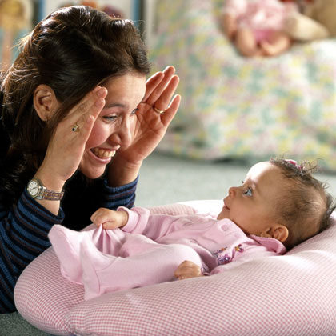
The Minor Third Construction
Common Uses
good morning
knock-knock
excuse me
unh-unh
go for it
peek-a-boo
…
What’s the shared meaning?

Slide 46
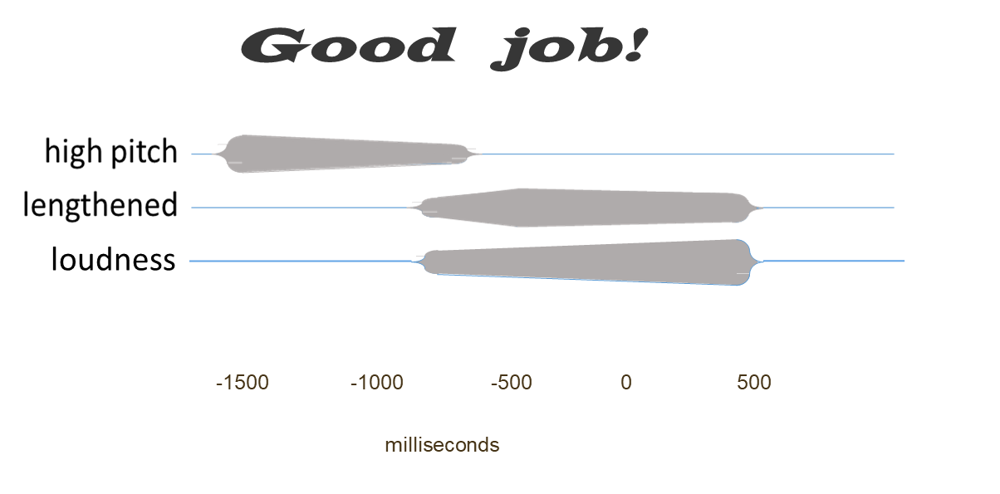
The Positive Assessment Construction
Meaning can inhere in multistream, temporal configurations of prosodic features
and possibly a stiffer tongue leading to clipped and/or released consonants

Slide 47
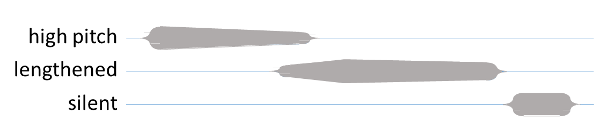
Positive Assessment Examples
I loved teaching, I love helping kids
I feel good
I also really love the Boondock Saints
stay on it … there you go
loudness
clipped
-1500 -1000 -500 0 500
milliseconds

Slide 48
Roles of Pragmatic Prosody
Turn taking
  Turn hold, turn end, basic turn switch, backchaneling, particle-assisted turn switch, fillers, emphatic pause …
Topic structuring
  Topic closing, topic involvement, topic development, digressions, priority topics
Expressing stance
  Positive assessment, contrast, apology
(Ward 2019)

Slide 49
Representations
punctuation (~200BC, ~700, ~1400 AD)
International Phonetic Alphabet
Conversation-Analysis conventions
ToBI (~1994)
Sable (1998)
. , ? !
˥˧ ˦˨ ˧˩ ˥˩ ˩˧ ˨˦ ˧˥ ˩˩˧ ˧˥˦ ˦˩˨ ˨˩˧
uh:m (1.0) pt [
L+!H* L-
<emph>

Slide 50
(Ladefoged, 1993)

Slide 51
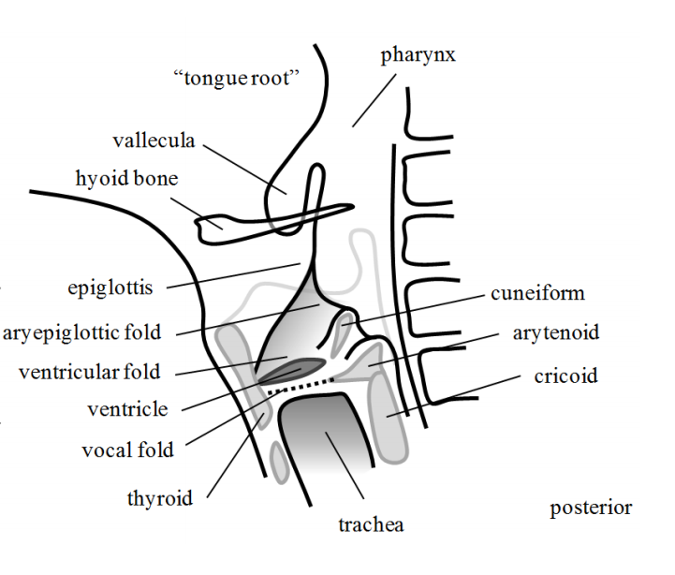
Still more features to discover?
(Ladefoged, 1993)
(Moisik 2013, Kaltenbacher 2019)

Slide 52
Corpus
The UTEP Social Speech Corpus
Ward & Werner, 2013

Slide 53
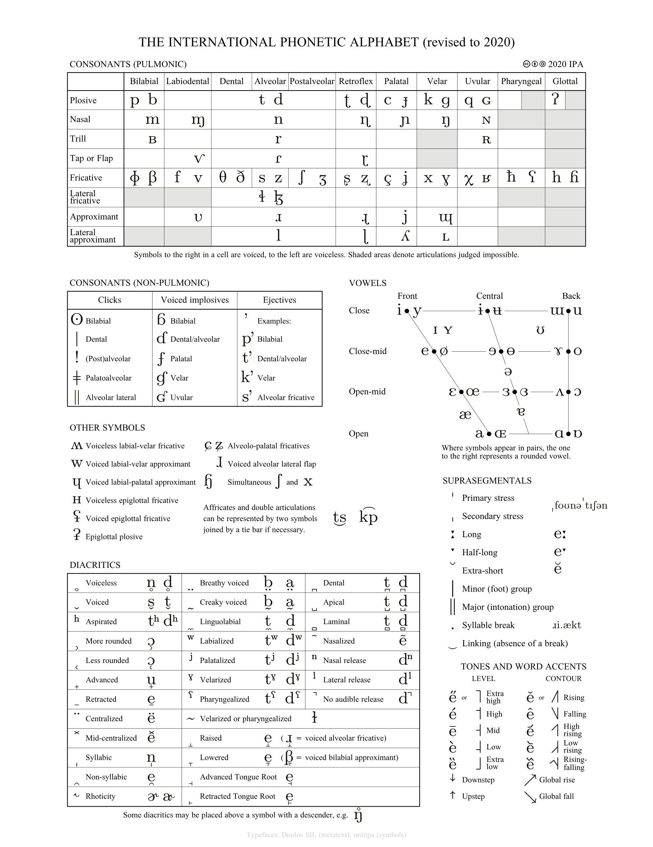
, and

Slide 55
nxh
n
Breathy voice is phonemic in Gujarati, but not English

