Slide 1
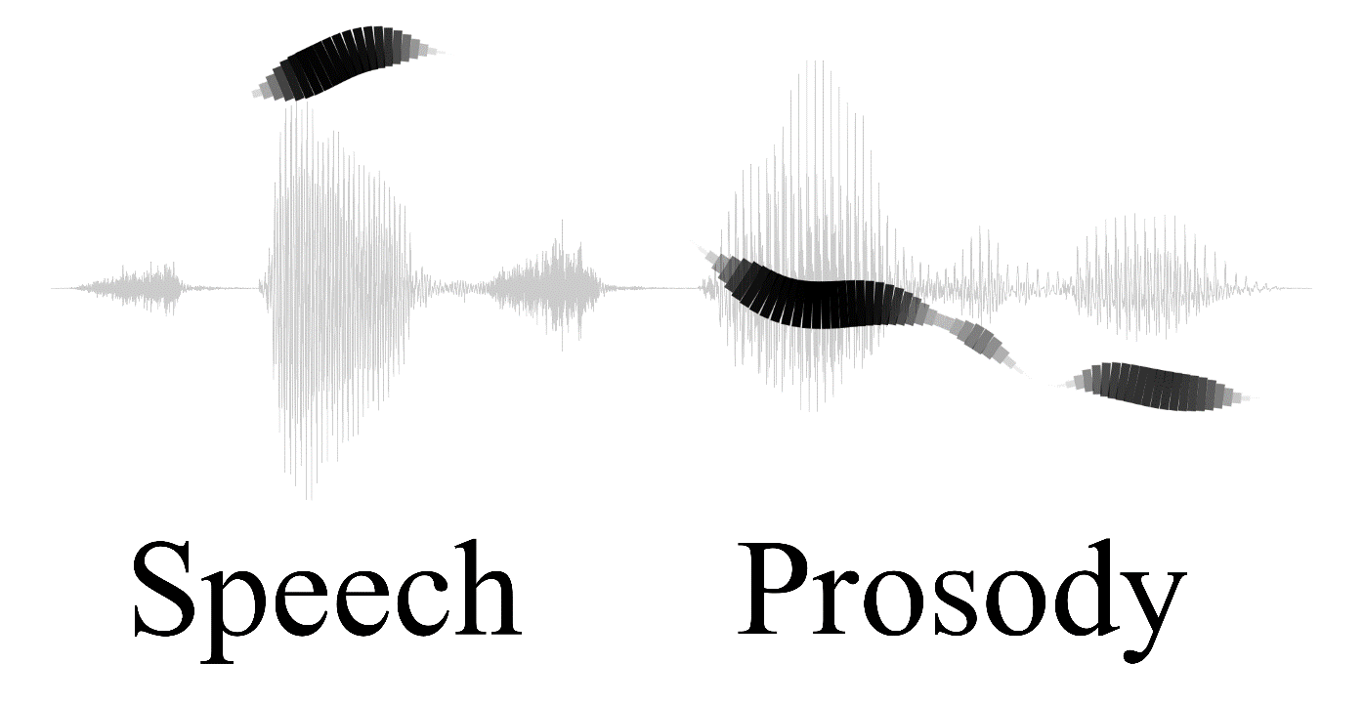
Prosody Research and Applications:
The State of the Art
Nigel G. Ward
University of Texas at El Paso
Interspeech, September 2019

Slide 2
good morning

Slide 3
good
morning

Slide 4
morn
good
ing
#1 Prosody has the power to move people!

Slide 5
Outline
Four prosodic constructions of English
Numerous applications
Recent significant
{ innovations
trends
issues
challenges }
cs.utep.edu/nigel/intro-to-prosody

Slide 6
Expressing Positive Feeling
thank you all for coming this morning
pitch
time

Slide 7
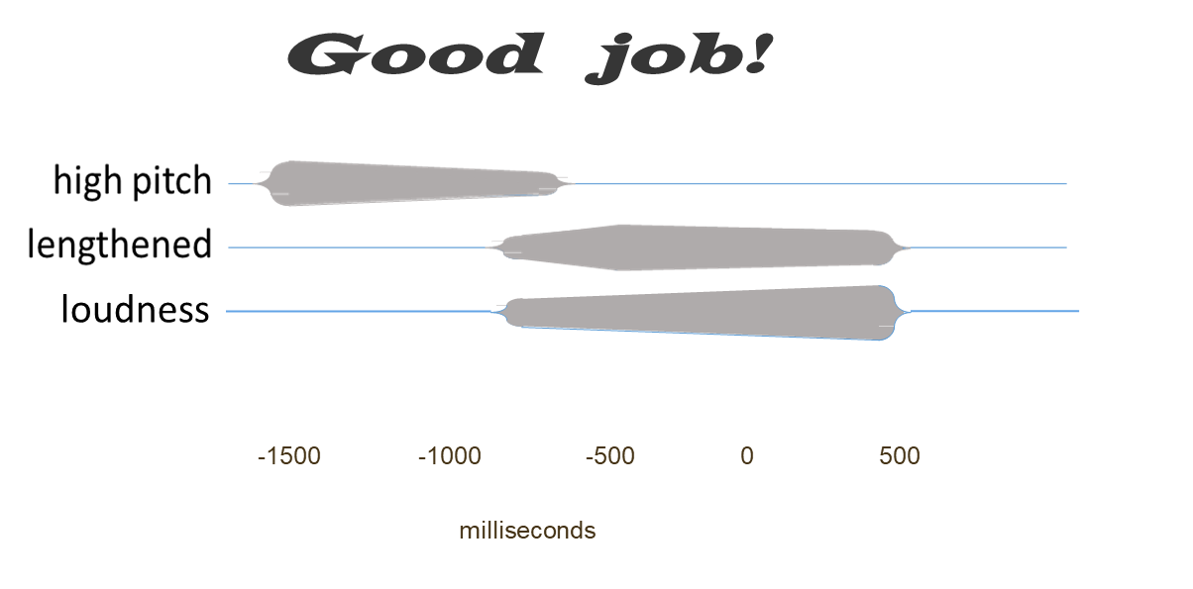
The Positive Assessment Construction
#2 Meaning can inhere in multistream, temporal configurations of prosodic features
and possibly a stiffer tongue leading to clipped and/or released consonants

Slide 8

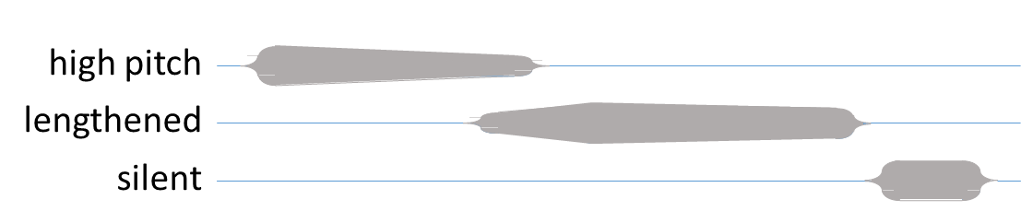
Positive Assessment Examples
I loved teaching, I love helping kids
I feel good
I also really love the Boondock Saints
stay on it … there you go
loudness
clipped
-1500 -1000 -500 0 500
milliseconds

Slide 9
Exercise
Find a partner and try it:
A: What’s this talk about?
B: It’s about Speech Prosody.
B’: It’s about ^{Speech} Prosody.

Slide 10
Positivity-Correlated Prosodic Features
longer vowel duration / longer stressed vowels in content words / fast and increasing rate
pitch ranges that extend higher / high pitch level, increased pitch range / exaggerated rise-fall F₀ / abrupt step-ups and rises / upward inflections
lower mean intensity / higher intensity / loudness on key words / earlier intensity drop / steeper intensity drop
modal voice / breathy voice
#2’ Correlation hunting is obsolete
#2’’ Early fusion can outperform late fusion
(Freeman et al., 2015; Freeman 2015; Freese and Maynard, 1998; Fernald 1989)

Slide 11
Functions of Prosody
paralinguistic
phonological
pragmatic

Slide 12
Functions of Prosody
paralinguistic
phonological
pragmatic

Slide 13
Paralinguistic Prosody
paralinguistic
Anger, frustration, uncertainty …
Tiredness, drunkenness …
Respiratory infections
Parkinsons, depression, autism …
Personality
Identity: gender, age, dialect, native language
…
Features + classifiers … a mature technology
(*c.f. OpenSmile (Eyben et al., 2010) (Schuller & Batliner 2013)

Slide 14
Paralinguistic Prosody
paralinguistic
Applications
Diagnosis
Emotional synthesis
Speaker identification
…

Slide 15
Functions of Prosody
paralinguistic
phonological
pragmatic

Slide 16
Phonological Prosody
phonological
Part of the identity of discrete linguistic elements
Tones and similar phenomena
  cónduct, condúct
  妈, 麻, 马, 骂
Boundaries
“Prominence”
. . .
Typically considered symbolic / categorical
(Hyman 2017)

Slide 17
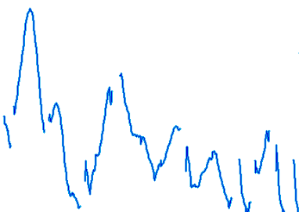
Phonological Prosody
phonological
… but in reality …
Beyond F₀
- c.f. duration, voicing, spectral info …
Beyond mere sequences of H and L, ˥˩ ˦˩˦ ˨˦ ˥ ...
- c.f. tone sandhi, coarticulation …
(Xu 2011)

Slide 18
Phonological Prosody
phonological
Applications
Speech recognition for tonal languages
Skills training
Synthesis: intelligibility, naturalness
…

Slide 19
Phonological Prosody
phonological
Approaches for Synthesis
Rule-based models
HMM Models
Sequence-to-sequence models

Slide 20
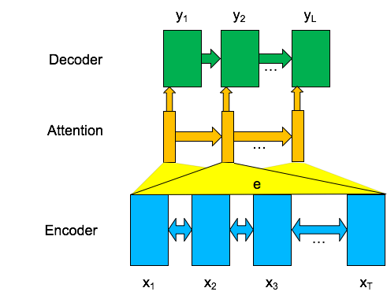
End-to-End Synthesis
phonological
Sequence-to-sequence modeling
No need to explicitly model intonation, duration, intensity, alignment …
Definition (new): Prosody is the variation in the speech signal not explained by phonemes, speaker identity, and channel effects.
Acoustic Sequence
Character or Phone Sequence
(Skerry-Ryan, Batenberg, et al. 2018) Figure from Andrew Rosenberg

Slide 21
Phonological Prosody
phonological
Approaches for Synthesis
Rule-based models
HMM Models
Sequence-to-sequence models
The Blue Lagoon is a 1980 American romance adventure film.
A mature* technology
intelligible / natural / expressive …
(Wang, Skerry-Ryan et al., 2017; etc)

Slide 22
End-to-End Synthesis
phonological
Sequence-to-sequence modeling
No need to explicitly model prosody
Acoustic Sequence
#3 How to leverage deep techniques to obtain knowledge to:
explain
transfer
control?
Character or Phone Sequence
(Skerry-Ryan, Batenberg, et al. 2018) Figure from Andrew Rosenberg

Slide 23
Functions of Prosody
paralinguistic
phonological
pragmatic
pragmatic
#4 Prosody works in diverse ways
# 5 Prosody is complexly multifunctional

Slide 24
Functions of Prosody
paralinguistic
phonological
pragmatic
#4 Prosody works in diverse ways
# 5 Prosody is complexly multifunctional

Slide 25
Applications involving Pragmatic Functions
Information retrieval
Speech recognition
Skills training
The science of human interaction
Synthesis for intent
Dialog systems
…
(Ward & DeVault 2016; Toyoma et al. 2018, Ward et al, 2018)

Slide 26
Roles of Pragmatic Prosody
Turn taking
  Turn hold, turn end, basic turn switch, backchaneling, particle-assisted turn switch, fillers, emphatic pause …
Topic structuring
  Topic closing, topic involvement, topic development, digressions, priority topics
Expressing stance
  Reluctance, shared enthusiasm, empathy bid, indifference, thoughtfulness, contrast …
(Ward 2019; Lai 2019 …)

Slide 27
Roles of Pragmatic Prosody
Turn taking
  Turn hold, turn end, basic turn switch, backchaneling, particle-assisted turn switch, fillers, emphatic pause …
Topic structuring
  Topic closing, topic involvement, topic development, digressions, priority topics
Expressing stance
  Reluctance, shared enthusiasm, empathy bid, indifference, thoughtfulness, contrast …
(Ward 2019; Lai 2019 …)

Slide 28
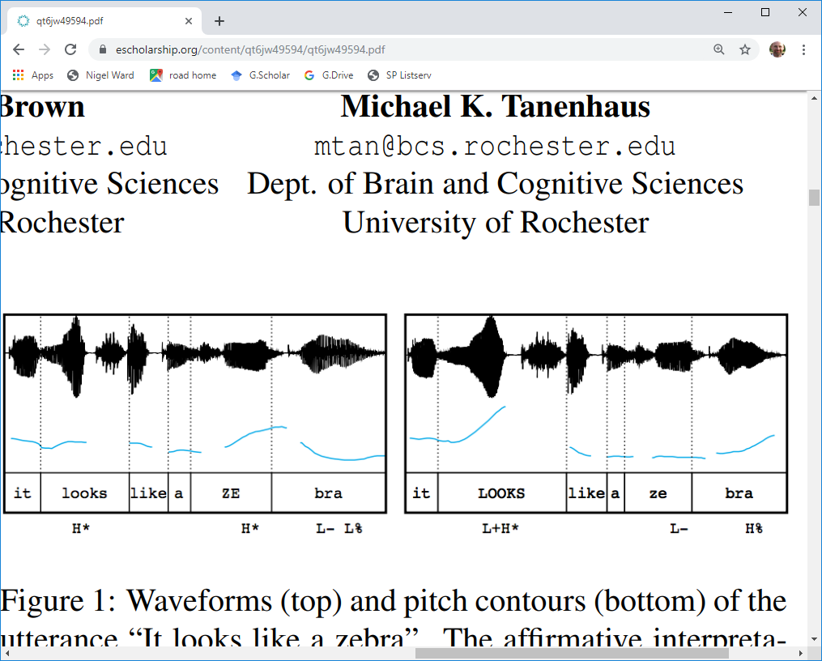
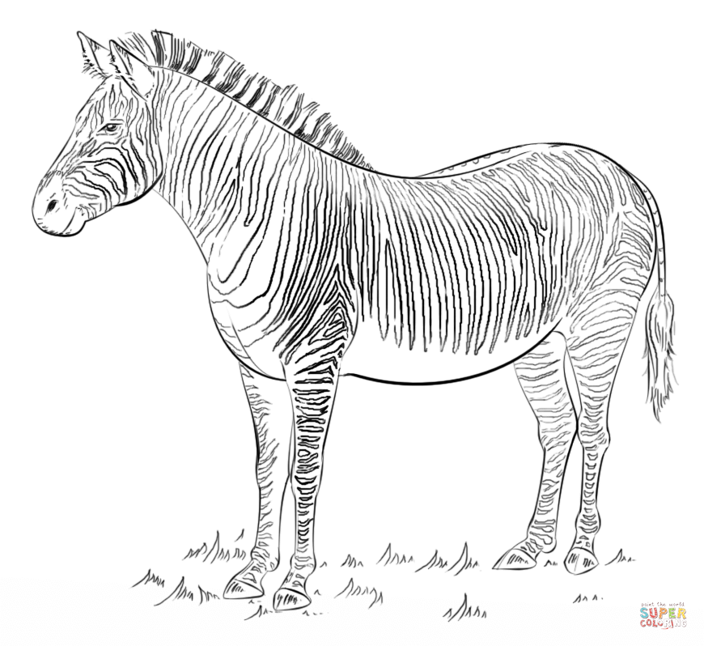
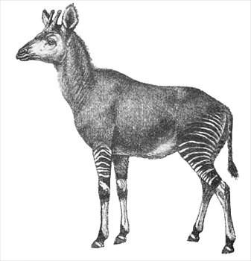
The Contrast Construction
Lena London, supercoloring.com
(Kurumada et al. 2012)

Slide 29
The Contrast Construction

Slide 30

The Contrast Construction
bookends
narrow pitch region
    The buses aren't the problem, they actually provide a solution.
#7 Prosody can be suprasegmental and supralexical

Slide 31

Still a Challenge for Synthesis
The buses aren't the problem, they actually provide a solution.
Synthesized
trained on data with prominence marked by capitalization
    The buses aren't the PROBLEM, they actually provide a SOLUTION.
Reference
#8 Not all of prosody is unit-linked!
#9 What are the functions? How do we help AI to catch up?
https://google.github.io/tacotron/publications/tacotron/index.html

Slide 32
A Matter of Degree
Δ = 20%
Δ =12.5%
8 steps
(Ward & Jodoin, 2019)

Slide 33
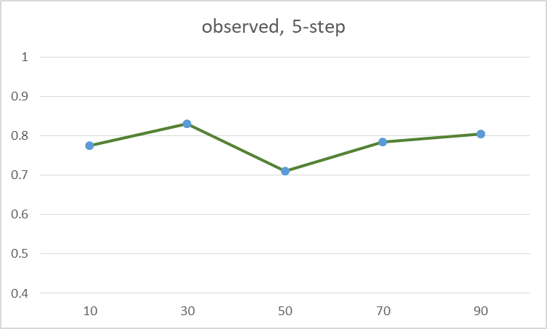
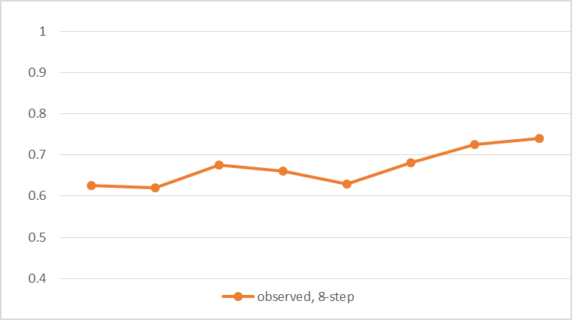
A Matter of Degree
Fraction of times the stronger prosody
was judged as sounding more positive*
Δ = 20%
Δ =12.5%
8 steps
#3 Gradient meanings (not categorical)
(Ward & Jodoin, 2019) *all p < 0.05 by the binomial distribution

Slide 34
morn
good
ing

Slide 35
The Minor Third Construction
“Good Morning”
loud
high harmonicity
not low in pitch range
preceded by silence
flat on lead-in too
pre-downstep articulated
post-downstep
  less flat
  longer
  more harmonic
flat
lengthened (200ms +)
pitch
~3 semitones
flat
lengthened
time
(Ladd 1978, Day-O’Connell 2013; Niebuhr 2015)

Slide 36

Much More than Just intonation!
#1 multistream configurations of prosodic features

Slide 37
Prosody, Classic Definition
The musical aspects of speech
Pitch … loudness, timing properties
and things that pattern with them:
Voicing present (binary) or periodicity
Phonation type: creaky / breathy / falsetto, nasal …
Reduction / enunciation
Rate features
Glottal pulse shape features
…
Thousands of derived features

Slide 38
Prosody, Classic-ish Definition
The musical aspects of speech
Pitch … loudness, timing properties
and things that pattern with them:
Voicing present (binary) or periodicity
Phonation type: creaky / breathy / falsetto, nasal …
Reduction / enunciation
Rate features
Glottal pulse shape features
…
Thousands of derived features
movement
breathing
gesture
…

Slide 39
(Ladefoged, 1993)

Slide 40
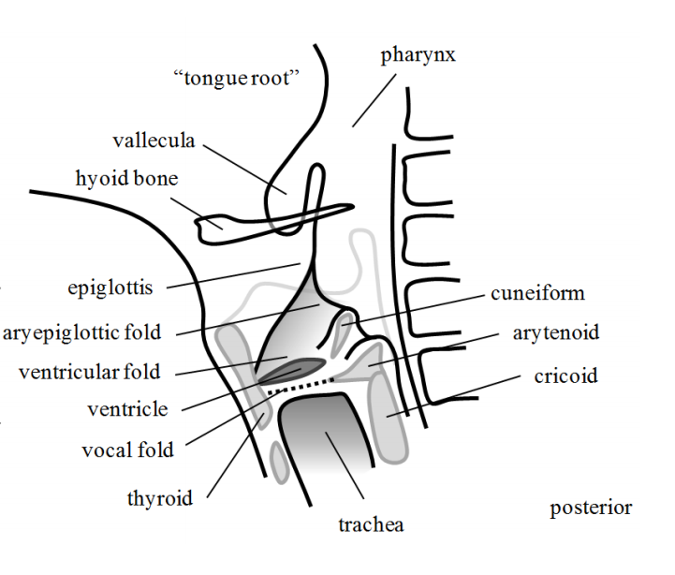
Still more features to discover?
(Ladefoged, 1993)
(Moisik 2013, Kaltenbacher 2019)

Slide 41
Prosody, Definition 2
The musical aspects of speech
Pitch, loudness, timing properties
and things that pattern with them:
Voicing present (binary) or periodicity
Phonation type: creaky / breathy / falsetto, nasal …
Reduction / enunciation
Rate features
Glottal pulse shape features
…
Thousands of derived features
Engineered Features Sets (or Feature Salads)

Slide 42
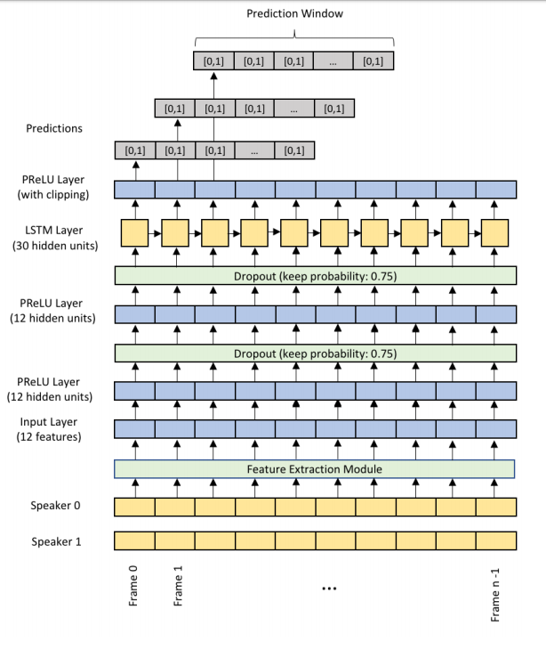
The Feature-Parsimony Alternative
Entrust temporal patterns to the model
  (e.g. a recurrent neural network)
Per-frame features only
  F₀ raw
  F₀ normalized
  voicing {0,1}
  energy
  voice activity {0,1}
  cepstral flux
(Skantze 2017)

Slide 43
The Feature-Parsimony Alternative
Entrust temporal patterns to the model
  (e.g. a recurrent neural network)
Enables better-than-human
prediction of turn end
Presumably computing
slope, max, avg etc.
multistream temporal
configurations
#10 Feature Parsimony
(Skantze 2017)

Slide 44
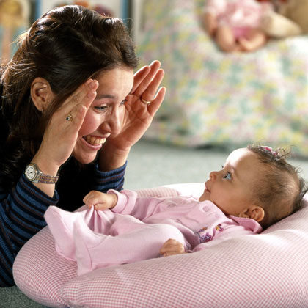
The Minor Third Construction
Common Uses
good morning
knock-knock
excuse me
unh-unh
go for it
bitte
peek-a-boo
…
What’s the shared meaning?

Slide 45

The Minor Third Construction
socially-required response
time
#11 Prosodic constructions can be joint patterns
(serving action coordination, rapport generation …)

Slide 46
Exercise
good
morning
Greet your neighbor, then reciprocate
Greet another neighbor the same way
Did it sound appropriate?
#12 Prosody marks role and interpersonal stance
#13 Prosody indexes context-awareness

Slide 47
Minor Third Construction for Calling
“S u s a n”
time

Slide 48
Calling: Variants
Can appear with
pitch wiggles - teasing
final rise - incomplete, inference invited, warning
shorter second syllable - reprimand
sloped pitch - command
initial syllabification - insistent
creaky voice - disappointment, judging
glottal stops - anger
…

Slide 49
Calling: Variants
Can appear with
pitch wiggles - teasing
final rise - incomplete, inference invited, warning
shorter second syllable - reprimand
sloped pitch - command
initial syllabification - insistent
creaky voice - disappointment, judging
glottal stops - anger
…

Slide 50
Calling: Variants
Can appear with
pitch wiggles - teasing
final rise - incomplete, inference invited, warning
shorter second syllable - reprimand
sloped pitch - command
initial syllabification - insistent
creaky voice - disappointment, judging
glottal stops - anger
…

Slide 51
Calling: Variants
Can appear with
pitch wiggles - teasing
final rise - incomplete, inference invited, warning
shorter second syllable - reprimand
sloped pitch - command
initial syllabification - insistent
creaky voice - disappointment, judging
glottal stops - anger
…

Slide 52
Calling: Variants
Can appear with
pitch wiggles - teasing
final rise - incomplete, inference invited, warning
shorter second syllable - reprimand
sloped pitch - command
initial syllabification - insistent
creaky voice - disappointment, judging
glottal stops - anger
…

Slide 53
Superposition
#14 Prosodic forms are superimposed (additive)
(not just concatenated)
With many communicative needs
(social, dialog, expressive, linguistic …),
and prosody being a low-bandwidth channel,
logically it must be multiplexed
#14’ Discovering prosodic forms is a challenge
(Novick, 2017)

Slide 54
Superpositional Modeling
(Bailly & Gerazov 2018; Fujisaki 1981; Xu & Prom-On 2014; Ward 2019)

Slide 55
Alignment Variation
good
hello everyone,
morning

Slide 56
Alignment Variation
good
hello everyone,
morning

Slide 57
Alignment Variation
good
hello everyone,
morning

Slide 58
Alignment Variation
good
hello everyone,
morning

Slide 59
Alignment Variation
good
hello everyone,
morn
-ing
#15 Prosody is semi-autonomous

Slide 60
More Alignment Variation
John

Slide 61
More Alignment Variation
John

Slide 62
More Alignment Variation
Joh
n

Slide 63
More Alignment Variation
Strategies for alignment ⁺
Segment Split
Epenthesis
Truncation
Undershooting
Compression
Re-alignment
Lengthening
Depend on the language
and the construction
John
ny
#16 Modeling Alignment Properties
(tricky since prosody is semi- autonomous)
⁺ a.k.a. tone-metrical association, a.k.a tune-text conflicts
(Torreira & Grice, 2018; Vigario, Cruz & Frota, 2019)

Slide 64
Positive Assessment, Again
I loved teaching, I love helping kids
I feel good
I also really love the Boondock Saints
stay on it … there you go

Slide 65
Positive Assessment, Again
I loved teaching, I love helping kids
I feel good
I also really love the Boondock Saints
stay on it … there you go
it's really cool like, coming up with like, you know, a program, and then like being able to see like, that program on someone else's phone
#14 Prosody is semi- autonomous

Slide 66
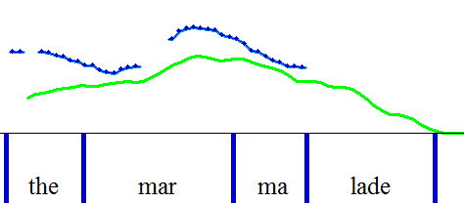
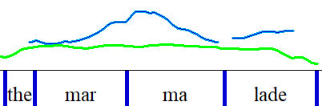
The Late Peak Construction
Aligned peaks
Late pitch peak
pitch
pitch
energy
energy
(c.f. Pierrehumbert & Steele, 1989, etc.)

Slide 67
Meanings in English
asking
questions
threatening
offering
seeking confirmation
inviting
inference
requesting
inviting
grounding
incredulity
new topic
correcting
misconceptions
storytelling
suggesting
reminiscing
distress
expressing
approval
mixed
feelings
speculating
imagining
shared
feeling
losing
control
partial
agreement
playing
laughing

Slide 68
Meanings in English
asking
questions
threatening
offering
seeking confirmation
inviting
inference
requesting
inviting
grounding
incredulity
new topic
correcting
misconceptions
storytelling
suggesting
reminiscing
distress
expressing
approval
mixed
feelings
speculating
imagining
shared
feeling
losing
control
partial
agreement
playing
laughing
#17 Sprawling networks of meanings

Slide 69
Meanings in English, etc.
but not in German
asking
questions
threatening
offering
seeking confirmation
inviting
inference
requesting
inviting
grounding
incredulity
new topic
correcting
misconceptions
storytelling
suggesting
reminiscing
distress
expressing
approval
mixed
feelings
speculating
imagining
shared
feeling
losing
control
partial
agreement
but not in
Swedish
playing
laughing
#17 Sprawling networks of meanings

Slide 70
Perceptions of Pitch
Factors affecting perceptions of lateness
#18 We don’t directly perceive pitch max (avg, min, height …)
(Niebuhr et al., 2011; Barnes et al., 2012)

Slide 71
Exercise
Máybe we can tálk more over cóffee.
Máybe we can tálk more over cóffee.
First as a brush-off (aligned pitch peaks)
Then as a sincere invitation (late peaks)
#19 Individual variation is enormous

Slide 72
Prosody Research and Applications:
The State of the Art
Máybe we can tálk more over cóffee.
A sincere invitation!
cs.utep.edu/nigel/intro-to-prosody
Interspeech, September 2019

Slide 74
(Cangemi, Albert, Grice, 2018)

Slide 75
Representations
punctuation (~200BC, ~700, ~1400 AD)
International Phonetic Alphabet
Conversation-Analysis conventions
ToBI (~1994)
Sable (1998)
. , ? !
˥˧ ˦˨ ˧˩ ˥˩ ˩˧ ˨˦ ˧˥ ˩˩˧ ˧˥˦ ˦˩˨ ˨˩˧
uh:m (1.0) pt [
L+!H* L-
<emph>

