Slide 1


Prosodic Patterns in Dialog
Nigel Ward
with Alejandro Vega, Steven Werner, Karen Richart, Luis Ramirez, David Novick and Timo Baumann
The University of Texas at El Paso
Based on papers in Speech Communication, Interspeech 2012, 2013 and Sigdial 2012, 2013.
SSW8, Sept. 1, 2013

Slide 2
Aims for this Talk
Prosodic Patterns in Dialog: A Survey
dialog
prosody
Prosodic Patterns in Dialog: A New Approach
Relevance for Synthesis

Slide 3
Outline
Using prosody for dialog-state modeling and language modeling
Interpretations of the dimensions of prosody
Using prosodic patterns for other tasks
Speech synthesis

Slide 4
Outline
Using prosody for dialog-state modeling and language modeling
Interpretations of the dimensions of prosody
Using prosodic patterns for other tasks
Speech synthesis

Slide 5
Dialog States
handy for post-hoc descriptions of dialogs
handy for design of simple dialogs
ask date
ask time
speak
listen
con-firm
grab
turn

Slide 6

True Dialog
dialog ≠ a sequence of tiny monologs
need true dialog to unlock the power of voice
rapport, trust, persuasion, comfort, efficiency …
voice user
interfaces
graphical user interfaces
human operators
low dialog complexity / richness / criticality high

Slide 7
Dialog States in True Dialog
Line | Transcription
GC0 | So you’re in the 1401 class?
S1 | Yeah.
GC1 | Yeah? How are you liking it so far?
S2 | Um, it’s alright, it’s just the labs are kind of difficult sometimes, they can, they give like long stuff.
GC2 | Mm. Are the TAs helping you?
S3 | Yeah.
GC3 | Yeah. *
S4 | They’re doing a good job.
GC4 | Good, that’s good, that’s good.
* Whose turn is this in? Is it a statement, question, filler, backchannel?
Disagreements are common … because these categories are arbitrary

Slide 8
Empirically Investigating
Dialog States
Using prosody, since
∈ {gaze, gesture, phonation modes, discourse markers … }
convenient
To be concrete, consider how prosody can help language modeling for speech recognition.

Slide 9
Language Modeling
Goal: assign a probability to every possible
word sequence
Useful if accurate,
e.g. P(here in Dallas) > P(here in dollars)
Standard techniques
use a Markov assumption
use lexical context (bigrams, trigrams)

Slide 10
Entropy Reduction Relative to Bigram, in bits, for Humans Predicting the Next Word
Lexical Context isn’t Everything
(Ward & Walker 2009)

Slide 11
Word Probabilities Vary with Dialog State (1/2)
In Switchboard, word probabilities vary with the volume over the previous 50 milliseconds:
more common after quiet regions:
bet, know, y-[ou], true, although, mostly, definitely …
after moderate regions:
forth, Francisco, Hampshire, extent…
after loud regions:
  sudden, opinions, hills, box, hand, restrictions, reasons

Slide 12
Word Probabilities Vary with Dialog State (2/2)
The words that are common vary also with the previous speaking rate:
after a fast word:
sixteen, Carolina, o’clock, kidding, forth, weights …
after a medium-rate word:
direct, mistake, McDonald’s, likely, wound
after a slow rate word:
goodness, gosh, agree, bet, let’s, uh, god …
(Do synthesizers today use such tendencies?)

Slide 13
Using Prosody in Language Modeling (Naive Approach)
For each feature
Bin into quartiles
At each prediction point, for the current quartile
Using the training-data distributions of the words,
Tweak the probability estimates

Slide 14
Evaluation
Corpus: Switchboard
    (American English telephone conversations among strangers)
Transcriptions: by hand (ISIP)
Training/Tuning/Text Data: 621K/35K/64K words
Baseline: SRILM’s order-3 backoff model

Slide 15
Perplexity Benefits
Feature Conditioned on | Perplexity reduction
Volume, speaker-normalized, over previous 50ms | 2.46%
Pitch height, speaker-normalized, over the previous 150ms | 1.90%
Pitch range, speaker-normalized, over the previous 225ms | 1.62%
Speaking rate, speaker-normalized, estimated over the previous 325 ms | 1.05% _____
Estimated lower-bound benefit (sum) | 7.0%
Top-8 Best Features, Combined | 4.8% *
* less than additive

Slide 16
The Trouble with Prosody (1/2)
Prosodic Features are Highly Correlated
pitch range correlates with pitch height
pitch correlates with volume
pitch at t correlates with pitch at t-1
speaker volume anticorrelates with interlocutor volume
…

Slide 17
The Trouble with Prosody (2/2)
Prosody is a Multiplexed Signal
there are so many communicative needs
(social, dialog, expressive, linguistic …)
but only a few things we can use to convey them
(pitch, energy, rate, timing …)
So the information is
multiplexed
spread out over time

Slide 18
A Solution
Principal Components Analysis

Slide 19
Properties of PCA
Can discover the underlying factors
Especially when the observables are correlated
Especially with many dimensions
The resulting dimensions (factors) are
orthogonal
ranked by the amount of variance they explain

Slide 20
Data and Features
The Switchboard corpus
600K observations
76 features per observation
we don’t go camping a lot lately mostly because uh
uh-huh
Both before and after
Both for the speaker and for the interlocutor
Pitch height, pitch range, volume, speaking rate

Slide 21
PCA Output
Component | % variance explained | Cumulative % variance explained
PC1 | 32% | 32%
PC2 | 9% | 41%
PC3 | 8% | 49%
PCs 1-4 |  | 55%
PCs 1-10 |  | 70%
PCs 1-20 |  | 81%

Slide 22
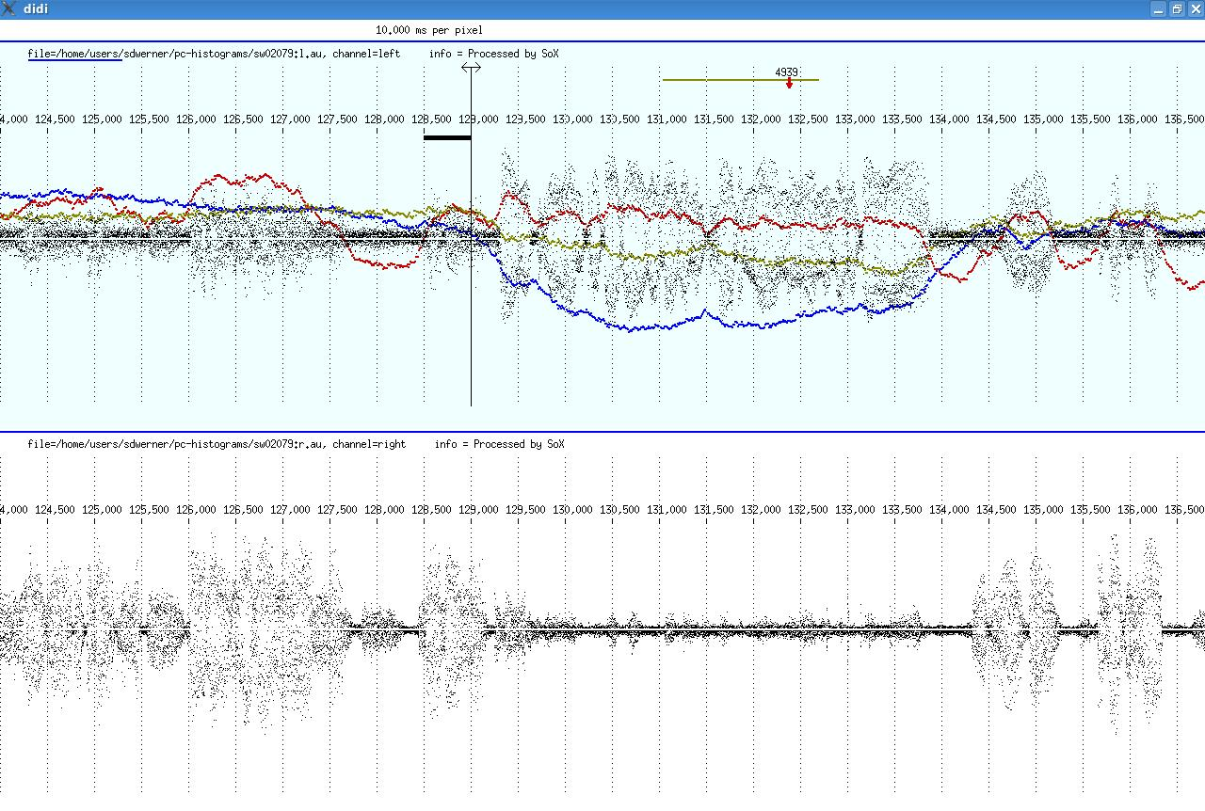
Example
PC2
PC3
PC1

Slide 23
Perplexity Benefits
 | Perplexity benefit | weight (k)
PC 12 | 4.1% | .70
PC 62 | 3.4% | .55
PC 72 | 2.3% | .45
PC 25 | 1.4% | .50
PC 15 | 1.1% | .50
PC 13 | 1.1% | .60
PC 21 | 1.0% | .50
PC 30 | 1.0% | .50
PC 1 | 1.0% | .25
PC 10 | 0.9% | .25
PC 23 | 0.9% | .60
PC 6 | 0.9% | .50
PC 26 | 0.9% | .35
PC 24 | 0.9% | .45
PC 18 | 0.9% | .45
Modeling as before
Model | Perplexity | Reduction
Baseline | 111.36
25 components, tuned weights | 81.52 | 26.8%

Slide 24
Also a Model of Dialog State
This model is:
scalar, not discrete
continuously varying,
not utterance-tied
multi-dimensional
interpretable …
PC2
PC3
PC1

Slide 25
Outline
Using prosody for dialog-state modeling and language modeling
Interpretations of the dimensions of prosody
Using prosodic patterns for other tasks
Speech synthesis

Slide 26
Understanding Dimension 1
Looking at the factor loadings:
points high on this dimension are
- low on self-volume at -25ms, +25ms, at +100ms …
- high on interlocutor-volume at +25ms, at -25ms, at +100ms …
Low where this speaker is talking
High where the other is talking
PC1

Slide 27
Understanding Dimension 2
Common words in high contexts:
laughter-yes, laugher-I, bye, thank, weekends …
Common in low context:
…
Low where no-one is talking
High where both are talking
PC2

Slide 28
Interpreting Dimension 3
Your turn now:
Some low points
Some high points
(5 seconds into each clip)
2. Negative factors:
other speaking rate at -900, at +2000 …; own volume at -25, +25 …
Positive Factors:
own speaking rate at -165, at +165 …; other volume at -25, at +25 …
3. Words common at low points:
common nouns (very weak tendency)
Words common at high points:
but, th[e-], laughter (weak tendencies)

Slide 29
Interpreting Dimension 4
Some low points
Some high points
(5 seconds into each clip)
2. Negative factors:
interlocutor fast speech in near future …
Positive Factors:
speaker fast speaking rate in near future …
3. Words common at low points:
content words
Words common at high points:
content words

Slide 30
Interpreting Dimension 12
Perplexity Benefit 4.1%
Low values:
Prosodic Factors: speaker slow future speaking rate, interlocutor ditto
Common words: ohh, reunion, realize, while, long …
Interpretation: floor taking
High values:
… floor yielding … quickly, technology, company …

Slide 31
Interpreting Dimension 25
Low: Personal experience
High: Opinion based on second-hand information
- Negative factors:
sudden sharp increase in pitch range, height, volume …
Positive Factors:
sudden sharp decrease in pitch range, height, volume …
- Words common at low points:
sudden, pulling, product, follow, floor, fort, stories, saving, career, salad
Words common at high points:
bye, yep, expect, yesterday, liked, extra, able, office, except, effort

Slide 32
Summary of Interpretations (1/3)
 | Interpretation | % var.
PC 1 | This speaker talking vs. Other speaker talking | 32%
PC 2 | Neither speaking vs. Both speaking | 9%
PC 3 | Topic closing vs. Topic continuation | 8%
PC 4 | Grounding vs. Grounded | 6%
PC 5 | Turn grab vs. Turn yield | 3%
PC 6 | Seeking empathy vs. Expressing empathy | 3%
PC 7 | Floor conflict vs. Floor sharing | 3%
PC 8 | Dragging out a turn vs. Ending confidently and crisply | 3%
PC 9 | Topic exhaustion vs. Topic interest | 2%
PC 10 | Lexical access / memory retrieval vs. Disengaging from dialog | 2%

Slide 33
Summary of Interpretations (2/3)
 | Interpretation | % var.
PC 11 | Low content / low confidence vs. Quickness | 1%
PC 12 | Claiming the floor vs. Releasing the floor | 1%
PC 13 | Starting a contrasting statement vs. Starting a restatement | 1%
PC 14 | Rambling vs. Placing emphasis | 1%
PC 15 | Speaking before ready vs. Presenting held-back information | 1%
PC 16 | Humorous vs. Regrettable | 1%
PC 17 | New perspective vs. Elaborating current feeling | 1%
PC 18 | Seeking sympathy vs. Expressing sympathy | 1%
PC 19 | Solicitous vs. Controlling | 1%
PC 20 | Calm emphasis vs. Provocativeness | 1%

Slide 34
Summary of Interpretations (3/3)
 | Interpretation | % var.
PC 21 | Mitigating a potential face threat vs. Agreeing, with humor | <1%
PC 22 | Personal stories/opinions vs. Impersonal explanatory talk | <1%
PC 23 | Closing out a topic vs. Starting or renewing a topic | <1%
PC 24 | Agreeing and preparing to move on vs. Jointly focusing | <1%
PC 25 | Personal experience vs. Opinion based on second-hand info | <1%
PC 26 | Downplaying things vs. Signaling interest | <1%
 | *
PC 29 | No emphasis vs. Stressed word present | <1%
PC 30 | Saying something predictable vs. Pre-starting a new tack | <1%
PC 37 | Mid-utterance words vs. Sing-song adjacency-pair start | <1%
PC 62 | Explaining/excusing oneself vs. Blaming someone/something | <1%
PC 72 | Speaking awkwardly vs. With a nicely cadenced delivery | <1%
* Omitting uninterpreted dimensions and noise-encoding dimensions

Slide 35
Implications
Suggests an answer to two questions:
What’s important in prosody?
What more should synthesizers do?

Slide 36
Outline
Using prosody for dialog-state modeling and language modeling
Interpretations of the dimensions of prosody
Using prosodic patterns for other tasks
Speech synthesis

Slide 37
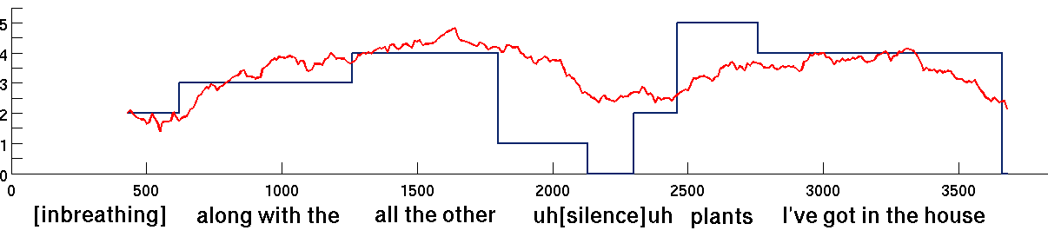
Where are the important things in the input?
Raw prosodic features tell us
(a linear regression model gives a mean absolute error of 0.75)
but they are hard to interpret
(speaker volume correlates positively, everywhere except over the window
0-50ms relative to the frame whose importance is being predicted)

Slide 38
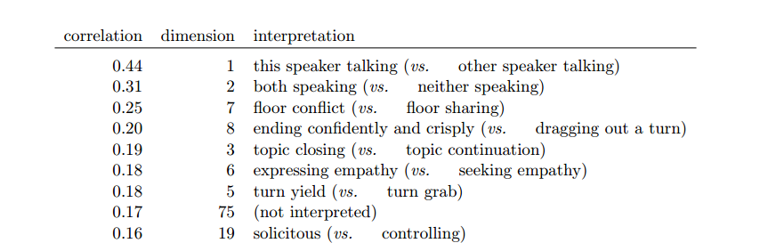
Relevant Dimensions
Importance correlates with various dimensions of dialog activity.

Slide 39
Dimension 6
Example high on dimension 6:
A: a lot of people go to Arizona
or Florida for the winter
and they’re able to
play all year round
B: yeah, oh, Arizona’s beautiful
features involved in dimension 6
loud, low pitch
loud, expanded pitch range and increased speaking rate
pause
long continuation by A
the “upgraded assessment” pattern (Ogden 2012) *
positive assessment
increased volume, pitch height,
and pitch range; tighter articulation
time
* common to English and German; unknown in Japanese

Slide 40
What Cues Backchannels?
the simplest turn-taking phenomenon
for recognition:
  deciding when the user wants a backchannel
for synthesis:
  eliciting backchannels, to foster rapport, or to track rapport
  discouraging backchannels, if the system can’t handle it

Slide 41
The distribution of uh-huh relates to many dimensions
turn-grabbing (dimension 5, low side)
new-perspective bids (17, low)
quick thinking (11, high)
expressing sympathy (18, high)
expressing empathy (6, high)
other speaker talking (1, high)
low interest (14, low)
signaling an upcoming point of interest (26, high)

Slide 42
Interpreting Dimension 26
High side, prosodically
A has moderately high volume
(for a few seconds)
then low volume, low pitch, slower speaking rate
(for 100-500ms)
then B produces a short region of high pitch and high volume, for a few hundred milliseconds, often overlapping a high-pitch region by A
then A continues speaking
High side, lexically:
laughter-yes, bye-bye, bye, hum-um, hello, laughter-but, hi, laughter-yeah, yes hum uh-huh …

Slide 43
Visualizing Dimension 26 High
low volume,
low pitch,
slower rate
high pitch
A mid-high volume ___ongoing speech__
B
-4 -3 -2 -1 0 1 2 3 4
high pitch,
volume

Slide 44
Two Views of Prosody
 | Monolog-Centered * | Dialog-Centered
 | Prosody is rules | Prosody is patterns
tied to | units (syllables, words, phrases, sentences) | time
in form | symbolic / discrete | continuous / weighted
processed as | a pragmatic function maps to a symbol-constellation symbol-constellations map to feature-level realizations | a function maps to a pattern patterns are composed
* for an overview, see Hirschberg’s 2002 survey

Slide 45

Representing Language, Dialog and Prosody
cuneiform (~3000 BC)
plays (~500 BC)
sentences (~200 BC)
other punctuation (~200BC, ~700, ~1400 AD)
Conversation-Analysis conventions (~1972)
speech acts (~1975)
ToBI (~1994)
.
,?!
uh:m (1.0) pt [
L+!H* L-
For prosody, it’s time to replace symbols.

Slide 46
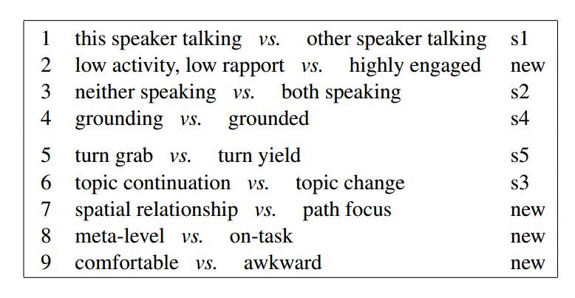
Prosody Relates to Content (1/2)
Some dimensions of Maptask

Slide 47
Prosody Relates to Content (2/2)
Web search relies on a vector-space model of semantics,
We can use this vector-space model of dialog activity for audio search.
Proximity correlates with similarity, e.g. for:
Complaints about the government, vs.
Fun things to do. vs.
Family member information

Slide 48
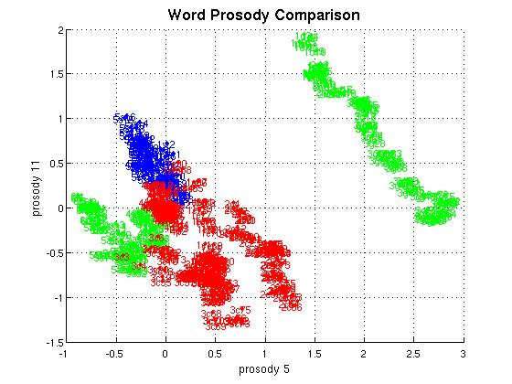
Different topics inhabit different regions of dialog space
Blue = planning
1) we had thought
2) we’ll sell
Green = surprise
1) oh my goodness
2) always shocked
(reported)
Red = jobs
1) electronics
2) carpenter
3) carpenter
4) plumbing

Slide 49
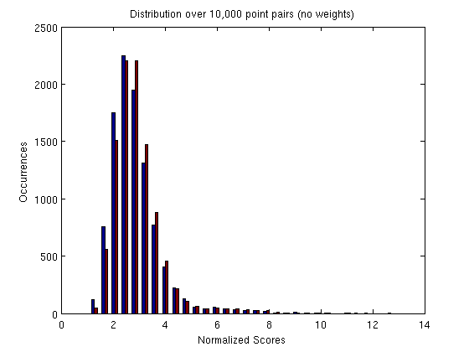
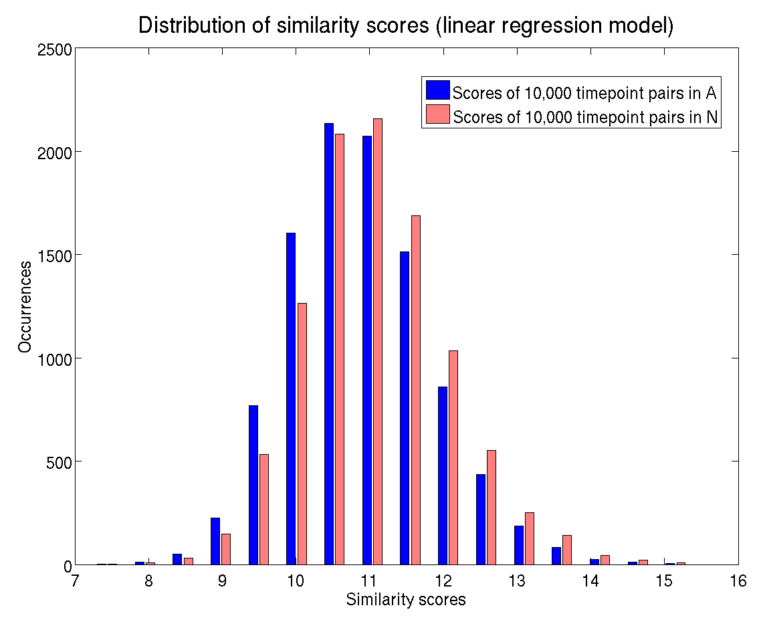
Linear Regression over Per-Dimension Differences as a Similarity Model
m = 0.19 std

Slide 50
Outline
Using prosody for dialog-state modeling and language modeling
Interpretations of the dimensions of prosody
Using prosodic patterns for other tasks
Speech synthesis

Slide 51
Implications for Synthesis
A new to-do list
A lightweight model, close to the data
Simple mechanisms

Slide 52
Combining Patterns
.6 x
+
.3 x
+
.1 x
…
=

Slide 53
Incrementality brings Choices
.6 x
+
.3 x
+
.1 x
…
=

Slide 54
Patterns may be Offset
.6 x
+
.3 x
+
.1 x
…
=

Slide 55
Cognition-Related Speculations
  Since “the brain is a prediction engine,” prosodically appropriate synthesis may reduce cognitive load.
  Prosody may be shared between the synthesizer and recognizer (c.f. Pickering and Garrod 2013).

Slide 56
Open Questions
Interactions with lexical prosody etc.
Incremental processing
Single-person vs. two-person patterns
Extensibility to multimodal behaviors
Individual differences

Slide 57
Prosodic Patterns in Dialog
Nigel Ward
with Alejandro Vega, Steven Werner, Karen Richart, Luis Ramirez and David Novick
The University of Texas at El Paso
Based on papers in Speech Communication, Interspeech 2012, 2013 and Sigdial 2012, 2013.
SSW8, Sept. 1, 2013

Slide 58
your thoughts?

Slide 59
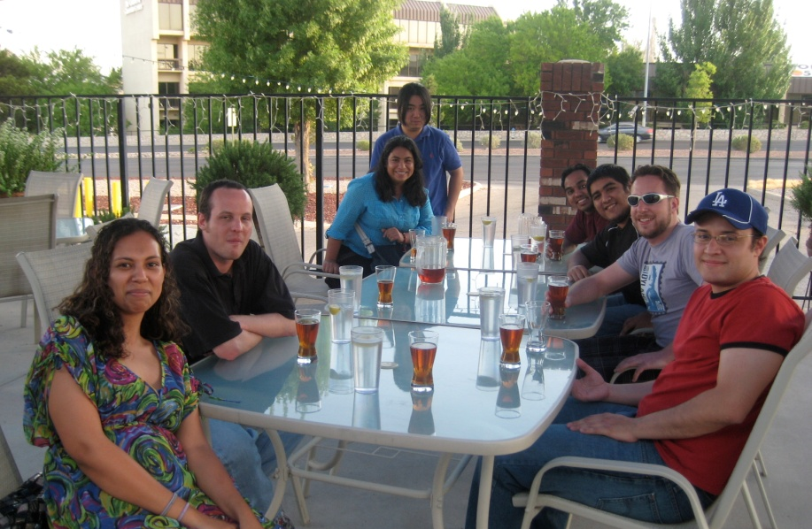
University of Texas at El Paso Interactive Systems Group
David Novick, Nigel Ward, Olac Fuentes, Alejandro Vega, Luis F. Ramirez,
Benjamin Walker, Shreyas Karkhedkar, …

Slide 61
Approaches to Synthesis
Two Strategies
develop “a voice” and parameterize it (slightly)
develop a universal voice, model all variation
… in the end this may give a simpler model

Slide 62
A Long-Term Goal: Mind Modeling
“In my humble opinion, the source and destination of spoken messages are the minds of speaker and listener.
Our attempts to understand and simulate … speech communication will never be complete unless we … succeed in modeling the speaker’s mind and the listener’s mind.”
- Hiroya Fujisaki 2008

Slide 63
Dialog Acts, Dialog States, and other Descriptions of Dialog
What’s are the units?
Turn
Pause
Backchannel
…
What are the acts?
Statement
Question
Backchannel
…
Inter-labeler agreements tend to be low (e.g 81% for Chinese BCs)

Slide 64
Empiricist Approaches to
Dialog State
Clustering
(Lefevre & de Mori 2007; Lee et al, 2009; Grothendieck et al, 2011)
Common-sequence identification
(Boyer et al. 2009)
Grouping based on active goals
(Gasic & Young, 2011)

Slide 65
The Big Picture
that’s
think
what
I
speaker A
yeah
yeah
when
that
well
you
speaker B
B’s states and processes
listening
take turn
hold turn
channel
control
primary
cognitive
effort
comprehending
formulating
{yeah, yes, feel…
slower, warmer… }
wanting to show empathy
emotional
affiliation
identifying
referent
wanting to confirm common ground
grounding
Time
(need a more concise representation of state)

Slide 66
Principal Component Analysis (PCA)
Normalize
observations on a hypothetical set of children
2. Rotate
3. Interpret
Other possible observables
body-fat percentage
gender
heartrate
waistline
shoe size
…
More possible factors:
sick-healthy
unfit-fit
…
young-old
weight
skinny-chubby
height

Slide 67
Dimension 14
Are the words being said important?
Points with low values on this dimension occur when the speaker is rambling: speaking with frequent minor disﬂuencies while droning on about something that he seems to have little interested in, in part because the other person seems to have nothing better to do than listen.
Points with high values on this dimension occur with emphasis and seemed bright in tone.
Slow speaking rate correlated highest with the rambling, boring side of the dimension, and future interlocutor pitch height with the emphasizing side.
Thus we identify this dimension with the importance of the current word or words, and the degree of mutual engagement (Ward & Vega 2012)

Slide 68
Dimension 16
How positive is the speaker’s stance?
Points with low values on this dimension were on words spoken while laughing or near such words, in the course of self-narrative while recounting a humorous episode.
Points with high values on this dimension also sometimes occurred in a self narratives, but with negative affect, as in brakes were starting to fail, or in deploring statements such as subject them to discriminatory practices.
Low values correlated with a slow speaking rate; high values with the pitch height.
Thus we identify this a humorous/regrettable continuum. (Ward & Vega 2012)

Slide 69
Two Similarity Models
Distance
Linear Regression
  Using 0 as target value if similar, 1 if not

Slide 70
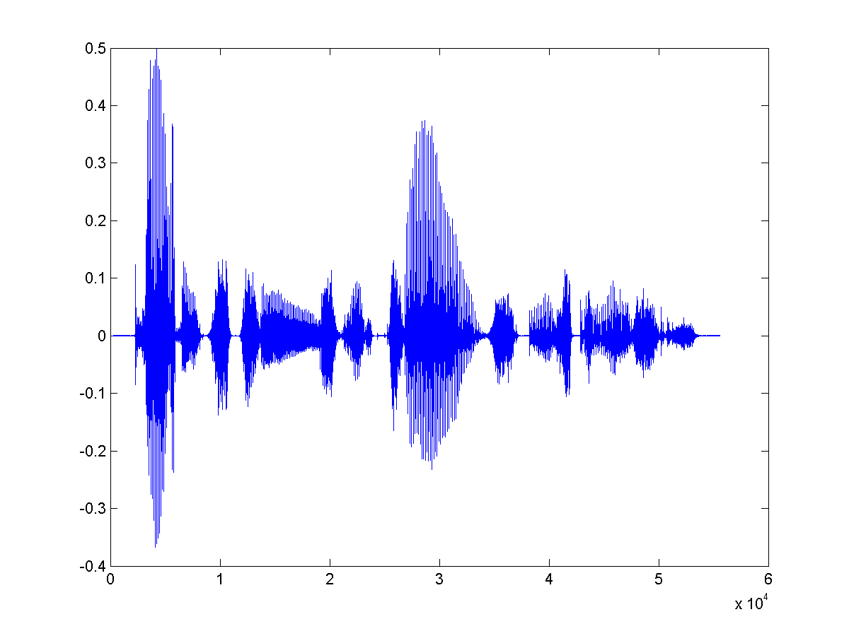
Speech Recognition
The Noisy Channel Model
speech signal S
word
sequence W
highest
probability
word
sequence
recognition
result
=
=
argmax P(S|W) P(W)
w
given by the
“language model”

