Slide 1
Haskell, Part 1
Basics, Tools, and Functions
CS 3360
Section 15.8
Unit 1 (Lessons 1-4) of [Kurt18]
Paul Hudak, et. al. A Gentle Introduction to Haskell, Version 98,
available online from http://www.haskell.org/tutorial/.
[Kurt18] Will Kurt, Getting Programming with Haskell, Manning, 2018

Slide 2
Outline
Basics of Haskell
Hugs/ghci -- Haskell interpreter
More about functions (recursions and conditionals

Slide 3
Haskell vs. Imperative
Imperative languages
  Tell computer what to do
  Accomplishes goals by using and modifying computer memory (i.e., variables)
Functional languages (e.g., Haskell)
  Describe desired result in mathematical language
  No variables
  No loops
  Heavy use of recursion

Slide 4
Haskell Features
A general purpose, purely functional programming language, providing:
  higher-order functions
  non-strict semantics (lazy evaluation <-> eager evaluation)
  static polymorphic typing
  user-defined algebraic data types
  pattern matching
  list comprehension
  module system
  monadic I/O system
  rich set of primitive data types, including lists, arrays, arbitrary and fixed precision integers, and floating point numbers.

Slide 5
non-strict semantics
(lazy evaluation)
pattern matching
primes = filterPrime [2..]
where filterPrime (h:t) =
h : filterPrime [x | x <- t, x `mod` h /= 0]
static polymorphic typing:
Integral a => [a] -> [a]
list comprehension
Code from Haskell website, http://www.haskell.org.

Slide 6
Purely Functional Language
There is no assignment.
Everything is a function or a definition
There is no branching, or looping; only recursion.
It is based on "typed lambda calculus".

Slide 7
First Class Values
All Haskell values are first class --- they may be passed as arguments to functions, returned as results, placed in data structures, etc.
A function definition in Haskell is indeed a definition; it fully
  describes the meaning of the function in terms of a series of equations and
  binds such entities to a name of the function.

Slide 8
Functional Program
A program in a functional language consists of
  a set of function definitions and
  an expression whose value is output as the program's result.
There are no side-effects to expression evaluation so an expression will always evaluate to the same value.
An expression can always be replaced by its value without changing the overall result. This is called referential transparency.

Slide 9
Lazy Evaluation
Haskell arguments are call-by-need (lazy evaluation).
An argument expression is evaluated at the time when it is actually used, or needed, in the called function; it is never evaluated if it’s not used.
  trap x = trap x
  squareFirst x y = x * x
  squareFirst (3 + 3) (trap 3)
infinite recursion
not used
Q: terminate? If so,
what value is returned?

Slide 10
Typed Lambda Calculus
Haskell is based on typed lambda calculus.
Every term is labeled with a type.
A function application f g is only syntactically valid if f has type s -> t, where the type of g is s and t is any type.
No term may be applied to itself, thus avoiding one kind of non-terminating evaluation.

Slide 11
Outline
Basics of Haskell
Hugs/ghci -- Haskell interpreter
More about functions (recursions and conditionals

Slide 12
Haskell Tools*
Hugs
  Old but compact (1.4MB/14MB) based on Glasgow Haskell Compiler (GHC) 6.6
  Interpreter only (hugs, winhugs)
  Available from https://www.haskell.org/hugs**
Haskell Platform
  New and big (~294MB) based on GHC 8.4.3
  Compiler and interpreter (ghc, ghci, winghci)
  Available from https://www.haskell.org/downloads
*For VS Code integration, see an article titled “Setting up Haskell in VS Code with Stack and the IDE Engine”
(google it). There is also an outdated Eclipse plug-in called EclipseFP.
**If the link is broken, try https://www.haskell.org/hugs/pages/downloading-May2006.htm.

Slide 13
Hugs/ghci --- Haskell Interpreter
Simple view of Hugs/ghci
  Very fancy calculator
  You type in expressions, it evaluates them.
  Read-evaluate-print loop (REPL)
Remember:
  A command to the tool starts with “:”
  Anything else is a Haskell expression to evaluate.

Slide 14
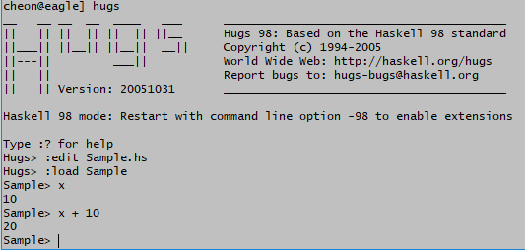

Running Haskell with Hugs
To create a Haskell file (.hs), use any text editor
  Can start the editor from Hugs, :edit Sample.hs.
Launch hugs on a terminal or command prompt.
To load a Haskell file, use the load command, e.g., :load Sample.

Slide 15
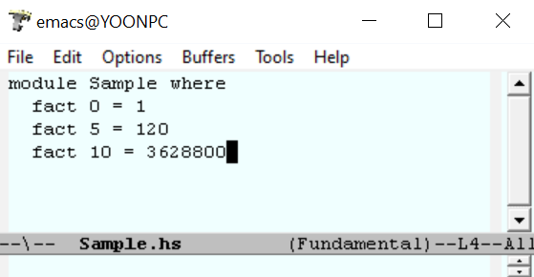
Running Haskell with WinHugs
Create a text file, say Sample.hs, with your favorite text editor.
A Haskell file should start with a line “module ModuleName where” which is followed by a sequence of Haskell definitions.
  A module is a unit of Haskell program.
  A module name should start with a uppercase letter, e.g., Sample.
Write your functions, e.g., factorial function.

Slide 16
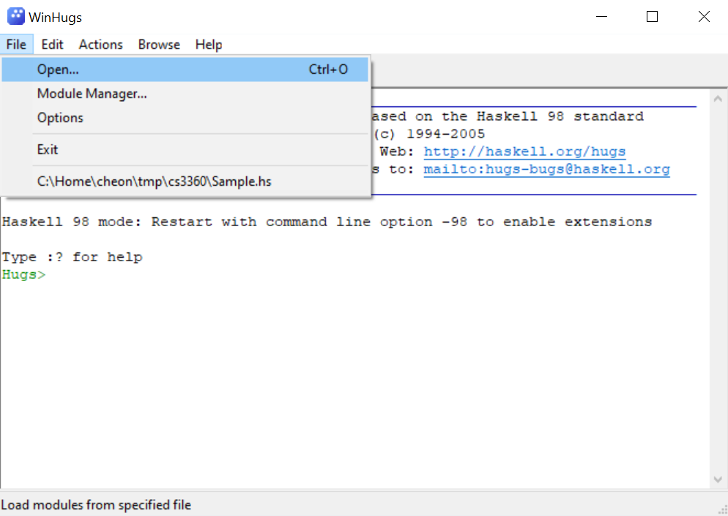
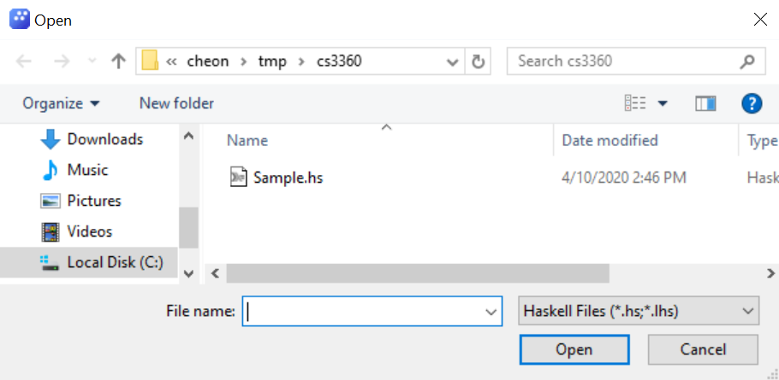
Running Haskell (Cont.)
Launch WinHugs
Load the Sample.hs file to WinHugs
  File > Open (or :load <file-name> on the prompt)

Slide 17
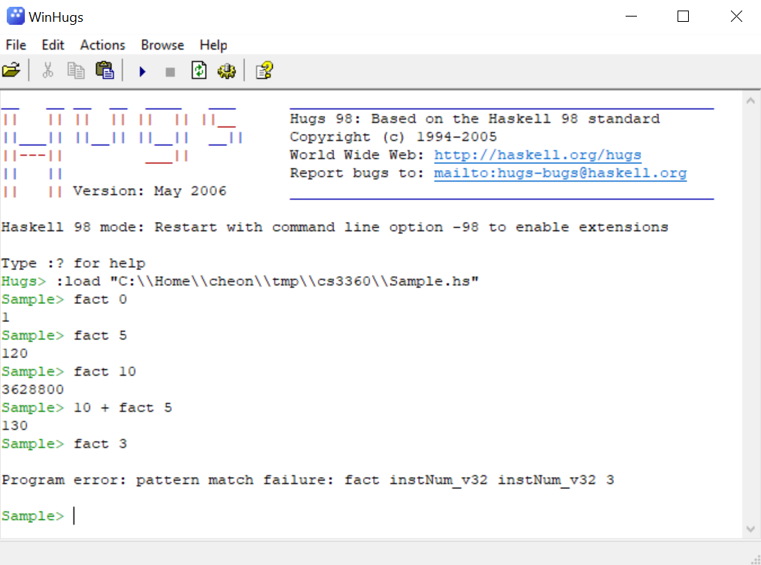
Running Haskell (Cont.)
Upon successful loading, the prompt is changed to the loaded module name.
Type Haskell expressions
change of
prompt

Slide 18
Outline
Basics of Haskell
Hugs/ghci -- Haskell interpreter
More about functions (recursions and conditionals)

Slide 19
Using Haskell Functions
<function-name> { <argument> }
No parenthesis needed
Example: mod 17 3
Some functions are “infix”: 3 + 4
infix -> prefix function: use ()
(+) 3 4
prefix -> infix: use backquotes
17 `mod` 3
EBNF: 0 or more

Slide 20
Lambda Abstraction in Haskell
\ ⟨parameter-list⟩ -> ⟨definition⟩
Examples:
\x -> x + 1
(\x -> x + 1) 1
\x y -> x + y
(\x y -> x + y) 10 20

Slide 21
Basic Haskell Types
Numeric types: Int/Integer, Float, …
Char: ASCII characters
  Constants use single quotes and escapes as in Java: ‘a’, ‘A’, ‘?’, ‘\n’, …
Bool: constants False and True
String: list of Char’s
  Constants use double quotes as in Java: “Hello, world!”
Usual operators as in Java

Slide 22
Capitalization
Identifiers start with lower-case (including function names).
Names of types and modules start with upper-case.
A rule, not a convention!

Slide 23
Definitions*
<name> = <value>
Haskell will infer the type, or you can state it first:
radius :: Float
radius = 4.2
Note that radius is a constant, not a variable.
You can’t change its value.
Optional type declaration
*Need to create a Haskell file, say Sample.hs, and define inside a module as follows:
module Sample where
radius = 4.2

Slide 24
Simple Function Definitions
<name> { <parameter> } = <value>
Conditionals?
Two ways: split up definition or use guards (later)
Loops?
Use recursion instead
Example: factorials
fact 0 = 1
fact n = n * fact (n -1)
Q: Fibonacci numbers?
any value except for 0; order matters.

Slide 25
More about Function Definitions ---Recursion and Conditionals
Imperative languages
  Loops
  If statements
Haskell
  Recursion
  Several tools:
    if expressions
    case expressions
    patterns
    guards

Slide 26
If Expressions
if <condition> then <expression> else <expression>
Examples:
if mod n 2 == 0 then True else False
if x >= 0 then x else –x
Q: factorial using if?
fact n = if n == 0 then 1 else n * fact (n – 1)

Slide 27
Case Expressions
EBNF: 1 or more
case <expression> of { <pattern> -> <expression> }⁺
For numeric expressions, pattern is:
literal value or
variable name
Example:
recip x =
case x of
0 -> 0
n -> 1 / x
any value except for 0; order matters.

Slide 28
Case Expressions (Cont.)
intToDay:: Integer -> String
intToDay num =
case num of
0 -> “Sunday”
1 -> “Monday”
2 -> “Tuesday”
3 -> “Wednesday”
4 -> “Thursday”
5 -> “Friday”
6 -> “Saturday”
x -> “Unknown”
Q: Factorial using case?
fact n =
case n of
0 -> 1
x -> n * fact (n – 1)

Slide 29
Patterns
Already seen in factorial using patterns:
fact 0 = 1
fact n = n * fact (n – 1)
Exactly equivalent to the case version
Some limitations as cases: can’t express more complex conditions
More interesting patterns possible with lists and tuples (to be discussed later)

Slide 30
Guards
<function-name> {<parameter>}
{ | <predicate> = <expression> }⁺
Example:
fact n
| n <= 1 = 1
| otherwise = n * fact (n – 1)
If predicate is true, the corresponding expression becomes the definition.
If predicate is false, Haskell tries the next definition.
“otherwise” means that “none of preceding predicates were true.”
conditions unlike case expressions

Slide 31
Guards (Cont.)
sign n
| n == 0 = 0
| n < 0 = -1
| otherwise = 1
max a b c
| a > b && a > c = a
| b > c = b
| otherwise = c
-- combining patterns and guards
sign 0 = 0
sign n | n < 0 = -1
| otherwise = 1
comment in Haskell

Slide 32
Exercise: Hamming Numbers
A positive number is a Hamming number if its only prime factors are 2, 3, or 5. Write a function to determine whether a positive integer is a Hamming number. Number 1 is also a hamming number.
E.g., isHamming 1 ≡ True
isHamming 3 ≡ True
isHamming 6 ≡ True (Q: why? 6 ≡ 2 x 3)
isHamming 7 ≡ False
isHamming 22 ≡ False
Use mod (%) and div (/) functions, e.g., mod 3 2 ≡ 1
and div 4 2 ≡ 2.

Slide 33
More Exercises: Recursion
-- Given two numbers, m and n, return m^{n}.
power:: Integer -> Integer -> Integer
-- Test if a given number is a prime number.
isPrime:: Integer -> Bool
-- Given a non-negative number n and a function f, return
-- a function that applies f n times, i.e., f(f(… (f x)…)).
iter:: Int -> (a -> a) -> (a -> a)

