Slide 1


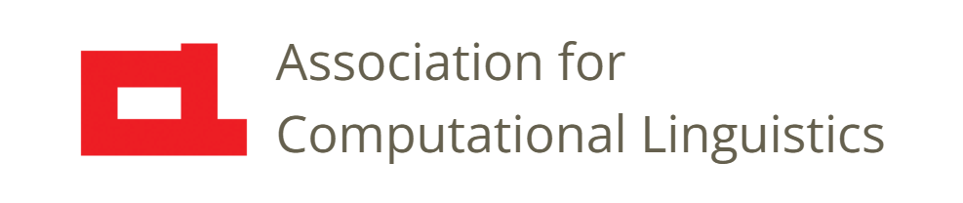

Prosody
- Models, Methods, and Applications -
Nigel G. Ward, University of Texas at El Paso
Gina-Anne Levow, University of Washington
Tutorial presented at ACL 2021
Notes:
Welcome to our tutorial on Prosody, a 24-lecture video series.
Our aim is to overview everything about prosody: how it’s produced, what meanings it has, how to analyze it, how to teach it, and how to use it in computational applications.
In fact, this tutorial was originally presented last year at the Association for Computational Linguistics Conference.
But this version has better explanations, to be clearer for non-technical viewers.
And we’ve updated the content, and have split it into a series of smallish videos, so you can watch just what you’re interested in.

Slide 2
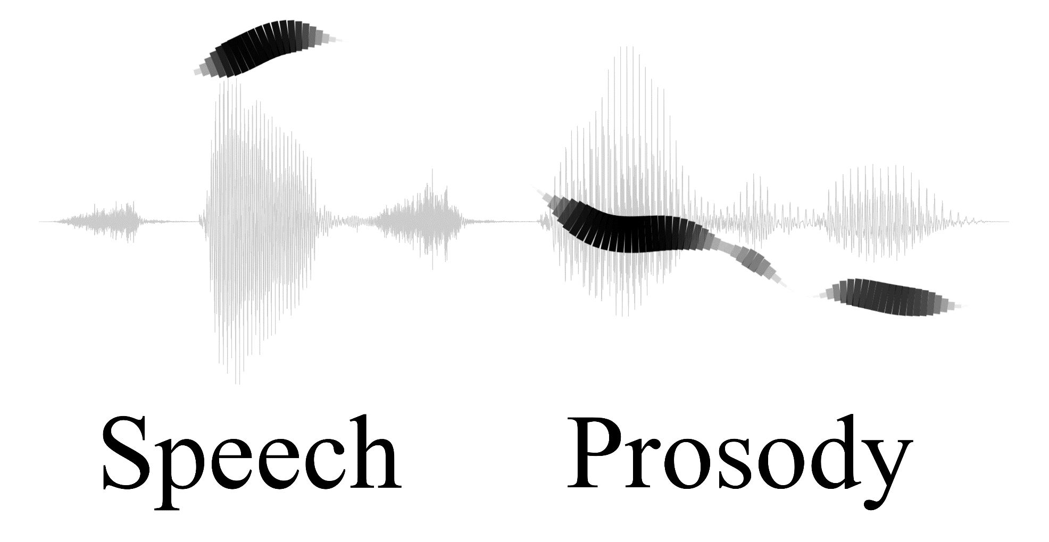
sprosig.org
Notes:
Language has two streams of information, the lexical and the prosodic. The lexical is well-studied …
[click] Here you see the waveform, in gray, and the black brushstrokes show some of the prosody: just the pitch and periodicity.
But you can already see that there’s a lot of extra information there.
When I say the words “Speech Prosody” like this, you can hear my feelings about this topic (positive, in awe) … something about my stance (serious, intending to teach), … and a few more things I didn’t particularly intend to convey, like my approximate age and my level of alertness.
That’s a lot of information! How is it all packed in? How do people use prosody do all these things … and thereby communicate successfully? Stay tuned!

Slide 3
Scope
The throat-generated aspects of speech
The musical aspects of speech
*
*
pitch
loudness
creakiness
breathiness
duration
timing
tone
The non-textual aspects of speech*
prominence
stress
phrasing
reduction
pragmatics
*and things that pattern with them
Notes:
So, what is prosody? We won’t give a hard definition, since we’re taking a very inclusive view. [click]
Musical aspects. Sometimes operationalized as “melody and rhythm”, but here we’ll focus on the lower-level components. [click] Now, there are lots of things that pattern with these [click] in particular [click] voice quality parameters, such as … .
In terms of production, all of these things involve things beyond familiar phonetic generators of the tongue and the lips, [click] so we can refer to as throat-generated aspects.
If we think about functions [click] these are what makes speech more than text … the extra information that can be conveyed includes [click]. Also in here, with the exact location depending on the language are [click] tone and stress.
And then we have articulatory reduction [click] which patterns with the other things, even if, it only matches the “non-textual” definition.
So, that’s a lot of things to cover! All related, in various ways, and all studied under the umbrella of Speech Prosody.
But we’re not covering just anything … in particular, the word “prosody” is also used to describe aspects of poetry, but that’s beyond the scope here.
Also, our aim is not to cover the prosody of any specific language. But we will have lots of examples .. Mostly from English.

Slide 4

Contents
Introduction
Production, Perception
Classic Linguistic Prosody
Technology 1
Paralinguistic and Pragmatic Functions
Speech Synthesis and Dialog
Perspectives
Notes:
Okay, here are the topics we will be covering.

Slide 5
Contents
Introduction
Production, Perception
Classic Linguistic Prosody
Technology 1
Paralinguistic and Pragmatic Functions
Speech Synthesis and Dialog
Perspectives
Stress and prominence
Tone
Contours and melodies
Emotion
Sentiment
Social control
Politeness
Notes:
One major topic is the functions of prosody.
- We’ll start with the relatively familiar [click]…. Aspects like the stress patterns in English, tone in Mandarin, contours and melodies. Other phonological phenomena. [click]
- Then the less-well known….
-- How prosody connects directly to our visceral emotions, but is also often deliberately controlled to achieve nuances.
-- For example, the prosody of sincere praise;
--- for example politeness via a half-syllable pitch peak shift.
We’ll see how prosody can be misunderstood, with some real-life examples, including a clash-of-cultures case. And why prosodic misunderstandings can get really serious.
We’ll also cover, how prosody is unlike everything else in language.

Slide 6
Contents
Introduction
Production, Perception
Classic Linguistic Prosody
Technology 1
Paralinguistic and Pragmatic Functions
Speech Synthesis and Dialog
Perspectives
Feature computations
Machine learning
Speech recognition
Notes:
Another major topic is technology and applications.
We will provide a high-level overview. No algorithms or download instructions. But we will explain how the technology works, and lay out some of the choices for developers --- for example [click] regarding Feature set issues: which to select for machine learning … and a little on models, for example, why transformers are effective for prosody.
And we’ll review the state of the art. Today there are some things that computers can do better than people, involving prosody. But also things that any 3-year old can, like be charming, or get people to help him, in ways that no program yet can.

Slide 7
Contents
Introduction
Production, Perception
Classic Linguistic Prosody
Technology 1
Paralinguistic and Pragmatic Functions
Speech Synthesis and Dialog
Perspectives
Notes:
The third major topic is the fundamentals, and that’s what we’ll cover first. What is prosody? How is it produced? (spoiler alert, using special hardware in the throat) How is it perceived? (spoiler alert, special hardware in the ear, plus of course the role of the brain) How can we measure it and visualize it?
There’s a paradox here: prosody is very important, yet it’s very hard to perceive. [resolve the contradiction]
Skill-building. It’s not just facts; you want to be able to hear these things, and produce them, and discuss them.
For all these topics … we’ll give a pretty comprehensive, entry-level, guided tour.
For those wanting more, in the final lecture we’ll give some pointers to other resources.

Slide 8
Contents
Introduction
Production, Perception
Classic Linguistic Prosody
Technology 1
Paralinguistic and Pragmatic Functions
Speech Synthesis and Dialog
Perspectives
  About the tutorial
  Why prosody matters
  Applications overview
  Historical perspective
  Teaching prosody
  Prospects and Challenges
Notes:
And all that content will be sandwiched between the intro and the outro.
In the outro… [click]
Historical perspectives: How it’s been misunderstood, in some critical ways, for five centuries, and how we’re now arriving at a better understanding, but still need to work to escape entirely.
Teaching: why it’s important, why it’s hard, some techniques that can help
and a conclusion
The intro [click] … after this lecture, we’ll talk about why prosody matters in the next lecture, and then the applications overview.

Slide 9
Intended Audiences
Students
Engineers
Scientists
Teachers
Clinicians
Anyone
Notes:
[for each, describe the group in a way to appeal to those who identify with it. Then say why they should care. Then say how this tutorial can help]
Students: prosody belongs not just in phonetics, and not just in pragmatics, etc.,… but as a result, it never gets properly covered in any class. Here we give 3 hours worth of the key information we wish we’d been taught as students.
Engineers: We designed this tutorial to help engineers, but we won’t be presenting any machine learning algorithms. We will mention transformers, end-to-end models, and deep learning, but only to explain what aspects of prosody make such models suitable, and when they’re not.
Scientists: With increasing interest in language in real life, beyond made-up sentences and tightly controlled in-laboratory recordings, the importance of prosody is becoming evident. While prosodists know what’s new, those in allied fields often do not .
Teachers and Clinicians: It would be great if everyone was a good communicator, fully adept at prosody. And if they aren’t, if we could help them. This is possible, sometimes, but unfortunately existing resources (textbooks, other Youtube resources) are spotty and often dated. We aim to …

Slide 10
Intended Audiences
(of computational linguistics, of phonetics, of English …)
(building dialog systems, translation systems … )
(linguists, psycholinguists, neuroscientists, sociolinguists …)
(of English, of other languages, of communications …)
(for diagnosis, design of interventions …)
who’s fascinated by how language works, or
who wants to communicate more effectively
Students
Engineers
Scientists
Teachers
Clinicians
Anyone
Notes:
[for each, describe the group in a way to appeal to those who identify with it. Then say why they should care. Then say how this tutorial can help]
Students: prosody often falls in the cracks, and gets covered briefly or not-at-all. Here we give 3 hours worth of the key information we wish we’d been taught as students.
Engineers: We designed this tutorial to help engineers, but we won’t be presenting any specific algorithms. We will mention transformers, end-to-end models, and deep learning, but only to explain what aspects of prosody make such models suitable, and when they’re not.
Scientists: With increasing interest in language in real life, beyond made-up sentences and tightly controlled in-laboratory recordings, the importance of prosody is becoming evident. While prosodists know what’s new, those in allied fields often do not .
Teachers and Clinicians: It would be great if everyone was a good communicator, fully adept at prosody. And if they aren’t, if we could help them. This is possible, sometimes, but unfortunately existing resources (textbooks, other Youtube resources) are spotty and often dated. We aim to …
Anyone: To be honest, despite the practical applications, prosody is just really neat. And there are some exciting new findings…

Slide 11
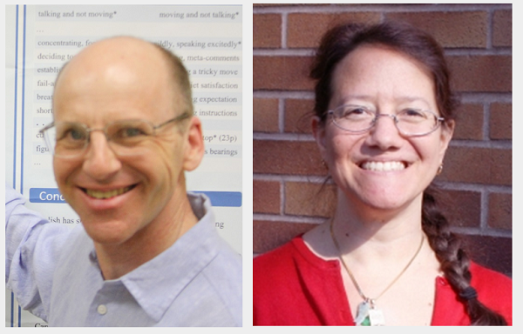
Your Instructors
With help from
Francisco Torriera,
Andrew Rosenberg,
Nicholas Cummins,
Aviad Albert,
Francesco Cangemi,
and others
Nigel G. Ward
Gina-Anne Levow
Notes:
Those new findings are the reason why we’re teaching this course … the field has really changed, over the past 5 years!
We won’t be presenting anyone’s specific latest research results, instead our aim is to share the new emerging perspective with a wide audience.
Gina and I each have 30 years experience, but please don’t call us old timers: we’re both research-active.
Gina is in Linguistics, at the U of W, where she teaches in the Computational Linguistics Masters program … trains the folk who go on to work for Amazon Alexa, Microsoft, start-ups … Nigel is in Computer Science, and teaches at U T E P. The students from his lab go to work for various companies including Google, and the US Government. Our aim is to give you this knowledge for free, as best we can.
[click]
And we’d like to acknowledge a lot of help …
((Prosody is not just for the academics and engineers … it’s fun, and useful, and empowering … so we’re here reaching out widely.))

Slide 12
Contents
1: Introduction
2: Why Prosody Matters
3: Applications Overview
Introduction
Production, Perception
Classic Linguistic Prosody
Technology 1
Paralinguistic and Pragmatic Functions
Speech Synthesis and Dialog
Perspectives
Notes:
Okay, so that was the “introduction to the introduction”. The next two lectures are …
Or you can skip ahead to lecture 4, where …

Slide 14
Prosody
1: Introduction
2: Why Prosody Matters
3: Applications Overview
4: Pitch Production
…

Slide 15
How do I choose or adapt a prosodic feature set?
When do Machine Learning models outperform humans?
What about pretrained models?
What myths about prosody still impede progress?
What are the open problems and technical challenges?

Slide 16
Why is prosody unlike everything else in language?
How does prosody convey so much, using only pitch etc.?
How are the latest models better?
Why is prosody high-risk, but also high-reward?

Slide 17

Aviad’s voice for the actual figure

Slide 18
Things to Look Forward To
Politeness via a half-syllable pitch peak shift
The prosody of sincere praise
Cross-cultural prosodic misunderstandings
What computers can do better than people
What computers can’t yet do at all
How prosody is unlike everything else in language
5 century-old misconceptions, plus recent ones

Slide 19
What is Prosody?
A Useful Definition
The musical aspects of speech
  pitch, loudness, timing, and things that pattern with them
Suprasegmental aspects of speech
Aspects of speech controlled by processes below the tongue
And what it’s not …
Notes:
So, what is prosody?
In this series we’ll look at it from many angles, and use several definitions. Here let’s just consider one ….
[break it down]
This is NOT about the prosody of poetry…. that is another meaning of “Prosody”, but not our focus here.
Not the prosody of any specific language.
Not just intonation … a word on “intonation” versus “prosody”…

Slide 20
Teaching Philosophy
Introductory-level, yet not dumbed-down
A comprehensive overview, with occasional depth
Skills, not just facts
for more exercises: http://nigelward.com/prosody
Notes:
[run thru the points]
Well, I hope you enjoy the series.
That’s it for this lecture. I’ll see you in the next one: Why Prosody Matters.

Slide 21
sprosig.org
Notes:
Now, every language has two streams of information: the lexical and the prosodic.
The lexical stream is well-understood. You can see these words and know what I mean. In fact, you spent many years in grade school learning all about letters and words.
The prosodic stream is seldom thought about, but often crucial.
For example, the way I say “speech prosody” is highly informative. [say it] From the speech signal, especially from the prosody, there’s a lot more information. A diagram can help…

