Slide 1


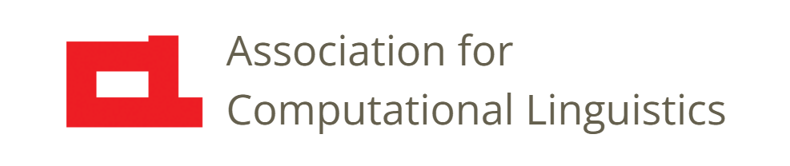
Prosody
Lecture 4: Pitch Production
Nigel G. Ward, University of Texas at El Paso
Gina-Anne Levow, University of Washington
Tutorial presented at ACL 2021
Notes:
[set up a browser window with the video linked from slide 7, ready to expose to play]
Welcome to Lecture 4 of our series. Here we’ll cover pitch production: the anatomy and aerodynamics.

Slide 2
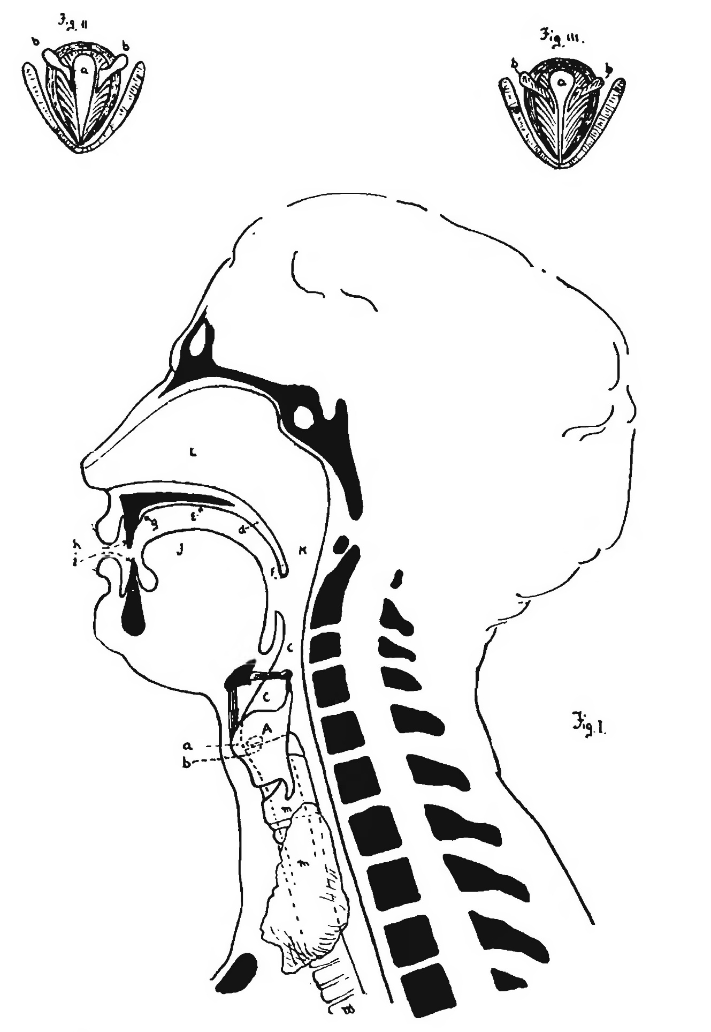
lips
tongue
Christian Brothers, 1905, via Wikimedia Commons
Notes:
Okay, so here we have a human head, in sagittal view. You see the nose and chin… And the lips and tongue [click]
(Yes, the tongue is one big chunk of muscles.)
These modify the airflow to create vowels and consonants. And where does the air come from?

Slide 3
lips
tongue
larynx
trachea
Christian Brothers, 1905, via Wikimedia Commons
Notes:
Of course, from the lungs. [click] passing through the trachea and the larynx [click] [Point to your own larynx.] [Note that it’s much bigger for males.] Let’s show a schematic view. [click] Now, mediating that flow is the larynx [click]. Let’s look more closely.

Slide 4
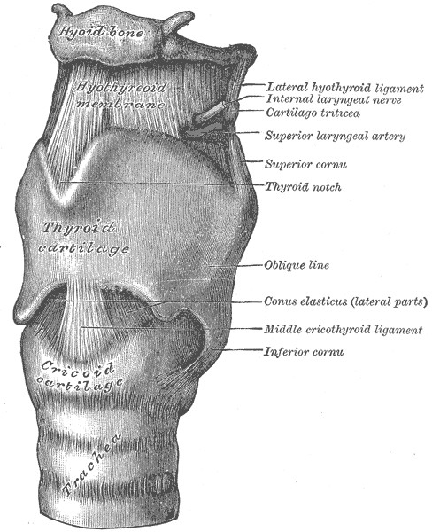
Larynx
Gray (1918) via Wikimedia Commons
Notes:
Well, there it is. It’s a nice hard box: an interlocking set of cartilages, almost hinged together, that can be pulled into different configurations by many tiny muscles. It’s hard to see much from this picture… because what matters is what’s inside. Like when you go out on Saturday night, and there’s a boxy grey building, with doors and walls and things … but what you really care about that there’s a dance floor inside. That’s where the action happens! That’s the glottis! It’s the place where the dancers do their thing … where the air molecules do their dance, guided by the vocal folds as they also dance.
Next let’s rotate this and look down from the top.

Slide 5
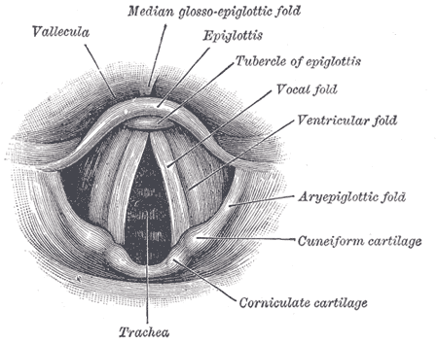
gl
glottis
Gray (1918) via Wikimedia Commons
Gray (1918), via Wikimedia Commons
Notes:
Now, we’re looking down the throat, looking into the larynx. The glottis isn’t labeled here, but can you see it? Yes, there it is, in the middle [click] The label was “trachea”, but that’s just because, what you see through the open glottis is the trachea. All around you see some of the cartilages units that form the box.
Now the reason that they have the ability to rotate relative to each other is to to stretch and shape the glottis in different ways.
Concretely, they do this by pushing and pulling the vocal folds [click] in various dimensions. In actuality they’re wider than they look here, since the Ventricular Folds, are partly obscuring them. Also known as the “false vocal folds,” you may use these gargling or growling. But the vocal folds are our main concern.
Now, in this diagram, they are positioned off to the sides, keeping the glottis open pretty wide, but they can also swing in to block the airflow entirely.

Slide 6
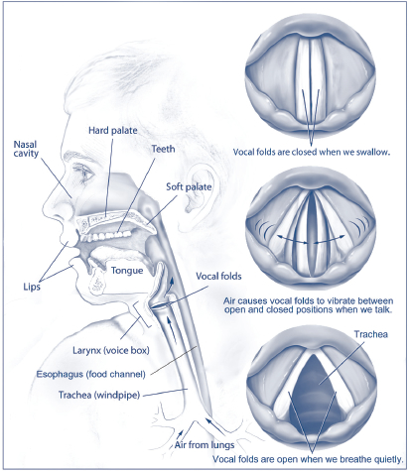
States of the Glottis
JohannaO14 via Wikimedia Commons
Notes:
… So, schematically, there are three main states …

Slide 7
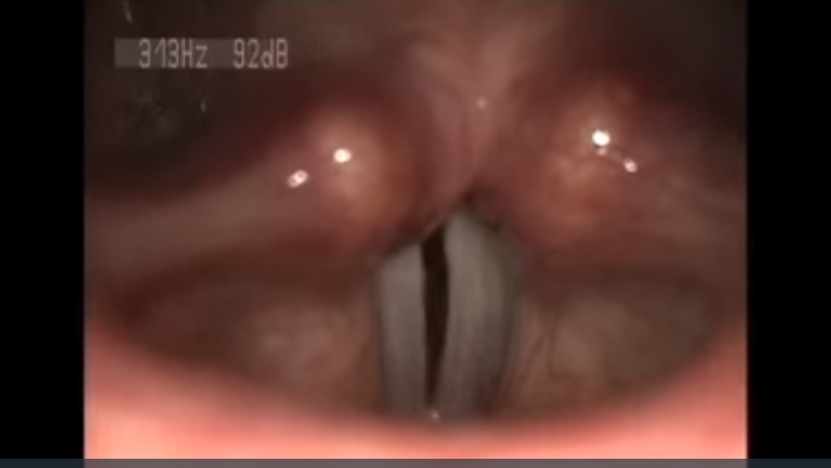
W. Wang et al. via Wikimedia Commons
https://commons.wikimedia.org/wiki/File:Laryngeal-Reinnervation-Using-Ansa-Cervicalis-for-Thyroid-Surgery-Related-Unilateral-Vocal-Fold-pone.0019128.s002.ogv
W. Wang et al, vial Wikimedia Commons https://commons.wikimedia.org/wiki/File:Laryngeal-Reinnervation-Using-Ansa-Cervicalis-for-Thyroid-Surgery-Related-Unilateral-Vocal-Fold-pone.0019128.s002.ogv
Notes:
Explain the image, vocal folds.
Explain how the image was made.
Shift to the browser and show the video.
Explain the stroboscope, so it’s not real time.
Okay, so the key thing here is *vibration*.
How does this create pitch? Well, that’s the topic of the next lecture.

Slide 8

Contents
Introduction
Production, Perception
Classic Ling. Prosody
Technology 1
Para. & Prag. Functions
Speech Synthesis and Dialog
Perspectives
4: Pitch Production
5: Pitch Acoustics
. . .
9: Pitch Perception
Notes:
This concludes our discussion of pitch production, but remember the glottis; it will be relevant later!
In the next lecture we’ll start talking about signal processing: specifically, about how to
compute an estimate of the pitch, namely F0, right from the speech signal.

Slide 10
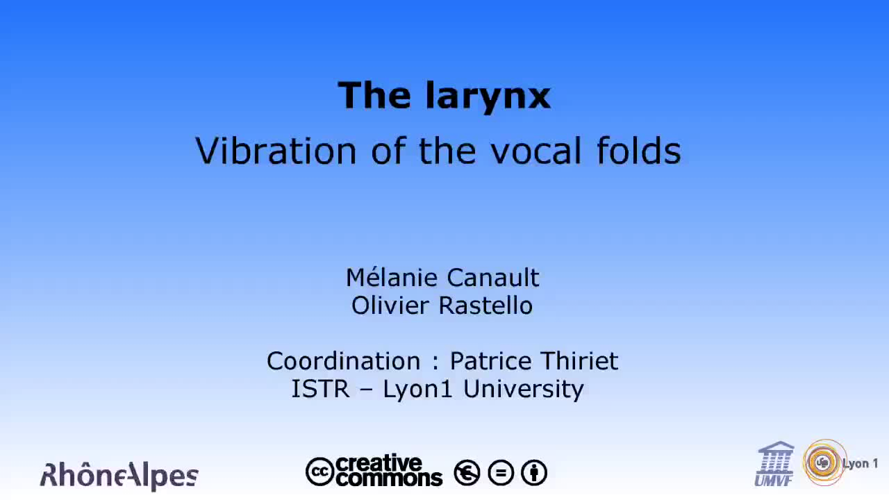

Slide 11
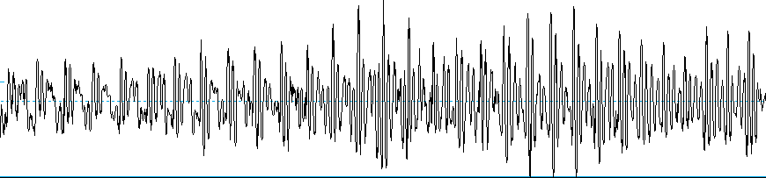
A real waveform

Slide 12
lips
oral & nasal
cavities
lungs
tongue
larynx
larynx
air
trachea
Christian Brothers, 1905, via Wikimedia Commons
Notes:
Of course, from the lungs. [click] passing through the trachea and the larynx [click] [Point to your own larynx.] [Note that it’s much bigger for males.] Let’s show a schematic view. [click] Now, mediating that flow is the larynx [click]. Let’s look more closely.

