Slide 1



Prosody
Lecture 5: Pitch and F₀
Nigel G. Ward, University of Texas at El Paso
Gina-Anne Levow, University of Washington
Tutorial presented at ACL 2021
Notes:
Welcome to Lecture 5 of our series on Prosody. Here we’ll start on the Acoustic aspects of prosody. We’ll cover very basic signal processing, and introduce F0 contours, which we’ll use a lot in this course.

Slide 2
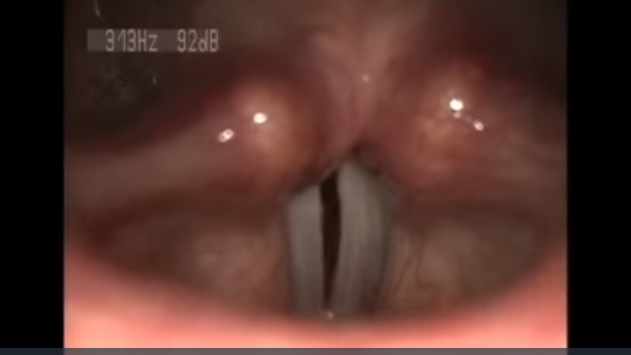
W. Wang et al. via Wikimedia Commons
https://commons.wikimedia.org/wiki/File:Laryngeal-Reinnervation-Using-Ansa-Cervicalis-for-Thyroid-Surgery-Related-Unilateral-Vocal-Fold-pone.0019128.s002.ogv
W. Wang et al, vial Wikimedia Commons https://commons.wikimedia.org/wiki/File:Laryngeal-Reinnervation-Using-Ansa-Cervicalis-for-Thyroid-Surgery-Related-Unilateral-Vocal-Fold-pone.0019128.s002.ogv
Notes:
In the last lecture we saw how the vocal folds, the white bands here, can open and close as air passes through the glottis.
How does this relate to pitch?
First, to give the short answer: each open-close cycle is a pitch period,
and as those get shorter, meaning a faster vibration rate, the pitch is higher, and conversely.
… but it’s actually more complicated…

Slide 3

Fundamental Frequency
F₀ = 150 Hz
Fundamental frequency, F₀ : cycles per second (Hertz, Hz)
Period: Time lapse between repeating cycles
F₀ = 1 / period
Synthetic glottal wave, Francisco Torreira
Notes:
Graphing it can help. Here time is on the x-axis. This indicates the effects of the glottis repeatedly opening (high airflow) and closing (plunging down to zero). This is not a direct measurement of the glottis, but a measurement of what’s going on in the air, so it’s an “acoustic” view, where before we only had the “articulatory” view.
Now, the “fundamental frequency” is a good way to summarize this pattern: It’s how many times this cycle repeats. The units are cyles-per-second, which is Hertz.
The fundamental frequency is also called “F0” for short.
To compute it, you can count how many cycles across a whole second, but since it may change faster than that, [click] you can just measure one pitch period, here 6.6 ms,
and compute the F0 using the formula, 1/ period. [click]
This sounds like [click click]. I think you can hear the pitch [click]. It’s 150 ms.
(Incidentally, you can also hear that this is not a real human voice [click]. In part because real human glottal flow is more complex … because the vocal folds wobble and dance as the air flow pushes them. Also, the human voice doesn’t come straight from the throat; it has to pass through oral and nasal cavities, which add some nice resonances.
[[comment: not clear what’s actually the y axis in this graph]]

Slide 4
Basic Visualizations
Waveforms
F₀ plots
Francisco Torreira
Notes:
So, now let’s compare two waveforms. The one on the left we’ve already seen.
On the right is a faster version, with the periods shorter. The result is higher fundamental frequency…
…Time domain and frequency domain. We’ll mostly be using the latter… it’s makes things easier to see.
Now in these two examples the pitch is constant. In speech that’s rare. So, let’s test your perception skill…

Slide 5

going up in pitch or down?
Up.
but not for everyone …
Notes:
Is it going up or down? [click] up or down? [click]
Well, I hear it going up. [dramatic pause] [click] Not everyone does! Perceptions vary!
Now, some people find this hard to believe. People with strong musical training, and a good ear may think this trivially obvious.
But many people find it hard to accurately classify small pitch differences or small pitch movements.
How do they survive? Well, in daily communication, prosodic meanings never rely on small pitch differences alone; there are correlates, which people can perceive. So you don’t have to be great at pitch to communicate.
But there are also people who have “amusia” … they are tone deaf, for example, as the result of stroke. That’s terrible for music appreciation, again, not necessarily for speech.
Anyway, the reason I say here, confidently, “Up”, is that most people agree with me, plus we can check, by graphing the signal …

Slide 6
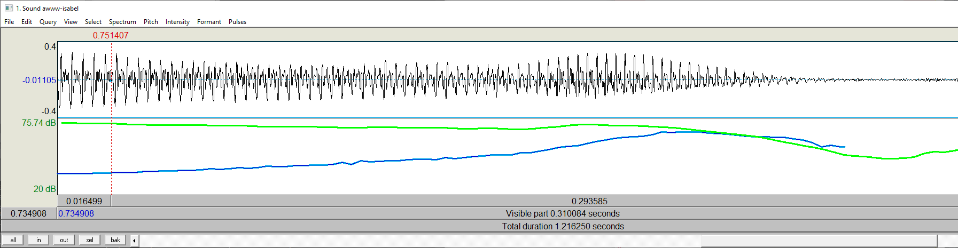
A real waveform
Praat
F₀ (a proxy for pitch)
https://www.fon.hum.uva.nl/praat/
Notes:
Specifically, here, what “Praat” shows us. (It’s a great tool, easy to download and run.) Here’s the sound again [click].
Its waveform…. looks roughly like the synthetic one we saw before, but this is more complex, since it’s real.
You can still see the glottal opennings, so we can we can mark off two cycles at the upper left [click], with the glottal opennings marked with arrows. The blue rectangle marks out 2 cycles. And [click] at the upper right … faster/shorter/higher…. We can also get some help from Praat …
[click] The blue oline is the “F0” that Praat computes. It is a “proxy” for pitch, for reasons we’ll discuss.

Slide 7
A real waveform
Praat
F₀ (a proxy for pitch)
Male or female voice? How do you know?
Notes:
But first, a little digression … male or female? … Well, it’s a female, though it could also be a male child. But not an adult male. How do you know?
The pitch is high-ish. The vocal folds are vibrating quickly, since they’re short, since they’re in a smallish larynx. Not an adult male, since we have
larger larynxes, that even bulge out of our throats. But of course the prosody of gender is actually very complicated, more social than physical.
Anyway, pitch diagrams are really useful. Download Praat and record your own voice, and take a look!
Of course, most of the time F0 contours are much more complex that this. To understand them, there are a few things to be aware of …

Slide 8
F₀ ≠ Pitch
Gaps
Errors
Differences
  Microprosody
F₀ is a proxy for pitch
Notes:
… gaps, errors, and microprosodic effects. We’ll cover each of these in turn.

Slide 9
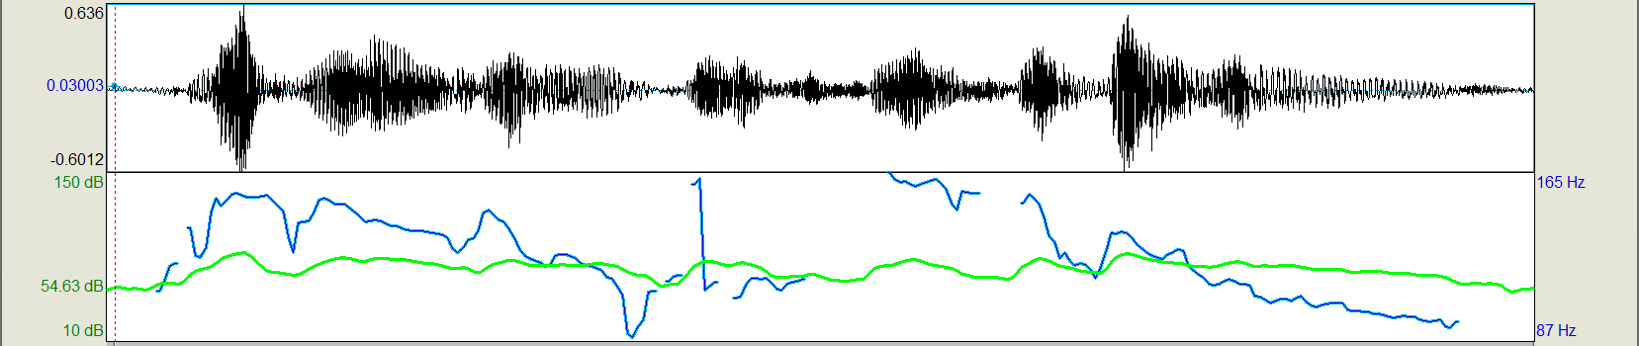
Missing pitch
/s/
/s/
| legumes | are | a |good| source | of | vitamins |
Unvoiced consonants have no pitch
i.e., F₀ is not defined for consonants without vocal fold vibration
Notes:
Now lets look at the pitch tracks for a real sentence [click].
Looking at the F0 contour, the blue line, you may notice some gaps [click].
These occur at the two /s/ sounds in “source”. [click] They are unvoiced … the glottis is open, with no vibration in the larynx. Try it with your hand on your throat and you’ll see: /s/ has no vibration. Unlike the /z/ sound of vitamins.
In general [click] …
…
Now another issue is …

Slide 10
Errors
| legumes | are | a |good| source | of | vitamins |
Notes:
Pitch trackers make mistakes. For example something looks strange here [click].
We know there is an error here, because the glottis can’t instantaneously reconfigure to create such an extreme pitch shift.
One of these two points must be wrong. Which?
Almost certainly the top one. Continuity constraints. … configurability of pitch trackers.
…
And finally there are issues due to microprosody.

Slide 11
Microprosody
/g/
/v/
| legumes | are | a |good| source | of | vitamins |
F₀ can be perturbed by vocal tract constrictions.
But humans don’t perceive these as pitch dips.
Notes:
When I say “legumes are a good”, probably you hear a pretty smooth pitch declination.
Maybe to your ear it may sounds like this [click]. Also for the second part [click] So then why does the graph have some little dips?
[click] Well, these are due to obstructions to the airflow. [click] For example, on the /g/, my tongue
momentarily stops the airflow. That doesn’t stop the vibrations, but slows them down. Same for /v/.
That is to say [click] … but …

Slide 12
Percept
Three Aspects
Articulatory Mechanism
Acoustic Measure
glottal cycles …
pitch … log F₀
Notes:
Now, it would be great if F0 and pitch always corresponded. But they just don’t.
Pitch is defined as something that we hear … it’s in our ears and brain. Acoustics is what you can measure with a microphone or compute from that signal.
It’s a “proxy” for pitch … usefully close, but not accurate.
In fact, for every prosodic feature we can talk in terms of these two aspects --- --- and actually a third [click] --- the articulatory mechanisms.
For pitch, these were of course the glottal closures. For pitch, these correspond pretty well to the acoustic measure,
And the discrepancies are mostly between the percept and the acoustic measure, (technically we’ll ususually use *log* F0, as we’ll explain later.)
Now for pitch the discrepancies are relatively minor, but for the other features, it’s far worse, as we’ll see, much later.
But for the next few lectures we’ll focus on the perceptions and the articulatory mechanisms [next]

Slide 13
Percept
Three Aspects
Articulatory Mechanism
Acoustic Measure
glottal cycles …
pitch log F₀
Notes:
… leaving acoustic measures for later.
Okay, so [next]

Slide 14

Contents
Introduction
Production, Perception
Classic Ling. Prosody
Technology 1
Para. & Prag. Functions
Speech Synthesis and Dialog
Perspectives
4: Pitch Production
5: Pitch and F0
6. Loudness, Timing, etc.
7: Phonation Types
8: Exercises
9: Pitch Perception
Notes:
In this lecture we’ve explained the Fundamental Frequency, or F0, seen how to graph it, and explained that it corresponds to the perception of pitch, but not exactly.

Slide 15
Contents
Introduction
Production, Perception
Classic Ling. Prosody
Technology 1
Para. & Prag. Functions
Speech Synthesis and Dialog
Perspectives
4: Pitch Production
5: Pitch and F₀
6. Loudness, Timing, etc.
7: Phonation Types
8: Exercises
9: Pitch Perception
Notes:
Next up, we’ll set pitch aside for two lectures while we complete our tour of prosodic properties.

