Slide 1


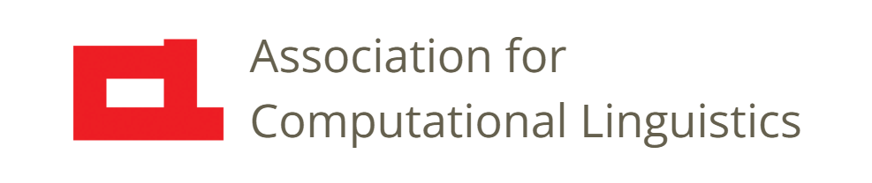
Prosody
Lecture 6: Loudness, Timing, and More
Nigel G. Ward, University of Texas at El Paso
Gina-Anne Levow, University of Washington
Tutorial presented at ACL 2021
Notes:
Welcome to lecture 6 of our series on prosody.
While pitch is important (which is why we devoted two whole lectures to it), prosody is far more than just pitch.
This lecture and the next will cover the other prosodic features.

Slide 2
Prosody is …
The musical aspects of speech
Pitch, loudness, timing, duration, and rate
and things that pattern with them:
Reduction / enunciation
Nasalization
Phonation type: creaky / breathy / falsetto …
Voicing presence, periodicity
Thousands of derived features
Notes:
Recalling our definition [next]

Slide 3
Prosody is …
The musical aspects of speech
Pitch, loudness, timing, duration, and rate
and things that pattern with them:
Reduction / enunciation
Nasalization
Phonation type: creaky / breathy / falsetto …
Voicing presence, periodicity
Thousands of derived features
Notes:
In this lecture we’ll cover …
Starting with loudness.

Slide 4

Percept Articulation Measure
Pitch … glottal cycles … log F₀
Loudness
airflow log energy (or log intensity)
Notes:
So, building out our table from the last lecture, loudness --- the perception --- can be approximated by log energy or log intensity. [click]
In terms of articulation, how do you make sounds louder? More airflow is one way.
Here’s a fun experiment … ask someone to produce a constant sound, then give them a stiff hug from behind.
Here, let’s try it. [click] Volume increases. Did you hear it?

Slide 5
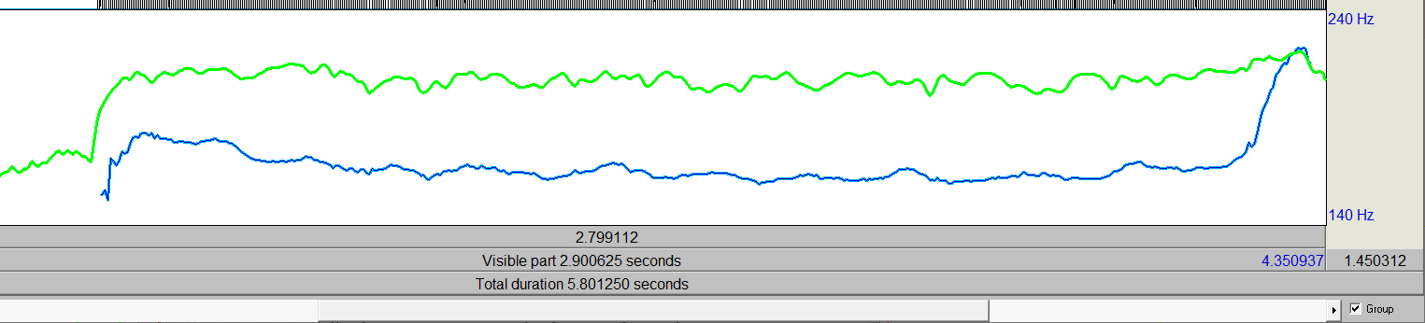

Picture of a Squeeze
squeeze
Notes:
- In Praat, it’s the green line.
- Actually the effects of the squeeze are pretty minor, compared to the effects of conscious control.
Let’s digress a little here … you probably noticed that the squeeze caused the pitch goes up too. [click]
Here it is again [click].
This makes sense: More airflow, faster vibration. Pitch and energy correlate, as a default. Of course it’s mostly under conscious control. But remember the correlation thing: we’ll discuss in a later lecture.

Slide 6
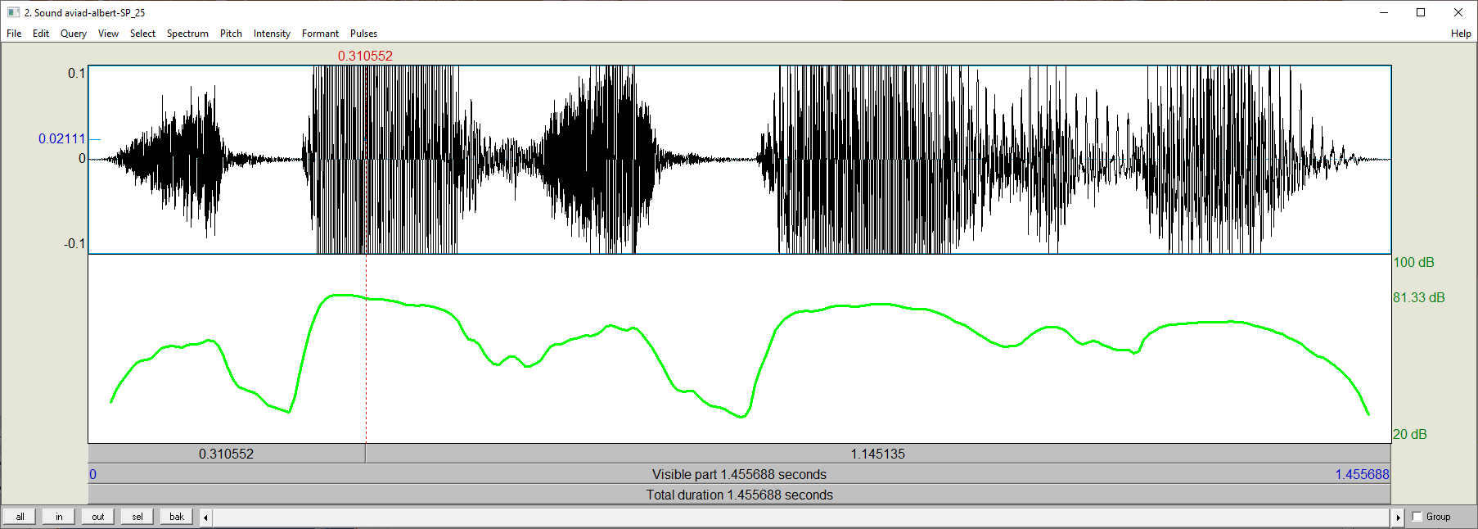
Microprosody in Intensity
s p i tʃ p r o s o d i
Speech Prosody
Aviad Albert
Notes:
Microprosody is an issue, for loudness too. Look at this crazy variation in intensity. What’s going on?
But if you listen to it [click] , I don’t think there’s a lot of variation. Some syllable stress differences, sure, but
not as crazy as it looks. But of course the issue is the vowels and consonants [click].
The microprosody of intensity is even worse than that of pitch.
Averaging over substantial windows helps. Also normalization. But that’s a later lecture.
Now the other properties of music that are most relevant are …
[next]

Slide 7
“Musical” Properties
Pitch
Loudness
Timing
Rate ∝ syllable rate and/or phoneme rate
for unlabeled speech, use mrate or ceptral flux
Pause lengths (log scale?)
Segment/word durations (cepstral flux)
Notes:
[next]

Slide 8
“Musical” Properties
Pitch
Loudness
Timing
Rate ∝ syllable rate and/or phoneme rate
Segment/word durations
Pause lengths (log scale)
microprosody, again
Notes:
((Just talk through these.))
Again microprosody is an issue…. Consider the duration of “peach” vs “pitch” .
Mostly serving to mark phoneme identity, nothing more. For many purposes, that’s just an annoyance.

Slide 9
Prosody is …
The musical aspects of speech
Pitch, loudness, timing, duration, and rate
and things that pattern with them:
Reduction / enunciation
Nasalization
Phonation type: creaky / breathy / falsetto …
Voicing presence, periodicity
Thousands of derived features
Notes:
Okay, next something a little different: articulatory precision, ranging from highly articulated to very reduced.

Slide 10
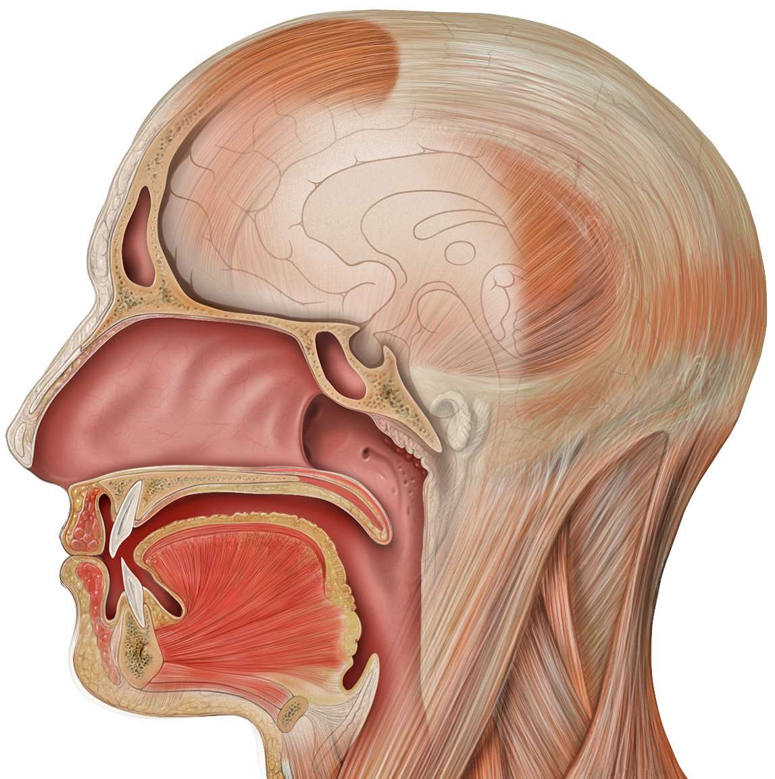
Reduction
Wikimedia Commons
Notes:
((Show for 5 seconds, then)) [next]

Slide 11
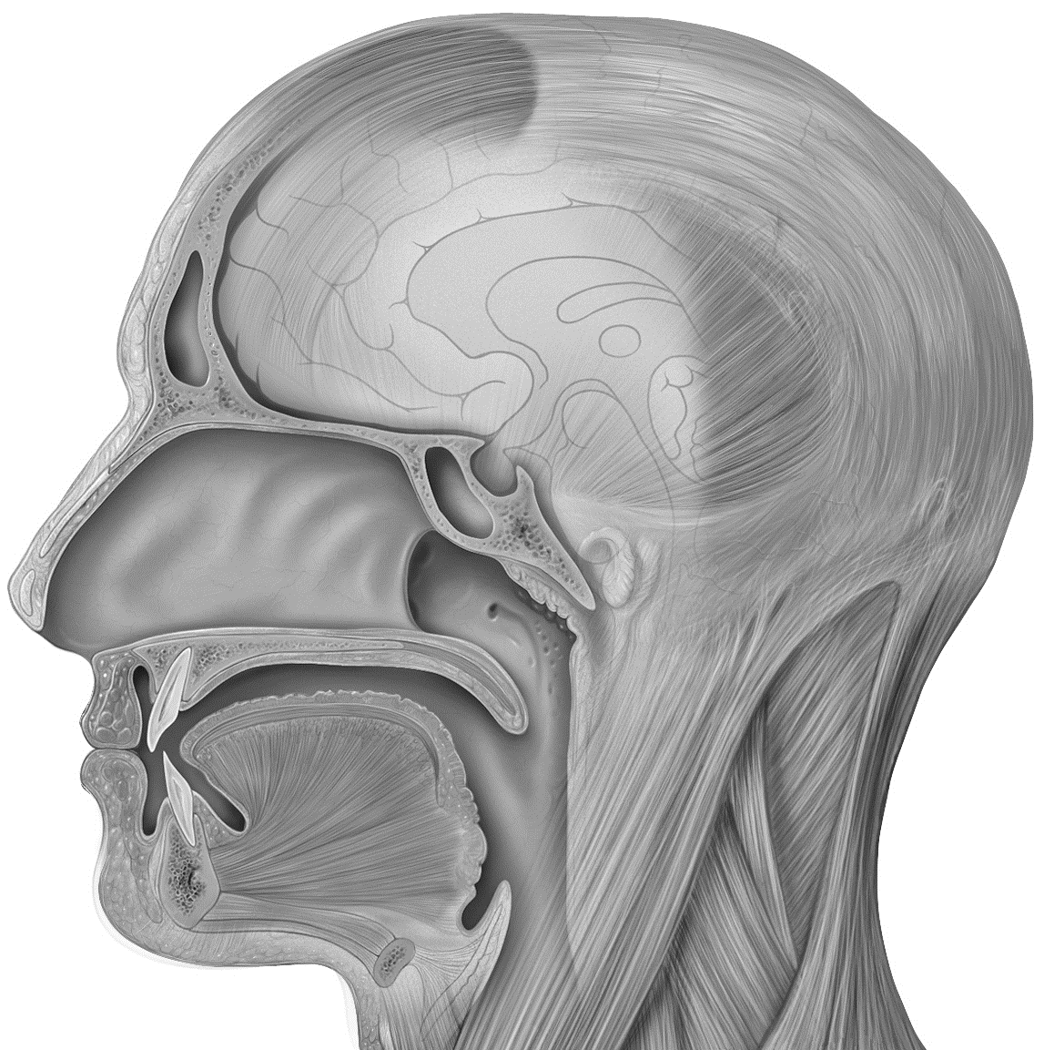
Reduction
Wikimedia Commons
Notes:
This is mostly about the tongue ….. Produce sounds atatata and akakak to illustrate the blue arrows.
Then say the word “articulation” first in a precise, enunciated (hyperarticulated) way, then in a mumbled way.
Functions of reduction? Known, predictable, unimportant. Over-enunciation can be insulting / talking down. Also involved in turn taking.

Slide 12
Prosody is …
The musical aspects of speech
Pitch, loudness, timing, duration, and rate
and things that pattern with them:
reduction versus enunciation
approximating the targets
versus
hitting the targets
microprosody
Notes:
Okay, so that’s reduction versus enunciation … also known as “precision of articulation”.
[read it]
And, no surprise, microprosody is huge for this also.
Our next topic is [next]

Slide 13
Prosody is …
The musical aspects of speech
Pitch, loudness, timing, duration, and rate
and things that pattern with them:
Reduction / enunciation
Nasalization
Phonation type: creaky / breathy / falsetto …
Voicing presence, periodicity
Thousands of derived features
Notes:
It is only borderline prosodic, but at times relevant.

Slide 14
Reduction
Wikimedia Commons
Notes:
….
First one is nasal; very subtle; may have to listen many times, with headphones.
Phoneme linked, such as /n/ … but also suprasegmental.

Slide 15
Prosody is …
The musical aspects of speech
Pitch, loudness, timing, duration, and rate
and things that pattern with them:
Reduction / enunciation
Nasalization
lowering of the velum
detectable by formant shifts
Notes:
To summarize, mechanism … acoustics …

Slide 16

Contents
Introduction
Production, Perception
Classic Ling. Prosody
Technology 1
Para. & Prag. Functions
Speech Synthesis and Dialog
Perspectives
4: Pitch Production
5: Pitch and F0
6. Loudness, Timing, etc.
7: Phonation Types
8: Exercises
9: Pitch Perception
Notes:
So, we have discussed loudness, various timing properties, articulatory precision, and nasalization.
In the next lecture…. [next]

Slide 17
Contents
Introduction
Production, Perception
Classic Ling. Prosody
Technology 1
Para. & Prag. Functions
Speech Synthesis and Dialog
Perspectives
4: Pitch Production
5: Pitch and F0
6. Loudness, Timing, etc.
7: Phonation Types
8: Exercises
9: Pitch Perception
Notes:
… we’ll dive back down the throat, to visit our friend the glottis again, to discuss
phonation types. And thereby wrap up our discussion of the components of prosody.

Slide 19
Speech Production:
Cognitive and muscular actions
Image sources:
Gillam, R.B. and Marquardt, T.P., 2019. Communication sciences and disorders: From science to clinical practice. Jones & Bartlett Learning
Cummins, N., Scherer, S., Krajewski, J., Schnieder, S., Epps, J. and Quatieri, T.F., 2015. A review of depression and suicide risk assessment using speech analysis. Speech Communication, 71, pp.10-49
Notes:
﻿language content, form,
Gillam, Ronald B.; Gillam, Ronald B.; Marquardt, Thomas P.; Marquardt, Thomas P.. Communication Sciences and Disorders (p. 41). Jones & Bartlett Learning. Kindle Edition.

