Slide 1


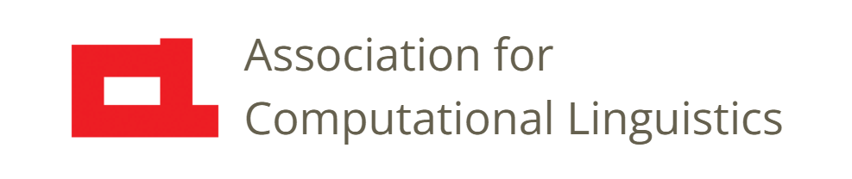
Prosody
Lecture 7: Phonation Types
a.k.a. Voice Quality
Nigel G. Ward, University of Texas at El Paso
Gina-Anne Levow, University of Washington
Tutorial presented at ACL 2021
Notes:
Welcome to Lecture 7 of our series on Prosody. We’ll talk about phonation types [click], also known as “voice quality properties” … that is things like creaky and breathy voice.

Slide 2
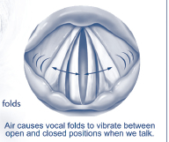
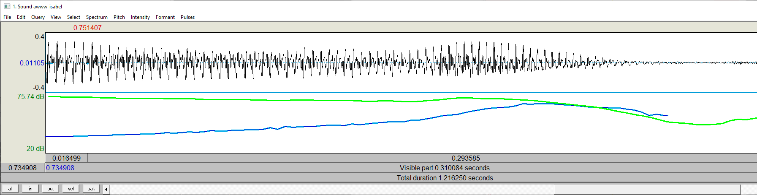
Background
Notes:
Now this lecture assumes you’re okay with diagrams like these two.
If not, you may want to go back and watch Lectures 4 and 5.

Slide 3

Perception Warm-up
What do you hear in
ii naa
(write it down and we’ll discuss this later)
Notes:
Before the explanations, how about a puzzle? [click] What prosody do you hear? [click] Write down what you hear, then we’ll come back to this example.
Now, some of you may object: “how can we tell without context? How does that compare to the speaker’s normal voice?” Well, here it is [click].
Okay, now, what do you hear [click].
Training up your perception is a good thing to do. Here I gave you a clip from an unfamiliar language, where you won’t be distracted by trying to infer the speaker’s attitude or intent; it’s just a sound object. It’s good to learn to be able to decouple the low-level percepts from the pragmatic force.

Slide 4
Prosody is …
The musical aspects of speech
Pitch, loudness, timing, duration, and rate
and things that pattern with them:
Voicing present (binary) or periodicity
Phonation type: creaky / breathy / falsetto …
Reduction / enunciation
Nasalization
Thousands of derived features
Notes:
Okay, back to our main topic: phonation types. Now, these things would not have been covered in a tutorial in prosody even 10 years ago.
They are certainly not big in classical musical scores (although, and this is a total digression, they are big in popular music, e.g. creaky voice in rock, breathy voice in bossa nova, falsetto in j-pop).
But they are relevant for us, because recent work has shown that these have important functions in language, especially in dialog.
Moreover, they often pattern together with the other features, so we need to cover them.

Slide 5
Creaky Voice
Articulatory correlates
  Low airflow
  Slack vocal folds, etc., due to various glottal configurations*
  Low pitch
“sing the lowest note you can, then go one lower”
https://www.youtube.com/watch?v=1PRzm7Lg9Vw
*Johns Hopkins Voice Center: What is Vocal Fry
Notes:
We’ll start with creaky voice. There are two pretty reliable ways to get creaky voice. One is to just keep talking, on and on, until you run out of air.
Pause and try it if you like. [dramatic pause] Yes, it goes creaky. Low airflow means less air passing the vocal folds, so it may not impart enough energy to keep them vibrating smoothly. Your glottis may adjust, to try to eke out some sound. In general, there are several glottal configurations involved, which we won’t distinguish here. The other reliable way to get creaky voice is to sing lower and lower. Here’s an example [click]. Now you can try [dramatic pause]
To sing low, you want long vocal folds, but at some point they get pretty seriously slack, and again, the vibration becomes irregular.

Slide 6
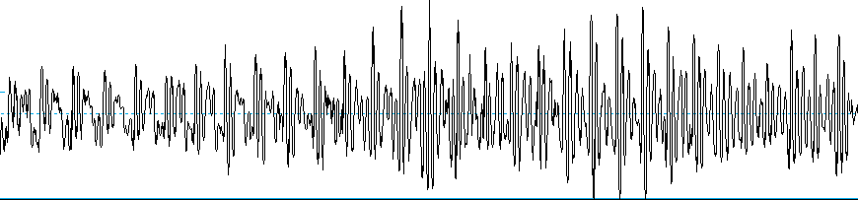
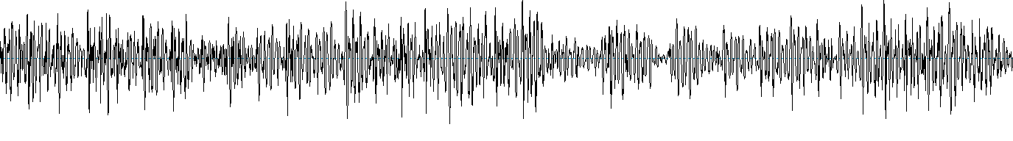
Creaky Voice
Modal Voice
baaa
Notes:
Now let’s talk about the acoustics ….
The first diagram …
The second diagram …
- Analogy to creaky door hinges (mechanism, also acoustics),
Analogy to frying fish, hence the alternate name “vocal fry”. Here’s another example of what it sounds like? [click]
That’s Nigel trying to sound like a kindergartener imitating a sheep.

Slide 7
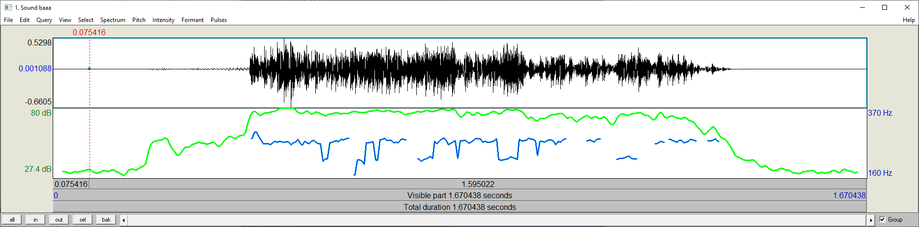
Creaky Voice
Notes:
Now if you’re working with speech samples, looking at glottal closures in the waveform, seen above, to make a decision, is a hassle.
There is an alternative: [click] to just look at the pitch tracker output. There are two things you may see.
The first is crazy impossible jumps. [click] Octaving errors. Pitch tracker is confused. Or maybe some of them are actually not there. [next]

Slide 8
Creaky Voice
Notes:
Okay, there’s something else. Even if we ignore those octaving errors [click] … the pitch track still looks funny. Jitter, i.e. …
In any case, if you see either of these (jitter, octaving errors) then it’s an indication of creaky voice.

Slide 9
Creaky Voice
Articulatory correlates
  Low airflow
  Slack vocal folds, etc., due to various glottal configurations*
  Low pitch
“sing the lowest note you can, then go one lower”
  Acoustic correlates
  Irregular glottal closures (thus “creak” or “fry”)
  May manifest as jitter, octaving errors, etc.
https://www.youtube.com/watch?v=1PRzm7Lg9Vw
*Johns Hopkins Voice Center: What is Vocal Fry
Notes:
Okay, to put it all together, creaky voice has these articulatory mechanisms and these acoustic correlates.
aging … smoking … it’s an individual marker. Thus thus baselines vary …
But for purposes of communication, we can be more or less creaky.

Slide 10
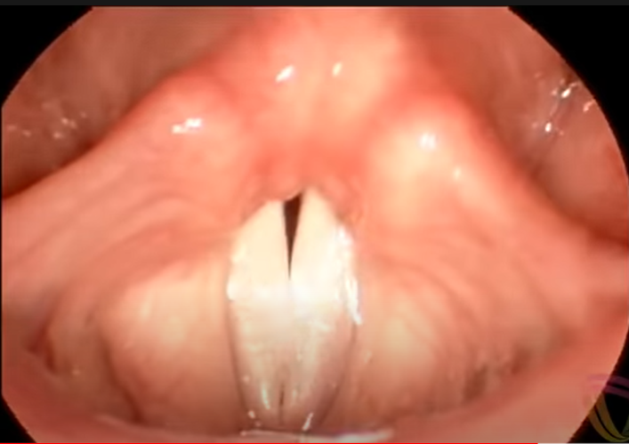
Breathy Voice
Articulatory correlate
incomplete glottal closures
Acoustic correlates
constant slight air leakage
low harmonicity
(different from whisper)
jump jump jump!
https://www.youtube.com/watch?v=y2okeYVclQo @ 1:52
LingualHealth: Speech-Language Pathology: The Vocal Cords in Action
Notes:
… articulatory story … [click]
… constant slight air leakage …
… You may hear this when people are marking urgency
This clip is from two people playing a cooperative video game.
One’s setting up the next move, when the other notices an urgent problem [click] “jump-jump-jump”.
Also exasperation (own voice “why did my soufflé fall again?!”). Also common in laughter.
… Note that this resembles whispered voice. They sound a little bit similar [illustrate]. But they are different [click].
For one thing, there’s a different mechanism: vocal folds never meet at all.
Now, to explain the acoustics a little better, we need to introduce a new kind of diagram.

Slide 11
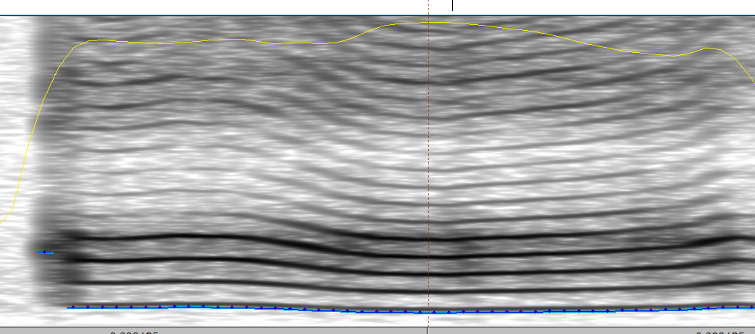
Modal Voice
frequency
time
Modal voice has a clear harmonic structure
Notes:
Analogy to musical instruments…
… and even stronger if highly harmonic….

Slide 12
Highly Harmonic Voice
  Articulatory Mechanisms
  lowered larynx
  widened pharynx
  Acoustic Correlates
  harmonic, musical, sung
Notes:
“yoo hoo”

Slide 13
Falsetto
  Articulatory Mechanism
  stretched vocal folds
  Acoustic Correlates
  very high pitch
  A: just stay in Interval
Notes:
Okay, our last phonation type is falsetto voice.
[explain]
Now, here’s an example from a real conversation [click] [click] .
The speaker is trying to convince to stay with her in the “Interval” course
Instead of dropping it to take another. Now for comparison [next]

Slide 14
Falsetto
  Articulatory Mechanism
  stretched vocal folds
  Acoustic Correlates
  very high pitch
  A: just stay in Interval
  B: but I like human-computer interaction ... …
  A: You can’t get a waiver to try and get in?
Notes:
Here is the same speaker’s voice in her normal range [click], although rather creaky.
It doesn’t sound like the same person, but it is. Here’s the context. [click click] .
Yes, falsetto voice can make you sound like someone else, or, as in this case, express sincere feeling.

Slide 15
Summary
creaky
highly harmonic
whispered
breathy
modal
falsetto
Periodicity
harsh, faucalized, slack …
Notes:
Now, that was a lot of different phonation types. Some of them we can arrange along an axis of “periodicity” [click].
It’s an acoustic measure, and helps us roughly line things up. But others don’t fit so well. [click]
The point is, voice quality is not just one dimension … the larynx and pharynx can take on all sorts of shapes and tensions.
()ther things they do include harsh, faucalized, and slack voicing These however lack clear percepts, or clear articulatory mechanism, or clear acoustic correlates. Or all three. ---
Anyway, we’ve covered enough for now. Let’s go back to our puzzle.

Slide 16
Perception Warm-up
What do you hear in
ii naa
Notes:
Okay, let’s go back to our puzzle. What prosody did you hear? What do you hear now? [click]
At least creaky voice, I hope. Also nasalization. Also high-ish pitch.
While creaky correlates with low pitch, it’s not just a low-pitch phenomenon: the two don’t always co-occur.

Slide 17
Prosody is …
The musical aspects of speech
Pitch, loudness, timing, duration, and rate
and things that pattern with them:
Voicing present (binary) or periodicity
Phonation type: creaky / breathy / falsetto …
Reduction / enunciation
Nasalization
Thousands of derived features
Notes:
Well, we’ve seen a lot of features, but it’s certainly not an exhaustive list.
In particular, there are what we can call “derived features”, like average and range, and like vibrato and rhythm,
which involve patterns over some span of time. We’ll cover those later.

Slide 18

Prosody is More than Intonation
Wikimedia Commons
F₀ is just the tip of the iceberg

Slide 19

Contents
Introduction
Production, Perception
Classic Ling. Prosody
Technology 1
Para. & Prag. Functions
Speech Synthesis and Dialog
Perspectives
4: Pitch Production
5: Pitch and F₀
6. Loudness, Timing, etc.
7: Phonation Types
8: Exercises
9: Pitch Perception
Notes:
Well, that wraps up our discussion of the basic prosodic features. The next lecture will be [next]

Slide 20
Contents
Introduction
Production, Perception
Classic Ling. Prosody
Technology 1
Para. & Prag. Functions
Speech Synthesis and Dialog
Perspectives
4: Pitch Production
5: Pitch and F0
6. Loudness, Timing, etc.
7: Phonation Types
8: Exercises
9: Pitch Perception
Notes:
a chance for you to sharpen your skills, both in perceiving and producing these properties.

Slide 22
Videos
- How the Larynx Produces Sound: first 10 sec, the 1:20 to end
- Vocal Fold Vibration – Slow Motion; 1 minutes

Slide 23
Modal/Breathy Spectral Envelopes
Modal voice
- high harmonics-to-noise ratio
- high CPPS*
Breathy voice
- low harmonics-to-noise ratio
- low CPPS
*ceptral peak prominence smoothed

Slide 24
Prosody is More than Intonation

