Slide 1


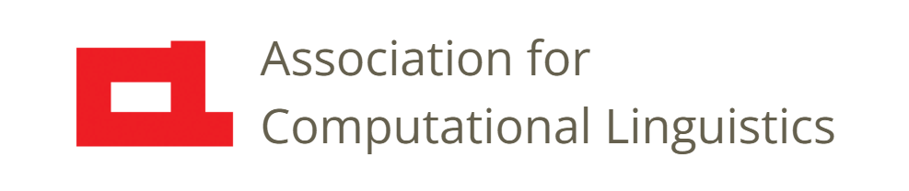

Prosody
Lecture 9: Prosody Perception
Nigel G. Ward, University of Texas at El Paso
Gina-Anne Levow, University of Washington
Tutorial presented at ACL 2021
Notes:
Welcome to Lecture 9 of our series on prosody; on Perception.
Now, we’ve seen a lot of prosodic properties so far [next]

Slide 2
Prosody is …
The musical aspects of speech
Pitch, loudness, timing, duration, and rate
and things that pattern with them:
Voicing presence (binary) or periodicity
Phonation type: creaky / breathy / falsetto …
Reduction / enunciation
Nasalization
Thousands of derived features
Notes:
and hopefully you’ve been able to perceive all of them.
We can’t explain how that happens! Many aspects are not well-understood.
But for two properties: loudness and pitch, psychoacoustics, the study of audio perception, can tell us a lot.
Back in Lecture 5, I mentioned that every prosodic property has 3 aspects. [next]

Slide 3
Percept
Three Aspects
Articulatory Mechanism
Acoustic Measure
glottal cycles
pitch log F₀ (semitones)
loudness airflow, etc. log intensity (decibels)
. . .
Notes:
[read them]
So, considering loudness, for example, we have the articulatory mechanisms (increased subglottal pressure and airflow, for example), and the acoustic measure of log intensity.
That is to say, the perception of loudness is well correlated with log Intensity.
For arbitrary crazy sounds, the relation breaks down, and that’s the sort of thing that psychoacoustic equations can model, but for speech signals, simple log intensity is a reasonable approximation to perception.
(Assuming you’re using controlled stimuli or otherwise dealing with the microprosodic effects.)
The rest of this lecture will focus on pitch perception, since it’s the best understood. And since there are some pervasive myths to debunk.

Slide 4
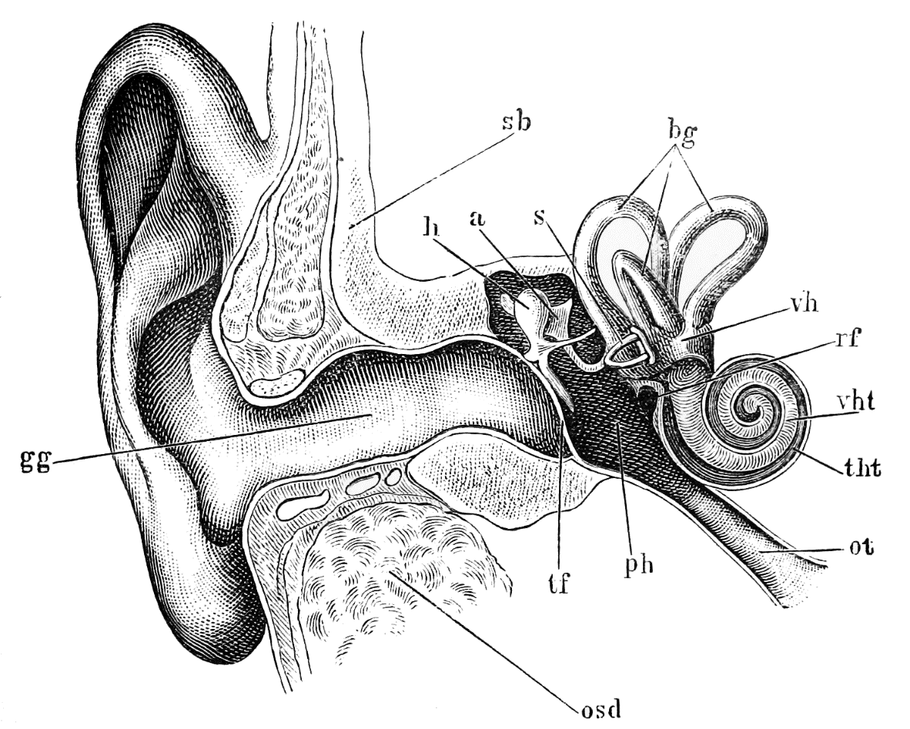
Frequency Perception
Cochlea
low-frequency sensors
high-frequency sensors
outer ear → eardrum → cochlea → brain
https://upload.wikimedia.org/wikipedia/commons/b/bf/Tidens_naturl%C3%A6re_fig40.png
Notes:
Okay, just pitch production relies on special hardware, our vocal folds, pitch perception
relies on special hardware: our ears.
Sound travels through outer ear --- which enhances certain frequency-direction pairings ---
Through the ear canal, eardrum, and ossicles, to the cochlea. This is frequency sensitive.
And in fact, the hair cells responsible for detecting the different frequencies are nicely arranged,
high frequency outside, lower frequency deeper in the snail’s coil.
So, some frequency information is computed directly in the ear, but
Pitch perception mostly happens in the brain.

Slide 5
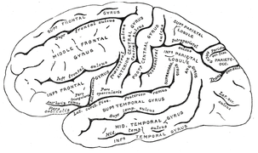
Pitch in the Brain
… is complicated …
Vandyke Carter, Gray, 1918, via Wikimedia Commons
Notes:
And there things get complicated. I wish it was easy like the ear, but many parts of the brain are involved. [click]
Neuro-imaging research has not yet pinned down all the details. But we do know that
aspects of pitch are represented in many places, for different purposes --- for example for emotional prosody versus linguistic prosody --- and probably in different ways. We also know that [next]

Slide 6
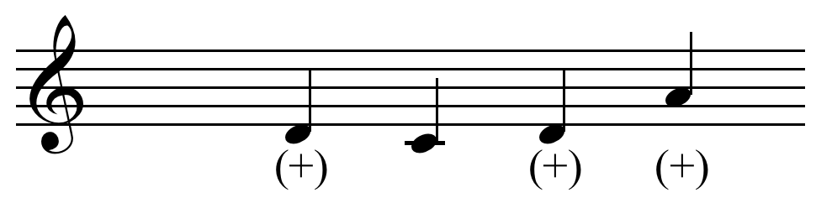
F₀ and Pitch
rate of vibration of the vocal folds
= fundamental frequency
= F₀
pitch
perceived
pitch
fundamental
frequency
By Hyacinth via Wikipedia C BY-SA 3.0
Notes:
F0 (which is roughly the rate of glottal closures) and pitch are monotonically related. That is, as F0 increases, perceived pitch goes up. [click]
(Temporarily forgetting all the microprosodic issues.) But what is the exact relation?
Is it linear? [click] In which case we should use raw F0, measured in Hertz, as our pitch proxy.
Or is it logscale? [click] In which case we should use *log* F0.
(Before we go on, let me just erase part of the graph [click]. Most people can’t perceive sounds as having pitch if the frequency is below 30 Hz or so. And most human voices can’t go below 50 hz or so.)
Okay, I left you in suspense there. The answer for music is logscale: that’s how it’s perceived. From 100 Hz to 200 Hz is an octave, and so is 200 Hz to 400Hz. It’s a bigger different in Hertz, but the same ratio. So, logscale. Musicians break up each octave into 12 steps, called “semitones” [click], and these are a convenient unit for log Hz.
Perception of the pitch of *speech* is more complex. However logscale is the most common choice in speech science. Okay, I have two more-concrete pitch perception examples for you.

Slide 7
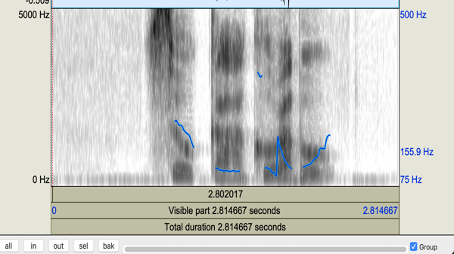
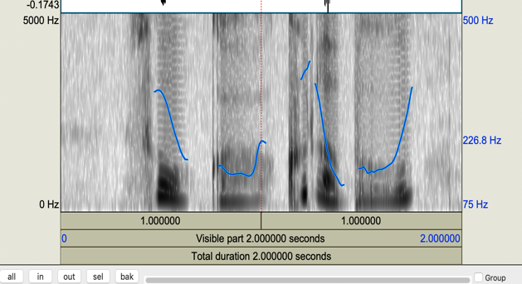
Why use log Hz?
Male
Female
Notes:
One good reason to use Log Hz for speech: it compensates for range differences. Here we see … Here I’m showing them in linear scale, so it looks like the female has much wider range [click]: the range from her minimum Hz to maximum Hz is greater. This is true for most males and females, however, perceptually, female ranges do not always seem greater.
(Using log scale corrects for this. In a later lecture we’ll introduce other pitch scales and when to use them.)
[really should to play audio for these]

Slide 8

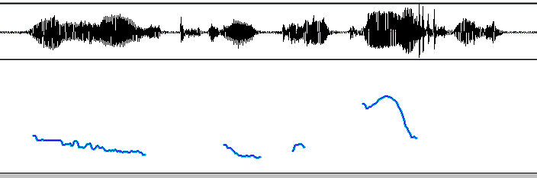
Ending High or Low?
“to get the degree … you have to take this class”
low pitch
or high?
Pitch perception is affected by creakiness, intensity etc. … Moreover, people differ
Szczepek Reed (2010) Example 2.1. audio source: SBC001 (by John W. Du Bois CC by3.0)
c.f. https://languagelog.ldc.upenn.edu/nll/?p=34251
Notes:
Please listen, and pay attention to the last word: is it’s pitch high or low.
[click] Okay, is the word “class” low or high? Here’s the last phrase again [click].
Well, whatever you think, some people will disagree with you. Even the pitch tracker may disagree with you [click]. But let’s not be intimidated by an algorithm: your perception is your perception. What’s going on? Creaky voice…. [click] …
Now things like this can drive musicians crazy. Okay, you can’t tell me what note it is, but you can’t tell me even if it’s higher or lower? But pitch in speech is complex!

Slide 9
Final Rise or Final Fall?
Notes:
Okay, one more little experiment: a two-word phrase: please listen for whether it rises or falls at the end. [click] Here it is again. [click]
When I first heard this, I thought it was falling.
But some perceive a final rise. Listening through headphones may increase this perception.

Slide 10
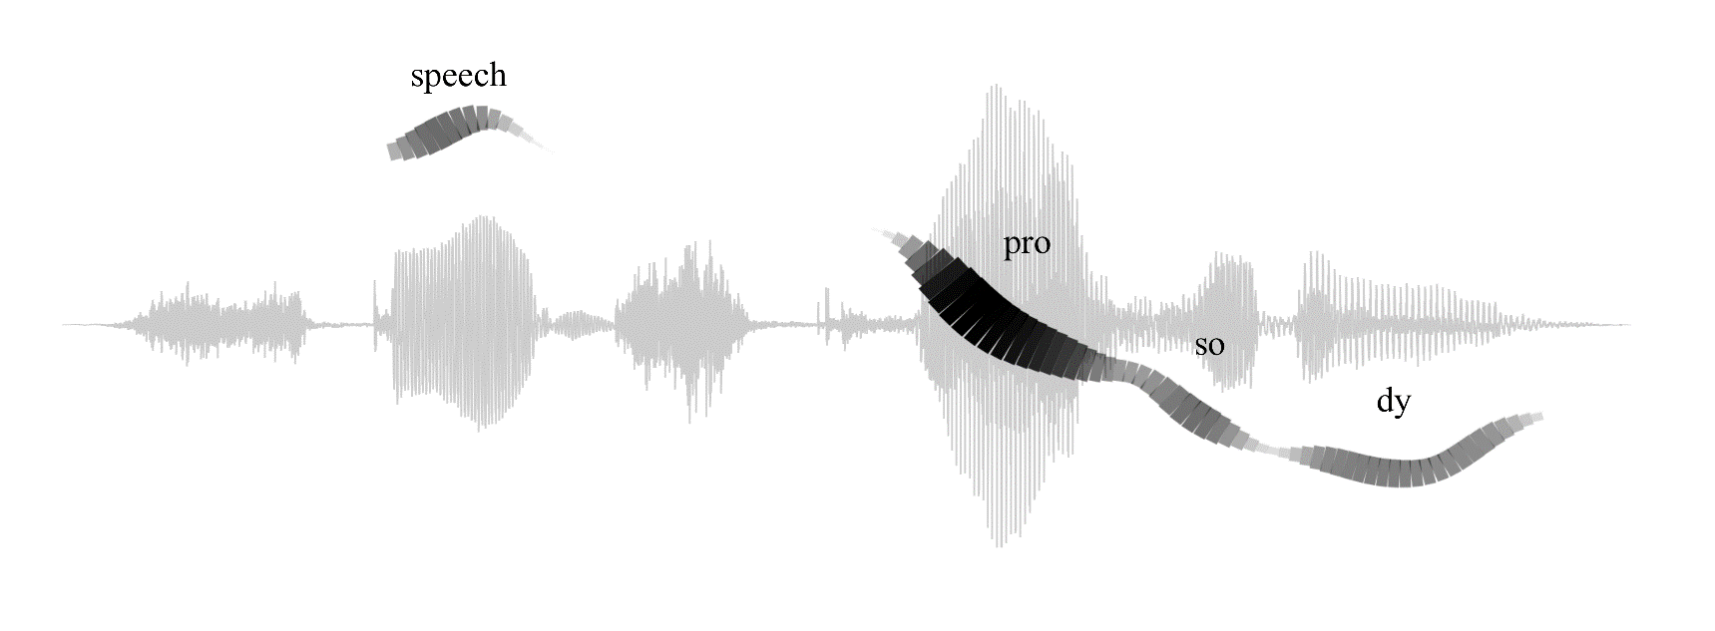
Final Rise or Final Fall?
Ribbon width and darkness represent periodic energy
People differ
(but perceptions at vowel centers are fairly consistent)
(Cangemi, Albert, Grice, 2018 )
Notes:
Here it is again [click].
Also it may help to look at a graph. [click] This shows a tiny pitch upturn, probably at the limits of perception.
Now, this graph is more sophisticated than the Praat graphs, where F0 was a thin blue line.
Here the width and darkness of the ribbon varies …
Periodicity: greater when louder, and when more harmonic.
As we see, at the end, the periodicity is fading out.
The pitch percept is weaker there, and it may be weak enough to not affect our perception of slope at all.
Here it is again [click]
Alright, I’ve chosen these examples to be tricky ones.
And while people do differ, [click] , most of the time we’re on the same page. In particular … vowel centers …

Slide 11
Pitch Myths
Pitch is the same for music and speech
everywhere equally informative
objective
the whole story
everywhere defined
reliable/meaningful in raw pitch plots
Notes:
Okay, so pitch is informative.
It’s just not as simple as we might wish. Here’s a list of “pitch myths”.
[discuss all]
When I say “the whole story”, I mean, don’t just give a single number, but “could be 110 or 220, but in any case is creaky”. As seen in the “take this class” example.
… the last two points are just a summary of some discussion in Lecture 5.
So sure, we’ll use pitch, but always remembering the complexities.

Slide 12
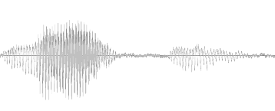
In my Fantasy World
percepts
perception
interpretation
meaning
Notes:
I wish I could tell you that the perceptual aspects of speech are well-understood.
Ideally, brain scientists could tell us exactly what people get from the speech signal.
But that’s not possible today. Instead, our inventories of pitch properties are based on [next]

Slide 13
… but in Reality …
percepts
perception
interpretation
meaning
We need to leverage facts about interpretation
to infer which prosodic features matter, and when
etc.
Notes:
a lot of indirect evidence, [click] from what matters for native speakers’ judgments. And more [click], notably some intuitions, and observations about articulation.
So, the bottom line is [next]

Slide 14
Prosody is …
The musical aspects of speech
Pitch, loudness, timing, duration, and rate
and things that pattern with them:
Voicing presence (binary) or periodicity
Phonation type: creaky / breathy / falsetto …
Reduction / enunciation
Nasalization
Thousands of derived features
Pitch range
Pitch slope
…
Notes:
That our list of prosodic properties is built on sand, not solidly tied to anything we can experimentally measure.
And sometimes the perceptions are faint or inconsistent. But it’s still very useful.
Finally, one last point, on the topic of perception, I’d like to emphasize something that’s incredibly obvious.
Hearing is not like vision.

Slide 15
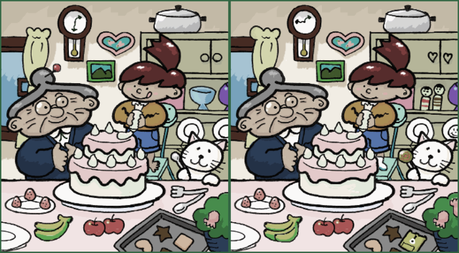
Visual Perception
By Muband at Japanese Wikipedia, CC BY-SA 3.0
Notes:
If I ask you to spot the differences ….
scan it over … the image is there as long as you want. Every part of it is fresh.
You can see all the pieces together, or focus on one.
Audio is different [next]

Slide 16
Auditory Perception
Sound is fleeting.
= “The echoic memory (auditory buffer) is volatile.”
So it helps to
present clips for comparison without delay
use visualizations
use measurements
Notes:
Lasts ~ 1 s without refreshing/rehearsal…

Slide 17

Contents
Introduction
Production, Perception
Classic Ling. Prosody
Technology 1
Para. & Prag. Functions
Speech Synthesis and Dialog
Perspectives
4. Pitch Production
5. Pitch and F0
6. Loudness, Timing, etc.
7. Phonation Types
8. Exercises
9. Perception
Notes:
Okay, we’re done with production and perception.
Starting with the next lecture [click]

Slide 18
Contents
Introduction
Production, Perception
Classic Linguistic Prosody
Technology 1
Para. & Prag. Functions
Speech Synthesis and Dialog
Perspectives
10. Tone and Stress
Notes:
We’ll start talking about the linguistic functions of prosody. We’ll start with

Slide 20
A Physiological Constraint
Pitch slope maximum: around 80 semitones per second
(excluding during transitions to/from creaky or falsetto)
(slightly faster for Mandarin speakers)
(normal language uses far less)
(Yi Xu 2002)

Slide 21
Implications
To prevent doubling and halving errors,
give the pitch tracker a tight pitch range:
gender-appropriate
typical male: 85-180 Hz, female 165-255 Hz
(excluding screams, laughter, falsetto, creaky voice, growls)
speaker-appropriate
utterance-appropriate
Or use a pitch tracker with strong smoothing

Slide 22
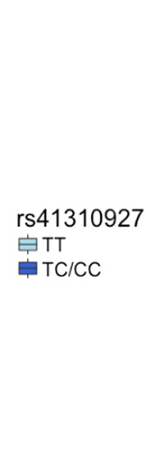
Lexical Tone Perception
ASDM gene
variants
Patrick C. M. Wong et al, ASPM-lexical tone association in speakers of a tone language.
Science Advances, 6, eaba5090, 2020
Notes:
Some people have a gene that makes cilantro taste like soap. … others …

Slide 23
Perception Miscellany
Pitch perception is affected by intensity
Just-noticeable difference: typically 1Hz in ideal conditions
People (and machines) can often perceive slope even when they can’t identify the absolute pitch value

Slide 24
no way
no way
Examples by Jonathan Gutmann

Slide 25
Perceptions of Pitch
Factors affecting perceptions of lateness
#13 We don’t directly perceive pitch max (avg, min, height …)
(Niebuhr et al., 2011; Barnes et al., 2012)

Slide 26
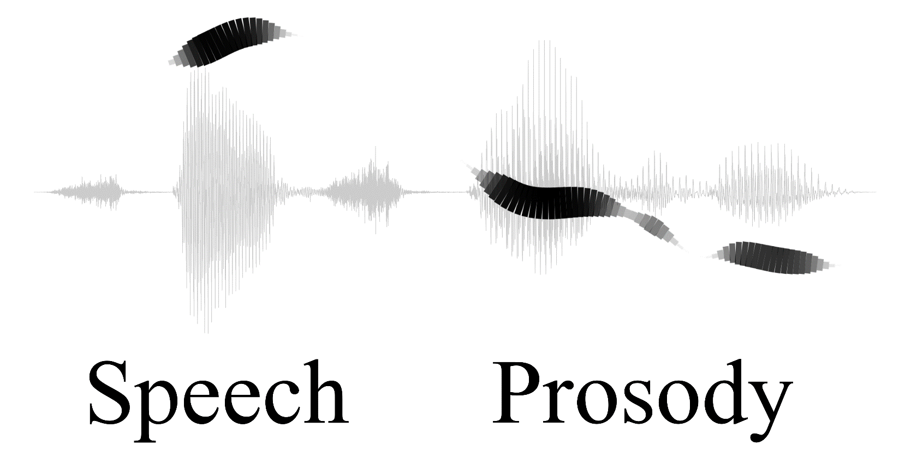
Ribbon width and darkness represents periodic energy (Cangemi, Albert, Grice, 2018 )

Slide 27
Pitch from Harmonic Structure
??
Mcdermott lab at MIT

Slide 28
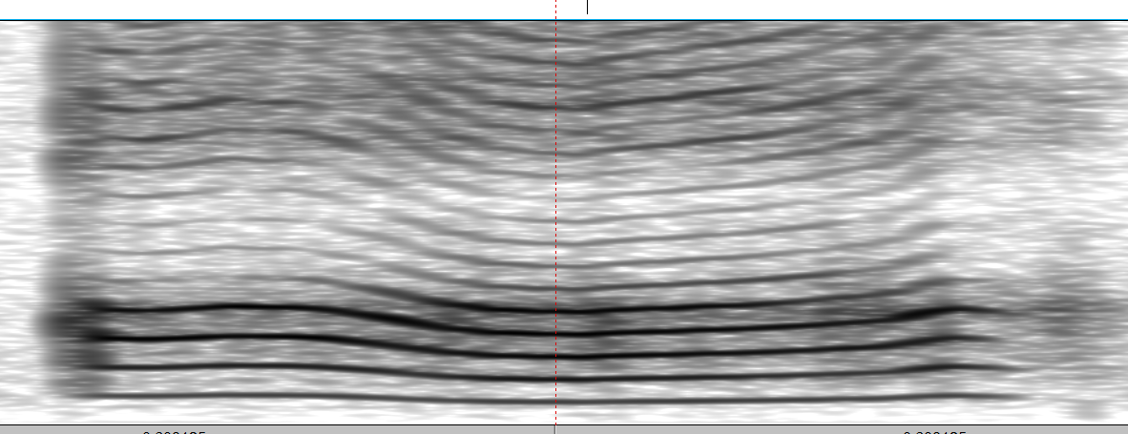
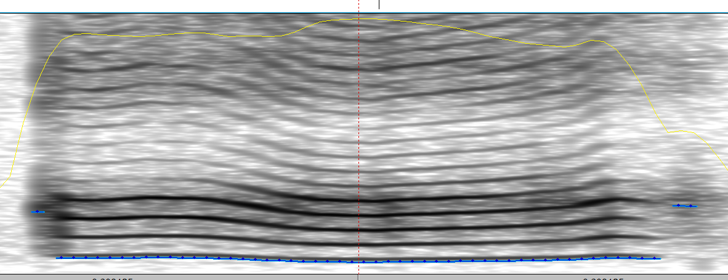
The fundamental frequency has harmonics,
so frequency domain information can also help track pitch.
Hz
F₀
time

Slide 29
The human pitch center probably does not correspond to a single area…
Christopher J. Yuskaitis, Mahsa Parviz et al, 2015

Slide 30
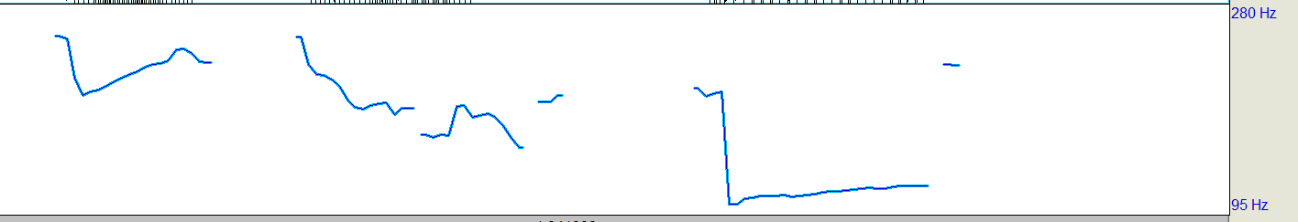
Perception is Tricky
once the eggs hatch
Which is higher in pitch?
once the eggs hatch
Mark Liberman https://languagelog.ldc.upenn.edu/nll/?p=34251

Slide 31
What do we Perceive?
We are exceedingly well trained in finding out by our sensations [relevantly meaningful information] … but we are completely unskilled in observing these sensations per se; and the practice of associating them with [meanings] actually prevents us from being distinctly conscious of the pure sensations.
Hermann von Helmholtz
quoted in Warren 1981, as quoted in Moore 2003

