Slide 1


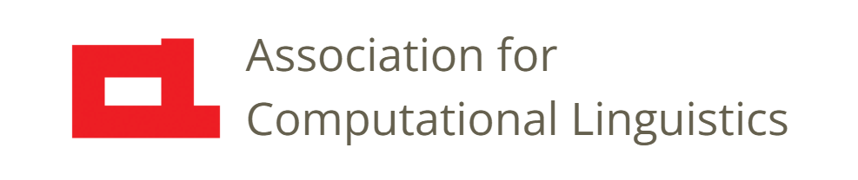

Prosody
Lecture 10: Tone and Stress
Nigel G. Ward, University of Texas at El Paso
Gina-Anne Levow, University of Washington
Tutorial presented at ACL 2021
Notes:
Welcome to Lecture 10 of our series on prosody. After covering production and perception, it’s time to start talking about the *functions* of prosody. In this lecture we’ll cover tone, stress, and related phenomena.

Slide 2
Some Roles of Prosody
Identifying Units
  Phonetic
  Morphemic
    Syllabic
    Lexical
  . . .
Notes:
To make it fun, let’s think about creating a new language!
How can prosody help?
Well, one important thing is making the sounds and words unambiguous.
So, how can we apply prosody to *identify*, or decorate, units: [next]

Slide 3

1. Identifying Phonemes
Duration
  Long vs short vowels
  Single vs geminant consonants
ojisan ojiisan
おじさん おじいさん
oto otto
音 夫
kako kakko
過去 括弧
Phonation
Loudness?
Pitch height?
Pitch slope?
etc.
Notes:
We can use prosodic properties to discriminate among phonemes. For example, we can distinguish long and short *vowels* [click], as used in Tokyo Japanese to distinguish uncle and grandfather [click]. We can also distinguish *consonants* by length, as used [click] to distinguish “sound” from “husband” and “past” from “parentheses”. [click]
NB, these are not usually considered to be prosody, but rather phonetics and phonology.
For most languages, they’re in the writing system, plus the IPA can handle them just fine.
What other prosodic properties could we use? [click] Phonation is possible but uncommon.
Loudness and pitch height are unavailable, due to strong microprosodic effects.
Pitch slope is tricky to realize on single phoneme: they’re just too short.
So let’s move up to the syllable level. [next]

Slide 4

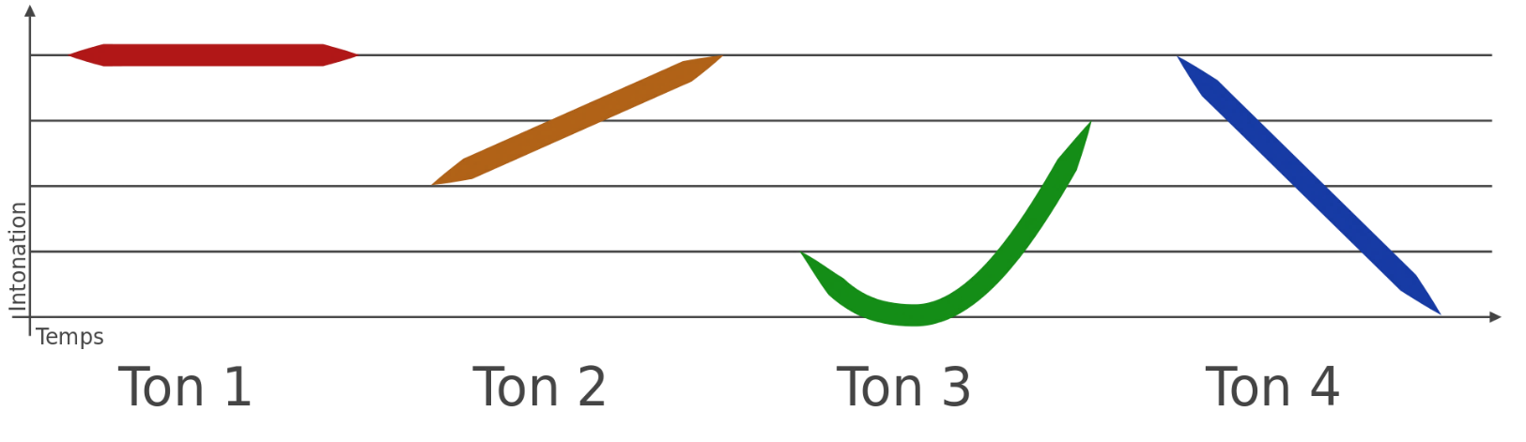
2. Identifying Syllables
    Example: the tones of Mandarin Chinese
    妈 ma¹: mother; 麻 ma²: hemp; 马 ma³: horse; 骂 ma⁴: scold
    (ma in neutral tone: question particle)
5
4
3
2
1
55 35 214 51
By User:Chrislb - Nach Bild:Mandarin 4 Toene.png von Benutzer:Herr Klugbeisser, CC BY-SA 3.0, https://commons.wikimedia.org/w/index.php?curid=978283
Notes:
using prosody to distinguish among syllables.
Why would you want to do this? Well, suppose you have a lot of words which are just one syllable, and you need some way to distinguish among them. For example, in Mandarin Chinese, there are 4 versions for “ma”, distinguishable only by *tone*. [click]
This works well for Mandarin Chinese, where every syllable is a morpheme (mostly). Now, these are taught as involving only pitch. That’s easy to represent as a diagram [click]. Or in terms of a sequence of levels. [click] [explain] …. Importantly, it’s not just pitch height, but also slope and contour. Further, it’s not just about *pitch*, if you listen again, what else is going on here? [click]
Durations vary; also phonation (creakiness). This is common in tone languages: they are not just about pitch.
Now, every syllable has a tone … almost. Nothing we say in this lecture is perfectly exactly true, but Language is like that.

Slide 5
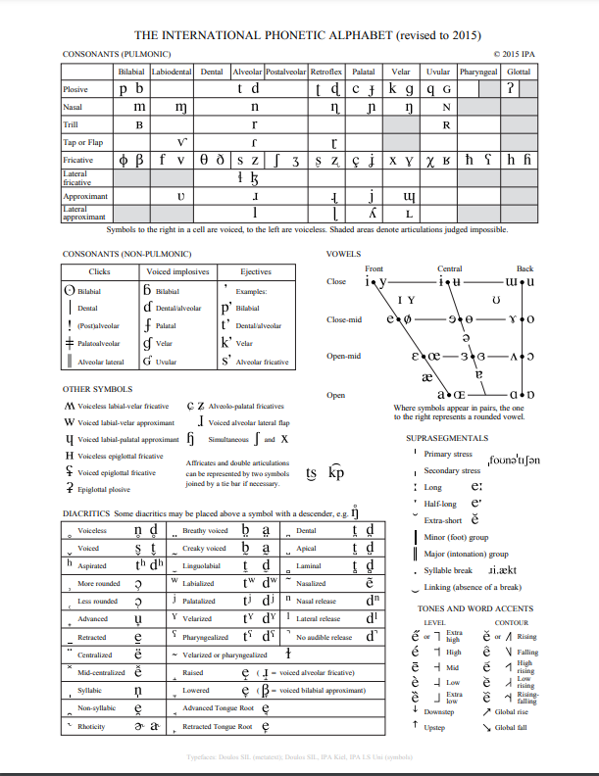
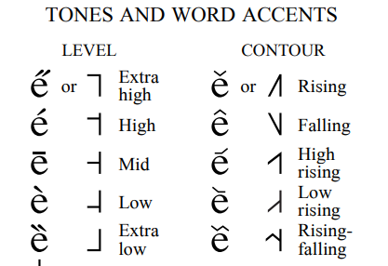
2. Identifying Syllables
Pitch height (low, mid, high, superhigh)
Pitch slope, contour (rising, falling, fall-rise … tones)
Duration (short and long tones)
Phonation (creaky, modal)
Copyright © 2015 International Phonetic Association. CC 3.0
Notes:
To summarize the common prosodic components of syllable-marking tones …
Now the IPA [click] that is to say, the International Phonetic Alphabet, has some symbols for tones,
Down in the bottom right corner [click]. Let’s look at “mid” [click] . The vertical line is iconic for
the speaker’s pitch range, and the height of the horizontal marks the height of the tone within that.
Similarly for the contour tones, like “falling” [click] .
How many tones can a language have? Vietnamese and Cantonese each have 6, and Iau: [next]
[[Now, tone languages are not rare. Geographically, they are more common in “hot and humid” climates than
elsewhere, which is, controversially attributed to drier vocal folds being less elastic and harder to manipulate. ((Caleb Everett et al (2015). ]]

Slide 6
2. Identifying Syllables
Iau
tone | be with tone | ba with tone
H | father-in-law | came
M | fire | has come
HS | snake | might come
LM | path | came to get
HL | thorn | came to end point
HM | flower | still not at endpoint
ML | small eel | come (process)
HLM | tree fern | sticking, attaching to
H = high
L = low
M = mid
S = superhigh
… and marking grammatical functions
Hyman & Leben, 2020
Notes:
, a language of West Papua, has 8. The same phoneme sequence, “be”, means entirely different things with the different tones.
Further, in this language tone can convey *grammatical functions*. The same tones, applied to the monosyllabic verb “ba” (come),
[click] …
In other languages, tones can be morphemes that mark singular/plural, first-person/second-person and so on, case, tense, and negation.
Now let’s move up from syllables [next]

Slide 7
3. Identifying Words
L H H L
niji niji
虹 二時
rainbow two o’clock
ni ji ni ji
Notes:
to words. We can use prosody here too: to identify words.
Consider two words in Tokyo Japanese. Can you hear the difference? [click] The first means “rainbow” [click] and the second “two o’clock”. [click]
Here it is again: [click] The difference is mostly about the *pattern* of pitch heights.
No single pitch piece is informative, unlike true tone; rather it’s the pattern that matters.
Now this *could* be notated with H and L symbols [click] for high and low.
But we can be more efficient and use corners [click], since once there’s one pitch drop, the rest are guaranteed low.
You can’t have just any arbitrary sequence of Hs and Ls.
For this reason also, Japanese is not a typical tonal language: not every syllable needs to be marked.
[[Japanese doesn’t have a lot of vowels and consonants, so there would be lots of ambiguities (homophones) if
prosody wasn’t used in this way. It’s not a huge functional load, not like Mandarin, but still matters. ]]
[[Ideally would reorder to go directly from Mandarin to African tone languages, if I had good examples]]

Slide 8
3. Identifying Words
A stress language: English
Please read our Code of Conduct, and conduct yourself accordingly.
Notes:
English also has prosodic marking marking of words, although there are only rarely is this is essential to word identity.
Consider this sentence [click].
The letters “conduct” appear twice, but the meanings differ: One’s a noun, one’s a verb.
And the *stress patterns* are different. [click]
(Incidentally, the reason to chose as example a nasty sentence, is that stresses are more evident when scolding:
that is to say, adding stronger or extra stresses are a way to convey scolding. This can get really strong “*please* “read* *our* *Code* ).
Now, stress location is seldom discriminative in English, but it is very important for intelligibility,
as you may observe when listening to non-native speakers whose stress locations or realizations differs from
those of native speakers.
Now, there are various notations for indicating stress [next]

Slide 9
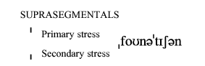
3. Identifying Words
A stress language: English
Please read our Code of Conduct, and conduct yourself accordingly.
H L L H
ˈconduct conˈduct
conduct (n) conduct (v)
cónduct condúct
Notes:
We could do H and L. In English, stressed syllables do tend to be high in pitch, and the
unstressed syllables tend to be lower. But they don’t act like real targets. This differs from some African languages, where there are true L (low) targets, and every syllable that’s not clearly high has to be clearly low. Rather, English unstressed syllables are just kind of blah: They are reduced and usually shorter, but in terms of pitch, but they mostly just come along for the ride.
(And thus they are available for realizing meaningful contours, as we’ll see later.)
Moreover, in English we know every word has at most one primary stress, so we don’t have to mark every syllable;
just the location of the primary stress [click]. This is an old-school notation, which nicely reminds us that the vowel
Is where the phonetic indicators of stress mostly happen. Or we can do it in IPA style [click], which provides generically-useful symbols for stress [click], so we could write it like this [click].
Anyway, what *are* the indicators of stress? [next]

Slide 10
3. Identifying Words
Indicators of stress:
longer, higher, louder, enunciated
ˈconduct conˈduct
Notes:
For English stress is marked by pitch height, lengthening, loudness, and articulatory precision. [click]
Many languages have the same basic mix, but in different ratios.

Slide 11
3. Identifying Words
Another stress language: Spanish
para llevar, por favor
(I’ll take it to go, please)
samples courtesy of Jonathan E. Avila
Notes:
For example, consider Spanish, where *pitch* is the main differentiator, and if you mistakenly also vary the duration too much, you sound like a gringo.
Here’s how English-accented Spanish might sound [click]: native speakers sound very different: [click] .
Questions of realization aside, stress is important enough in Spanish [next]

Slide 12
3. Identifying Words
Another stress language: Spanish
para llevar, por favor
(I’ll take it to go, please)
papá (dad)
papa (potato)
Spanish lexical stress is penultimate, for vowel-final words …
French is word-final.
Finnish is word-initial.
… affecting perceptions of rhythm
samples courtesy of Jonathan E. Avila
Notes:
that accents are marked in the orthography [click]
in cases where they are not predictable from the general rules of the language, for example [click].
For example, the basic rule for Spanish is [click] with lots of exceptions.
Some languages have fewer exceptions, for example French where it’s word-final, or Polish (penultimate);
others many exceptions like English, where it tends to be word-initial for nouns, but this is a very weak tendency.
Because of these factors, [click] some language pairs have very salient differences in *rhythm*: these seem to be due largely to different stress realizations and different placement rules.

Slide 13
Summary
Prosody can mark
and Phrases, Utterances, Turns
etc
etc.
Phonemes
Syllables
Words
Using many prosodic properties
Structured as
Tone Inventories
Stress Patterns
Notes:
In summary [read it]
Now, there is a tradition of taxonomizing languages, “stress languages versus tone languages” for example,
but really language vary in all sorts of ways, and describing big categories is not too helpful.
Okay, so that’s it for “unit-linked” prosody … but there are many more things that prosody can do for us [click], as we will see.
Well, that wraps it up for Tone and Stress [next]

Slide 14

Contents
Introduction
Production, Perception
Classic Linguistic Prosody
Technology 1
Para. & Prag. Functions
Speech Synthesis and Dialog
Perspectives
Tone and Stress
Sequencing and
Connecting
12. Representations
Notes:
[dramatic pause] In the next lecture we’ll see how [next]

Slide 15
Contents
Introduction
Production, Perception
Classic Linguistic Prosody
Technology 1
Para. & Prag. Functions
Speech Synthesis and Dialog
Perspectives
Tone and Stress
Sequencing and
Connecting
12. Representations
Notes:
Prosody is used in sequencing and connecting units.

Slide 17
3. Identifying Words
and Morphemes
Yoruba akwa HH crying akwa HL cloth
Carter-Enyi et al, 2016)
A tone language: Xhosa
Xoliswa Matrokko at Wikimedia Commons
Hyman & Leben, 2020
Notes:
In other languages prosody is used more intensively to mark word identity, for example, in many African languages.
Here is a clip of the language Xhosa (whose name I’m not saying right) [click]. Xhosa is an example of a tonal language, but the tones are associated with words,
not syllables, unlike Mandarin. There are two tones: high and low, or H and L.
For example, it can distinguish words, for example ubulele (which I’m also not saying right). you were sleeping, or you thanked.
Tone can also distinguish other elements of meaning, such as distinguishing you killed, or he killed, or, did you kill (xhosaroots.com). These are tonal morphemes (*check terminology*) and serve some roles that might suffixes might cover in other languages.
Languages vary greatly in how they use prosody to mark works. “Stress” systems also exist. Classic Stress languages include English and Spanish.

Slide 18
Prosody and Language
Prosody affects meaning at all linguistic levels
  Lexical: determines identity, meaning
    Tone, stress, pitch accent
  Syntactic: highlights phrasing, prominence
  Sentential force: indicates statement, question
  Information structure: marks given/new information
  Discourse structure: demarcates topic bounds

Slide 19
Variation
Prosody can influence meaning at all linguistic levels
However,
  Different factors are marked prosodically in different languages
    e.g. “Focus”:
      English, Mandarin: prosody, reordering, or both
      Wolof, Gùrùntùm: morphological focus markers (“a”)
      Hungarian, Hausa: syntactic reordering, ”focus position”

Slide 20
Variation
Prosody can influence meaning at all linguistic levels
However,
  Different prosodic cues are employed by different languages for similar phenomena
    E.g. Yes/no questions
      English: Low pitch with high final rise
      Kabardian: Drop in pitch, lower for question than statement

Slide 21
Word-level Prosody
Gussenhoven’s (2001) continuum
    Cf. Hyman (2009)
Stress
Language
Pitch Accent
Language
Tone
Language
N. American
English
W. Basque
Tokyo
Japanese
Luganda
Mandarin
Chinese

Slide 22
Stress, Tone, Pitch Accent
Stress systems:
  Strong and weak syllables form
    Hierarchical metrical structure of words
    Strong syllables:
      Longer duration, louder intensity, pitch
  Pitch contour varies independently
  Example: American English
    Every word has a syllable bearing primary stress
      Isolated word stress predictable by rule

Slide 23
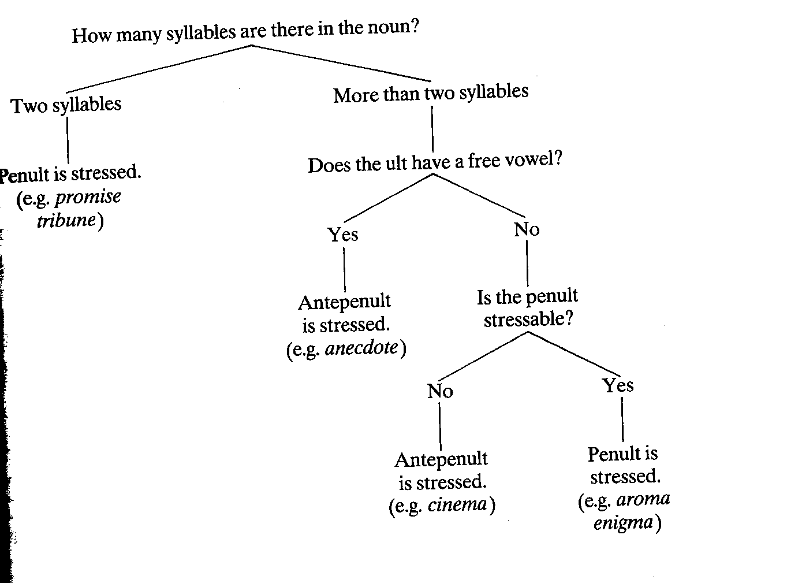
English Noun Stress (Kreidler 1989)

Slide 24
Stress, Tone, Pitch Accent
Tone systems
  Pitch determines word meaning
    Pitch height targets (H/L)
    Contour targets (Rising/Falling)
  Pitch contrasts on tone-bearing units (TBUs)
    E.g. syllables
  Common across world’s languages
    70% estimated to be tonal: Africa, Asia (Yip, 2002)

Slide 25
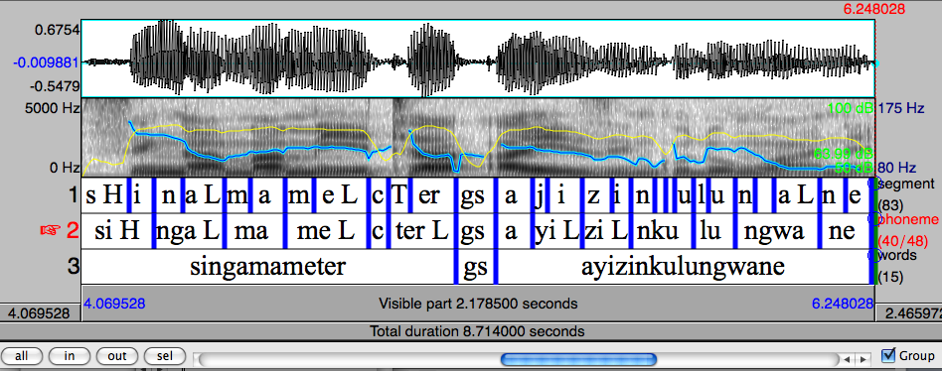
Tone Language Example (II)
isiZulu: Southern Bantu language
  H(igh), L(ow) tones
    HL ”falling” sequence on long syllables

Slide 26
Stress, Tone, Pitch Accent
Pitch accent languages:
  “Invariant tonal contours” on accented syllables
    Not present on all words or syllables
    Specific contours are obligatory
      Many different configurations
Example: Tokyo Japanese
  Pitch drop from High to Low required in some words, at specific position
  At most one such accent per word

Slide 27
Acoustics of Tone
Tonal phenomena typically defined in terms of pitch height or contour
May also incorporate additional acoustic-prosodic cues:
    Intensity: Loudness can also differentiate some tones
    Duration:
      Cantonese “checked” tones on shorter, closed syllables
    Voice quality:
      Low tone in Mandarin associated with creaky voice
      Tone & phonation in Vietnamese

Slide 28
Prosodic Realization
Many processes affect tonal realization
  Differences between underlying tone/stress and observed prosody
    Speaker-based
    Phonological rule-based vs
    Phonetic, articulation-based

Slide 29
Summary & Challenges
Word-level: Stress, pitch accent, tone
  Carry important information, different form
    “Functional load”: tone>>pitch accent>> stress
          (Surendran, 2004)
Challenges:
  Ensembles of acoustic cues, contrasts
  Variation in surface realization
    Speaker, phonology/morphology, phonetics

