Slide 1


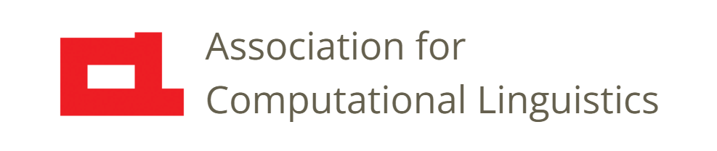

Prosody
Lecture 11: Sequencing
and Connecting
Nigel G. Ward, University of Texas at El Paso
Gina-Anne Levow, University of Washington
Tutorial presented at ACL 2021
Notes:
Welcome to Lecture 11 of our series on prosody. In the last lecture we saw how prosody can identify units,
such as tones for syllables and morphemes, and stress patterns for words.
Building on that, let’s consider the prosody of *sequences* of units.

Slide 2
Sequencing and Connecting
Prosodic coarticulation
Tone sandhi
Noun-noun compounding
Notes:
We will see how the prosody of a unit can affect its neighbors’ prosody, and how prosody can mark semantic connections.

Slide 3
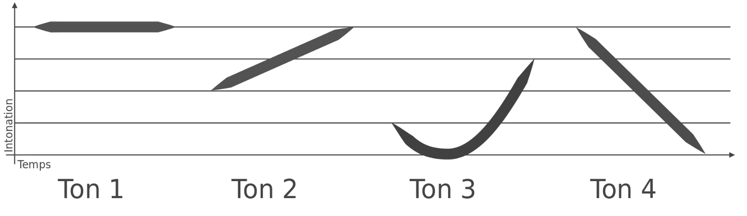
Coarticulation
Notes:
Okay, suppose you’ve being practicing your Mandarin tones diligently and are really good
at the high tone and the falling tone.
Then one day you need to produce an entire word, with two tones.
Putting tones together is sometimes easy [click]

Slide 4
Coarticulation
Notes:
But what if you have two falling tones? [click]
You can’t instantaneously stretch your vocal folds to hit a higher pitch!
And pausing for a moment between every tone would be tedious and weird.
So, both tones change a little

Slide 5
Coarticulation
(Shih&Kochanski 2000, Yi Xu 2001)
Notes:
You may start the first a little higher than usual, and the second rather lower, and reduce its slope.
This is legit! The exact start and end points will change; so it’s no longer 5 down to 1.
But that’s not the important thing: the essence of Tone 4 is the falling slope, and it’s still there in both: both tones are perceived just fine.
Another interesting example is [next]

Slide 6
Coarticulation
Notes:
Tone 3 followed by Tone 4. [click] What people do is [next]

Slide 7
Coarticulation
Tone 4’s essence is the slope
Notes:
something like this. You sort of smooth things out. You can cut corners, especially when you’re in a hurry: when the speaking rate is high.
Some aspects of the targets are not fully reached .
But again, critically, the slope of Tone 4 is preserved. The underlying essence of Tone 4 is its slope [click].
(As a side note, this case may also be analyzed as involving a kind of allophone, the half tone.)
But the point is, this sort of thing is common: processes of smoothing, or “coarticulation”, where the properties of one target
bundle, affect the realization of a neighboring target bundle.
This is often, mostly just about operating your larynx as economically as possible, while still getting the job done.
But not always. Sometimes things are different.

Slide 8
Notes:
Imagine now that you if you have to produce two Tone 3 syllables together.
Here just smoothing is No Good. Instead [next]

Slide 9
Tone Sandhi
Phonological Rule:
Tone3 Tone3
Tone2
你好
Notes:
The second syllable changes to Tone 2 [click]. You can hear this in the common greeting NiHao [click]
This is an example of Tone Sandhi.
It’s a phonological rule of the language [click]: Tone 3 changes to Tone 2 when preceeded by Tone 3.
This may seem strange. It would be neat and tidy if the properties of a tone were all *internal* to the syllable it marks.
But no, things can leak across to, or influence their neighbors, or even distant neighbors, in almost arbitrary ways.
And this is not uncommon.
Many kinds of tone sandhi are common, including tonal copying and tone spreading, to mention just two of the simplest.
Now this example is (to a first approximation), just about sequencing. But some of these non-internal effects involve semantic connections.
Consider some English suffixes [next]

Slide 10
Suffixes and Stress
apˈprove ... apˈproval
aˈrrive ... aˈrrival
ˈbury ... ˈburial
ˈfatal ... faˈtality
ˈlethal ... leˈthality
ˈnational ... nationˈality
periˈodic ... perioˈdicity
Jaˈpan ... Japaˈnese
Seneˈgal ... Senegaˈlese
ˈBurma ... Burˈmese
ˈlove ... ˈlovely
ˈfriend ... ˈfriendly
preˈcise ... preˈcisely
English has two -al inflectional morphemes with different stress rules:
verb ... noun and noun ... adjective (oriental, tribal, universal …)
The Pronunciation of English, 2nd Edition, Charles W. Kreidler, 1989
Notes:
where the addition of a morpheme adds something to the original meaning. How do suffixes affect stress locations in English?
If you like, hit pause and try to figure it out. [dramatic pause] Okay, you’re back already.
Different suffixes have different rules. “al” does not change the stress of the stem (but it’s complicated [click]), wherease “ese” pulls the stress one to the right. Kreidler’s book has all the details.
Other rules apply for different kinds of combinations.

Slide 11
Quiz
Dr. Francisco Torreira is originally from Spain. He is a professor in the Linguistics Department at McGill Uninversity, where he teaches Phonetics and Prosody.
    a) Franˈcisco is a ˈSpanish proˈfessor.
    b) Franˈcisco is a ˈSpanish professor.
    c) none of the above
NP → adjective noun
NP → noun noun(destressed)
Notes:
So here’s another puzzle. [read it].
Of course, the answer is “a”. Why? It’s like “green house” and “greenhouse”.
Here the words “Spanish” and “Professor” are combined in a new descriptor, “Spanish Professor”,
And this combination process takes away the stress of the second noun. [click]
Details aside, the point is that prosody can indicate semantic relations.

Slide 12
Semantic Connections
ˈNiebuhr’s ˈinsight
the ˈNiebuhr insight
Notes:
Here’s another example. To talk about one of Niebuhr’s insights, I can connect the two words “Niebuhr” and “Insight” in at least two ways, with a phonetically realized morpheme, apostrophe-s, or with that combining process, that includes a prosodic rule for destressing.
That is to say, in the latter case [click] the stress on “Insight” is suppressed.
Now, it would be neat and tidy if always syntax did its thing, and prosody did its own thing, and they stayed out of each others’ way.
But in thise types of semantic connections, they’re active in the same space.
Actually this happens a lot: especially when you look at other languages. What prosody does in some languages is quite amazing.
And it’s also amazing how some languages convey typically prosody-type functions *without* prosody.

Slide 13

Contents
Introduction
Production, Perception
Classic Linguistic Prosody
Technology and Techniques
Para. & Prag. Functions
Speech Synthesis and Dialog
Perspectives
Tone and Stress
Sequencing and
Connecting
Prosodic Structures
Representations
Notes:
Alright, this lecture has discussed some basic ways in which prosody can serve to sequence and connect units. [next]

Slide 14
Contents
Introduction
Production, Perception
Classic Linguistic Prosody
Technology and Techniques
Para. & Prag. Functions
Speech Synthesis and Dialog
Perspectives
Tone and Stress
Sequencing and
Connecting
Prosodic Structures
Representations
Notes:
In the next lecture, we’ll look at other forms of prosodic connections, and how prosody relates to other structures of language.

Slide 16
Ways of combining constructions/forms
Concatenation (like the rest of language)
Superposition
… (various alignment processes)
For synthesis
need to combine all these (multiplex them)
For recognition and understanding
need to detect them all (demux them)

Slide 17
Realization: Phonology
English stress shift
(Morpho-)phonological tone spreading
    E.g. in Bantu languages, affixation affects tone
Tone sandhi
    Systematic tone changes in context:
      E.g. Mandarin: tone3 tone3 → tone2 tone3

Slide 18
Realization: Phonetic
Prosodic coarticulation:
  Similar to coarticulation at segmental level
  Affected by neighboring prosodic events
    Especially in faster or casual speech
      Maximum speech of pitch change
Prosodic targets not fully reached
  Context can even reverse tonal contours
  Predominantly carry-over from prior syllables

Slide 19
Realization: Phonetic
    Shih & Kochanski, 2000, Figure 3

Slide 20
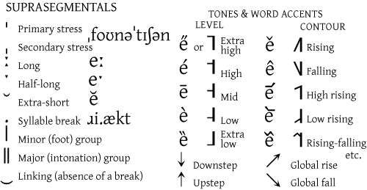
Mark intonation break locations and stress locations for the following. Use IPA conventions (below) if they seem helpful; otherwise any ad hoc notation.
I pledge allegiance to the flag of the United States of America and to the republic for which it stands one nation under God indivisible with liberty and justice for all

Slide 21
Mark intonation break locations and stress locations for the following. Use IPA conventions (below) if they seem helpful; otherwise any ad hoc notation.
I pledge allegiance to the flag of the United States of America and to the republic for which it stands one nation under God indivisible with liberty and justice for all
What do you think are the reasons why the stresses fall in these positions?
What do you observe as prosodic correlates of the stresses? Of the intonational phrases and breaks?

Slide 22
Sequencing and Connecting

