Slide 1


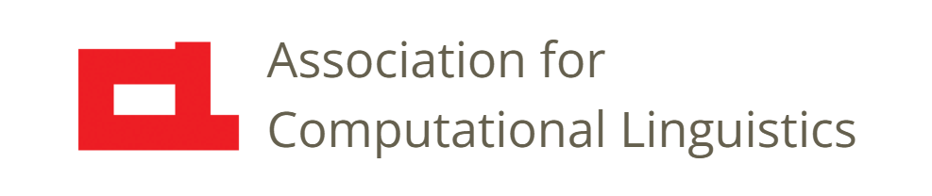

Prosody
Lecture 13: Visualizations
and Representations
Nigel G. Ward, University of Texas at El Paso
Gina-Anne Levow, University of Washington
Tutorial presented at ACL 2021
Notes:
Welcome to Lecture 13 of our series on prosody. Here we look at many different ways to visualize and represent prosody.

Slide 2

Notes:
Humans need visuals! As we said earlier, sound is fleeting.
Consider [click]. What can you say about the prosody? Probably not much, as the sound rapidly fades
from your auditory buffer. If we create a visualization, it’s static, and we can examine it at leisure.
Okay, so, let’s talk about our visualization options. We’ve already seen pitch and energy plots. [next]

Slide 3
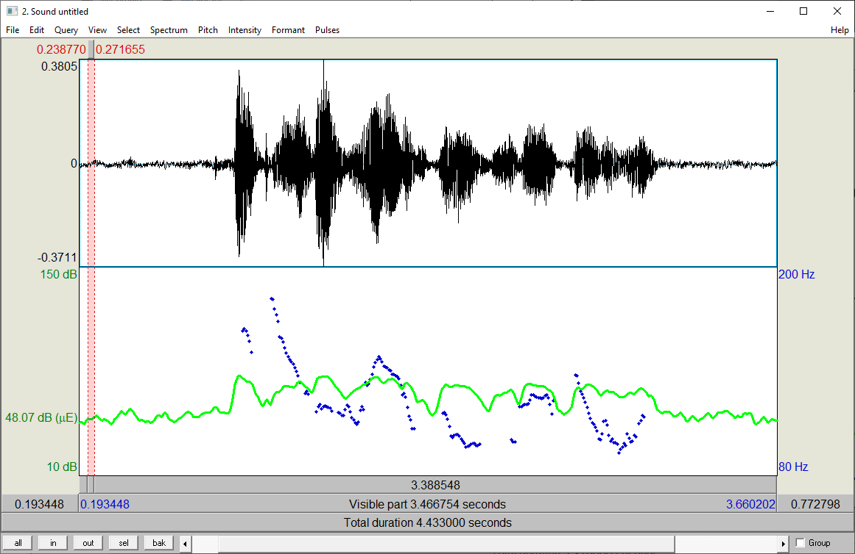
Raw F₀ and Intensity
Notes:
With the blue dots for pitch and the green line for intensity.
It’s not that pitch and loudness are uniquely important, but that the other prosody properties
--- creaky voice, lengthening, reduction --- are even harder to compute reliably, so are rarely visualized.
(There’s a huge unmet need here. )
Now, looking just at the pitch dots [next]

Slide 4
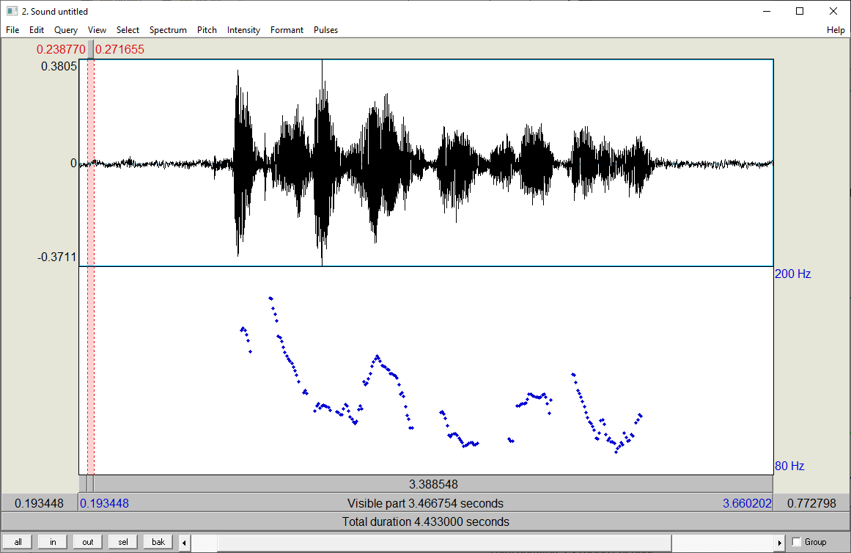
Raw F₀
Notes:
We have a very honest representation of pitch across time. Each dot represents one computed pitch point.
But, perceptually, we hear a smooth pitch contour, so let’s connect the dots. [next]

Slide 5
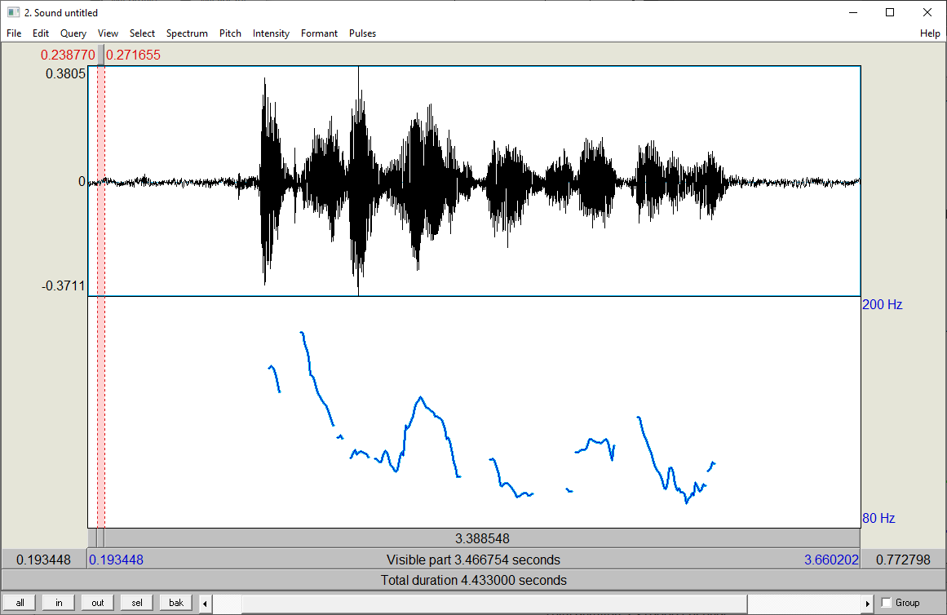
F₀ Contours
Notes:
Praat makes this easy. While we’ve lost some information, the results is much prettier. It may even seems more informative.
We can go a step further [next]

Slide 6
Smoothed F₀ Contours
Notes:
And apply some smoothing. Here comes the slow fade [click].
I did this in powerpoint, but there are packages that can automatically smooth, either by local
smoothing, or by fitting lines or curves to the F0 track.
Is it okay then to forget the original F0 information? [next]

Slide 7
Smoothed F₀ Contours
plus interpolation
Notes:
Maybe. This is rather prettier, and maybe more interpretable, though we’ve lost some information.
Further, we can interpolate. While those pitch gaps are real, they are perhaps not perceptually significant.
So sometimes it’s okay to patch them up [click] perhaps even just linearly, though this can be misleading.

Slide 8
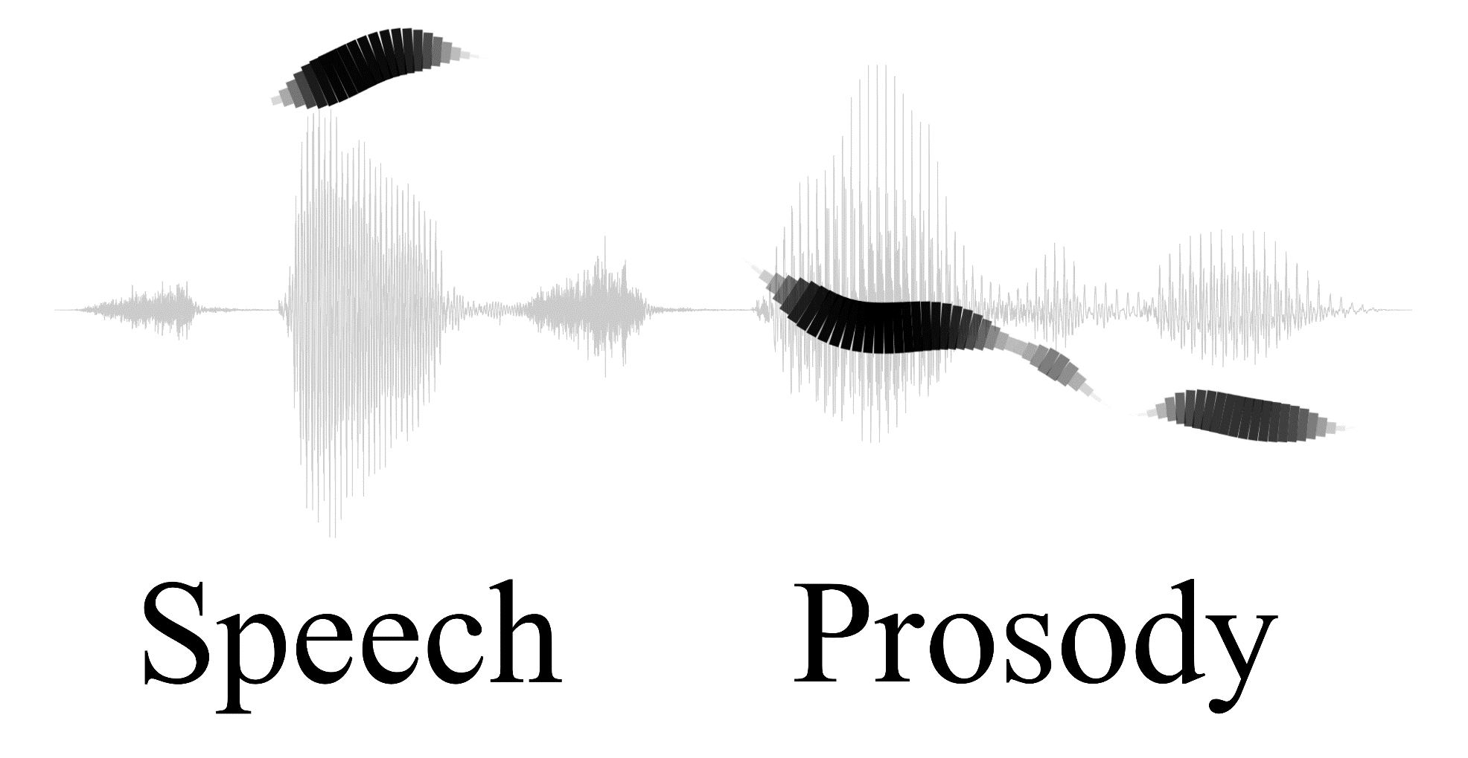
sprosig.org
Notes:
Or we can reject interpolation, and not only leave the gaps, but also show places where the percept fades.
We’ve seen these ribbon diagrams before, they encode not only pitch but also an intensity correlate.
(They’re also aesthetically pleasing; and shouldn’t we strive to have more beauty in our lives?)
Okay, so those are things we can do to enhance “fix up” the visualization. Pretty conservative.
There’s a more radical approach: only represent what matters, and throw away the rest. [next]

Slide 9
Average Pitch Levels
is not going to help
talking about
learning styles
Notes:
[click] Here’s the same pitch track, stretched out I can add the words. [click]
Now, maybe we believe that only the average pitch on each word matters.
If so, that’s easy to represent [click]. (assuming you have transcribed your data)
And, depending on your theory, that may be enough *by itself* to represent the pitch. [next]

Slide 10
Average Pitch Levels
talking about
learning styles
is not going to help
Notes:
How’s this?
Clearly we’re losing even more information. It’s risky, but for some purposes can be helpful.
Or maybe you have a different theory of what matterns: not the average height per word, but the *pitch turning points*. [next]

Slide 11
Pitch Turning Points
Notes:
From our original F0 contour, we might pick them out like this [click] . Again, I did this by hand, but there are tools for this.
And also tools with the ability to draw lines between these points, [click] as a way to *stylize* the contour.

Slide 12
Two Strategies
Tidy things up
Little wiggles*
Gaps
Perceptually Salient Things
Extract things
Pitch turning points
Average pitch per syllable
Pitch range
Pitch peak shapes
Overall contours
Slope, final slope
. . .
*Hopefully correcting for
microprosody effects
Notes:
In summary, we’ve seen two strategies for abstraction: two ways to deal with the overwhelming complexity of pitch tracks.
First, we can tidy things up. Ideally our tools would detect microprosodic effects [click] and correct for them,
But today they mostly just smooth and interpolate. This is not risk-free, but still on the conservative side.
And it’s universal, in that it doesn’t assume anything about the language.
The other strategy is the radical one of extracting what matters, either being perceptually salient [click] or otherwise important.
Do we really know what matters? Well, maybe we do, a little, at least for English.

Slide 13
Tadpole Notation
talking about
learning styles
is not going to help
Niebuhr, Alm, et al, 2017
Notes:
For English we know pitch height is important, and that the pitch on stressed syllables is more salient.
So with one traditional British notation, we mark pitch height with height on the page,
syllable-by-syllable, and mark loudness by circle size.
Further, if there are significant pitch excursions within a syllable, we indicate that [click].
These are great for teaching; shown a figure like this, someone could really see
how I said it, and then replicate it pretty well. If you’d like to try, hit pause [dramatic pause].
Okay, I said it like this [click]; did your re-creation match fairly well? [next]

Slide 14
Tadpole Notation
talking about
learning styles
is not going to help
Niebuhr, Alm, et al, 2017
Notes:
These diagrams can be pretty informative.
Perhaps you can see overall shape of presence of a contradiction contour here.
The fact that these diagrams show the relation between pitch and intensity is also a big plus.
You can see a “late pitch rise” on “Learning”, that is, the pitch height point is displaced from the energy center.
If you were writing this down, that fact might impel you to add quotes around “Learning Styles”.

Slide 15
ToBI
HH*
H* L* L*H L* H* L-H%
talking about
learning styles
is not going to help
Assumptions
Pitch height is categorical
Only some syllables have targets
Notes:
Our final example is ToBI, for “Tones and Break Indexes”. (In the name, “Tone” is rather metaphorical.)
It builds on the old tradition of marking H and L.
Now, ToBI makes two strong assumptions. [click] First, it assumes that pitch height is categorical: that the exact values don’t matter, just whether it’s H or L.
Of course, in reality, some Hs will be higher than others. But this can often be inferred.
For example, we know that English sentences have declination, so the H at the start will be higher than the H at the end.
And since this is always true, there’s no need to clutter the representation with such details.
Second, ToBI assumes that only the targets matter. In English, the unstressed syllables [click] mostly just come along for the ride.
They don’t really have an independent pitch, so there’s no need to explicitly represent anything about them.

Slide 16
ToBI
HH*
H* L* L*H L* H* L-H%
talking about
learning styles
is not going to help
Assumptions
Pitch height is categorical
Only some syllables have targets
Notes:
Now, the previous visualizations were mostly intended for describing individual sentences.
As visualizations, they can serve to show things, to human eyes.
ToBI, in contrast, approaches a “representation”.
In general, representations can be useful for encoding *general* rules about English or other languages.
Ideally, we could use them to represent prosody *symbolically*, and far more concisely, and forget about
all the messiness seen in any specific real sentence.
But effective representations are, at best, incredibly difficult to design.

Slide 17
Cautions
Auditory and visual perception may differ
Intonation alone may mislead
Assumptions may be language-inappropriate
Choose carefully a representation for your purpose
Notes:
So, lots of methods are available.
[read the points]
Purposes: language teaching, linguistic theory, aids to empirical discovery

Slide 18

Contents
Introduction
Production, Perception
Classic Linguistic Prosody
Technology and Techniques
Para. & Prag. Functions
Speech Synthesis and Dialog
Perspectives
Tone and Stress
Sequencing and
Connecting
Prosodic Structures
Representations
Notes:
Okay, that wraps it up for the first half of discussion of linguistic prosody.
In the next lecture we’ll

Slide 19
Contents
Introduction
Production, Perception
Classic Linguistic Prosody
Technology and Techniques
Para. & Prag. Functions
Speech Synthesis and Dialog
Perspectives
Frame-Level
Features
Mid-Level Features
Machine Learning
17. Speech Recognition
Notes:
revisit questions of abstraction and representation,
starting with the nuts-and-bolts of computing features robustly.

Slide 21
ToBI
Inspired by the IPA
Has a pitch-shape inventory
Specifies only targets
Categorical
Works best for professional speech
(Silverman, Beckman et al. 1992)
Notes:
Tones and Break Indices

Slide 22
What do People Perceive?
Candidates for significant prosodic events include:
Pitch turning points
Pitch peak shapes
Overall contours
Average pitch per syllable
Slope … final slope
Pitch range … standard deviation … interquartile range
. . .

Slide 23
Intonational Phonology:
ToBI and English
ToBI
  “Tones and Break Indices” (Pierrehumbert,1980)
    Combined model of prominence and phrasing
      Analogous models created for several other languages
        J-ToBI, G-ToBI, K-ToBI, C-ToBI
  Model comprising four tiers
    Orthographic tier: word transcription
    Tonal tier: pitch accent, boundary tone transcription
    Break-index tier: break transcription
    Miscellaneous tier: other comments and notes

Slide 24
Break Indices
Indicate degree of disjuncture at boundary
    0: no (or cliticized) boundary (~ Tseng’s SYL)
    1: typical word boundary (~Tseng PW)
    3: Intermediate phrase boundary (~Tseng PPh)
      Often coincides with syntactic phrase
    4: Intonational phrase boundary (~Tseng BG)
      Often coincides with full clause, sentence boundary
(Relatively) Predictable from pause duration

Slide 25
ToBI Tonal Components
Modeled as H(igh) or L(ow) pitch targets
Pitch accents
Phrase accents
Boundary tones

Slide 26
ToBI Pitch Accents
In American English:
      Prominence
      * marks tone aligned with stressed syllable in word
    H*: high pitch accent, most common prominence
    L*: low
    L+H*: low rising to high on stressed syllable
    L*+H: low on stressed syllable
    !H*: Downstepped high

Slide 27

Phrase Accents & Boundary Tones
Phrase accents: H-,L-
    Extend from last pitch accent to end of intermediate phrase
Boundary tones: H%, L%
    End intonational phrases
Common tone sequences and meanings:
    L-L%: Final fall, completed thought, declarative
    H-H%: High rise, typical of yes/no questions
    L-H%: “Continuation rise”, not finished speaking
    H-L%: may mark implied question

Slide 28
ToBI Impacts
Formal framework for intonational phonology
  Adapted for range of languages
  Work on linking tone patterns to meaning
Computational applications:
  Categorical inventory for continuous prosody
  Inventory for prediction of prosodic labels
    Recognition, synthesis
  Representation for factored models in ASR

Slide 29
Beyond ToBI
Limitations:
  Phonological model, elides phonetic variation
  Fine-grained labels difficult even for experts
  Intermediate representation; may prefer E2E
Alternate models:
  Stem-ML, Tilt, MOMEL, IntSint, PENTA
  RaP, POLAR

Slide 30

Prosodic Labeling Exercise
Prominence
  Mark each acoustically salient word
Phrasing
  Mark each boundary with '|'
I really don't know I think in today's world what they call the nineties that uh it's like everything is changed

Slide 31
Prosodic Labeling Exercise
Prominence
  Mark each acoustically salient word
Phrasing
  Mark each boundary with '|'
i really don't know | i think | in today's
world | what they call the nineties | that |
uh it's like everything is changed |

