Slide 1


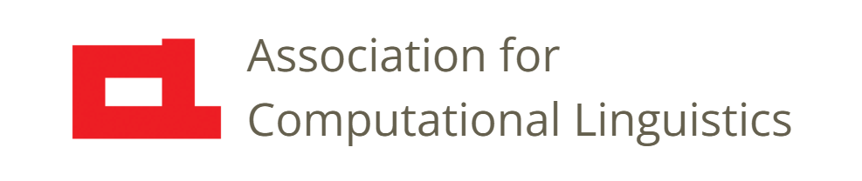

Prosody
Lecture 14: Introduction to Features
Nigel G. Ward, University of Texas at El Paso
Gina-Anne Levow, University of Washington
Tutorial presented at ACL 2021
Notes:
Welcome to Lecture 14 of our series on prosody.
In previous lectures, we explained many things known about how prosody functions.
Maybe you believed us, but suppose you want to check things for yourself. [next]

Slide 2
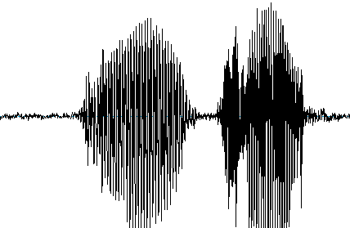
Overview
speech
signal
insight,
model,
etc.
Notes:
There are many strategies for this, but all involve features.
Or maybe you want to investigate some aspect of prosody yourself.
You will need to use features. Or maybe build a model, or a system.
In every case, working with prosody, is usually a process of going from a speech signal,
--- or a million speech signals ---
To some ultimate insight, or verified fact, or a model, or a system.
Whether you use pure human observation, or pure black box modeling, or any other method,
you probably need features. A “feature” is just a measurement done to support some downstream use.
There are many possible features [click].

Slide 3
Overview
speech
signal
features
features
features
features
features
features
features
features
features
features
features
features
features
features
features
features
features
features
features
features
features
features
features
features
insight,
model,
etc.
Notes:
We introduced a few in previous lectures [next]

Slide 4
Prosody is …
The musical aspects of speech
Pitch, loudness, timing, duration, and rate
and things that pattern with them:
Voicing presence (binary) or periodicity
Phonation type: creaky / breathy / falsetto …
Reduction / enunciation
Nasalization
Thousands of derived features
perceptual features
and computed features
Thousands of derived features
Notes:
Here’s our slide back from Lecture 9.
Going forward, we’ll broaden our view, in two ways.
First, we move from perceptual features to discuss *computed* features. [click]
Second, beyond the basic, low-level features, we’ll overview the “thousands of derived features”. [click]

Slide 5
Overview
speech
signal
features
features
features
features
features
features
features
features
features
features
features
features
features
features
features
features
features
features
features
features
features
features
features
features
insight,
model,
etc.
Notes:
So this is about how to compute features.
And how to understand them. They really aren’t just an undifferentiated mass [click]
but rather, they come in some basic categories [next]

Slide 6
Overview
meaningful
features
speech
signal
mid-level features
frame-level features
insight,
model,
etc.
normalized features
Notes:
In particular, features are typically computed in stages, and these stages will serve to organize our discussion.
[explain]

Slide 7
Overview
meaningful
features
speech
signal
mid-level features
15
frame-level features
insight,
model,
etc.
normalized features
(low-level features)
Notes:
Acoustic.
Every 10 ms. Small slices. Not perceivable.
Directly represent articulatory processes (ideally)

Slide 8
Lectures
speech
signal
mid-level features
15
17
18
frame-level features
16
insight,
model,
etc.
normalized features

Slide 9
Lectures
speech
signal
mid-level features
15
17
18
frame-level features
16
insight,
model,
etc.
normalized features
Notes:
Examples: average pitch height over a word.
Getting perceptual.

Slide 10
Lectures
meaningful
features
speech
signal
mid-level features
15
17
18
frame-level features
16
insight,
model,
etc.
normalized features
Notes:
… meaningful features, that have value for some specific language.
For example, Tone 3 in Mandarin, or the L*+H late-peak pattern in English.
That won’t be our focus here, but we will cover [next]

Slide 11
Lectures
meaningful
features
speech
signal
mid-level features
15
17
18
frame-level features
16
insight,
model,
etc.
normalized features
Notes:
Several ways to get insights from features.
Visualizations…
Statistics …
Modeling e.g. a predictive model. Especially Machine Learning.
A system for some application.

Slide 12
Technical Pitfalls
And how to avoid them
For example: “pitch range”
it seems so simple
but there are many ways to mess it up
Notes:
One theme of these lectures will be common pitfalls.
There are many good choices in how to approach prosody,
but many of them have similar risks.
We’ll see some things that many naïve people have tried, including me, and how those choices have caused problems.
For example, pitch range ….
false negative results are very common

Slide 13

Conceptual Pitfall 1
Perceptual
breathy
nasality
volume
rate
creaky
pitch
There’s a big gap!
F₀
intensity
jitter
voicing
CPPS
spectral tilt
cepstral flux
Computable
periodicity
Notes:
There are also two big conceptual pitfalls.
Here are some of the perceptual features we talked about earlier.
Now, ideally we’d have a good computable feature for each [click],
And for some we almost do [click]. Still, there’s a deep, dark forest. [click]
Others have weakly correlating factors [click]. Even more distant.
There are also are other computational factors that don’t correspond well to any specific percept,
but are still useful. [click]
So that big deep dark forest is always something to keep in mind.
Now, things are getting better, and computationalists are likely to producece better features for creaky voice, breathy voice, and so on, but there will always be a gap we need to be aware of [click] . The second pitfall [next]
[[NB: spectral tilt correlates with perceptions of prominence.
Increased subglottal pressure leads to increased energy in higher frequencies. ]]

Slide 14
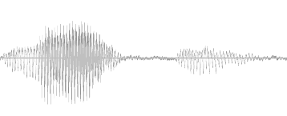
Conceptual Pitfall 2
percepts
perception
interpretation
meaning
Notes:
Arises because percepts are tricky things.
When I was young and foolish, I just wanted someone to tell me the exact set of prosodic percepts … [click]
All the things that brains pull out of the speech signal. That would be great.
Then people could study the mapping from percepts to meaning [next]

Slide 15
In my Fantasy World
percepts
perception
interpretation
meaning
Notes:
. Interpretation alone [click], without worrying about perception.
And the only people who’d have to work on perception [next]

Slide 16
In my Fantasy World
percepts
perception
interpretation
meaning
Notes:
would be the psycho-acoustic researchers, and the signal processing engineers, who could model perception [click] without having to worry about interpretation.
And, while we’re fantasizing [next]
((We want to know, given a signal, what’s the representation? That is, what do people actually perceive for each input.
For example, given an F0 value, what’s the corresponding pitch value?))

Slide 17
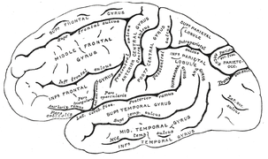
Conceptual Pitfall 2
percepts
perception
interpretation
meaning
Our foundations
are shaky.
Notes:
Maybe we could discover those percepts by studying the brain, [click] with imaging, or with electrodes.
Yet so far neuroscience and psychoacoustics haven’t done this for us. They likely never will.
The pitfall is believing that percepts are real and solid and objective.
Instead it really seems that what people perceive, depends on what task they’re trying to perform.
So, the thing to remember is that, the features we use are built on shaky foundations. [click]
But still, they’re useful, if used carefully.
((We want to know, given a signal, what’s the representation? That is, what do people actually perceive for each input.
For example, given an F0 value, what’s the corresponding pitch value?))

Slide 18

Contents
Introduction
Production, Perception
Classic Linguistic Prosody
Technology and Techniques
Para. & Prag. Functions
Speech Synthesis and Dialog
Perspectives
Intro to Features
Using Pitch Trackers
Normalization
17. Aggregation
18. Machine Learning
19. Speech Recognition
Notes:
Okay, that wraps up our overview.
In the next lectures we’ll work our way through the various feature-computation processes,
starting with frame-level feature: F0.

Slide 19
Contents
Introduction
Production, Perception
Classic Linguistic Prosody
Technology and Techniques
Para. & Prag. Functions
Speech Synthesis and Dialog
Perspectives
Intro to Features
Using Pitch Trackers
Normalization
17. Aggregation
18. Machine Learning
19. Speech Recognition
Notes:
Specifically, we’ll cover the things you need to know, in order to effectively use pitch trackers.

Slide 22


Feature Set Options
A continuum of choices:
None
Frame-level
Midlevel
Meaningful

Slide 23
Features Overview
Lecture 15: Using Pitch Trackers
Lecture 16: Normalization
Lecture 17: Mid-level Features
Lecture 18: Options for Machine Learning
Notes:
We will have three lectures on features …
.. and Lecture 15 will also overview some top-level choices for those modeling prosody using machine-learning techniques.
This lecture [click] …
Okay, let’s start with F0-pitch. [next]

Slide 24
Why Features?
Features are measurements
Purposes
To supplement perception
For statistical analyses
For model-building
For applications
Notes:
A feature is just a measurement, of some aspect of the prosody of some speech signal.
There are many reasons to use features.
- Perception. As we saw in the last lecture, audio memory is fleeting. If we put a number on it, we can pin it down. All the visualizations in the last lecture were generated based on the output of some feature detector.
Statistical Analyzes. In experiments…. Testing hypothesise…. Trying to show that some aspect of meaning X is related to prosodic aspect Y… The tendency today is to collect extra data, and use sophisticated statistical models.
But if you know what you’re doing with the features, you can get more power from your data.
Similarly for those trying to build models, for example, predictive models that explain something.
And also for applications: using appropriate features, and using them properly, can simplify your model and your data requirements.

Slide 25
Why Features?
Features are measurements
Purposes
To supplement perception
For statistical analyses
For model-building
For applications
Notes:
Now maybe you don’t care. Maybe you can control everything in your data, by studying only one person, saying only two things, and sayin both 1000 times, recorded in a broadcast studio. Then you may want to skip ahead 5 lectures. [dramatic pause]
Okay? You’re still here.

Slide 26
Good features are …
Percept Articulation Measure
Pitch … glottal cycles … log F₀
Loudness
airflow log energy (or log intensity)
Represents the physical reality (the articulatory processes)
Matches human perception (including normalization)
Reliable even in running speech, dialog, and noise

