Slide 1


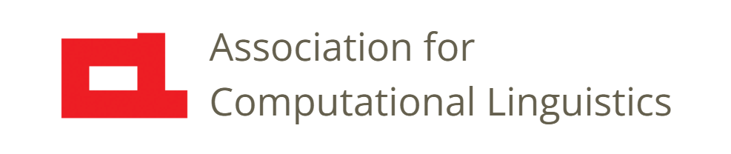

Prosody
Lecture 15: Using Pitch Trackers
Nigel G. Ward, University of Texas at El Paso
Gina-Anne Levow, University of Washington
Tutorial presented at ACL 2021
Notes:
Welcome to Lecture 15 of our series on prosody.
Here we’ll get into some technical detail, but nothing really hard to understand.
Now, pitch trackers are amazing things. They can take a speech signal and [next]

Slide 2
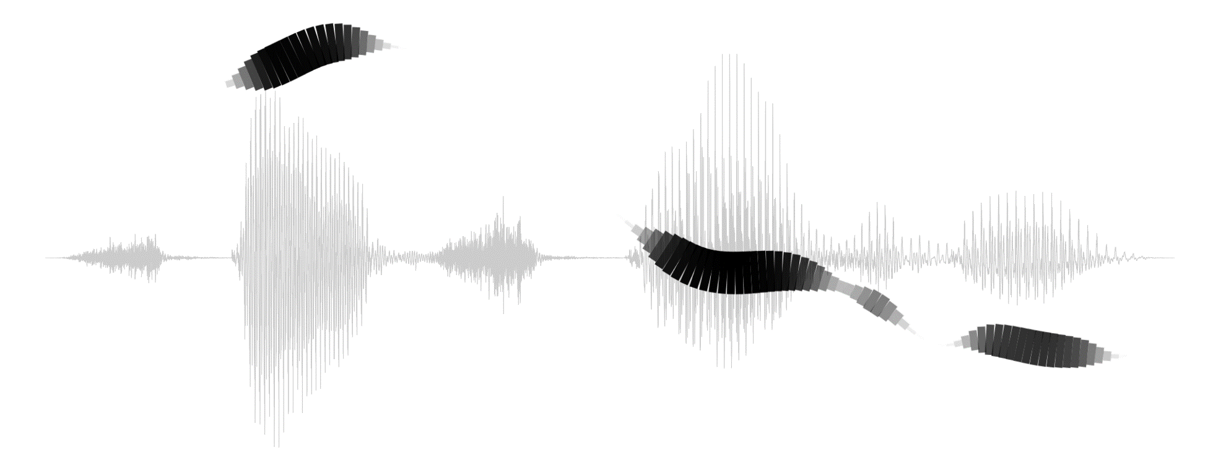
Cautions
While textbook pitch contours are seductive
Have realistic expectations
Use your pitch tracker appropriately
Notes:
Give you something clear and informative. And even beautiful. Voluptuous even.
But don’t be fooled: real pitch contours are seldom like this. If that’s what you want, you can try finding …
A speaker with a great voice
Speaking carefully selected sentences
In good recording conditions
And after many takes
Probably your data is not like this. But pitch trackers can still give you a lot of information, if used correctly.

Slide 3
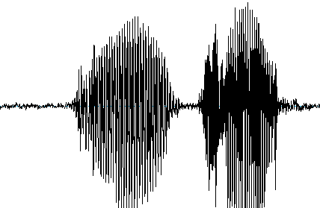
Pitch Extraction
parameters
Generate Candidate Values
Output
Pitch Tracker
178 Hz
176 Hz
174 Hz
171 Hz
.
.
.
Select Best Candidates
Notes:
So, a pitch tracker is an algorithm that ….
Now you can find pitch trackers for speech and pitch trackers for music [next]

Slide 4
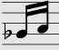
Pitch Extraction
parameters
Generate Candidate Values
Output
Pitch Tracker
178 Hz
176 Hz
174 Hz
171 Hz
.
.
.
Select Best Candidates
Searobin at Wikimedia Commons
Notes:
…
another choice you probably want to avoid is [next]

Slide 5
Pitch Extraction
parameters
parameters
Generate Candidate Values
Output
neural
178 Hz
176 Hz
174 Hz
171 Hz
.
.
.
Select Best Candidates
Notes:
Using a neural pitch tracker.
While these can perform very well on the specific dataset they were trained on,
that performance may not translate to data collected from other speakers or in different recording conditions, or languages.
That is, they tend to lack robustness, and they even lack parameters so you can customize the to work for _your_ data.

Slide 6
Pitch Extraction
parameters
parameters
Praat’s
Reaper (David Talkin)
FXRAPT
pYAAPT
Kaldi’s
Generate Candidate Values
Output
178 Hz
176 Hz
174 Hz
171 Hz
.
.
.
Select Best Candidates
Notes:
So you’ll most likely use one of these 5.
Praat is incredibly convenient for quick looks at short speech samples.
Reaper is a stand-alone program that we’ve found to be reliable even on noisy samples and even without tuning the parameters.
FXRapt does almost as well as Reaper, and may be more convenient.
pYAAPT is in python, and Kaldi has available python wrappers.
All perform well in most cases, especially if you set the parameters properly. [click].
To understand how to do this, we need to “look inside the black box”. [next]

Slide 7
Pitch Extraction
parameters
Generate Candidate Values
Output
178 Hz
176 Hz
174 Hz
171 Hz
.
.
.
400 Hz ???
200 Hz ?
100 Hz ??
87 Hz ???
Select Best Candidates
Notes:
We’ll start with Candidate Generation: … may have multiple values [click] … methods include … glottal burst tracking, autocorrelation/periodicity computations, perhaps over LPC residuals, etc. (usually in the time domain despite what human perception *probably* does)
So, the first parameters we’ll talk about are … [next]

Slide 8
Pitch Extraction
min_f0, max_f0
Generate Candidate Values
Output
178 Hz
176 Hz
174 Hz
171 Hz
.
.
.
400 Hz ???
200 Hz ?
100 Hz ??
87 Hz ???
Select Best Candidates
Notes:
those to set the pitch range. … Many pitch trackers by default look for a pitch in the range 50-500 Hz … enough to work for anyone,
from children, to adult males. But this can cause problems…

Slide 9
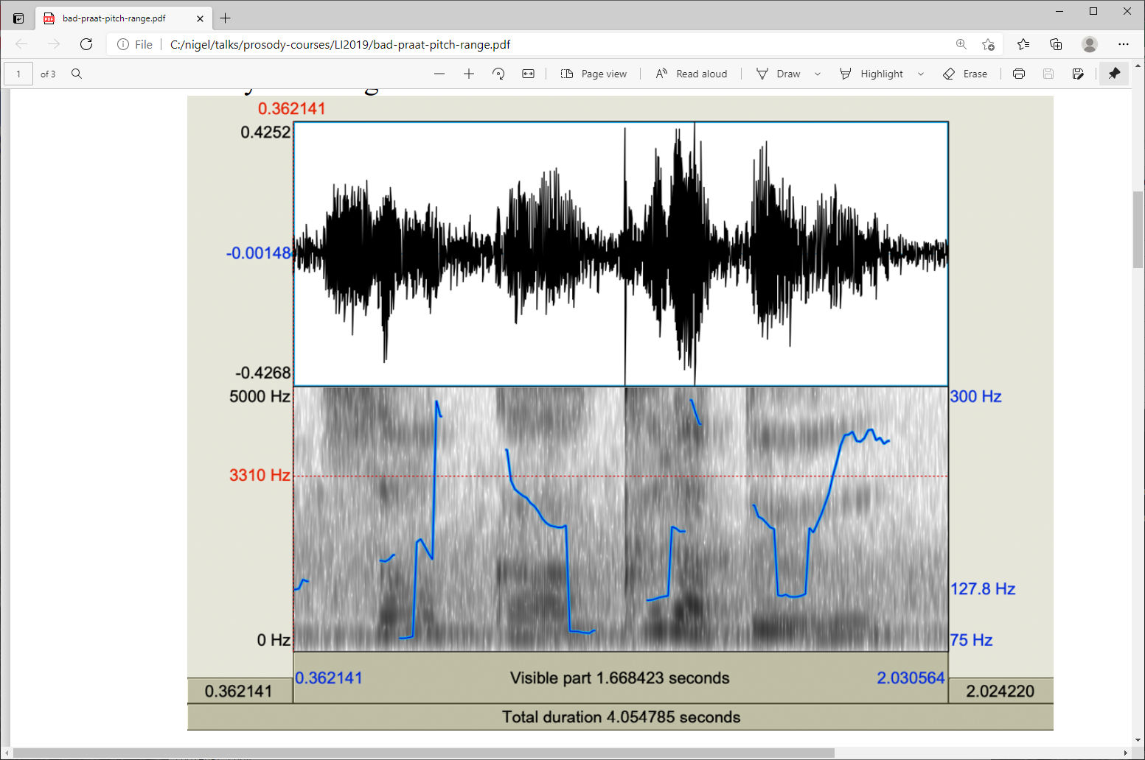
Impossible Pitch
Notes:
A real speech input, but a nonsense pitch track. Can you see what’s wrong? [next]

Slide 10
Impossible Pitch
Notes:
Right, [click] there are pitch doubling/halving errors, as discussed in Lecture 5.
The cause is a too-wide range [click] from about 60 to 340: over 2 octaves.
You can prevent this by setting the pitch range: telling the pitch tracker what is possible [next]

Slide 11
Impossible Pitch
260
130
Notes:
… if you do this, the pitch tracker knows not to output pitch values outside this range, so those
off-by-an-octave pitch values [click] won’t be output. Most likely, it will instead give you values
in the correct range [click], shown in green here, which gives a much more sensible-looking result.
[[Incidentally, this can reduce false readings of jitter, and thus false detection of creakiness.]]

Slide 12
Pitch Extraction
min_f0, max_f0
Generate Candidate Values
Output
178 Hz
176 Hz
174 Hz
171 Hz
.
.
.
400 Hz ???
200 Hz ?
100 Hz ??
87 Hz ???
400 Hz ???
200 Hz ?
100 Hz ??
87 Hz ???
Select Best Candidates
Notes:
So, you just set min_f0 and max_f0 appropriately, and that prunes out irrelevant pitch candidates [click]
Next, revisiting another topic from Lecture 5 [next]

Slide 13
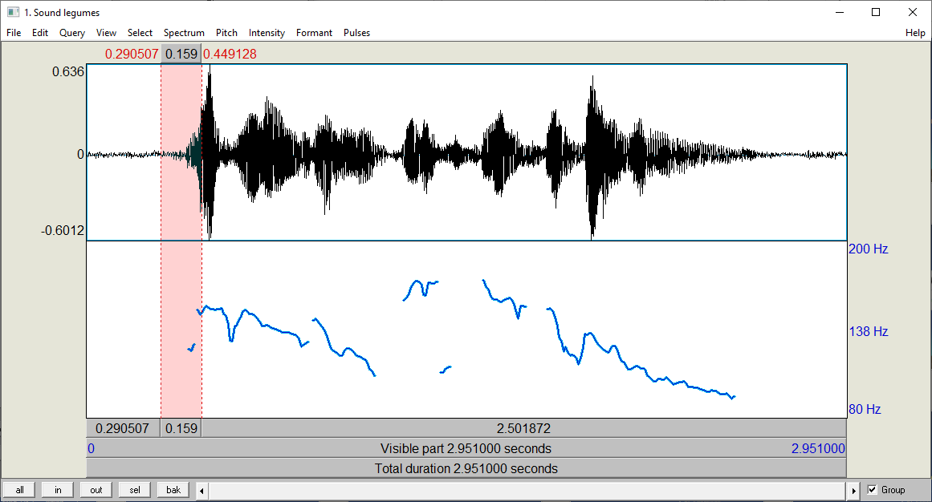

Microprosody, etc.
/s/
|good| source | of | vitamins |
Solutions
increase the smoothness priority
increase the voicing threshold
measure pitch only at vowel centers, or
trust the downstream model to learn to compensate,
etc.
increase the smoothness priority
Notes:
microprosody is a pervasive problem. In this clip we see something very odd
[click] right on the first /s/ of “source” [click]. My perception disagrees with the pitch tracker.
What about you? [click to play]. Right: it doesn’t *sound* low.
While the value it shows is in a plausible _range_, it’s not realistic given the context.
So here, we’d like the pitch tracker to better consider the local context, so we can tell it to apply a “smoothness constraint”, to only select pitch candidates that are likely given the local context. [click] Pitch trackers have a “smoothness” parameter for this.
Another option [next]
[[Microprosody! Remember, every time I say “microprosody”, I mean dependent on the lexical/phonetic content.
Incredibly damaging to automatic feature computation. ]]

Slide 14
Microprosody, etc.
/s/
|good| source | of | vitamins |
Solutions
increase the smoothness priority
increase the voicing threshold
measure pitch only at vowel centers, or
trust the downstream model to learn to compensate,
etc.
increase the voicing threshold
Notes:
is to just ignore pitch candidates that have only weak support.
In this example, maybe there is some vocal fold wobbling happening during the /s/,
but it’s certainly weak; that is to say, low periodicity.
You can tell the pitch tracker you don’t want such points. This is the “voicing threshold” parameter [next].
[[Microprosody! Remember, every time I say “microprosody”, I mean dependent on the lexical/phonetic content.
Incredibly damaging to automatic feature computation. ]]

Slide 15
Pitch Extraction
min_f0, max_f0
smoothness
voicing threshold
Generate Candidate Values
Output
178 Hz
176 Hz
174 Hz
171 Hz
.
.
.
Select Best Candidates
Notes:
So here we see those two parameters. Both can often help not only with microprosody, but also with octaving errors.
But can be risky: overuse can distort the information you get from your pitch tracker.
The last parameter to mention is the “scale” parameter [next]

Slide 16
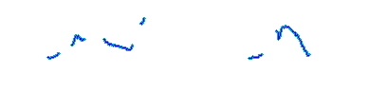
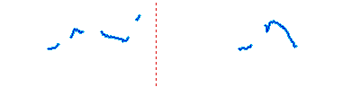
Pitch Extraction
voicing threshold
min_f0, max_f0
smoothness
scale
Generate Candidate Values
Output
178 Hz
176 Hz
174 Hz
171 Hz
.
.
.
Select Best Candidates
Notes:
which determines whether the output is Log Hz, or equivalently semitones, which you want if you’re visualizing the contour [click], not least to avoid exaggerating the importance size of pitch peaks. But if you’re going to do subsequent processing, you’ll probably just output a sequence of raw Hertz values, and take the Log in the next processing stage.
Finally, most pitch trackers give you bonus outputs: voicing decisions or voicing probabilities. [click]
[Clip shown is ojiisan-ojisan.wav; the diagram underneath is straight Hz, not log Hz]

Slide 17
Pitch Extraction
178 Hz
176 Hz
174 Hz
171 Hz
.
.
.
Notes:
this is because the F0 is not meaningful everywhere. [click] [next]

Slide 18
Pitch Extraction
257
8
92
412
0
0
0
0
1
1
1
1
0
0
0
178 Hz
176 Hz
174 Hz
171 Hz
NaN
NaN
NaN
Notes:
pitch trackers give you F0 output, frame-by-frame, but F0 is _not defined_ for every frame. So they need to tell you
which frames are unvoiced [click] sometimes by outputting a 0 for such frames, or by outputting a Not-a-number value.
Others give you their best guess in any case, [click] but output a 0, or a number near zero,
when they think the frame is actually unvoiced.
This information is valuable in itself, as an indicator of phenomena such as devoicing and creaky voice.

Slide 19

Contents
Introduction
Production, Perception
Classic Linguistic Prosody
Technology and Techniques
Para. & Prag. Functions
Speech Synthesis and Dialog
Perspectives
Intro to Features
Using Pitch Trackers
Normalization
Aggregation
Machine Learning
Speech Recognition
Notes:
Okay, pitch trackers give you an unusual amount of control.
But in other respects, they are like other frame-level feature detectors,
In that they results they given need further processing.
[next]

Slide 20
Contents
Introduction
Production, Perception
Classic Linguistic Prosody
Technology and Techniques
Para. & Prag. Functions
Speech Synthesis and Dialog
Perspectives
Intro to Features
Using Pitch Trackers
Normalization
Aggregation
Machine Learning
Speech Recognition
Notes:
As we’ll see in the next two lectures, on normalization and on aggregation the more meaningful mid-level features.

Slide 22
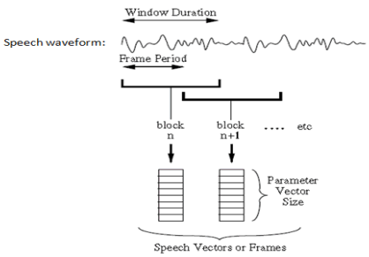
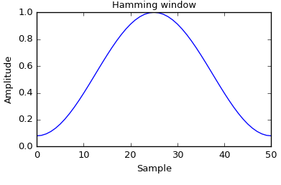
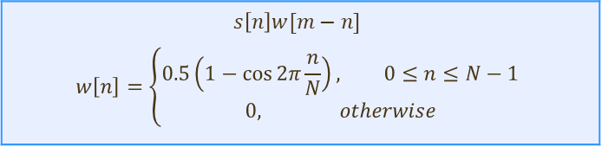
Low-Level Feature Extraction
Source: Hebse, V. R., & Anitha, G. (2015). The Learning Method of Speech Recognition Based on HMM. Learning, 3(4).
Windowing
Typical window length is 25ms
Usually window shift of 10ms
Hamming window
The window function is zero at the edges and rises gradually to 1 in the centre
  Minimise distortions due to artificial cutting of signal
$$s\left[n\right]w[m−n]$$ $$w\left[n\right]=\left\{\begin{aligned}0.5\left(1−\cos{2π\frac{n}{N}}\right), 0≤n≤N−1 \\ 0, otherwise\end{aligned}\right.$$

Slide 23
Implementation Considerations
Typically compute every 10 or 20 milliseconds
Typically use a ~25 millisecond window
Typically use a Hann window function

Slide 24
Frame-Level Features
Typically every
10 milliseconds
Generate Candidate Values
.8
-.3
-.4
-.1
.6
.7
...
Output
Select Best Candidates
Notes:
So, every feature processing pipeline starts with frame-level features, also called “low-level” features.
… closer to the acoustic reality, and hopefully the articulatory reality
… unbiased/unaided by any knowledge of the specific language.
Instantaneous properties of the voice … measured every 10 milliseconds, or sometimes 20.
It doesn’t change that fast, so either is fine.

