Slide 1


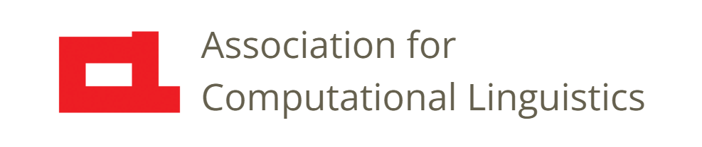

Prosody
Lecture 16: Normalization
Nigel G. Ward, University of Texas at El Paso
Gina-Anne Levow, University of Washington
Tutorial presented at ACL 2021

Slide 2
Prosody
Lecture 16: Normalization
Because people differ!
Notes:
people differ! This implies that some measurement, like 190 Hz, may mean
different things for different people. For my voice, that would be very high,
but for yours, maybe on the low side.
This lecture will discuss normalizations that help us make measurements comparable across people. There also exist more meaningful differences in individual’s prosodic behavior, but those will be addressed in a later lecture.
Where to start? Well, in the previous lecture we discussed how to compute pitch at the frame level [next]

Slide 3
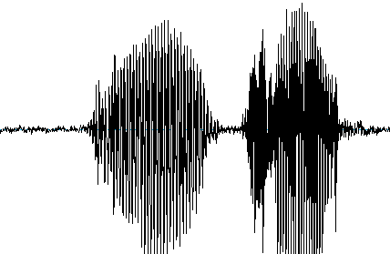
Overview
speech
signal
mid-level features
frame-level features
insight,
model,
etc.
normalized features
Notes:
We can also compute intensity frame-by-frame, breathiness, and so on.
This lecture will discuss how to normalize such frame-by-frame features. .
Let’s start by considering a very basic need.

Slide 4
Is the Pitch Here High?
190 Hz
pitch
Notes:
.. determining whether a pitch value is high or low. Suppose we measure someone’s pitch on some syllable and get a value of “190 Hz”. This by itself is meaningless.
It only has meaning relative to the speaker’s range.

Slide 5
Pitch Histograms
count
pitch (log Hz)
Notes:
so we can exploit statistics on what pitch values this speaker uses in general. This plot shows … .
So here we we can clearly see that, for this speaker, 190 Hz is on the high side.
By contrast, if we observe this value in data from a different speaker [next]

Slide 6
Pitch Histograms
count
pitch (log Hz)
count
pitch (log Hz)
Notes:
With a higher pitch range, we can say it’s low for that speaker.
How much data do you need for such determinations?
In our experiments with a backchanneling agent, we found that 2 seconds was plenty.
It helped a lot, that in conversations people start using their normal pitch range.
Later they may vary as they get excited or bored, but that initial sample is generally reliable.
[2 seconds enough to identify the 22nd percentile pitch point to within about 5 percentiles of accurate].

Slide 7
Pitch Histograms
count
pitch (log Hz)
count
pitch (log Hz)
Notes:
In fact, that’s actually a social custom. When we meet someone new, we say something obvious and pointless --- "hello, I’m pleased to meet you“ --- but the real value is probably in providing a reference sample of our speech.
Okay, so visually, that works, but what *function* should we use to normalize the raw pitch?
There are many choices.
One way to start is to identify each speaker’s minimum pitch value [next]

Slide 8
Pitch Histograms
count
pitch (log Hz)
count
pitch (log Hz)
Notes:
and then report how high the pitch is above this minimum.
That is, we can normalize by subtracting the minimum.
But this is risky since minimums are noisy, as in this example.
There are commonly outlier values, due creaky voice, background noise, or other causes.
This can cause misleading results ...
A more robust way to do things is to subtract the _average_. [next]

Slide 9
Pitch Histograms
count
pitch (log Hz)
count
pitch (log Hz)
Notes:
We can then report. …
Another issue is differences in range. Some speakers have wide pitch ranges [next]

Slide 10
Pitch Histograms
count
pitch (log Hz)
count
pitch (log Hz)
Notes:
and other speakers have narrower ranges. [click]
For the first speaker, the yellow pitch is quite high in range, but for the second speaker,
It’s incredibly high in range. The averages may be the same [click] but we also need some measure of the range. For this, the standard deviation is common, so we can divide by that. That is, it is common to

Slide 11
Pitch Histograms
count
pitch (log Hz)
Common Normalization Methods
z-normalize
Identify the tied Gaussians,
then z-normalize and correct octaving*
Just use percentiles, since robust
* Sonmez et al, Eurospeech 1997
Notes:
do z—normalization.
This is not great if the distribution is not normal, for example here, were we really have
three Gaussians, one for modal voice, one for creaky voice, and one for pitch doubling [click].
We can then estimate the parameters together, and normalize more robustly.
Or simply use percentiles. We can then report …. This is robust.
Okay, so pitch is just one of the frame-level features. What about the others? [next]

Slide 12
Frame-level Features
Percept | Acoustic Correlate | Normalization
Pitch | log F₀ (log Hz), semitones | z-normalization, percentiles
Loudness | Intensity (dB)
Voicing | Periodicity | ?
Breathiness | Low HNR, low CPPS | ?
Reduction | Cepstral distance | ?
Notes:
People vary on these dimensions also.
For example one person could be breathy all the time, but we still want to estimate whether his pronunciation
of one word is breathier than his typical. Depending on your downstream processing, z-normalization
may work well in general, except for loudness. [next]

Slide 13
Frame-level Features
Percept | Acoustic Correlate | Normalization
Pitch | log F₀ (log Hz), semitones | z-normalization, percentiles
Loudness | Intensity (dB) | ?
Voicing | Periodicity | ?
Breathiness | Low HNR, low CPPS | ?
Reduction | Cepstral distance | ?
Notes:
Loudness depends not only on the individual, but also on the microphone you use, the gain level,
the noise in the room, and many other things.
For these reasons, many prosodists don’t measure it. But it is informative to listeners.
There is no standard normalization for loudness [click]
but let’s look at one technique. [next]

Slide 14
Intensity Histogram
Does a certain speech frame count as “loud”?
count
intensity
Normalize energy so that the Gaussians’ centers are at 0 (silence) and 1 (speech).
Notes:
Like for pitch, a key question is, whether some speech frame counts as loud.
Again, we can answer this with respect to a histogram. [click]
At some times, the speakers will be silent, so we want to identify what typical silence is like. [click]
At other times speakers will be producing typical vowels, so we want to identify that also. [click]
The height of these two lumps will differ, depending on the ratio of speaking versus silence,
but their shapes are often consistent. We can model these with Gaussians, and then [read it]
Thus, we can infer that the frame whose value is shown in blue, is actually on the quiet side for this speaker. Okay [next]

Slide 15
Summary
Normalization is tricky
Normalization is imperfect
Normalize carefully
!
Elizabeth E. Shriberg (p.c.)
Notes:
To summarize, normalization is hard, and no perfect normalization methods are known.
We’d like a way to erase all the uniqueness from my voice, to make it directly comparable to your voice.
We can’t do this yet. (But research on disentanglement for prosody transfer is working on it.)
However we can’t give up on normalization.
As Elizabeth Shriberg often told me, attention to normalization can be the key to success in modeling. [click]
And I can attest from many experiences, that _failure_ to normalize properly is a frequent cause of bugs, and terribly misleading results.
Okay, so that wraps it up for normalization, [next]

Slide 16

Contents
Introduction
Production, Perception
Classic Linguistic Prosody
Technology and Techniques
Para. & Prag. Functions
Speech Synthesis and Dialog
Perspectives
Intro to Features
Using Pitch Trackers
Normalization
Aggregation
Machine Learning
Speech Recognition
Notes:
at least at the frame level.
The next lecture, [next]

Slide 17
Contents
Introduction
Production, Perception
Classic Linguistic Prosody
Technology and Techniques
Para. & Prag. Functions
Speech Synthesis and Dialog
Perspectives
Intro to Features
Using Pitch Trackers
Normalization
17. Aggregation
18. Machine Learning
19. Speech Recognition
Notes:
will cover how to aggregate frame-level features into more meaningful “mid-level” features.

Slide 19
Popular Software
Praat
SRI’s set
OpenSmile
Midlevel
CoVarep
Surfboard

Slide 20
Pitch Scales
 | linear | log | Mel* | percentiles | 5 levels | {H, L}
Matches perception | ? | ✓ | ✓ | ? | ? | ?
Robust to outliers |  |  |  | ✓ | ✓ | ✓
Supports averaging | ✓ | ✓ | ✓ | ✓
Handles speaker range differences |  | ✓ |  | ✓
F₀
pitch
.
*Mermelstein (1976)
Notes:
There are other choices. Just briefly, the Mel scale may be more accurate, for some kinds of perception.
5-Level scales and {H,L} scales are crude, but it has been argued that they match perceptions, but only convincingly for a few aspects of speech.
So Log Hz is a very common choice by people working in speech prosody.
Okay, so we know how to get numbers and scale them. Working out what they mean can be something else entirely.

