Slide 1


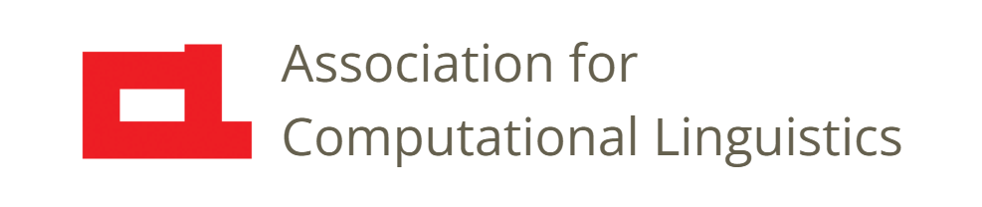

Prosody
Lecture 17: Midlevel Features
Nigel G. Ward, University of Texas at El Paso
Gina-Anne Levow, University of Washington
Tutorial presented at ACL 2021
Notes:
Welcome to Lecture 17 of our series on prosody.
Here we cover [next]

Slide 2
Lecture 17: Midlevel Features
pitch
(log Hz)
time
Notes:
computational features that correspond directly to things you can hear and see.
This goes beyond the frame-level features discussed in previous lectures. [click]
One measurement can never tell you much. Even if normalized [click].
To model things that humans can truly hear, you need [next]

Slide 3
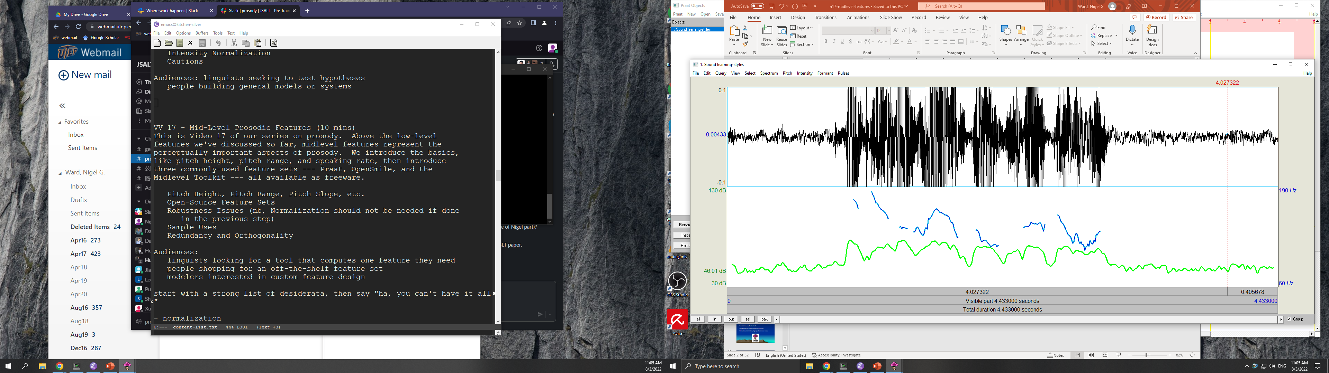
Lecture 17: Midlevel Features
Notes:
Some context . Then you can get things like, where are the pitch peaks? How high are they? Which words are louder? Is there a wide pitch region here?
So, this lecture is about such *midlevel* features. These are the most relevant to speech recognition, speech synthesis, emotion recognition, speaker identification, and dialog applications.
We obtain mid-level features by Aggregating measurements, such as measurements at nearby times, or measurements of different prosody features.
So, aggregation …. [next]
[NB, this is from learning-styles.wav]

Slide 4
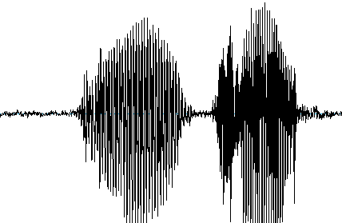
Processing Stages
speech
signal
mid-level features
Aggregation
frame-level features
insight,
model,
etc.
normalized features
Notes:
in terms of the workflow for prosody analysis, [click] from Lecture 14,
is the third step: we aggregate _normalized frame-level features_ to obtain _midlevel_ features, relating to perceptions.
There are several issues to talk about [next]

Slide 5
Outline
Timespans: aligned and unaligned
Multistream features
Robustness issues
Toolkits
Some less-known features
Notes:
[pause] The first issue is, over what _timespan_ do you aggregate. For example, *over the third word* what is the average pitch.
Looking at our example again [click]

Slide 6
Aligned Features
talking about
learning styles
is not going to help
Notes:
one common strategy is to first to transcribe all the words, [click].
Then you could compute the average pitch over the word “learning”. [click], and, remembering that the F0 is in blue,
see for “learning” the average pitch is relatively high [click]
Or you could do syllables [click] or phrases, or whatever unit you like.
Such “unit-aligned” features are appropriate if you’re looking at tone or stress (Lecture 10), in which the prosody is tightly linked to the units.
There are also *unaligned* features [next]

Slide 7
Unaligned Features
talking about
learning styles
is not going to help
Moral: choose features to match the phenomenon
Notes:
For these, we don’t care about the word and syllable locations. [click]
These can include features to detect pitch excursions [click], involving regions of wide pitch.
And features to detect regions of narrow pitch [click].
In English, combinations of these two, in configurations like this, can convey contrast or contradiction,
Regardless of what words they align with.
So, choice of alignment, if any, is a big choice we have, for many features. We need to [click] [read it] [next] .

Slide 8
Multistream Features
pitch stream
intensity stream
talking about
learning styles
is not going to help
Moral: include multistream prosodic features
Notes:
Further, some features are intrinsically about the relations between different “streams”.
Here we see two streams: F0 and intensity. Some features relate to both.
For example the feature that quantifies the disalignment between energy peaks [click] , and the nearby pitch peaks, [click]
Here it’s barely noticeable, but when large, this can convey things like incredulity or insinuation in English.
[say it: “talking about ``learning styles””]
If your tools independently compute “pitch features” and “intensity features” such multi-stream configurations will be missed.
So be careful [click] In general, you want to include multistream features.
Okay, now let’s talk about some specific features. [next]
[[This can be a problem, since, in machine learning terms, for prosody we know that early fusion often outperforms late fusion. ]]

Slide 9
Sample Features
Pitch height
Pitch range
Speaking rate
Articulatory precision
Creaky voice
Peak alignment
Vibrato
Voice/unvoiced intensity ratio
. . .
Notes:
There are *many* we could talk about, but we’ll just discuss a few.
We’ll start with pitch height [next]

Slide 10
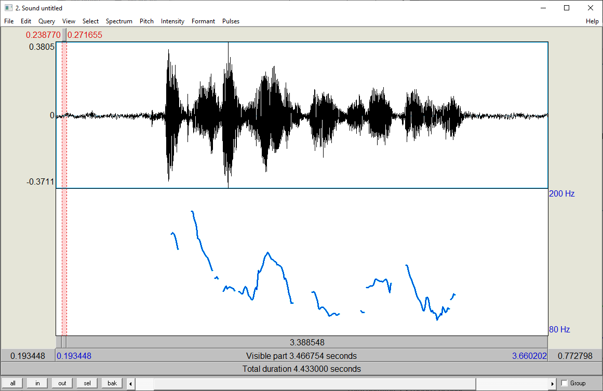
Pitch Height
Input: pitch values, log Hz, or percentiles
Combination method: average
is not going to help
talking about
learning styles
Notes:
It seems simple: you just average the pitch values over whatever timespan you like.
For example, words, as seen here.
What could go wrong? Actually, a lot!
Microprosody can mess things up [click] especially for words of one syllable.
To reduce this effect, use features with wider timespans: over half-a-second or so, microprosodic effects mostly wash out.
Outliers are also common. For these, representing pitch in terms of [next]

Slide 11
Pitch Height
Input: pitch values, log Hz, or percentiles
Combination method: average
Notes:
*percentiles* is an easy way to achieve robustness. [next]

Slide 12
Pitch Height
Input: pitch values, log Hz, or percentiles
Combination method: average
Dealing with microprosody - use wider windows
- weight by periodicity
Dealing with outliers - model to exclude them
- represent as percentiles
Notes:
There are also other ways to achieve robustness, listed here.
Robustness is an even bigger issue for [next]
[[deliberately not discussing all the options on the slide; nor discussing Hz vs Log Hz]]

Slide 13
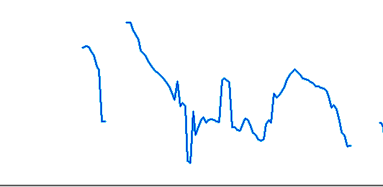

Pitch Range
Alternative: compute evidence of narrow/not-narrow pitch
Combination methods: max – min, standard deviation
talking | about | …
Notes:
pitch range. Outliers and microprosody affect this even more.
Consider the words “talking” and “about”, with the F0 here shown using Praat defaults.
Which has wider pitch range? It sounds like this [click]. Here it is again. [click]
Visually, it looks like the pitch range on “about” is wider than that on “talking“, [click]
but it doesn’t sound that way. The problem is, even a single wrong point can totally change the result.
Standard deviation is only slightly more robust. What can we do?
Well, we never actually really care about the exact pitch range, in Hz or in semitones. I don’t know of any evidence that such measures are perceptually relevant.
But wide/narrow certainly is. And can be more robustly computed.
Similar problems arise for Pitch Slope, and for many other features…. [next]
[learning-styles.wav plotted using Praat default parameters]

Slide 14
Pitch Height
Pitch Range
Pitch Slope
. . .
Moral: General functionals, may not be reliable for real pitch tracks.
Notes:
In general, simple functionals, like max – min, or average, are elegant and simple, but may not be robust enough for your data.
Now, there is a school of thought which says that more features are better than fewer, even if some are not robust.
For example, one configuration of OpenSmile had over 6000 features. It’s not that hard [next]

Slide 15
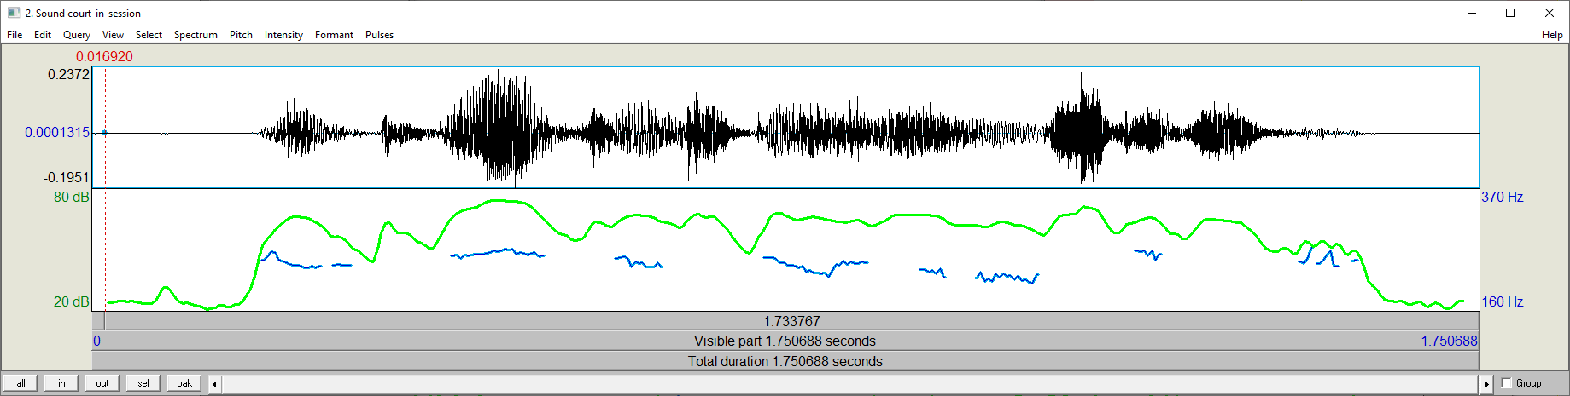
1000s of Features
Features
Frame-level
Pitch
Intensity
Harmonicity
Jitter
Spectral tilt
Cepstral coefficients
Formants
…
Timespans
Syllable
Word
Phrase
First half
Last 100 ms
. . .
Functionals
Max, min, range, mean
Percentiles, quartiles
Standard deviation
Peak counts
Peak locations
Regression coefficients
Durations . . .
plus Smoothing, Normalizing, Pooling …
Schuller, B.W. and Batliner A., 2013 Computational Paralinguistics: Emotion, Affect and Personality in Speech and Language Processing Wiley Online
Notes:
Frame-level features [click] … functionals [click] …. Timespans [click] other processes [click] which could happen at any stage.
How many features can you define, taking one choice from each column, plus 0 or more from the options below?
A heck of a lot. Can we instead just take the ones that are perceptually relevant? Or have practical value?
… ideally yes, but it’s problem dependent. More on this in the next lecture.
We’ll wrap up this lecture with some practical comments. First, on the _toolkits_ you might use.

Slide 16
Feature Toolkits
Toolsets aiming to support many uses
Praat
OpenSmile
Midlevel
CoVarep
Surfboard
Degottex, G., et al, COVAREP: A Collaborative Voice Analysis Repository for Speech Technologies. ICASSP 2014.
Lenain, R., et al. Surfboard: Audio Feature Extraction for Modern Machine Learning. Interspeech 2020.
Notes:
The overall aim: make life easier for modelers.
If you boss says “ we need some prosodic features”, then you can use any of these, and you’ve done what you were told.
However to getting a set of features that are *useful* for any specific purpose,
you really need to think about exactly what you really need, and consider all the pitfalls and issues.
But I can offer a few general comments [next]

Slide 17
 | Praat | OpenSmile | Midlevel | Covarep | Surfboard
coverage | ✓ | ✓ | ✓ | ✓ | ✓
perceptual relevance
fast |  | ✓ | ✓
open source | C++ | C++ | Matlab | Matlab | Python
configurable or scriptable | ✓ | ✓ | ✓
other | GUI | Incremental | Robust
Linguistic
research
…
Emotions
Personality
Depression
Fatigue
Autism
Intoxication
Mask-wearing
Language
modeling
Sentiment
Stance
Pattern
discovery
…
Sentiment
Depression
Parkinsons
Paralinguistics
Notes:
[Go across by column ]
[click] [go down by row]
Okay, I’m going to end this lecture with a few comments on some less-used prosodic features,
That can still be important.

Slide 18
Other Midlevel Features
Speaking Rate
  Phoneme rate, syllable rate, cepstral flux
Articulatory precision
  Average cepstral distance from global mean
Creaky voice … Jitter in pitch
Peak alignment … time difference
Voice/unvoiced intensity ratio
. . .
Notes:
…
…
Those are the most interesting and important midlevel features. [next]

Slide 19

Contents
Introduction
Production, Perception
Classic Linguistic Prosody
Technology and Techniques
Para. & Prag. Functions
Speech Synthesis and Dialog
Perspectives
Intro to Features
Using Pitch Trackers
Normalization
Aggregation /
Mid-Level Features
Speech Recognition
Machine Learning
Notes:
There are many more, but we’ll wrap it up here. In the next lecture, [next]

Slide 20
Contents
Introduction
Production, Perception
Classic Linguistic Prosody
Technology and Techniques
Para. & Prag. Functions
Speech Synthesis and Dialog
Perspectives
Intro to Features
Using Pitch Trackers
Normalization
Aggregation /
Mid-Level Features
Speech Recognition
Machine Learning
Notes:
we’ll _illustrate _how the different feature types can be _used_,
for speech recognition: the task of mapping from a speech signal into the sequence of words.

Slide 22

Example 1: Praat
Purpose: phonetic analysis of small data sets
Has built-in visualization tools
Configurable via scripting (awkward) or Parselmouth
Many feature detectors, high quality, but many are slow
https://www.fon.hum.uva.nl/praat/

Slide 23
Example 2: SRI’s Feature Sets
Purposes
Speaker identification
Detecting dialog phenomena
disfluencies, dialog acts, hotspots…
Core: syllable-level measurements of pitch and energy
Kajarekar, S., Ferrer, L., Sönmez, K., Zheng, J., Shriberg, E., & Stolcke, A. (2004). Modeling NERFs for speaker recognition. In ODYSSEY04-The Speaker and Language Recognition Workshop.

Slide 24
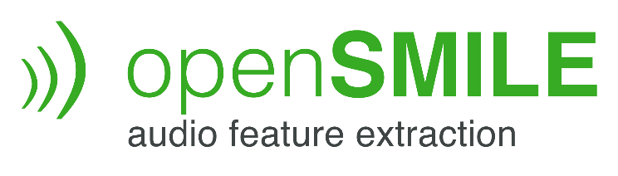
Example 3: OpenSmile
Initial Purpose: emotion detection
e.g. for kids with an Aibo toy robot
Utterance-oriented
Clean-speech-oriented
Applied to many paralinguistic classification tasks
2008

Slide 25
OpenSmile Architecture
Features
Smoothing,
Normalizing
Low-level descriptors
(frame-level descriptors)
Pitch
Intensity
Harmonicity
Jitter
Spectral tilt
Cepstral coefficients
Formants
…
Functionals
Max, min, range, mean
Percentiles, quartiles
Standard deviation
Peak counts
Peak locations
Regression coefficients
Durations
…
Feature
Computation
Smoothing,
Normalizing,
Chunking,
Pooling
…
Schuller, B.W. and Batliner A., 2013 Computational Paralinguistics: Emotion, Affect and Personality in Speech and Language Processing Wiley Online
Notes:
Maybe a snide comment on visual saliency.

Slide 26
Notes on OpenSmile
Fairly comprehensive
Later enhancements
release of a “minimal” subset: eGeMaps
configuration files for customization
Robustness can be questioned, since assumptions are made
Interpolation, since pitch is not everywhere-defined
Smoothing, to reduce the impact of outliers on max etc.
Robustness

Slide 27
Using Local-Context Features
  Multiple windows, both before and after
uh gone laugh laugh it’s okay, it’s okay
oh no nooooooooooooo I didn’t see
Enable easy learning of
local normalization
computing change (Δs)
cross-stream alignments

Slide 28
Example 4: The Midlevel Toolkit
Purposes: language modeling, sentiment, stance, turn-taking, information retrieval, pattern discovery
Features included: pitch, energy, rate, cepstral flux, vvir, peak disalignment, cepstral peak prominence smoothed, pitch highness, pitch lowness, pitch wideness, pitch narrowness
No risky features like max, range, or slope
Built-in intensity normalization
Pitch computations in terms of percentiles

Slide 29
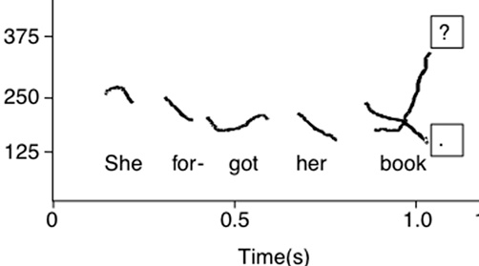
Prosodic Features
Not linguistic
Assumption-free
Perception-inspired
1 simply rank-normalize
2 simply use fixed-offset windows
3 simply use fixed-width windows
4 simply use filterband sums
Mid-Level Prosodic Feature Toolkit http://www.cs.utep.edu/nigel/midlevel/
The wrong way to do things:
correct doubling/halving ¹
subtract avg. to speaker-normalize ¹
segment into utterances ²
fit a curve and interpolate ³
align to words, phrases, etc. ^{2,3}
time-warp ³
compute avg, range, max, min ⁴

Slide 30
The critical importance of proper normalization
intensity, pitch, creakilness, rate (the latter perhaps better not normalized)
Don’t trust that any toolkit will do this the way you need it

Slide 31
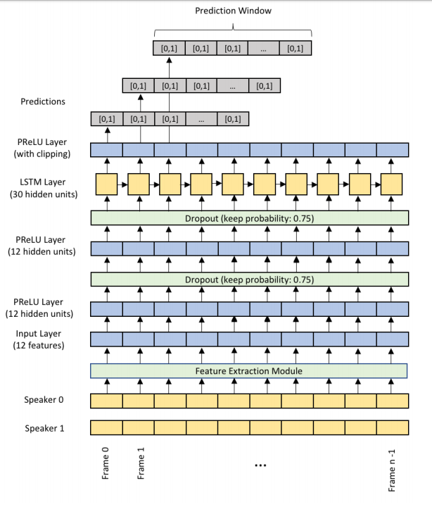
An Alternative
Entrust temporal patterns to the model
  (a recurrent neural network)
feeding it only per-frame features
  F₀ raw
  F₀ normalized
  voicing {0,1}
  energy
  voice activity {0,1}
  cepstral flux
(Skantze 2017)

Slide 32
Source: Schuller, B.W. and Batliner A., 2013 Computational Paralinguistics: Emotion, Affect and Personality in Speech and Language Processing Wiley Online

Slide 33
Open question
Length normalization
sampling at points at 25%, 50%, 75% in
also computing over last 200 ms

Slide 34
Example 5: Covarep
Covarep: collaborative voice analysis repository
Purpose: make diverse features and other code available
Degottex, G., Kane, J., Drugman, T., Raitio, T., & Scherer, S. COVAREP—A collaborative voice analysis repository for speech technologies. ICASSP 2014 (pp. 960-964). IEEE.

Slide 35
Example 6: Surfboard
Purpose: paralinguistic challenges
Features included: many
Language: Python
Lenain, R., Weston, J., Shivkumar, A., & Fristed, E. (2020). Surfboard: Audio Feature Extraction for Modern Machine Learning. Interspeech 2020.
https://github.com/novoic/surfboard

Slide 36
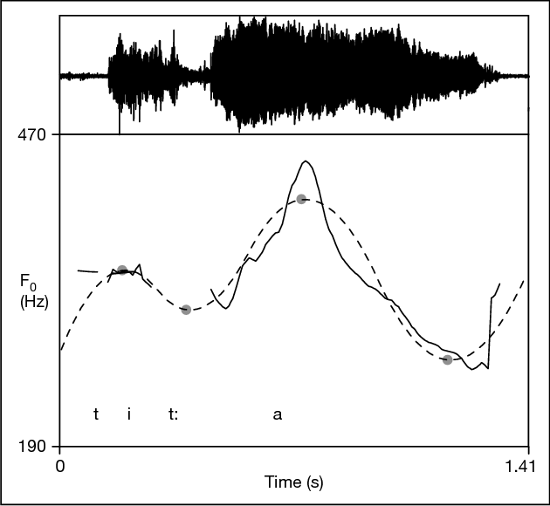
Midlevel Prosodic Features
= Features that are perceptually salient
average pitch
pitch range
pitch peak location
final slope
…
= that span more than a frame
= that function as a set (for humans, or for machines)
Figure: Children’s Production of Word Accents in Swedish Revisited. Mitsuhiko Ota. Phonetica 2006
Notes:
Maybe a snide comment on visual saliency.

Slide 37
Notes:
Welcome to Lecture 17 of our series on prosody.

Slide 38
Frame-level Features
Percept | Articulatory Correlate | Acoustic Correlate | Issues
Pitch | Rate of glottal closings | log F₀ (log Hz), semitones | doubling, halving, microprosody
Loudness | Airflow, etc. | Intensity (dB) | microphone distance, microprosody
Voicing | Regularly-timed glottal closures | Periodicity
Breathiness | Leaky glottal closures | Low HNR, low CPPS
Nasality | Lowered velum | Formant properties
Falsetto | Stretched vocal folds | Very high pitch
 |  | Spectral tilt
Notes:
There are many others. These are some of the most common.
Usually no parameters to modify: for these, our options are in the next phases,
Normalization (the topic of the next lecture), or aggregation, the topic of the one after that.

Slide 39
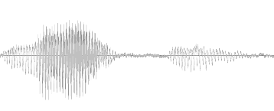
In my Fantasy World
pitch
slope
pitch
HL%
p1
p2
p3
inter-pretation
meaning
Notes:
we’d like to be able to get more. [explain]
And to get that information by probing the brain [next]

Slide 40
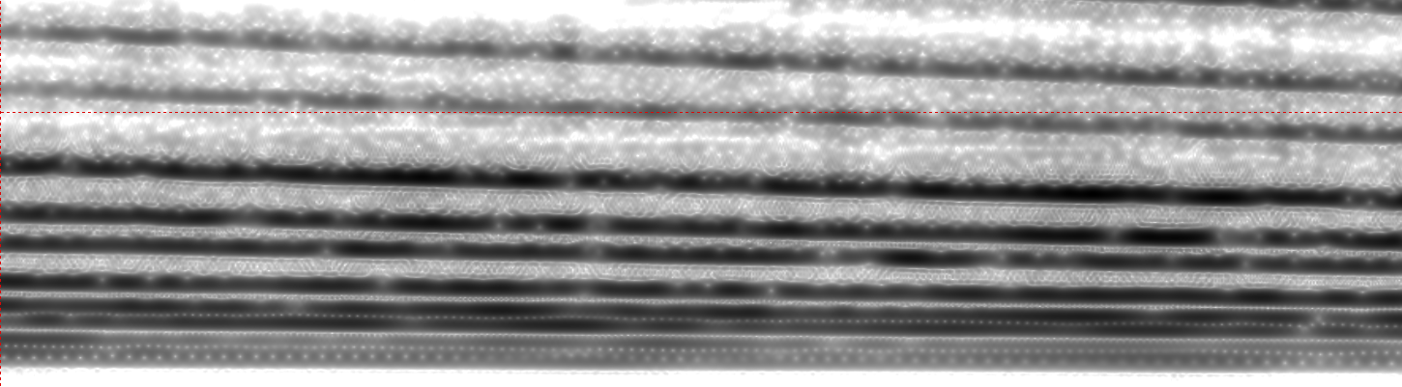
A Shepard Tone
High or low?
Rising or falling?
audio source: DescenteInfinie by Gloumouth1 at Wikimedia Commons
Notes:
Okay, here’s the first example. Is the tone rising or falling? [click]
You probably hear it falling. But it’s weird, it never actually gets lower.
If you like spectrograms, this may be helpful. You see that each component is going down
over time, but new components periodically appear, as you see at the upper right.
There are lots of great “audio illusions” out there to listen to for fun.
But this is the most relevant for us: it shows that people can clearly perceive pitch slope,
here falling, even when they can’t meaningfully compute the pitch.
“Pitch slope without pitch” … so my little block diagram was truly naïve.

Slide 41
Midlevel Features
Percept | Accoustic | Issues
Speaking rate | Syllables per second, Phonemes per second, Stresses per second | Elision, reduction
Pitch height | Average pitch, intensity-weighted pitch percentile | Window size, outliers
Pitch range | Max – min, standard deviation, etc. | Outliers
Creaky voice | Jitter, etc.
Pitch slope | Linear regression coefficient | Outliers
Enunciation | Cepstral variation

Slide 42
Other Features
Voicing fraction
Voiced-unvoiced intensity ratio
Syllable stress | c₁ pitch + c₂ duration + c₃ intensity
Overall stress | Pairwise variability index
Rhythm
Syllable-level pitch shape
Vibrato

