Slide 1


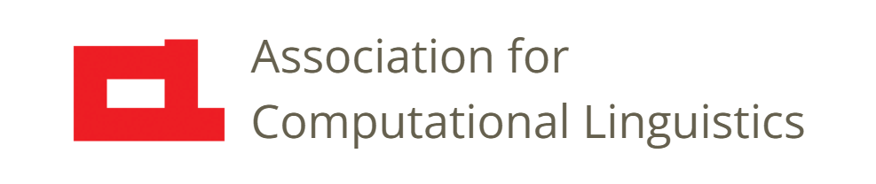

Prosody
Lecture 18: Speech Recognition
Nigel G. Ward, University of Texas at El Paso
Gina-Anne Levow, University of Washington
Tutorial presented at ACL 2021
Notes:
Welcome to Lecture 18 of our series on prosody.
Here we cover speech recognition [next]

Slide 2
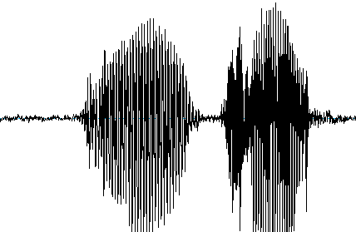
Concept
below?
billow?
Phoneme
Recognition
/bɪləʊ/
Fusion
/bɪˈləʊ/ (below)
Prosody
Recognition
unstressed-stressed
H L L H . . .
Tone 4, Tone 2, Tone 3 …
Notes:
, the process of going from the speech signal to the words said.
How might prosody help? Well, the spectral (or phonetic) information alone may not suffice. [click]
If you hear “b.low”, it could be [click] “billow”, or “below”. (At least in dialects where those are the same phoneme sequence).
So, if we can add a prosody module [click] that can identify the stress pattern,
[click] Then clearly only one of the lexical possibilities matches. So it has to be “below”.
Now, for English, the functional load of prosody is low, but for languages like Zulu, [click] or Mandarin, as discussed in Lecture 10,
the prosody is often an essential part of word identity.
So,, here’s the argument [next]
[[note that American English “below” is “bɪˈloʊ”]]

Slide 3
Concept 1*
Prosody can mark word and syllable identity
Prosody is an independent source of information
3. Prosody requires different processing
4. Prosody is robust
* Not entirely realistic
Notes:
for using prosody in Speech Recognition. First, prosody indicates tone and stress patterns, so it can be useful.
Second, if it’s a new, *independent* source of information, we should certainly use it.
Third, prosody may require special processing. You can spot phonemes from just a short time slice of spectral information (sometimes),
but prosody operates at a slower time scale.
Fourth, prosody can be robust. For example, if you hear speech through a wall, a low-pass filter,
you still may be able to make out a word or two.
Okay, so that’s the concept. Thirty years ago these considerations inspired researchers to use prosody for speech recognition. The way the approached it [next]

Slide 4
Concept 1
Phoneme
Recognition
bɪləʊ
Fusion
bɪˈləʊ (below)
Prosody
Recognition
unstressed-stressed
H L L H . . .
Tone 4, Tone 2, Tone 3 …
Notes:
was to do prosody recognition …. [click] [click]
in about 3 steps [next]

Slide 5
Implementation
stressed?
unstressed?
Pitch Tracker
etc.
Aggre-gation
Prosody
Recog-
nition
F₀
syllable duration, height
Notes:
much as we’ve seen in the previous lectures. First, they’d compute frame-level features, like F0. [click]
Then aggregate, to obtain mid-level features, like syllable duration and average pitch height. [click]
Then the final module can use this to decide: stressed vs unstressed, and so on.
However, none of this is trivial [next]

Slide 6
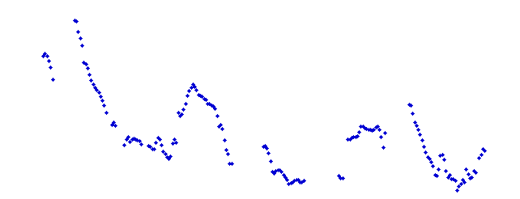
Implementation
local context and semantics
syllable boundaries
stressed?
unstressed?
phoneme
identities
Pitch Tracker
etc.
Aggre-gation
Prosody
Recog-
nition
F₀
syllable duration, height
Notes:
Computing F0 is fine. But what you get is hard to interpret. [click]
It’s not like the stressed/unstressed pattern leaps out at you.
One problem is microprosod. We can compensate; for example, if we know there’s a /g/, we can correct the pitch up. But this requires access somehow to the phoneme identities [click].
Aligning features to the syllables … [click] …
Then considering that not all stressed syllables have the same prosody: the details depend on coarticulation, tone sandhi, semantic rules (Lecture 11),
so we need … [click].
So, we find that computing useful features needs *a lot* of help from the phoneme recognition process.
Now, there’s another way prosody could be helpful [next]

Slide 7
Concept, Part 2
model how the sound-meaning mapping is affected by local prosody
Phoneme
Recognition
Fusion
words
Prosody
Recognition
stressed or
unstressed
Notes:
Since that bottom pathway needs too much help [click], and in practice has little value, let’s erase [click].
Another role for prosody arised because it can affect phoneme realizations. This could be worth modeling [click]. For example consider the /ɪ/ phoneme. How it sounds exactly, depends on the prosody: whether it’s in a stressed or unstressed syllable.
The unstressed /ɪ/, as in “giraffe” reduces to a schwa, so is different from the stressed /ɪ/, as in “billow”.
The “phoneme recognition” module”, also known as the “acoustic model”, has the job of mapping form sounds to phonemes. If it hears a sound that might be a schwa, and it knows that this is within an *unstressed* syllable [click], it might infer that it’s an underlying /ɪ/. But not if it’s in a stressed syllable. This is something the prosody module [click] should know.
In practice, though, this suffers the same problems as our first concept. There’s a chicken-and-egg problem... To sum up, we can say that

Slide 8
Concept, Revisited
Prosody can mark word and syllable identity
Prosody is an independent source of information
not really (at least in this realm)
3. Prosody requires different processing
not really (at least in this realm)
4. Prosody is robust
but not the only approach to robustness
Notes:
the initial concept was mistaken.
Prosody is not all that independent, at least in the realm of marking lexical identity. (Later we’ll talk about other realms.)
Based on many experiments, we now know that early fusion, rather than separate processing, performs better.
Moreover, the idea that _special processing_ is needed for prosody, also turns out to be incorrect. So, from these research efforts,
we’ve learned something: [next]
[deliberately don’t read item 4 since it breaks the flow]

Slide 9
We now know …
Phonetic speech recognition can be very good
Unit-linked prosody is often redundant
to non-prosodic information,
even for tone languages
except for punctuation …
Notes:
If a system can fully and accurately model the non-prosodic information --- and current speech recognizers can do this ---
prosodic information is very often redundant, in the technical sense, of providing no additional information,
So, speech recognizers today don’t much use prosody. Even for tone languages. (Except sometimes for punctuation, for dictation: deciding whether the user intended to have a comma in the output or not.)
But, just to be clear, we’re talking only about *unit-linked* prosody [click], serving to mark word identity. In its other roles, it very often is non-redundant, even critically important.
For _speech recognition_, however [next] ]

Slide 10
Prospects
Mainstream ASR
powerful models
huge datasets for training
Unmet Needs
concise models
low-resource languages
individuals
Notes:
Mainstream models are powerful enough they likely are *implicitly* handling much of the unit-linked prosodic information,
using the same mechanisms they use for modeling phonetics in context.
They accomplish this feat using poswerful models, generally multilayer neural networks, with recurrence or attention, and so are able to capture many context effects. And, rather than being trained on a little data, they have thousands of hours
of training data. So, regarding say, the possible ways that people may say “giraffe”, they don’t have to infer it from hard-won linguistic discoveries about stress patterns; they can actually observe pretty much all the possibilities.
But these models don’t work for all needs. And it is possible that knowledge of prosody may turn out helpful for speech recognition in such contexts.

Slide 11

Contents
Introduction
Production, Perception
Classic Linguistic Prosody
Technology and Techniques
Para. & Prag. Functions
Speech Synthesis and Dialog
Perspectives
Intro to Features
Using Pitch Trackers
Normalization
Aggregation /
Mid-Level Features
Speech Recognition
Machine Learning
Notes:
So, this has been a case study in using prosody for practical applications.
We learned that much of prosody is *not* independent of the phonetic content.
And we saw how, for engineering purposes, prosody does not always require special processing.
In the next lecture, we’ll go up a level of generality, to talk about the wide spectrum of
machine learning algorithms, and choices for prosodic features to support them.

Slide 12
Contents
Introduction
Production, Perception
Classic Linguistic Prosody
Technology and Techniques
Para. & Prag. Functions
Speech Synthesis and Dialog
Perspectives
Intro to Features
Using Pitch Trackers
Normalization
Aggregation /
Mid-Level Features
Speech Recognition
Machine Learning
Notes:
So, this has been a case study of how to use prosody for practical applications.
We learned that much of prosody is *not* independent of the phonetic content.
And we saw how, for engineering purposes, prosody does not always require special processing.
In the next lecture, we’ll go up a level of generality, to talk about the wide spectrum of
machine learning and choices for prosodic features to support them.

Slide 14
The Noisy Channel

Slide 15
Concept 2
Language modeling
  Constrains output to be legal string in language
    Some sequences of syntax (POS, parse) and prosodic event (accent) are more likely
      Part-of-speech also provides cue to accent
        DT: usually unaccented; NNP: usually accented

Slide 16
Bottom Line
… a word on punctuation…
Rosenberg, 2018

Slide 17
ASR Today
Prosody is not explicitly modeled.
Handled along with everything else.
Rather than 13 MFCCs + F0,
just use 40 MFCCs, or else the raw signal

Slide 18
Prosodic Events
  E.g. prominence, pitch accents, phrasing
Goals:
  As input to downstream task:
    Pronunciation assessment, feedback
    Parsing, disfluency detection, emphasis detection, summarization, segmentation
  ASR?

Slide 19
Improving ASR with Prosody
Successful integration methods:
    Adding tonal features, tonal phones (Metze et al, 2013)
      Improved Vietnamese, Cantonese AND English WER
    Modeling prosody as “hidden events”/”speaking modes”
      Incorporate prosodic events in models
      Address prosodic training data sparsity with factored models
        Stolcke et al, 1999; Ostendorf et al, 2002; Chen et al, 2005; Ananthakrishnan and Narayanan, 2009

Slide 20
Hidden Mode Formulation
W = argmax_{W} max_{QABSP}p(X,Y|Q,A,B) p(Q,A,B|W,S,P) p(W,S,P)
 | Standard Variable | Hidden Speaking Mode | Description
Word | W=[w₁,w₂,...,w_{n}] | P=[p₁,p₂,…,p_{n}] S=[s₁,s₂,…,s_{n}] | Prosodic labels Syntax labels
Allophone | Q=[q₁,q_{2,}…,q_{m}] | A= [a₁,a₂,…,a_{m}] B= [b₁,b₂,…,b_{m}] | Accent labels Boundary labels
Acoustic Features | X=[x₁,x₂,…,x_{t}] | Y=[y₁,y₂,..,y_{t}] | F0 values
Simple prosody-dependent transcription:
Used to train model
  Word variants for each accent, boundary condition
  Allophones for different accent, boundary configurations
Chen et al, 2006; Hasegawa-Johnson, 2016

Slide 21

Factored Models
Acoustic model:
  p(X,Y|Q,A,B) = $\prod_{i}{p(d_{i}}|q_{i},b_{i})\prod_{t}{p\left(x_{t} | q_{i}\right)p(y_{t}|q_{i},a_{i})}$
    d: duration modeled by Explicit duration HMM
    q: prosodic allophone, b: boundary tag; a: accent
Language model:
    $p\left(W,S,P\right)=p\left(W\right)p\left(S | W\right)p(P|S)$
      Prosody depends on syntax
      Syntax depends on words
Chen et al, 2006; Hasegawa-Johnson, 2016

Slide 22
Factored Models
Jointly predict :
  Words, accents, and boundaries
    On Boston University Radio News Corpus
Improves on all measures over baseline prosody independent model
  WER reduced by > 10% relative
Chen et al, 2006; Hasegawa-Johnson, 2016

Slide 23
Language Understanding
Beyond speech-to-text; instead do speech-to-X
Direct recognition/prediction of phenomena
  E.g. topic boundaries, miscommunications, discourse cues, dialog acts, sentence mood, etc
Strategy:
  Exploit prosodic evidence in predictive task.
    Where prosody is known to disambiguate

Slide 24
Task | Lang | Labels | Prosodic Features | Success Levels
Pitch Accent | EN | H*,L*,L+H*,etc | Pitch,intensity, spectral, duration | Medium
Pitch Accent Prominence | EN,DE, FR, IT | Binary | “ “: duration, Pitch (FR) | Medium- good
Boundaries | EN,PT,SE,SP,MC | Binary| 0-4 | Pitch reset, pause duration, intensity | Good- excellent
Sent. mood | EN,MC | Statement/Quest | Pitch (slope), intensity | Med-good
Dialog acts | EN | S,Q-Wh,Q-Y/N,BC | Duration,intensity,p | Med-good
Disfluency | EN,MC | Binary/Type (Rep) | MFCCs, intensity | Good- excellent
Emotion | EN,MC,DE,etc | 5-6 class VAD | Intensity, pitch, rate | Low (V)-Good (A)
Non-native | Multiple | Binary | Duration, Rhythm | Good
Success levels: Accuracy, Pearson’s r: excellent: 90% (>0.8); good: 80-90% (0.63-0.8);
medium: 70-80% (0.46-0.63); low: 60-70%(0.24-0.46); very low: <60%
Batliner & Möbius, 2020
,

Slide 25
Overall Methodology
Extract representation of input
  Detailed feature representations
    Acoustic-prosodic, lexico-syntactic
  Or waveform, embedding
Employ machine learning techniques
    Supervised, semi-/un-/self-supervised
  “Shallow”: often for feature analysis
  “Deep” : neural, end-to-end models

Slide 26
Example
AUToBI (Rosenberg, 2010)
      Java, https://github.com/AndrewRosenberg/AuToBI
  Automatic ToBI prosodic event labeling
    Employs acoustic feature extraction preprocessing
      Pitch, intensity, spectral measures, etc
      Speaker-based normalization
    Assumes word segmentation
    Applies trained models using LIBLinear
    Predicts pitch accents, phrase accents, boundary tones

Slide 27
Implications & Challenges
Modeling potential:
  Multi-task approaches can bring prosodic information to speech tasks
ASR leverages data-intensive regimes
  Prosodic training data is limited
    Data augmentation?
    Alternate supervision, proxies?

Slide 28
Perspectives
Recognition of events with prosody
  Recognizing prosodic events, structure
    “Analysis by classification”*
  Language understanding

Slide 29
Bottom Line
Prosody is seldom explicitly used
  Even for tone languages
  (except for punctuation …)
Speech recognition today
40-dimensional filterbanks
Very powerful models
Huge datasets for training
Prospects
On-device models
Low-resource languages
Notes:
… prosodic information is very often redundant, in the technical sense, of providing no additional information, in cases where the non-prosodic information is fully and accurately extracted ….

