Slide 1


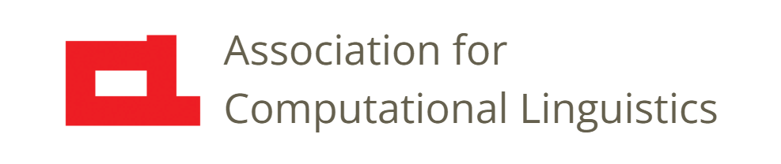

Prosody
Lec. 19: Features for Machine Learning
Nigel G. Ward, University of Texas at El Paso
Gina-Anne Levow, University of Washington
Tutorial presented at ACL 2021
Notes:
Welcome to Lecture 19 of our Series on Prosody. For prosody applications, and increasingly for research,
machine learning is very important. Here we overview some options in the choices of features and of models.

Slide 2
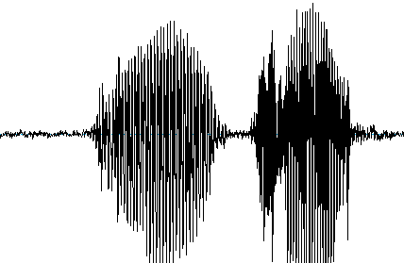
Overview
speech
signal
Machine Learning,
etc.
Is this Tone 2?
Is this stressed?
Is this Joe?
Is he tired?
Is he uncertain?
Is he done speaking?
.
insight,
model,
etc.
Notes:
Machine learning generally is done to create a model [click],
often for some practical need. For example, to take as input some speech signal and decide if it’s stressed or unstressed, or what tone it is, as discussed in the previous lecture. There are many other tasks, such as [read them].
Now, machine learning requires features as input [click], and these can be of various types.
In terms of the overview from Lecture 14 [next]

Slide 3
Overview
meaningful
features
speech
signal
mid-level features
Machine Learning,
etc.
frame-level features
normalized features
insight,
model,
etc.
Notes:
anything may be used. Including even _meaningful features_ [click] if available, which usually requires hand labeling. [next]

Slide 4


Overview
meaningful
features
speech
signal
mid-level features
Machine Learning,
etc.
frame-level features
normalized features
insight,
model,
etc.
Notes:
To simplify the discussion, we’ll consider a continuum of feature types [click], specifically these four [next],

Slide 5
Feature Options for ML
Other
Frame-level
Midlevel
Meaningful
Notes:
which we’ll cover from right to left, starting with Meaningful Features [next].

Slide 6
Other
Frame-level
Midlevel
Meaningful
Examples: H, L*+H, <emphasis>
Provenance: designed, by linguistics or engineers
Hopes: general
Reality: language-dependent
theory-internal
genre-specific
not automatically computable
Use: linguistic investigations
Notes:
These are things that have some special significance in some language, or in some theory.
Like H vs L tones, or the L*+H late peak pattern, or the tag <emphasis> that you can use to
tell some speech synthesizers how to treat a word specially.
… hopes … reality … nevertheless useful… The next option is to use [next]

Slide 7
Other
Frame-level
Midlevel
Meaningful
Examples: phrase with wide pitch, creaky voice over 200 ms
Provenance: designed, by linguistics or engineers
Hopes: general, interpretable
Advantage: can be fixed-length
Drawback: involves many choices; not robust
Uses: linguistic and psycholinguistic investigations
Notes:
midlevel features, things like the pitch height over a syllable.
These are useful quite generally, as they encode fewer assumptions.
One advantage they have over frame-level feature sequences … fixed in length …
Drawback …
Uses …
Another option is [next]

Slide 8
Other
Frame-level
Midlevel
Meaningful
Examples: F₀, CPPS, etc. (every 10 milliseconds)
Provenance: designed, by engineers
Advantages: universal
Drawback: requires a RNN or other powerful model
able to capture temporal patterns
Uses: phonetics research, speech synthesis, etc.
Notes:
frame-level features, low-level things like intensity or reduction, computed every 10 milliseconds.
Carefully designed and validated; special purpose code, open source.
Universal, based on articulatory state.
Drawback… since just individual measurements, these require…
Uses …
Now, modeling for prosody-related tasks does not always require prosody-specific features.
In particular, [next]

Slide 9
Other
Frame-level
Midlevel
Meaningful
Non-specific features: 2010s-era options
signal
mel-frequency cepstral coefficients
Drawback: requires very powerful models
Uses: many classification and regression tasks
Notes:
one can use non-specific features, that generically capture many aspects of the speech signal.
These are not specifically designed to capture prosodic information, and indeed, also work well for non-prosodic tasks, like phoneme recognition.
There are two options for non-specific features. About 10 years ago …
Then, over the past 2 or 3 years, another option has emerged [next]

Slide 10
Other
Frame-level
Midlevel
Meaningful
Non-specific features: 2020s-era options:
pretrained model features
(from HuBERT, Wav2vec2, etc.)
Provenance: trained using self-supervised learning
Advantage: modest data needs
Drawbacks: numerous, uninterpretable
Uses: many classification and regression tasks
Mohamed, Abdelrahman, et al. "Self-Supervised Speech Representation Learning: A Review." arXiv preprint arXiv:2205.10643 (2022).
Notes:
…
Okay, so, that was all a little vague. Now let’s consider some specific tasks [next]

Slide 11
Feature Set Choices
 | None | Frame-level | Midlevel | Meaningful | Pretrained
Speech recognition | ✓ | - | - | - | ✓
Speech synthesis | ✓ | ✓ | - | -
Paralinguistic classifications | ✓ | ✓ | ✓ |  | ✓
Dialog intent detection |  | ✓ | ✓
Language tutoring |  |  | ✓ | ✓
Tools for scientific discovery |  |  | ✓
?
Notes:
what feature set type is best for each? Well, it’s complicated. And new advances are constantly being made.
Still, I can summarize [next]

Slide 12
Feature Set Choices
 | None | Frame-level | Midlevel | Meaningful | Pretrained
Speech recognition | ✓ | - | - | - | ✓
Speech synthesis | ✓ | ✓ | - | -
Paralinguistic classifications | ✓ | ✓ | ✓ |  | ✓
Dialog intent detection |  | ✓ | ✓
Language tutoring |  |  | ✓ | ✓
Tools for scientific discovery |  |  | ✓
Notes:
some tendencies I see in much of the best recent work for the various specific needs.
Here a Check means effective, and a Dash means has at least been tried.
We’ll talk more about some of these later.
Okay, to summarize [next]

Slide 13
Other
Frame-level
Midlevel
Meaningful
Fewer assumptions
Less training data needed
Better performance ?
Simpler machine learning models
More robust ?
More explainable
Controllable and transferrable ?

Slide 14
Other
Frame-level
Midlevel
Meaningful
Fewer assumptions
Less training data needed
Better performance ?
Simpler machine learning models
More robust ?
More explainable
Controllable and transferrable ?
Notes:
…
In general, specific tasks do better with simpler features; the ones with less data or where explainability is valuable do better with richer features.

Slide 15
Other
Frame-level
Midlevel
Meaningful
Fewer assumptions
Less training data needed
Better performance ?
Simpler machine learning models
More robust ?
More explainable
Controllable and transferrable ?
Notes:
…
Okay, that’s it for our overview of [next]

Slide 16

Contents
Introduction
Production, Perception
Classic Linguistic Prosody
Technology and Techniques
Para. & Prag. Functions
Speech Synthesis and Dialog
Perspectives
Intro to Features
Using Pitch Trackers
Normalization
17. Mid-Level Features
Speech Recognition
Machine Learning
Notes:
feature choices for machine learning applications.
Which wraps up our first set of technically-focused lectures.
In the next lecture, we’ll go back to talking about the *functions* of prosody, starting with paralinguistics.
[smile] -

Slide 17
Contents
Introduction
Production, Perception
Classic Linguistic Prosody
Technology and Techniques
Paralinguistics, Pragmatics
Speech Synthesis and Dialog
Perspectives
20. Paralinguistics
21. Pragmatics
. . .
  . . .
Three Realms
Notes:
… other functions of prosody …

Slide 19
Advantages of Feature Set Types
None Frame-Level Midlevel Meaningful
Less training data needed
Simpler machine learning models
More explainable
Fewer assumptions
Better performance ?
More robust ?
Controllable/transferable ?

Slide 21
1. Meaningful Prosodic Features
Applications: linguistic inquiry, perhaps others
Issues:
may need hand-labeled syllables, etc.
invariably theory-internal, with many assumptions
generality across genres, languages is unclear
Notes:
Designed for linguists, for linguistic purposes. (Though this may change)

Slide 22
2. Midlevel Feature Sets
Involves: local summary features, perceptually salient
Advantages:
often good performance
generally interpretable
may require less training data
Issues: may involve many choices
Notes:
If we can build a model using such features, then discover, say, that teasing involves increased pitch range, then that’s easy to understand and communicate. In a few lectures we’ll see many examples of such things.
But if you care about performance above all, and have lots of data, this is not the best option. Also it requires some thought. (Can just use OpenSmile blindly, but that’s not really best practice.)

Slide 23
Feature Set Options
A continuum of choices:
None
Frame-level
Midlevel
Meaningful
Pretrained Models
wav2vec2.0, HUBERT …
Notes:
Explain pretraining.
Advantages: great performance. Modest training-data needs.
Disadvantages: uninterpretable.

Slide 24
3. Frame-Level Prosodic Features
frame-by-frame pitch
frame-by-frame intensity
often also Δ and ΔΔ
often also voicing presence, or probability, or periodicity
often also voice activity detector (VAD) output: {speech/silence}
maybe also cepstral flux …
maybe also ~13 mel-frequency cepstral coefficients (MFCCs)
typically with a stride of 10 or 20 milliseconds
Skantze (2017), Ward, Aguirre et al. (2018)
Notes:
Was hot about 5 years ago.
Requires a recurrent neural network (LSTM) or transformers or something similar.

Slide 25
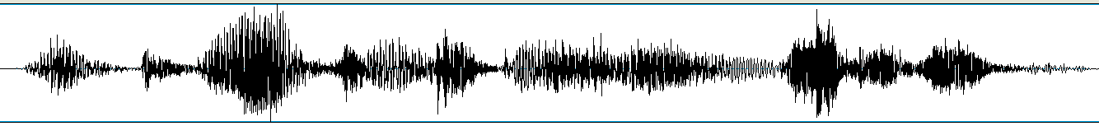
4. No Explicit Prosodic Features
Idea: prosody needs no special treatment:
it can be handled implicitly
all the information is there in the waveform
or in the spectrogram …

Slide 26
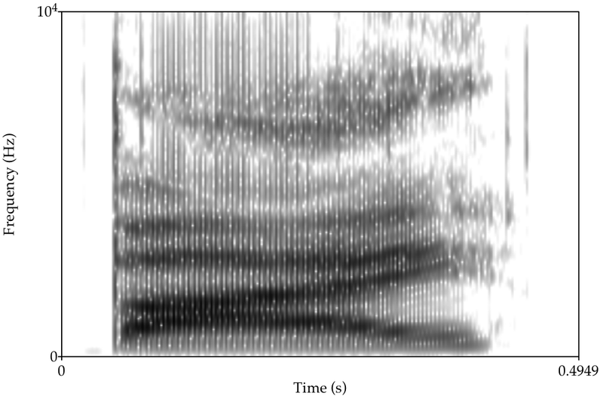
Filterbank Representations
[
Use of MFCCs is common; ~40 coefficients per frame is typical

Slide 27
[
Use of MFCCs is common; ~40 coefficients per frame is typical

Slide 28
Robust to channel noise, recording gain variation,
to transient noise, microphone distance variation …
to pitch tracker octaving, outliers
to speaker differences
Can be tackled by
Carefully curated corpora
Huge feature sets with powerful models on large data
Wider windows
Normalization …
!! Or say this in the ML lecture!! ??
Normalization
Notes:
You’ll need to test: how well it works on *your* data.
Some common issues you might encounter.
Some you can address by choice of feature set, or by careful parameterization.
Others may be better addressed by more care on the data.

Slide 29
[
Use of MFCCs is common; ~40 coefficients per frame is typical

Slide 30
Seeking a Minimal Set
With no redundancy…
Notes:
The concept of a feature *set*

Slide 31
loudness
pitch height
correlated
anticorrelated
Notes:
Pause during the animation for a Puzzle: pitch range is … does it correlate with anything here? Yes, pitch height, because …

Slide 32
Voicing Properties
loudness
creaky
pitch height
rate
breathy
high
harmonicity
duration
falsetto
vibrato
reduction
nasal
correlated
anticorrelated

Slide 33
pitch range
pitch slope
Voicing Properties
loudness
creaky
pitch height
rate
breathy
high
harmonicity
duration
falsetto
vibrato
reduction
nasal
correlated
anticorrelated
Notes:
But the correlations vary across languages and genres.
Can always do PCA to reduce redundancy.
In practice, seeking a minimal set was abandoned by computationalists long ago, but still an inspiration for high-level feature design,
As discussed in the next lecture.

