Slide 1


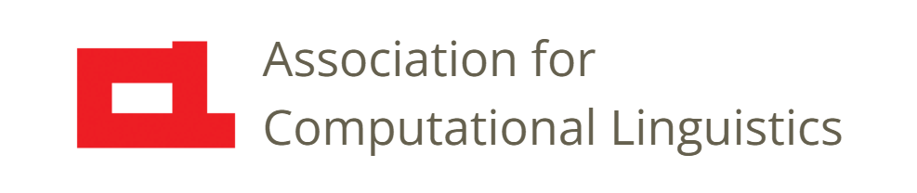

Prosody
Lecture 20: Paralinguistic Prosody
Nigel G. Ward, University of Texas at El Paso
Gina-Anne Levow, University of Washington
Tutorial presented at ACL 2021
Notes:
Welcome to Lecture 20 of our Series on Prosody, on paralinguistics.
This kicks off a mini-series of videos on more *functions* of prosody:
Things that prosody can do for us as we communicate.
So, “Paralinguistics” [next]

Slide 2

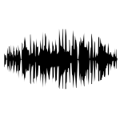
Linguistic Communication
aadapted from freesvg.org
Paralinguistic Communication
Notes:
means something like “outside language”.
Most of linguistics traditionally views the primary role of language as the transmission of meaning.
For example, [click] starting with a mental representation in one brain, and producing a speech signal [click] to enable
Another brain [click] to reconstruct that mental representation [click] .
Most of this work is done by word sequences, with prosody having only a supporting role.
Now paralinguistic communication is different [next]

Slide 3
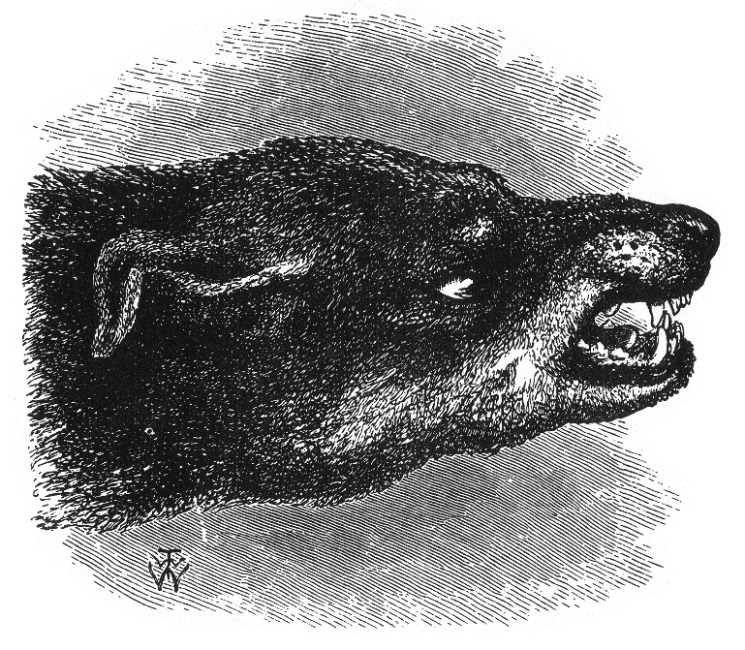
Linguistic Communication
aadapted from freesvg.org
Paralinguistic Communication
Audio communication without language
Prosody has big role
Charles Darwin 1872, via Wikimedia Commons
Notes:
It’s direct.
Imagine what this kind of sound this dog is making. Is he using language to communicate a concept here?☺
No. More likely his snarling is a direct read-out of his emotion.
In general, paralinguistics is when the sounds from your mouth directly index who you are, how you feel, and so on
That is [click] paralinguistics is audio communication without language. Of course, prosody has a big role [next]

Slide 4
Emotion Correlations
 | Anger | Happy | Sad | Fear | Disgust
Speech Rate | Slightly Faster | Faster or slower | Slightly slower | Much faster | Very much slower
Pitch Average | Very much higher | Much higher | Slightly lower | Very much higher | Very much lower
Pitch Range | Much wider | Much wider | Slightly narrower | Much wider | Slightly wider
Energy | higher | higher | lower | normal | lower
NB: these prosodic features are whole-utterance averages
Notes:
We‘ll start with emotion.
Prosody can express emotion without words, as in a sigh, a scream, or laughter.
More often, it occurs together with words.
Early work just identified correlations [next]

Slide 5
Emotion Correlations
 | Anger | Happy | Sad | Fear | Disgust
Speech Rate | Slightly Faster | Faster or slower | Slightly slower | Much faster | Very much slower
Pitch Average | Very much higher | Much higher | Slightly lower | Very much higher | Very much lower
Pitch Range | Much wider | Much wider | Slightly narrower | Much wider | Slightly wider
Energy | higher | higher | lower | normal | lower
NB: these prosodic features are whole-utterance averages
Murray, I.R. and Arnott, J.L., 1995. Implementation and testing of a system for producing emotion-by-rule in synthetic speech. Speech Communication, 16(4), pp.369-390.
Notes:
such as that between anger and speaking rate, or anger and pitch height. The ones shown here are very classic mid-level features, classically computed as averages over entire utterances. Subsequent work explored more specific mid-level features, and better pinned down what‘s going on.
For example, anger often tends to be relatively louder _specifically_ on the consonants.
Why do such correlations exist? Let‘s consider the mechanisms [next]
((Playing no audio examples is perhaps sad, but probably best, to avoid stirring up emotions, and to avoid going down a rathole of detail.))

Slide 6
Why Prosody is Informative
intention
prosodic specification
phoneme sequence
muscle control
glottis
articulators
lungs
[[
sound
Notes:
of speech production. … airflow … … Now, the physical dimensions of the vocal tracts are modulated by [click] in the musculature that
adjusts the vocal folds, etc. [click] which is controlled by neural signals, which in turn are driven by higher centers of the brain [click].
Let’s consider depression, as a relatively simple example [next]

Slide 7
Depression
intention
  Prosodic Observables: low, monotone, long pauses before responding, highly variable pause lengths
  General cause: “psychomotor retardation, or slowing”:
  decreased intensity, irregular timing
prosodic specification
phoneme sequence
muscle control
glottis
articulators
lungs
[[
sound
(Yang, Fairbain, Cohn 2016)
Notes:
The prosody of depression includes [read it]. The is largely due to the _general_ effect of depression --- on all muscles, not just articulators --- of
“psychomotor retardation, decreased intensity, and irregular timing”. So there’s a direct causal relationship, in this case.
Next let’s consider individual identity, another important paralinguistic property. [next]
((Other Symptoms of depression: insensitivity to positive and negative stimuli, and attenuated interest in other people.))

Slide 8
Speaker Identification
*
intention
prosodic specification
*
phoneme sequence
*
muscle control
*individuals differ
*
glottis
articulators
lungs
[[
sound
Notes:
People differ in many ways, including potentially everything that has to do with prosody production. [click]
They vary in the physical shape of the larynx, etc., and also in the control regime. Just as people may have a characteristic way of walking --- that is, their gait, reflecting their physique but also their characteristic ways of timing the activations of their various leg muscles --- they may have a characteristic style of muscle control for speaking. So, individual identity [next]

Slide 9
individual identity
age
gender
personality
surprised
angry
sad
respiratory infection
fatigue
intoxication
uncertain
confident
thinking of a word
intending to continue
depression
dominant
Alzheimers
Parkinsons
autism
team leader
group affiliations (regional, ethnic …)
stable fleeting
Notes:
is one of the things that can be inferred, to some extent, from prosody. Prosody also conveys depression [click] and emotion, as we have seen. Paralinguistics is very diverse, and in particular [click] some paralinguistic properties are very stable, and others vary from utterance to utterance. Other things that prosody can convey include [click*7] (More on autism is coming.)
[[ no need to comment on applications-relevance: speaker identification, diagnosis and screening, language modeling, dialog systems]]]

Slide 10
individual identity
age
gender
personality
surprised
angry
sad
respiratory infection
fatigue
intoxication
uncertain
confident
thinking of a word
intending to continue
depression
dominance
Alzheimers
Parkinsons
autism
team leader
group affiliations (regional, ethnic …)
stable fleeting
Notes:
It’s worth noting that, while some of these are very mechanical or visceral, others are significantly socially mediated. For example, gender … anger … intending to continue speaking.
So, let’s talk about the problem of model paralinguistic prosody. On the task of going from a speech signal to any of these properties, there are models that do about as well as people, and sometimes better. At least on carefully chosen data.
The methods used [next]
[[ no need to comment on applications-relevance: speaker identification, diagnosis and screening, language modeling, dialog systems]]]

Slide 11
Paralinguistic Inference
Midlevel features⁺ → linear regression
→ decision trees
→ neural networks
Frame-level features → recurrent networks
→ deep networks with attention, etc.
Pretrained models → linear regression
more informative
better performing*
*often as well as humans
⁺seldom unit-linked, except roughly for speaker identification
Notes:
have already been discussed ... ...
[click] later came black-box models: deep neural networks, then came pretrained models [click]. As discussed in the previous lecture, the newer models tend to excel in terms of performance [click] but the simpler ones reveal more about what actually is going on. .
As an aside, the features most useful for paralinguistic discriminations differ from those most useful for Speech Recognition,
notably in that the latter are unit-linked, whereas the paralinguistically relevant features [click] tend to be distributed widely across the speech signal.
For example, if I‘m happy, that will usually come through on every word I say.
So, there are a lot of differences between [next]

Slide 12
Realms of Prosody
phonological
paralinguistic
Linked to language Independent
Mental Bodily Language-specific Universal Controllable Uncontrollable Symbolic Iconic/Gradient
Notes:
prosody used to convey word identity, through tone and stress patterns, and prosody as it works to convey paralinguistic meanings.
This slide summarizes some differences we’ve seen, and some we’ll discuss later.
Overall, we can call thse two different *realms* [click].
Usually we’ll want to use different features and modeling methods for the two realms.
While remembering that *pure* paralinguistic prosody is rare, and the two realms often overlap [click], as we’ll discuss in a later lecture.
Okay, that wraps it up for [next]

Slide 13

Contents
Introduction
Production, Perception
Classic Linguistic Prosody
Technology and Techniques
Paralinguistics, Pragmatics
Speech Synthesis and Dialog
Perspectives
20. Paralinguistics
21. Pragmatics
. . .
  . . .
Three Realms
Notes:
paralinguistics. In the next lecture [next]

Slide 14
Contents
Introduction
Production, Perception
Classic Linguistic Prosody
Technology and Techniques
Paralinguistics, Pragmatics
Speech Synthesis and Dialog
Perspectives
20. Paralinguistics
21. Pragmatics
. . .
  . . .
Three Realms
Notes:
we’ll start talking about the pragmatics-related functions of prosody. [smile]

Slide 16
Paralinguistics
Emotional states
Health conditions
Momentary states
Individual identity
Traits
Social identity
. . .
Notes:
So, here are some examples of paralinguistic information often conveyed by prosody.
[go through them]
this lecture will illustrate how prosody conveys paralinguistic functions, with a wide scattering of examples.
Part of the fascination of paralinguistics is the idea that it’s a direct window to the mind …
that such nonverbal behaviors may be involuntary leakages, that let us read the hidden feelings of the speaker.
That may even be true, sometimes. In any case,

Slide 17
Paralinguistics
Applications
Emotional states
Health conditions
Momentary states
Individual identity
Traits
Social identity
. . .
Emotional recognition
Diagnosis, screening
Language modeling
Speaker identification
. . .
Notes:
Here’s our overview slide again.
Now, modeling paralinguistic prosody has various practical applications [next]

Slide 18
Paralinguistics
Emotional states
Health conditions
Momentary states
Individual identity
Traits
Social identity
. . .
Emotional recognition
Diagnosis, screening
Language modeling
Speaker identification
. . .
Notes:
[go through them]

Slide 19
Traits (just a few samples)
  Autism: monotone, high, loud, nasal …
  Depression: low, monotone, long switching pauses (latencies), variable ditto
    From a psychopathology perspective, one would expect depression to be associated with decreased intensity, irregular timing, and decreased F₀ variability. These features are conceptually related to what is referred to as psychomotor retardation, or slowing, insensitivity to positive and negative stimuli, and the attenuated interest in other people that are common in depression. (Yang, Fairbain, Cohn 2016)
  Parkinsons, aging, etc.
  History of alcohol abuse: aprosodia (production, also perception)

Slide 20
More Biological Codes
Production code: (Gussenhoven 2002)
  End of breath group -> lower air pressure -> lower intensity, pitch
  Beginnings: louder, higher pitch; Endings: quieter, lower pitch
    "Declination": gradual reduction across a phrase
Effort Code: (Gussenhoven 2002)
  Greater articulatory effort/precision -> greater importance, emphasis
  Wider pitch range, more precise pitch movements, louder speech
    Associated with surprise, anger, etc
Perhaps also mention iconicity, as in biiig fish.

Slide 21
Speech Health Analysis
Condition | Task | Metric | Conventional | State-of-art
Fatigue | Regression (0-10) | Correlation | 0.343 | 0.383
Intoxication | 2-class classification | UAR | 0.659 | 0.710
Alzheimer’s | 2-class classification | Accuracy | 0.625 | 0.708
Depression | Regression (0-24) | RMSE | 8.19 | 6.80
Parkinson's disease | Regression | Correlation | 0.390 | 0.649
Child Development Disorders | 4-class classification | UAR | 0.671 | 0.694
Results from ComParE, AVEC and ADReSS challenges (compiled by Nicholas Cummins)
Notes:
Excellent performance on some of these, e.g. intoxication and Alzheimers.
intoxication: a general effect on muscle control circuits.
Others are harder to recognize.
In this figure,
“Conventional” = mid-level features plus classifiers
“State of art” = recurrent or deep models
where no one cares about the findings: it’s all about better models and more data
generality is not guaranteed, so maybe we DO need those explainable models …
mention the issue of generalization; the dataset-internal research;

Slide 22
Beyond Classic Emotion
More subtle states
More communicative states
More transient states, e.g. confidence, thinking of a word, turn-taking intentions
C.f. language modeling

Slide 23
personality
marking social identity: as gay, or as a stoner, or a businessman,
or a free spirit, or as a professor.
Useful for parodies and mocking.

