Slide 1


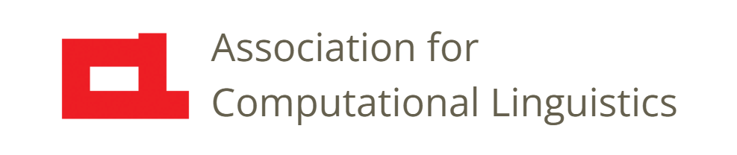

Prosody
Lecture 21: Prosody in Pragmatics
Nigel G. Ward, University of Texas at El Paso
Gina-Anne Levow, University of Washington
Tutorial presented at ACL 2021
Notes:
Welcome to Lecture 21 of our Series on Prosody, on one of my favorite topics: prosody serving pragmatic functions.

Slide 2
Realms of Prosody
paralinguistic
phonological
(unit-linked, symbolic)
pragmatic
Notes:
So far we’ve focused on the paralinguistic realm and the phonological realm; the former involving speaker state and speaker identity, and the latter involving the marking of word identity and linguistic structure. This lecture is on _pragmatic_ functions [click]: things that are important in interaction.
[[NB, here I’m using the word “phonological” for the aspects of prosody that intimately connect to linguistic units, as Gina presented earlier, like tone in Mandarin.]]

Slide 3
6 Properties of
Prosody in Pragmatics
Multistream temporal configurations
Gradient, not categorical
Flexible alignment with words
Direct form-function associations
Joint constructions
Superposition of prosodic constructions
Notes:
A theme of this lecture is, how different this realm of prosody is, from the other realms, and indeed almost everything else in language. We’ll work our way through these 6 points, with many illustrations, starting with the prosody of positive assessment [next]

Slide 4
Positive Assessment (+)
How do people show they feel good about something?
We’re really glad you’re watching these videos.
Not paralinguistically (not a visceral emotion)
Notes:
Back in Lecture 2 that I said that “We’re really glad you’re watching these videos.” and I said it with the proper prosody to show that I was sincere. What *is* that prosody?
Before we go on, I have to note, this is not about emotion. Yes, there are positive emotions and negative emotions. But when I say these words with positive feeling, I am not experiencing joy. Rather it’s a social statement: I’m taking a stance and professing a sentiment.
Still, early research examined this in the same was as research on emotion, by looking for *correlations* between single prosodic features and positive feelings. [next]

Slide 5
Correlates of +
In meetings … on the word yeah: longer vowel duration, pitch ranges that extend higher, lower mean intensity, earlier and steeper intensity drop (Freeman et al., 2015)
In meetings … in general: longer stressed vowels in content words (Freeman, 2015)
In announcements of good news… high pitch level, increased pitch range, abrupt step-ups and rises, modal voice, loudness on key words, fast and increasing rate (Freese and Maynard, 1998)
To infants… exaggerated rise-fall F₀ (Fernald 1989)
In emotion displays… higher intensity, breathy voice, upward inflections
Notes:
Now, you might expect tons of research on this. Being positive is important! And in most conversations people find an opportunity to express positive feelings at least a few times. But there are hundreds more papers on the prosody of anger than on the prosody of positive feeling. Go figure.
Anyway, there have been a few studies. [click] What stands out, is that there is no consistent pitcture.
In fact, some of the findings are contradictory. [next]

Slide 6
Correlates of +
In meetings … on the word yeah: longer vowel duration, pitch ranges that extend higher, lower mean intensity, earlier and steeper intensity drop (Freeman et al., 2015)
In meetings … in general: longer stressed vowels in content words (Freeman, 2015)
In announcements of good news… high pitch level, increased pitch range, abrupt step-ups and rises, modal voice, loudness on key words, fast and increasing rate (Freese and Maynard, 1998)
To infants… exaggerated rise-fall F₀ (Fernald 1989)
In emotion displays… higher intensity, breathy voice, upward inflections
Notes:
Some studies find positive assessment involves louder speech, others quieter [next]

Slide 7
Correlates of +
In meetings … on the word yeah: longer vowel duration, pitch ranges that extend higher, lower mean intensity, earlier and steeper intensity drop (Freeman et al., 2015)
In meetings … in general: longer stressed vowels in content words (Freeman, 2015)
In announcements of good news… high pitch level, increased pitch range, abrupt step-ups and rises, modal voice, loudness on key words, fast and increasing rate (Freese and Maynard, 1998)
To infants… exaggerated rise-fall F₀ (Fernald 1989)
In emotion displays… higher intensity, breathy voice, upward inflections
louder and quieter
faster and slower
???
Notes:
And some find faster speech and others slower.
Now, there are certainly technical issues in what exactly is being measured, and in genre dependencies.
But the big problem, I feel, is that everyone is measuring different aspects in isolation.
It’s like the parable of the blind men and the elephant [next]

Slide 8
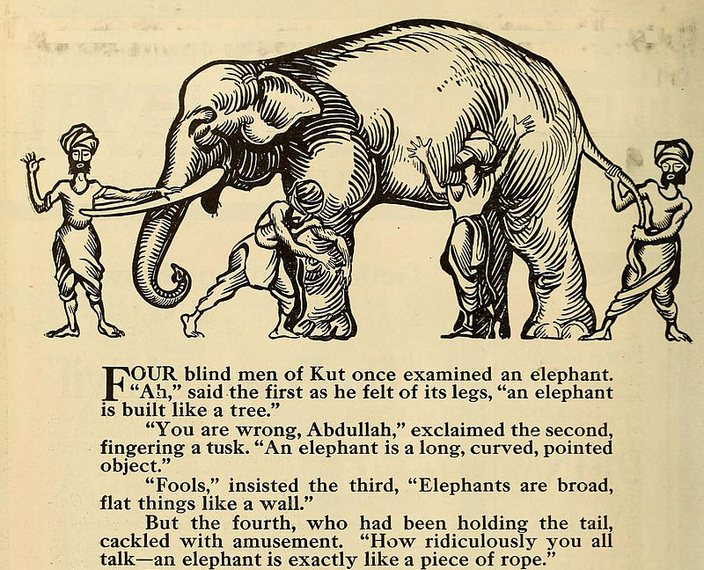
Wikimedia Commons
Notes:
Each is doing his best, but when only looking at volume in isolation, or speaking rate in isolation, or pitch slope in isolation, you get a strange pitcture.
What happens if you put all the information together? Looking at the various prosodic features together, the picture looks like this: [next]

Slide 9
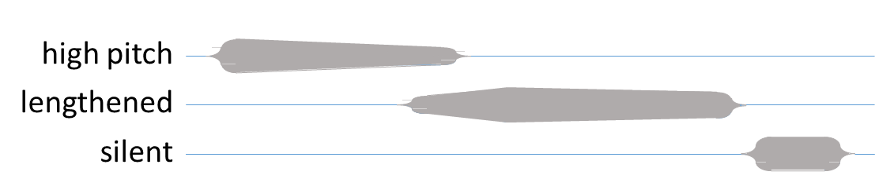

#1 Temporal
Configurations
The Positive Assessment Construction
Good job!
loudness
clipped
-1500 -1000 -500 0 500
milliseconds
I like her style. Go Cougars!
Notes:
First there is a region of high pitch, then a region of lengthening and significant loudness. It sounds like this [click] “good job”.
The components come in this order: they are not generically correlating; rather there is a specific temporal configuration [click]. And this is commonly true of pragmatics-related prosody. We can call this the Positive Assessment Construction [click].
It’s very widely used. Here are two examples [click], one from a real conversation [click], and one as a team cheer [click]. Some additional examples [ext]
[[Say this pattern can also be used for evaluation --- “she makes the best cheesecake” --- and many other purposes]]

Slide 10
Positive Assessments
I loved teaching, I love helping kids
I feel good
I also really love the Boondock Saints
it's really cool like, coming up with like, you know, a program, and then like being able to see like, that program on someone else's phone
stay on it … there you go
Notes:
In the first one, the prosody is reinforcing lexical meaning [click], where the positive assessment prosody appears twice [click], as shown be the little ovals.
At other times, prosody is pulling more of the weight, as in the last example [click]. This was produced while playing a video game, and the prosody on “there you go” [click] is again this construction, used for praise.
Okay, so these examples were to show that this configuration can express many types of positive assessment, in many contexts.
And, just to drive the point home, this is a configuration [next]
[NB Only playing the first and last]

Slide 11
#1
Temporal Configurations
The Positive Assessment Construction
Good job!
loudness
clipped
-1500 -1000 -500 0 500
milliseconds
I like her style. Go Cougars!
Notes:
and in particular a [next]

Slide 12
#1 Multistream
Temporal Configurations
The Positive Assessment Construction
Good job!
loudness
clipped
-1500 -1000 -500 0 500
milliseconds
I like her style. Go Cougars!
Notes:
*multistream* configuration.
Let’s consider another example, [next]

Slide 13
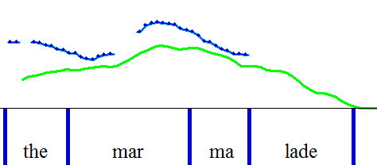
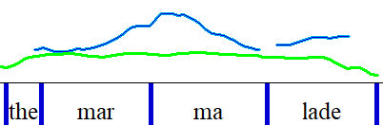
The Late Peak Construction
Aligned peaks
Late pitch peak
pitch
pitch
energy
energy
(Pierrehumbert & Steele, 1989, etc.)
Notes:
the Late Peak Construction.
Now, in Lecture 17 I advocated treating this as a midlevel feature, since it does a lot of things in many languages. But we can equally well analyze it as a construction. In either case, what’s important is the departure from the general pattern of aligning the pitch peak and the energy peak, as seen at left. That’s sort of the natural thing to do, but you can also make the pitch peak come later, as seen at right. Here are two diagrams illustrating the difference: in the first, the two peaks are very close; in the second the pitch peack comes later; in fact, here shifted all the way to the next syllable. The first sounds like this [click], and the second like this [click] where you may have some feeling of implication; for example, that maybe we should try the marmalade. As another example, consider German [next]

Slide 14
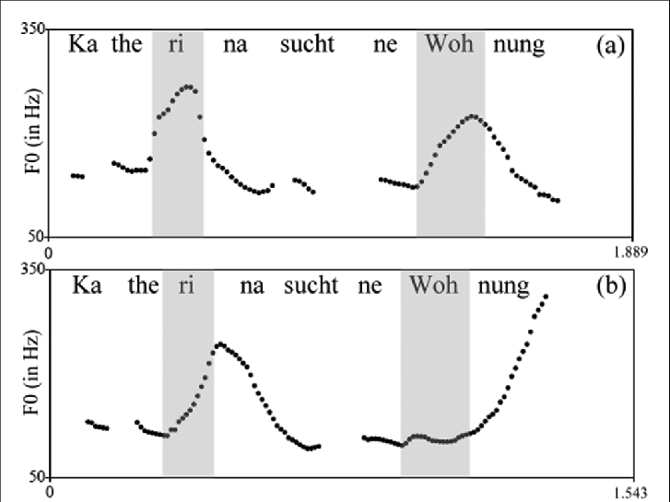
Statement
Question
(Petrone & Niebuhr, 2014)
Petrone, Niebuhr (2014)
Notes:
Where question marking can include a late peak, early in the utterance. In the first case, the pitch peak the blue arrow, aligns with the energy peak, roughly at the green arrow, within the stressed syllable of “KateRIna”. In the second cases, the pitch peak comes late, clearly after the “stressed” syllable, in gray. Here’s how the first sounds [click] and the second [ click]. Now again, just with the name [click] [click].
Coming back to English,

Slide 15
Exercise
Máybe we can tálk more over cóffee.
Máybe we can tálk more over cóffee.
First as a brush-off (aligned pitch peaks)
Then as a sincere invitation (late peaks)
an 80 millisecond difference can determine polite vs cold
NB: not everyone can do this
Notes:
This difference is implicated in politeness. If you like, give it a try. Try saying this phrase in two ways. First, with aligned pitch peaks on the stressed syllables, something like …. as a cold brush-off, then as a warm invitation. Pause if you like.
Yes, so it’s a little bit amazing a an 80 millisecond difference can be the difference between polite vs cold click. However, importantly, people vary. [click] A small but non-negible fraction of the population appears unable to do this; it’s not part of their language. Maybe some are unable to perceive it either.
One final example, of a [next]

Slide 16
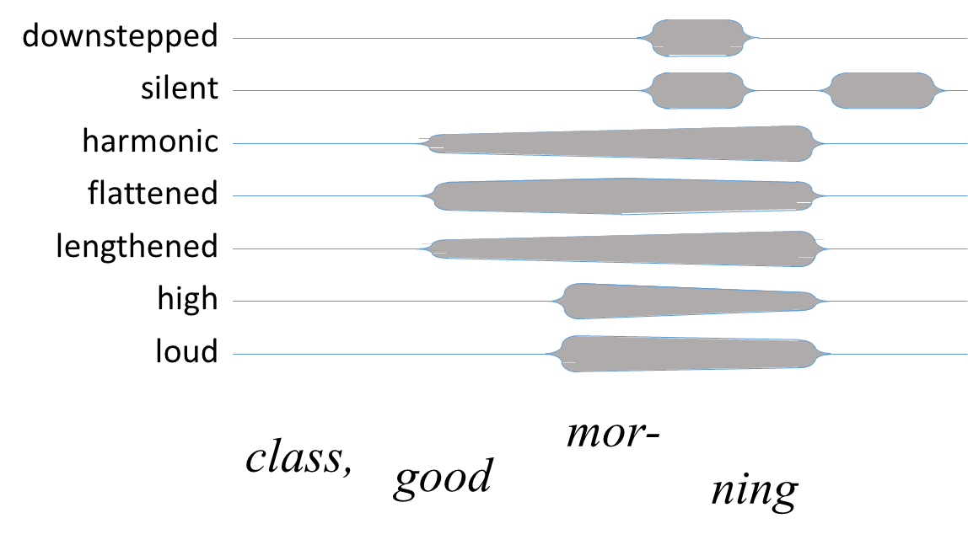
#1 Multistream …
Oliver Niebuhr; Daniel Day-O’Connell 2012
Notes:
multistream configuration, is the Minor Third Construction, as when I cue the class to greet me back with “class, good morning”. In terms of intonation, there’s a pitch downstep, between “good” and “morning”. But this is truly a *multistream* constructions, as Day-O’Connell showed experimentally. It includes [click] …
Okay, to recap, as we said back in Lecture 7 [next]

Slide 17

Prosody ⊃ Intonation
Wikimedia Commons
F₀ is just the tip of the iceberg
Notes:
Prosody is more than Intonation: it’s a superset. Pitch alone is just [click] the tip of the iceberg.
Multistream prosodic constructions are involved in all sorts of pragmatic functions. Just to list some common categories, they include [next]

Slide 18
Pragmatic Functions
Managing turn-taking
Marking cognitive state
Indicating stance
Marking topic structure
Managing interpersonal relations
Notes:
[read them]
Alright, in this lecture we’ve introduced the notion of multistream temporal configurations.
There’s more to say [next]

Slide 19
6 Properties of
Pragmatic Prosody
Multistream temporal configurations
Gradient, not categorical
Flexible alignment with words
Direct form-function associations
Joint constructions
Superposition of prosodic constructions
Notes:
so we’ll pick up points 2 through 6 in the next lecture

Slide 20

Contents
Introduction
Production, Perception
Classic Linguistic Prosody
Technology and Techniques
Paralinguistics, Pragmatics
Speech Synthesis and Dialog
Perspectives
20. Paralinguistics
Pragmatics
Prosodic
Constructions
. . .
Notes:
paralinguistics. In the next lecture [next]

Slide 21
Contents
Introduction
Production, Perception
Classic Linguistic Prosody
Technology and Techniques
Paralinguistics, Pragmatics
Speech Synthesis and Dialog
Perspectives
20. Paralinguistics
Pragmatics
Prosodic
Constructions
. . .
Notes:
where we explain more about how Prosodic Constructions convey pragmatic meanings. [smile]

Slide 23
Statement
Question
c.f. English
would you like something to drink?
c.f. English
would you like something to drink?
an 80 millisecond difference
can determine polite vs cold
Petrone, Niebuhr (2014)
Notes:
German, question marking includes a late peak, early in the utterance. Also often true in English.
Comment that there’s not a single “question prosody”, as is sometimes thought.

Slide 24
(of course it’s complicated)
the homeowner and his family, apparently safe.
that’s Space Coast Radio News in ninety seconds
where she died from her injuries …
arraigned on ten counts of production of child pornography

Slide 25
Implications
Technical
Speech synthesis, dialog systems, information retrieval
Other
- Language learning
  (individual performance varied from 43% to 95%)
- Skills training

Slide 27
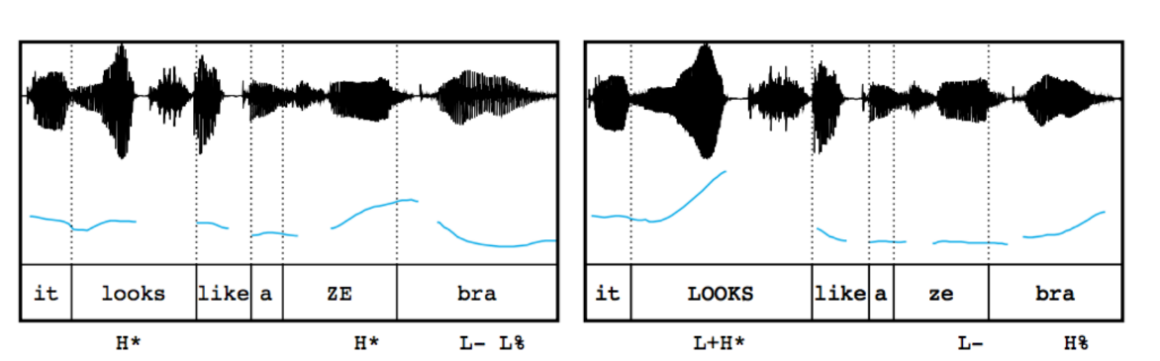


Contrastive Prosody…
neutral prosody
contrastive prosody
(Kurumada et al. 2012)

Slide 28
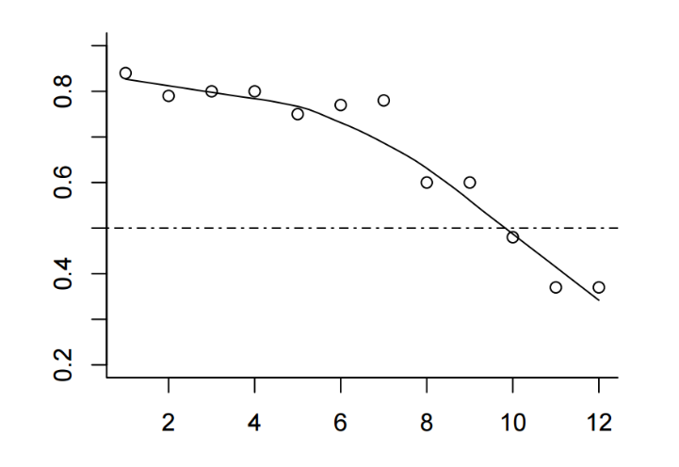
Construction Use is Non-Binary!
neutral prosody
contrastive prosody
The only example
so far
% thinking it
refers to an
actual zebra
(Kurumada et al. 2012)

Slide 29


* Still a Challenge for Synthesis
The buses aren't the problem, they actually provide a solution.
Synthesized
trained on data with prominence marked by capitalization
    The buses aren't the PROBLEM, they actually provide a SOLUTION.
Reference
#6 Not all of prosody is unit-linked!
#7 What are the functions? How do we help AI to catch up?
https://google.github.io/tacotron/publications/tacotron/index.html

Slide 30
The Minor Third Construction
“Good Morning”
pitch
~ 3 semitones
time
* minor-third pattern (Ladd 1978, Day-O’Connell 2013)

Slide 31
Much More than Just intonation!
Flat in pitch
Lengthened
Pitch drop
  a. small,
  b. consistent-ish
High in pitch
Even in intensity
High in harmonicity
Loud
Flat on lead-in too
Second syllable
  Less flat
  Longer
  More harmonic
10. Drop is fast
11. Silent after end
12. Downstep at volume dip
13. Preceding upstep common
14. First syllable
a. articulatory precision
Based on production studies and corpus-based rule refinement
(Day-O’Connell 2013, Niebuhr 2015, Ward 2019)

Slide 32
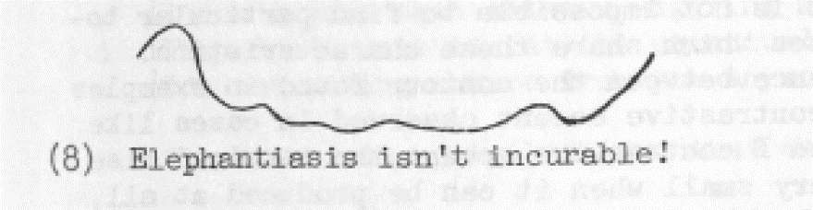
How Does Prosody Convey Meaning?
Consider intonation contours / melodies / tunes
Are these symbolic/phonological/categorical?
    e.g. L*_HL-H%
2. Are these about intonation alone?
(Liberman and Sag, 1974)

Slide 33
Meanings in English
asking
questions
threatening
offering
seeking confirmation
inviting
inference
requesting
inviting
grounding
incredulity
new topic
correcting
misconceptions
storytelling
suggesting
reminiscing
distress
expressing
approval
mixed
feelings
speculating
imagining
shared
feeling
losing
control
partial
agreement
playing
laughing
#15 Sprawling networks of meanings

Slide 34
Meanings in English, etc.
but not in German
asking
questions
threatening
offering
seeking confirmation
inviting
inference
requesting
inviting
grounding
incredulity
new topic
correcting
misconceptions
storytelling
suggesting
reminiscing
distress
expressing
approval
mixed
feelings
speculating
imagining
shared
feeling
losing
control
partial
agreement
but not in
Swedish
playing
laughing
#12 Sprawling networks of meanings

Slide 35
Perceptions of Pitch
Factors affecting perceptions of lateness
#13 We don’t directly perceive pitch max (avg, min, height …)
(Niebuhr et al., 2011; Barnes et al., 2012)

Slide 36
The Positive Assessment Construction
“we’re very glad you’re here”
pitch
time
Meant sincerely, felt sincerely … thanks to the prosody

Slide 37
Some Pragmatic Functions Served
Hold the turn
Mark a transient disfluency
Yield the turn
Cue a backchannel
Produce a backchannel
Yield/take for an extended turn
Supportively overlap
Cue an immediate response
Show autonomy
Bid for empathy
Assess positively
Contrast or complain
Invite an inference
Close a topic
Promote continuation of a topic
Develop a topic
Make a meta comment
Interpolate a parenthetical or subdialog
Prosodic Patterns in English Conversation,
Nigel G. Ward, Cambridge University Press, 2019

Slide 38
Four Downstep (HL) Constructions
Minor Third (excuse me) (H!H)
high, very flat, downstep, harmonic, lengthened
Positive Assessment (good job!) (typically)
high initial pitch, lengthened second syllable, wide range
Apology (I’m really sorry)
small downstep, long second syllable, fairly flat, slightly creaky
Cursing (screw you)
lengthened consonants, tiny downstep
Oliver Niebuhr (2015)

Slide 39
Correlates of Positive Feeling
In meetings … on the word yeah: longer vowel duration, pitch ranges that extend higher, lower mean intensity, earlier and steeper intensity drop (Freeman et al., 2015)
In meetings … in general: longer stressed vowels in content words (Freeman, 2015)
In announcements of good news… high pitch level, increased pitch range, abrupt step-ups and rises, modal voice, loudness on key words, fast and increasing rate (Freese and Maynard, 1998)
To infants… exaggerated rise-fall F₀ (Fernald 1989)
In emotion displays… higher intensity, breathy voice, upward inflections
Burr Sutter

Slide 40
Why are we the first here?
It’s so obvious (at least in retrospect)
Possible reasons
Over-focus on intonation alone
Over-focus on logical semantics alone
Over-focus on intelligibility
Inability to tease out superimposed patterns

Slide 41
A Prosodic Configuration that Conveys
Positive Assessment in American English
Nigel G. Ward, James A. Jodoin
International Congress of the Phonetic Sciences
August 2019

Slide 42
Hypotheses
1) This prosodic configuration conveys positive assessment
2) Fine differences in pattern strength are perceived as differences in positivity
3) The temporal configuration of features matters

Slide 43
Preparation of Stimuli
Neutral source + neutral prosody
Neutral source + positive prosody
Positive source + neutral prosody
Positive source + positive prosody
Prepared using Praat:
annotate … adjust duration … transplant pitch

Slide 44
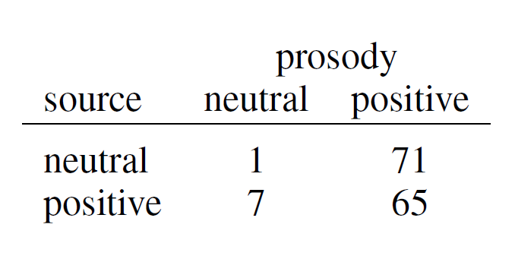
Hypothesis 1: Results
p < 0.05 by the binomial distribution
(Actually p < .0000000000000000000000000000002)

Slide 45
Hypotheses
1) This prosodic configuration conveys positive assessment
2) The stronger the prosody, the stronger the positive perception
3) The temporal configuration of features matters

Slide 46
Hypotheses
1) This prosodic configuration conveys positive assessment
2) The stronger the prosody, the stronger the positive perception
3) The temporal configuration of features matters

Slide 47
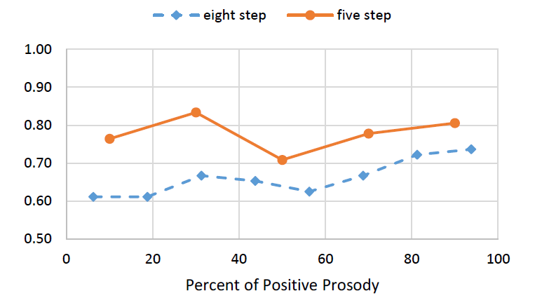
Results
all p < 0.05 by the binomial distribution

Slide 48
Stimuli Generation - Algorithms
Duration = neutral_duration * (1 – s) + positive_duration * s
Pitch = neutral_pitch * (b – 1) + positive_pitch * b
where b = 2^{s} – 1 , to make the steps log-linear

Slide 49
Hypotheses
1) This prosodic configuration conveys positive assessment
2) Fine differences in pattern strength are perceived as differences in positivity
3) The temporal configuration of features matters

Slide 50
Hypotheses
1) This prosodic configuration conveys positive assessment
2) Fine differences in pattern strength are perceived as differences in positivity
3) The temporal configuration of features matters

Slide 51
Hypothesis 3
Stimuli:
Increased pitch in syllable 1 and duration in syllable 2
Increased pitch and duration in both syllables
(while matching the total duration and the average pitch)

Slide 52
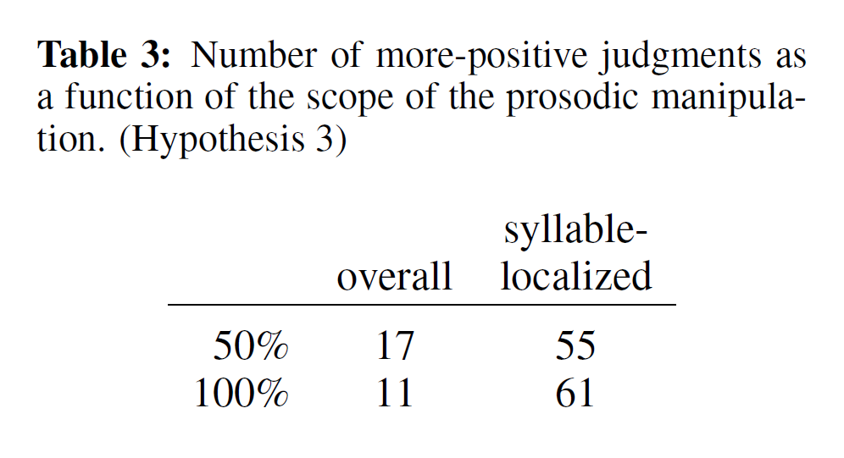
Results
p < 0.05 by the binomial distribution

Slide 53
Findings
1) This prosodic configuration conveys positive assessment
2) Fine differences in pattern strength are perceived as differences in positivity
3) The temporal configuration of features matters

Slide 54
like
it's really cool like, coming up with like, you know, a program, and then like being able to see like, that program on someone else's phone

Slide 55
paralinguistic
phonological
pragmatic

Slide 56
paralinguistic
phonological
pragmatic

Slide 57
