Slide 1


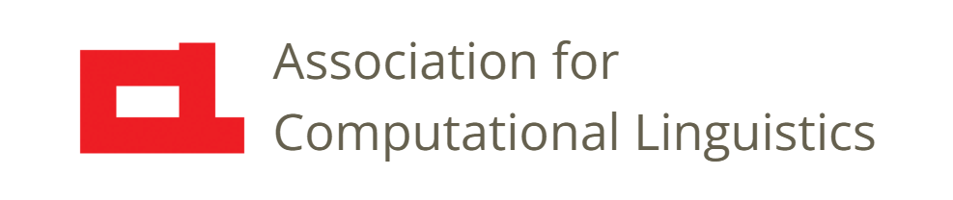

Prosody
Lecture 22: Properties of
Prosodic Constructions
Nigel G. Ward, University of Texas at El Paso
Gina-Anne Levow, University of Washington
Tutorial presented at ACL 2021
Notes:
Welcome to Lecture 22 of our Series on Prosody, continuing the topic of how prosody serves pragmatic functions, and [click]

Slide 2
Lecture 22: Properties of
Prosodic Constructions
in the service of
pragmatic functions
Notes:
elaborating the notion of “prosodic constructions.” This is the mechanism by which prosody serves many important functions ---- indicating positive and negative feelings, managing who has the turn, marking topic shifts, and so on. In the last lecture we introduced the key idea, namely [next]

Slide 3
6 Properties of
Pragmatic Prosody
Temporal multistream configurations
Gradient
Flexible alignment with words
Direct form-function associations
Joint constructions
Superposition of prosodic constructions
vs binary / categorical
vs fixed alignment
vs symbol-mediated
Notes:
that prosodic constructions generally involve multiple prosodic streams --- such as pitch and intensity and lengthening and reduction --- and that the various features appear in specific temporal configurations. We’ll cover 5 additional properties [next]

Slide 4
6 Properties of
Pragmatic Prosody
Temporal multistream configurations
Gradient
Flexible alignment with words
Direct form-function associations
Joint constructions
Superposition of prosodic constructions
vs binary / categorical
vs fixed alignment
vs symbol-mediated
Notes:
some of which contrast strongly with the more familiar ways that sound conveys meaning [click]. We’ll start by talking about their [next]

Slide 5
6 Properties of
Pragmatic Prosody
Temporal multistream configurations
Gradient
Flexible alignment with words
Direct form-function associations
Joint constructions
Superposition of prosodic constructions
vs binary / categorical
vs fixed alignment
vs symbol-mediated
Notes:
gradient nature, in contrast with the *categorial* elements of language. [next]

Slide 6
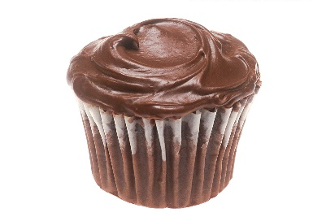
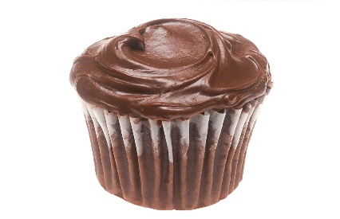



cupcake
vs binary / categorical
cupcakes
The plural morpheme /s/
is categorical
cupcake
Renee Comet, Wikipedia Commons
Notes:
such as plural /s/ in English. Consider “one cupcake” vs “two cupcakes” [click] . The “s” on the end is categorical.
It’s binary: either present or absent. Logically, if my lunch was more than one but less than two [click] I could indicate that with half an /s/, [click] since it’s halfway between singular and plural. But no, English doesn’t allow that. The plural morpheme /s/ is *categorical”.
Prosody is sometimes like that. You can’t have a tone halfway between Tone 3 and Tone 4. But pragmatics-related prosody is generally Not categorical. [next]

Slide 7

#2 Gradient Nature
Example: the Positive Assessment Construction
Stronger realization of a pattern → stronger meaning
0% vs 20% 80% vs 100%
Stimulus creation example:
  20% positive = neutral prosody
  + 20% of the pitch delta, affecting syllable 1
  + syllable 2 duration increased by 20% of the delta
(Ward and Jodoin, ICPhS 2019)
Notes:
Consider again the Positive Assessment Construction. If you’re pleased, but not hugely pleased, you can tone down the prosody a little: going halfway between neutral and positive. In fact, you can do it at 20% or 40 %; [click]. Here’s an experiment: of the following two clips, which sounds more positive? [click]. The second one, right. And here’s two more [click]. Again the second one. Almost everyone can hear these distinctions, and many people even finer ones. In general, the prosody of pragmatic functions is often [click] *gradient* in nature. Okay, on to our third point [click]

Slide 8
#3 Alignment Flexibility
good
hello everyone,
morning
Notes:
the alignment of prosody to words is often flexible. I’ll ullustrate with the Minor Third Construction. As seen in the last lecture, this is often used to elicit responses, as in “hello everyone, good morning”, if I want the class to respond back cheerfully. In this case the pitch downstep falls between “good” and “morning” [next]

Slide 9
#3 Alignment Flexibility
good
hello everyone,
morning
Notes:
but it could be different. For example, if the alignment is moved [click] so the the word “morning” is in the hot spot [next]

Slide 10
Alignment Variation
good
hello everyone,
morn
-ing
Prosody is semi-autonomous
Notes:
then the downstep can come between the two syllables of “morning”, and it works like this [click and wait] including an upstep lead-in. So we get [now sing it] “morning”, as in “hello everyone, good morning”. Same construction, same pragamatic force, different alignment.
So pragmatics-related prosody but it is often [click] semi-autonomous in this way.
We can have more fun with this construction. [next]

Slide 11
More Alignment Variation
John
Notes:
If we want to call someone who has only one syllable in their name, like “John”, we can either split that one syllable into two [next]

Slide 12
More Alignment Variation
Joh
n
Notes:
, as in ^Jo _ohn. Or we can give them a nickname, like [next]

Slide 13
More Alignment Variation
Strategies for alignment *
Segment Split
Epenthesis
Truncation
Undershooting
Compression
Re-alignment
Lengthening
depending on the language
and the construction
John
ny
* a.k.a. tone-metrical association, a.k.a resolving tune-text conflicts
(Torreira & Grice, 2018; Vigario, Cruz & Frota, 2019)
Notes:
Johny. The details of alignment are *very* complex [click] , and research is still working out the details. But the general point is that [next]

Slide 14
6 Properties of
Pragmatic Prosody
Temporal multistream configurations
Gradient
Flexible alignment with words
Direct form-function associations
Joint constructions
Superposition of prosodic constructions
vs binary / categorical
vs fixed alignment
vs symbol-mediated
Notes:
prosodic constructions can align flexibly with the lexical content. Now, moving on to point [next]

Slide 15
6 Properties of
Pragmatic Prosody
Temporal multistream configurations
Gradient
Flexible alignment with words
Direct form-function associations
Joint constructions
Superposition of prosodic constructions
vs binary / categorical
vs fixed alignment
vs symbol-mediated
Notes:
4, prosodic constructions are *direct* mappings between form and function. So far, we’ve focused on the form [next]

Slide 16
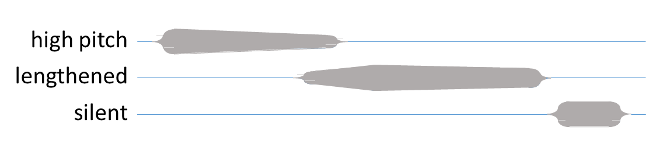
Direct Mappings
Positive Assessment
loudness
clipped
-1500 -1000 -500 0 500
Notes:
like this configuration that we’ve already seen. But really a *construction* has two parts, the form, and the meaning [click]. That pairing, together, constitutes the construction. [click]
Here’s another example. [next]

Slide 17
Direct Mappings
respectfully distanced
Admiration
throughout: high pitch, creaky voice, nasal, loud
pitch generally flat, with small peaks initially and finally
long duration
Lexical content: awww
Context:
a cute baby sleeping, etc.
speaker is female
audience is female
. . .
Notes:
the mapping between this configuration of properties and a meaning of admination. [click] It sounds like this [click] . Unlike our previous example, this conveys a very specific meaning: one of *respectfully distanced* admiration [click] as, typically, this also reassures the mother that, though her baby is incredibly cute, you’re not going to do anything to wake it up. There’s also a lexical constraint, that this comes only with the word “awww”, [click] and contextual constraints, [click] in that you can only use this for a sleeping baby [click], or a picture of a baby, or a puppy, or something of that nature, and that both you and the audience are female, usually.
Just as a side note, the meanings of prosodic constructions vary [next]

Slide 18
Specificity Varies
Positive Assessment Construction
Awww-of-Cute Construction
Minor Third Construction
specific words
any words
specific situations
and contexts
many situations
and contexts
specific meaning
vague meaning
minor
constructions
general
constructions
Notes:
from the very specific, like this one, to the more general, like the Positive Assessment Construction, to the very vague, like the Minor Third Construction, which we saw earlier. That construction [next]

Slide 19
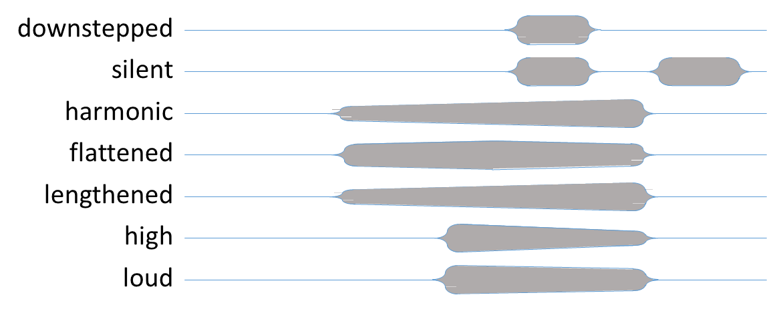
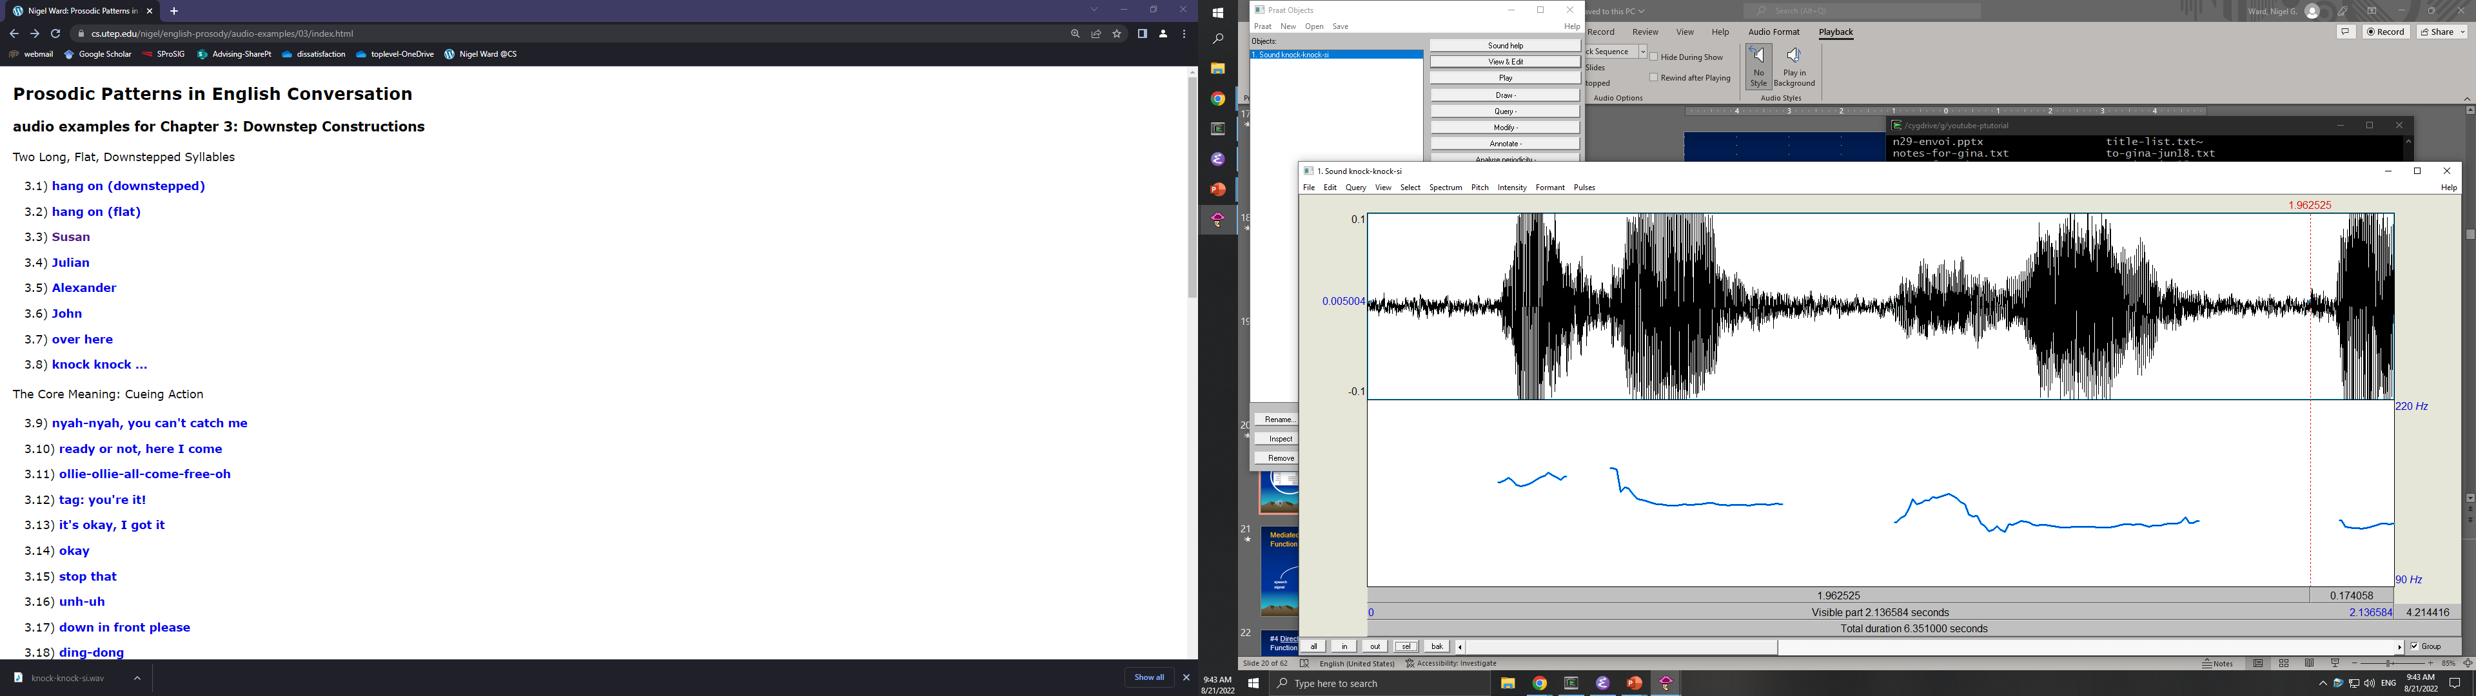
Direct Mappings
Cuing an obvious action
Notes:
serves very generally to cue an obvious action, as when I say “excuse me” to get you to move aside, or “knock knock” [click], to get you to respond. Now, getting back to our main point, every construction is a mapping from some set of speech signals [click] to some mental representations or activities [click]. The meaning contributed by one construction gets combined with everything else, complexly. But each construction is a *direct* mapping.
This contrasts with the ‘mediated’ mappings that also exist in language [next]

Slide 20
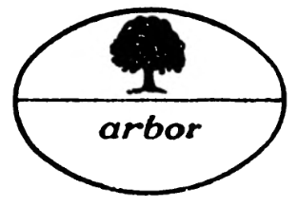
Direct Mappings
Mediated Mappings
Cuing an obvious action
tree
symbolic intermediate representation
L*_HL-H%
/tɹi/
Notes:
For example, when I convey the concept of a tree, by saying the word “tree”, there is a mapping, from the sequence of phonemes to the concept. And below that, another set of mappings [click] that connect the sound to that phoneme sequence. Using that intermediate representation [click], that is to say, that sequence of phonemes [click and wait], as the key for analysis is very helpful. People have proposed similar sequences of symbols [click] as the intermediate representation for prosody, but in general, for pragmatics-related prosody, *direct* mappings [click] seem descriptively more accurate, and more efficient.
Okay, moving on to the fifth interesting thing about prosodic constructions [next]

Slide 21
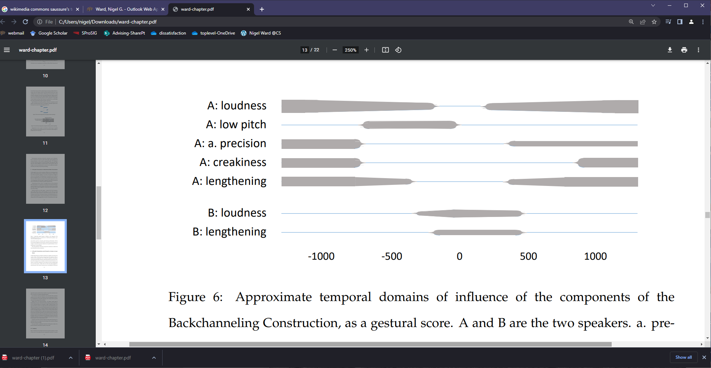
#5 Joint Constructions
A: … before it was even in America, like,
B: really
A: because, yeah, I think it was released in Canada …
Notes:
they can be joint constructions. In dialog people coordinate. Consider the word “really” here, which speaker B uses as a backchannel. [click]
While it’s got a pitch upswing at the end, it also has fairly typical backchannel prosody, being rather lengthened, and only modestly loud. [click] It also appears in a typical context, as A is also following a prosodic score [next]

Slide 22
#5 Joint Constructions
A: … before it was even in America, like,
B: really
A: because, yeah, I think it was released in Canada …
Notes:
Including, producing an utterance that ends with low pitch [click], pausing, then A starting up again [click] . So, backchanneling is a *joint* construction, in the sense that it partly specifies the prosody of both speakers.
Okay, so, the final key property of prosodic constructions is that they can be superimposed [next]

Slide 23
#6 Superposition
high pitch specification
Minor Third
Construction
late peak
sum
Su-
sa ^{n}
The meaning of a combination is the combined meaning of the forms
Notes:
As we saw, the minor third construction can govern how I say a name, as in Su-san, and the late peak construction can also make a contribution, as in Susan (quizzically). If I combine the two [click] then I get the combined meaning. It can sound like this. Here’s another way to diagram this [next]

Slide 24
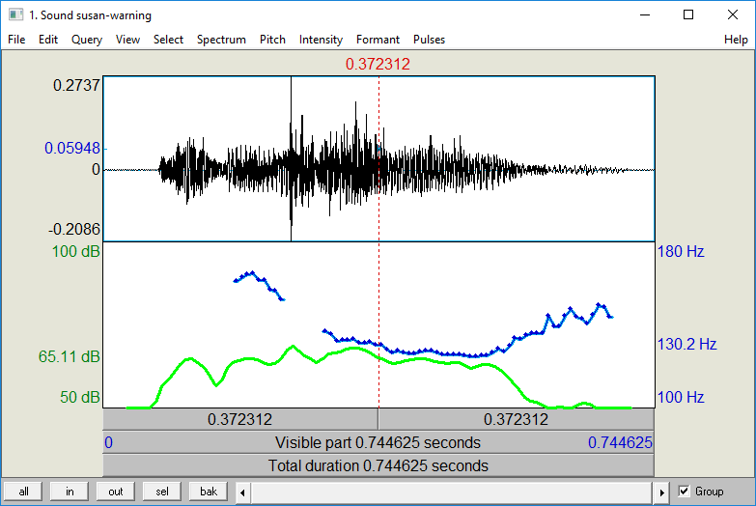
Superposition
+
=
Notes:
This is an “intonational contours” view.
We’re illustrating superposition using F0 alone, but in fact it’s probably general for all prosodic features: every element of every construction involved.

Slide 25

An metaphor for superposition
Prosodic Patterns in English Conversation, N. G. Ward, Cambridge University Press, 2019.
Notes:
We can explain this with a metaphor ….
So, that’s how pragmatic prosody works: [next]

Slide 26
6 Properties of
Pragmatic Prosody
Temporal multistream configurations
Gradient, not categorical
Flexible alignment with words
Direct form-function associations
Joint constructions
Superposition of prosodic constructions
Notes:
It involves prosodic constructions, which have these 6 properties. This is true of prosody as it serves *many* functions, [next]

Slide 27
Prosodic Constructions
turn hold / quietly listen
2a. overlap 2b. silence
3. turn take / turn yield
4. backchannel (cue) ing
5a. topic closing 5b. topic continuation
6a. topic development 6b. positive assessment
7. empathy bid / unemotional
8a. turn-hold fillers 8b. bipartite form
9. floor take / floor yield
10a. late peaks 10b. turn-initial fillers
11a. meta-comment 11b. contrast
12. minor-third cue / response
Notes:
Including, for American English, all of these. You can learn about each in a nice little paperback book [click]: Prosodic Patterns in English Conversation, by Nigel G. Ward. (That’s me.) I wish there were similar books for other languages, but not yet. / So, anyway, that wraps it up for our discussion of [next]

Slide 28

Contents
Introduction
Production, Perception
Classic Linguistic Prosody
Technology and Techniques
Paralinguistics, Pragmatics
Speech Synthesis and Dialog
Perspectives
20. Paralinguistics
Pragmatics
Prosodic
Constructions
The Three
Realms
. . .
Notes:
prosodic constructions and pragmatics. In the next lecture [next]

Slide 29
Contents
Introduction
Production, Perception
Classic Linguistic Prosody
Technology and Techniques
Paralinguistics, Pragmatics
Speech Synthesis and Dialog
Perspectives
20. Paralinguistics
Pragmatics
Prosodic
Constructions
23. The Three
Realms
Notes:
we’ll zoom out, to consider the big picture of the three realms of prosody.

Slide 31
A Puzzle:
How to Explain Variation
Answer: superimposed constructions
Notes:
Good job medley.
*start a separate lecture here?**

Slide 32
Calling: Variants
Can appear with
final rise - incomplete, inference invited, warning
pitch wiggles - teasing
shorter second syllable - reprimand
initial syllabification - insistent
creaky voice - disappointment, judging
glottal stops - anger
…

Slide 33
Calling: Variants
Can appear with
final rise - incomplete, inference invited, warning
pitch wiggles - teasing
shorter second syllable - reprimand
initial syllabification - insistent
creaky voice - disappointment, judging
glottal stops - anger
…

Slide 34
Calling: Variants
Can appear with
final rise - incomplete, inference invited, warning
pitch wiggles - teasing
shorter second syllable - reprimand
initial syllabification - insistent
creaky voice - disappointment, judging
glottal stops - anger
…

Slide 35
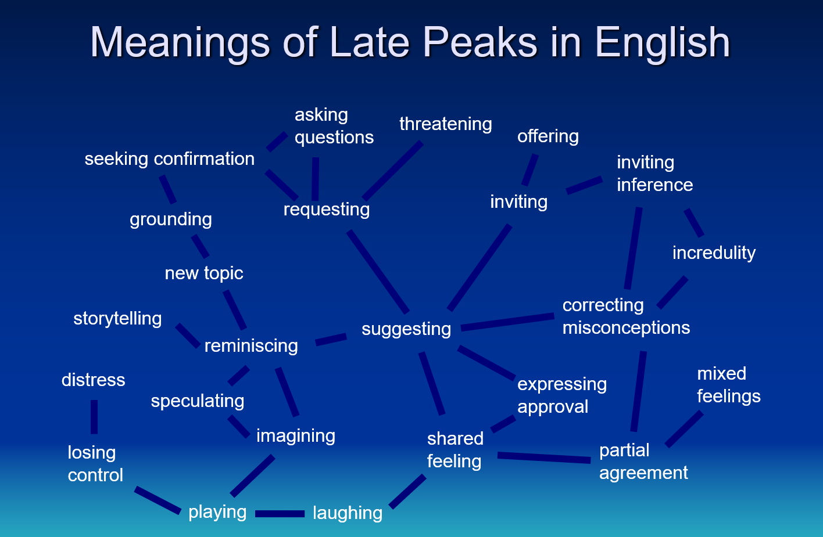
Uses of Late Peak
and context-dependent …

Slide 36
Domains of Pragmatics
Turn-taking
Marking topic structure
Expressing stance
Managing interpersonal relations
etc.

Slide 37
The Minor Third Construction
“excuse me”
pitch
time

Slide 38
A Failure
“excuse me”
pitch
time

Slide 39
The Minor Third Construction
“Good Morning”
pitch
~ 3 semitones
time
* minor-third pattern (Ladd 1978, Day-O’Connell 2013)

Slide 40
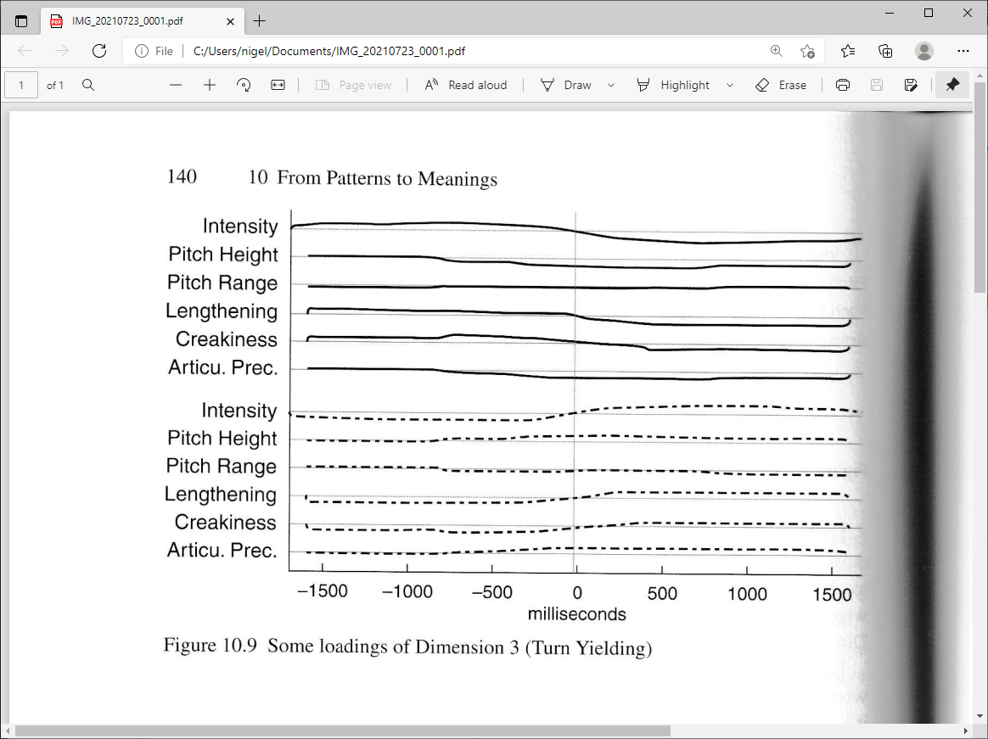
Turn Yield
Configurations exist
But for predictions
  (At each point in time,
  predict future speech activity)
  A LSTM model, on frame-level features
  Outperformed crowdworkers in predicting turn shifts
The most common turn-yield configuration
Ward (2019), Skantze (2017)

Slide 41
Some Uses
good morning
hang on
excuse me
ding-dong
knock-knock
Marco Polo
uhn-uh
down in front please
Johnny
peek-a-boo
ku-kuck-da

Slide 42
The Minor Third Construction
“Good Morning”
pitch
~ 3 semitones
time
* minor-third pattern (Ladd 1978, Day-O’Connell 2013)

Slide 43
Constructions are Rich
“Good Morning”
loud
clear (modal voice)
not low in pitch range
preceded by silence
flat
lengthened (200ms +)
pitch
~ 3 semitones
flat
lengthened (300ms +)
time
* minor-third pattern (Ladd 1978, Day-O’Connell 2013)

Slide 44
Much More than Just intonation!
Flat in pitch
Lengthened
Pitch drop
  a. small,
  b. consistent-ish
High in pitch
Even in intensity
High in harmonicity
Loud
Flat on lead-in too
Second syllable
  Less flat
  Longer
  More harmonic
10. Drop is fast
11. Silent after end
12. Downstep at volume dip
13. Preceding upstep common
14. First syllable
a. articulatory precision
Based on production studies and corpus-based rule refinement
(Day-O’Connell 2013, Niebuhr 2015, Ward 2019)

Slide 46
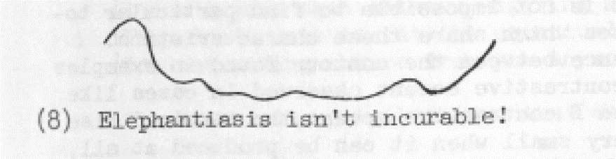
How Does Prosody Convey Meaning?
Consider intonation contours / melodies / tunes
Are these symbolic/phonological/categorical?
    e.g. L*_HL-H%
2. Are these about intonation alone?
(Liberman and Sag, 1974)

Slide 47
Properties of Prosodic Constructions
Form
  pitch, plus energy, rate, creakiness … … …
  patterns in time
  may have contributions by both interlocutors
Function
Flexibility in Use
  Different strengths
  Superimposable
Related Constructions

Slide 48
(of course it’s complicated)
the homeowner and his family, apparently safe.
that’s Space Coast Radio News in ninety seconds
where she died from her injuries …
arraigned on ten counts of production of child pornography

Slide 49
Implications
Technical
Speech synthesis, dialog systems, information retrieval
Other
- Language learning
  (individual performance varied from 43% to 95%)
- Skills training

Slide 50
How Does Prosody Convey Meaning?
A matter of degree?
Intonation plus more?
Temporal configurations?
Are these symbolic/phonological/categorical?
    e.g. L*_HL-H%
(Liberman and Sag, 1974)

Slide 51
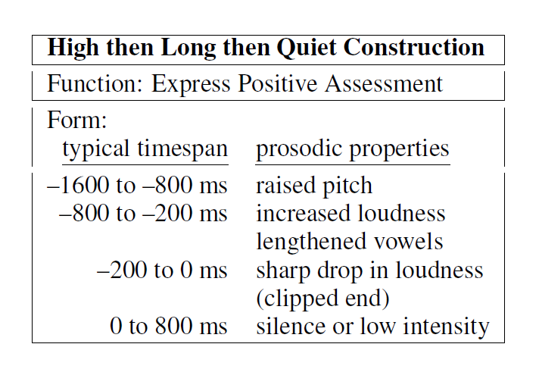
Our Hypothesized Configuation
(PCA dimension 6) (Ward 2019)

Slide 52
Outline
A Prosodic Configuration that Conveys
Positive Assessment in American English
Nigel G. Ward, James A. Jodoin
UTEP Computer Science
Issues in Prosody and Meaning
Previous Work
Hypotheses, Experiments, Results
TLS, February 22, 2019

Slide 53
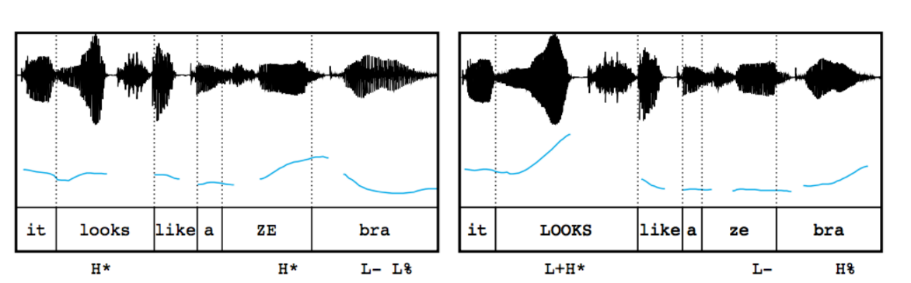
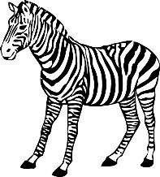
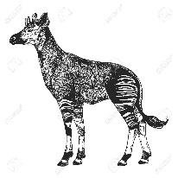
Contrastive Prosody…
neutral prosody
contrastive prosody
(Kurumada et al. 2012)

Slide 54
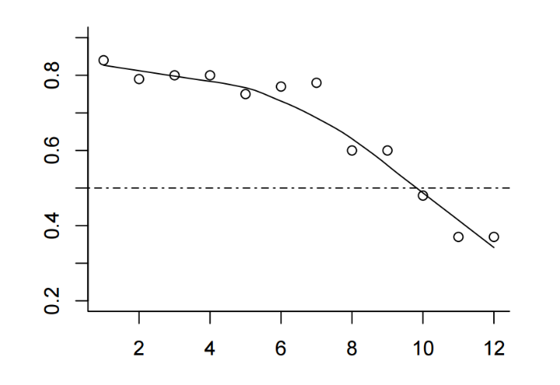
Construction Use is Non-Binary!
neutral prosody
contrastive prosody
The only example
so far
% thinking it
refers to an
actual zebra
(Kurumada et al. 2012)

Slide 55


* Still a Challenge for Synthesis
The buses aren't the problem, they actually provide a solution.
Synthesized
trained on data with prominence marked by capitalization
    The buses aren't the PROBLEM, they actually provide a SOLUTION.
Reference
#6 Not all of prosody is unit-linked!
#7 What are the functions? How do we help AI to catch up?
https://google.github.io/tacotron/publications/tacotron/index.html

Slide 56
The Minor Third Construction
“Good Morning”
pitch
~ 3 semitones
time
* minor-third pattern (Ladd 1978, Day-O’Connell 2013)

Slide 57
Much More than Just intonation!
Flat in pitch
Lengthened
Pitch drop
  a. small,
  b. consistent-ish
High in pitch
Even in intensity
High in harmonicity
Loud
Flat on lead-in too
Second syllable
  Less flat
  Longer
  More harmonic
10. Drop is fast
11. Silent after end
12. Downstep at volume dip
13. Preceding upstep common
14. First syllable
a. articulatory precision
Based on production studies and corpus-based rule refinement
(Day-O’Connell 2013, Niebuhr 2015, Ward 2019)

Slide 58
How Does Prosody Convey Meaning?
Consider intonation contours / melodies / tunes
Are these symbolic/phonological/categorical?
    e.g. L*_HL-H%
2. Are these about intonation alone?
(Liberman and Sag, 1974)

Slide 59
Some Pragmatic Functions Served
Hold the turn
Mark a transient disfluency
Yield the turn
Cue a backchannel
Produce a backchannel
Yield/take for an extended turn
Supportively overlap
Cue an immediate response
Show autonomy
Bid for empathy
Assess positively
Contrast or complain
Invite an inference
Close a topic
Promote continuation of a topic
Develop a topic
Make a meta comment
Interpolate a parenthetical or subdialog
Prosodic Patterns in English Conversation,
Nigel G. Ward, Cambridge University Press, 2019

Slide 60
Maybe a medley of “yeah” in various prosody, to drive home the message
Observe that prosodic meanings are hugely context-dependent.
Even more than for words.

Slide 61
Uses of the Minor Third
good morning
hang on
excuse me
ding-dong
knock-knock
Marco Polo
uhn-uh
nyah-nyah
down in front please
Johnny
peek-a-boo
ku-kuck-da
somewhat diffuse
Notes:
… sometimes the meanings are rather diffuse [click]

Slide 62
Awww-of-Cute
Construction

Slide 63
Direct Mappings
respectfully distanced
Admiration
throughout: high pitch, creaky voice, nasal, loud
pitch generally flat, with small peaks initially and finally
long duration
Notes:
the mapping between this configuration of properties and a meaning of admination. [click] It sounds like this [click] . Unlike our previous example, this conveys a very specific meaning: one of *respectfully distanced* admiration [click] as, typically, this also reassures the mother that, though her baby is incredibly cute, you’re not going to do anything to wake it up. There’s also a lexical constraint, that this comes only with the word “awww”, [click] and contextual constraints, [click] in that you can only use this for a sleeping baby [click], or a picture of a baby, or a puppy, or something of that nature, and that both you and the audience are female, usually.
Just as a side note, the meanings of prosodic constructions vary [next]

