Slide 1


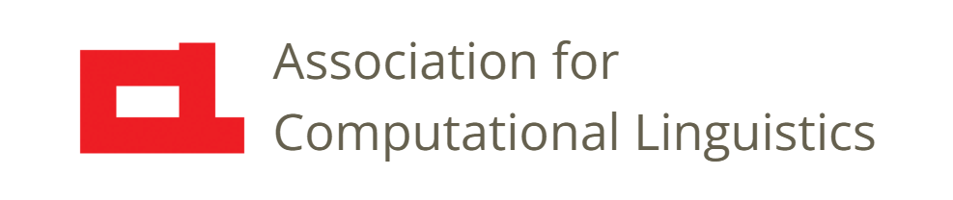

Prosody
Lec. 23: The Three Realms, Revisited
Nigel G. Ward, University of Texas at El Paso
Gina-Anne Levow, University of Washington
Tutorial presented at ACL 2021
Notes:
Welcome to Lecture 23 of our Series on Prosody. We’ve said a lot about the various functions of prosody; in this lecture we’ll put it all together, reviewing the three realms of prosody, telling a story about the evolution of prosody, and looking at some deep roots of some common social misunderstandings.

Slide 2
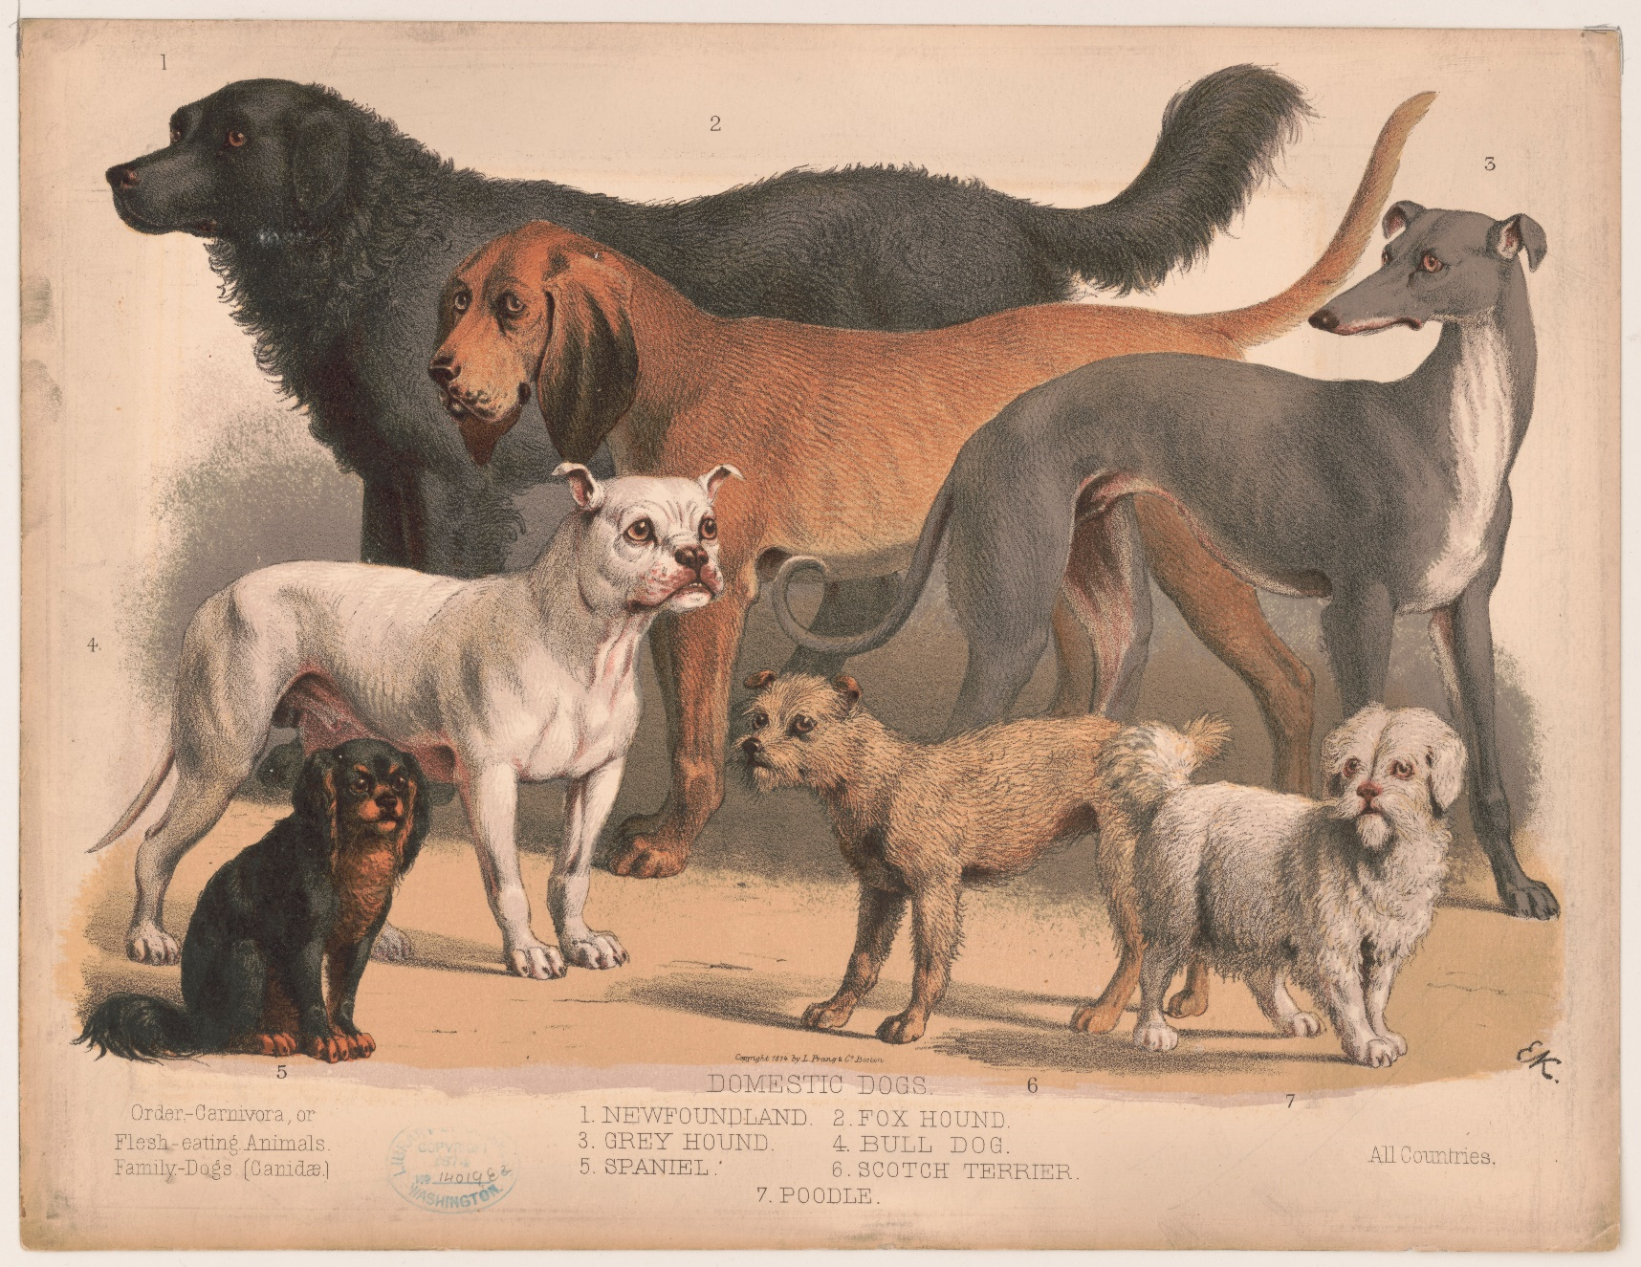
The Frequency Code
Wikimedia Commons
Notes:
So, which of these dogs seem likely to have the louder, deeper barks?
/ Large size -> large larynx -> longer vocal folds -> slower vibration -> deeper pitch
/ Also, larger mouth and throat (longer vocal tract) -> deeper resonances.
/ Also, if a dog wants to seem scarier, it can bark or growl deeper.
/ Digression: It’s fun to extend the story to account for human male voices being mostly deeper than female voices. But that’s a little off topic.
/ Anyway this correlation underlies what is called the “frequency code” [next]

Slide 3
The Frequency Code
paralinguistic
Bigger larynx -> Lower pitch -> Larger individual
Extends to
Low pitch ∝ Dominance …
∝ Certainty, finality, non-questionhood …
pragmatic
(Ohala 1983)
Notes:
At root, this is purely paralinguistic: the connection between the physics of sound and the size of bodies, iconically extends to a connection between low pitch and larger size.
It also extends further, to dominance [click]. Further, if we believe that dominant people are usually more certain, when you’re more certain, you may naturally adopt a lower pitch. Dominance may also also correlate with making statements that are final, in various senses of the word, including not being questions. (I’m getting self-conscious here … is my pitch low enough to make you think of me as a big dog, full of confidence and worth believing?)) Anyway, across many languages, low pitch tends to mark many things.
More generally, there are paralinguistics roots underlying many linguistic meanings of low pitch. [click] Yes, the connections are tenous, but the two realms are not entirely independent. / Further, regardless of the validity of our little story about evolution, entanglements among the realms are also relevant in daily life.

Slide 4
Three Tangled Realms
For example: use of creaky voice is…
      Showing authority or knowledge?
      Showing tiredness or disengagement?
      Marking topic closure?
      Displaying an American identity?
      Glottal reinforcement of /t/?
pragmatic
paralinguistic
pragmatic
paralinguistic
phonological
Prosody is a “half-tamed savage” (Dwight Bolinger)
Notes:
For example, what’s the meaning of creaky voice? Well, it has various meanings, in the different realms. Consider airline pilots, who sometimes talk to the passengers in a very creaky voice: “we’ll be flying at thirty-thousand feet, with a 180-knot tailwind”. What impression do you get? Are they showing competence and confidence? Or tiredness and lack of interest? What about creaky voice when used by young professional women, as discussed in many confused articles about vocal fry? Perceptions can differ! It’s even more interesting, since creaky voice has many other roles. We can easily misunderstand the intended function, and such misattribution can be devastating [in a child’s voice] “I don’t want to play with that boy again”. So, prosody can be tricky business! Okay, let’s take stock [next]

Slide 5
Paralinguistic
Phonological
emotion
other states
speaker identity
speaker traits
…
tone
lexical accent
prominence
phrasing
… …
turn-taking
stance
topic management
interpersonal
positioning
…
Pragmatic
Notes:
Prosody has three realms, and in each, it serves many important functions [click click click] . Since prosody does so much, some confusion is unsurprising. / Especially when people differ in dialect or subculture. Or are learning a new language, as we’ll discuss in a later lecture. / But, amazingly, most of the time we understand each other reasonably well. / And this is despite the fact that any given utterance can include not only superimposed prosodic constructions [next]

Slide 6
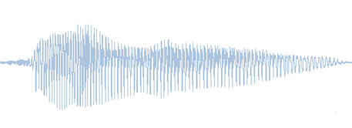
Prosody can be Busy
Paralinguistic
Functions
Paralinguistic functions
Phonological functions
Pragmatic functions
Phonological
Functions
super-position
Pragmatic
Functions
Notes:
but superimposed prosodic meanings of all types. It’s quite amazing that all the simultaneous messages can fit into one little speech signal. It’s such a thin little channel, not like vision, where you can see gesturing hands and mouths and eyebrows and shoulders and finger. Prosody can do so much. It’s truly amazing.
Alright, let’s summarize [next]

Slide 7
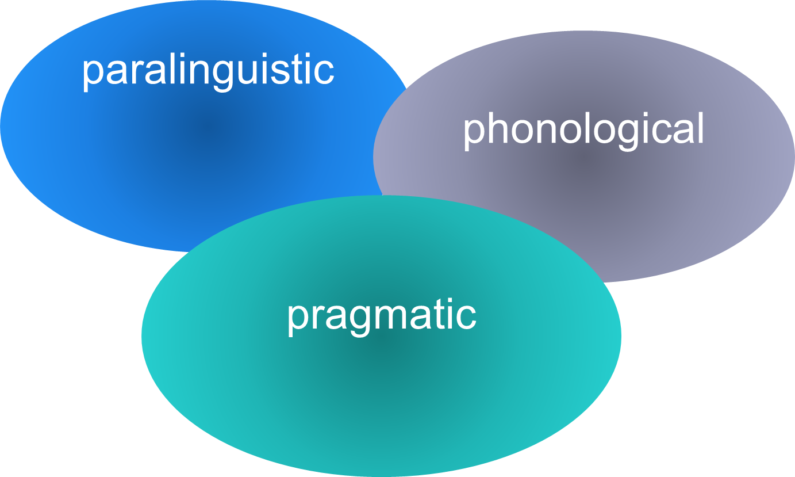
Realm Properties
 | Paralinguistic | Phonological | Pragmatic
Feature-Unit Alignments | Non-localized | Unit-aligned | Flexibly aligned
Meaning Types | Gradient | Categorical | Gradient
Relation to Lexical Content | Independent | Supporting | Mostly independent
Different realms need different modeling techniques.
Notes:
these three tangled realms: the paralinguistics, phonological, and pragmatic. These are three ways of relating form and meaning. This table summarizes just a few of the differences we’ve seen. The claim here is that [click] different realms need different modeling techniques. / Earlier we saw examples where trying to model phenomenon from one realm but using techniques appropriate for different realm, didn’t work out so well. This has been sadly very common. / Okay, let’s talk more about the issue of the independence of prosody [click]. Is it independent of the words or tied to them? [next]

Slide 8
Is Pragmatic Prosody Independent of Words?
Not entirely
Alignments matter
Prosody can modulate word meanings “It was a biiiiig fish.”
Notes:
well, it can be either way. We talked earlier about alignments. And we know that sometimes even pragmatic prosody is locally relevant to one word, as in “it was a biiiiig fish”. / But there is some element of independence [next]

Slide 9
Is Pragmatic Prosody Independent of Words?
Not entirely
Alignments matter
Prosody can modulate word meanings “It was a biiiiig fish.”
But largely
Many contours can appear on almost any words
uh-huh can mean almost anything you like
Prosodic meanings can contradict the lexical
Notes:
Just to elaborate on one aspect [next]

Slide 10
Is Pragmatic Prosody Independent of Words?
Not entirely
Alignments matter
Prosody can modulate word meanings “It was a biiiiig fish.”
But largely
Many contours can appear on almost any words
uh-huh can mean almost anything you like
Prosodic meanings can contradict the lexical
Notes:
prosodic meanings can contradict the lexical. If you think of all the information we take in to decide how to interpret what someone is saying, [next]

Slide 11
Determining Meaning
possible interpretations
context
words
prosody
Notes:
we have at least the context, the words said, and the prosody. Out of the huge space of possible interpretations, together these enable us to figure out what the meaning is. Now, most of the time there are no big clashes [next]

Slide 12

Determining Meaning
possible interpretations
Sarcasm!
context
words
prosody
I love ethics
Notes:
and in particular, prosody and the words reinforce each other, pointing to the same meaning. Indeed, they’re often partly redundant, so for example, if you don’t hear all the words, you can sometimes catch the meaning from the prosody.
However, prosody sometimes brings its own meaning. [click] Consider the following [click], where the words convey one meaning, but the prosody conveys another [click] . The mismatch flags the sarcasm.
Okay, that wraps up this lecture [next]

Slide 13

Contents
Introduction
Production, Perception
Classic Linguistic Prosody
Technology and Techniques
Paralinguistics, Pragmatics
Speech Synthesis and Dialog
Perspectives
Notes:
, and completes our coverage of the functions of prosody. Next we return to the theme of [next]

Slide 14
Contents
Introduction
Production, Perception
Classic Linguistic Prosody
Technology and Techniques
Paralinguistics, Pragmatics
Technology, Part 2
Perspectives
Speech Synthesis
Dialog Systems
Notes:
technology and applications, starting with a lecture on how prosody is handled in speech synthesis.

Slide 16
Paralinguistic
Phonological
Pragmatic

Slide 17
High pitch can convey …
feeling energetic
being female
acting feminine
being timid
emphasizing a word
starting a phrase
marking tone
calling for attention
bidding for empathy
assessing positively
the realms are somewhat tangled
Notes:
various prosodic constructions. The details here are definitely iffy, but it’s clear that our three realms are quite tangled.
Why are we not always confused? Well, prosody provides more resources than just pitch … many, probably most meanings, are conveyed with _multistream_ constructions.
As our final example, consider creaky voice.

