Slide 1


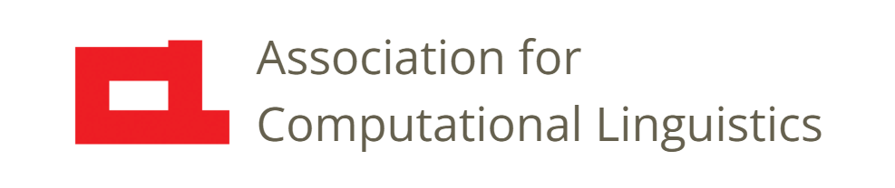

Prosody
Lec. 24: Prosody in Speech Synthesis
Nigel G. Ward, University of Texas at El Paso
Gina-Anne Levow, University of Washington
Tutorial presented at ACL 2021
Notes:
Welcome to Lecture 24 of our Series on Prosody. \\ In the previous lecture we wrapped up our overview of the functions of prosody in human language. \\ Now it’s time for two lectures on technology: first on prosody as it is used, or could be used, in speech synthesis, and then, in the next lecture, in dialog systems. \\
We’ll review why prosody is hard to model, and see why humans are still better than machines, for some purposes. \\ As usual, we’ll focus on needs, approaches, and models, not specific algorithms or software. We’ll start by reviewing the history [next]

Slide 2

Prosody for Intelligibility
DECtalk (1984)
What prosody do you hear?
Lexical accent
Phrasing and boundaries
pitch height
duration
DECtalk clip by Morn, via Wikimedia Commons
Notes:
starting with a classic synthesized voice [click] Okay let’s listen again, thinking about what prosody we hear [click], if any. [click] Alright, what prosody did you hear? //
Or does this seem like a trick question? This certainly sounds very robotic. And, in fact, voices like this are popular for robots in movies, starting with Hal in 2001 A Space Odyssey. [[1968]] And yes, robots stereotypically have bad prosody.
But a truly prosody-free voice would have each phoneme the same length and same height. But stress patterns are important for comprehension … if I start talking about e*LE*phants and *GI*raffes, it will really impair your understanding: versus ELephants and giRAFFes. We don’t want to impose a high cognitive load on listeners. // And from the earliest days, it was understood that proper prosody is essential to synthesizer acceptablility. At a minimum, synthesizers need [click] …explain… Now let’s look at some architectures for synthesis, [next]
[NB: there are other fun clips at commons.Wikimedia.org, including Festival, Amiga, and Amstrad. Daft Punk examples also exist]

Slide 3
Three Synthesis Approaches
Rules
  for “Wikipedia” the stress is on the 3rd syllable
  syllable stress is +30% duration and +5% pitch
  after a comma, increase the pitch
it was a <emphasis> big </emphasis> fish …
Parsing
decorations
tags
Rules
text
Unit Selection
Assembly
Modification
waveform
Units
Notes:
starting with the earliest, rule-based systems. These relied on rules, *hand-written* rules like these the stress patterns for every word, rules on how to realize those stress patterns, rules for what to do for punctuation, and so on.
Now the basic idea of these early systems was unit selection and concatenation [click] A “unit” was just a piece of speech, for a word, or a syllable, chopped out of recordings done by some human speaker. Given some text input, they would look break it into units and lookup the speech signal for each unit, and then concatenate them [click] . The prosodic rules could then operate on the result [click] to produce the output waveform. For the rules to apply, they needed to know the phrase structure of the input, so there was a basic parsing [click] process for that. Further, tags were often available [click] so that you could specify some aspects of how you wanted the speech to be realized, for example [click] with emphasis on one word. The next generation of synthesizers [next]

Slide 4
Three Synthesis Approaches
2. Targets and Interpolation (HMMs)
  Learned statistical patterns instead of rules
Learned
Models
Parsing
tags
Rules
text
Unit Selection
Assembly
Modification
waveform
Units
Notes:
used learning. Rather than relying on hand-written rules, these used models of the prosodic effects, _learned_ from training data [click] . Importantly, these were not absolute, but statistical. Being learned from data, large data sets were needed: in order to create a “voice” you might need a few hours of speech from one patient speaker.
Further, rather than direct operations to modify the speech signal

Slide 5
Three Synthesis Approaches
2. Targets and Interpolation (HMMs)
  Learned statistical patterns instead of rules
  Learned statistical parameters for smoothing
Learned
Models
Parsing
targets
text
Unit Selection
Assembly
Modification
waveform
Units
Connecting and Smoothing
Notes:
the prosody module could provide targets [click] and then a concatenation and smoothing module [click] would produce speech that met the targets as well as possible, while avoiding choppy or jerky transitions. This was done using Hidden Markov Models, or HMMs. The innovation, of using learned parameters everywhere, dramatically improved naturalness. The third generation of synthesis systems [next]

Slide 6
Three Synthesis Approaches
3. End-to-End
(aka sequence-to-equence, neural)
Examples:
Tacotron
40 hours of data
13M parameters
Fastspeech
…
Recurrent Neural Network
or
Transformer
etc.
Learned
Models
Deep Model
Parsing
decorations
Rules
text
Unit Selection
Concatenation and Smoothing
waveform
Assembly
Modification
(Tan, Qin, Soong, Liu, 2019; Wang, Skerry-Ryan et al., 2017; Ren, Ruan et al. 2019)
Notes:
are “end-to-end” systems. These have no intermediate representations. There’s nothing in them that’s designed at all. Rather they map directly from a grapheme sequence, of letters or characters, to a sound sequence. Doing this requires deep neural networks [click]. And not just any deep network; since prosody is context-dependent, meaning that you can’t chose the prosody by just looking at one word or two, thre must be recurrence or attention [click]. Since they have to learn *everything*, they require much more data [click] for example, Tacotron some 40 hours. As these systems are completely black-box, there is no way to understand them or control them, but doing both are active research topics.

Slide 7
What do these models learn?
Perhaps how to compute
How many syllables since utterance start?
Is it a name?
Is it a Japanese name?
Is it a first mention?
Is it the name of a distinguished professor?
…
and then how all these factors, in combination, affect the
pitch
intensity
duration
. . .
Notes:
These models often perform very well. While we don’t know exactly what they learn, they probably learn how to compute all the text features that affect pronunciation, and maybe some factors beyond just the words and local structure, including some semantics, and some more distant structure. How do they learn? There’s some Machine Learning magic, involving the model architectures and the training processes, which we won’t discuss, but let’s consider the training data and the loss function …

Slide 8
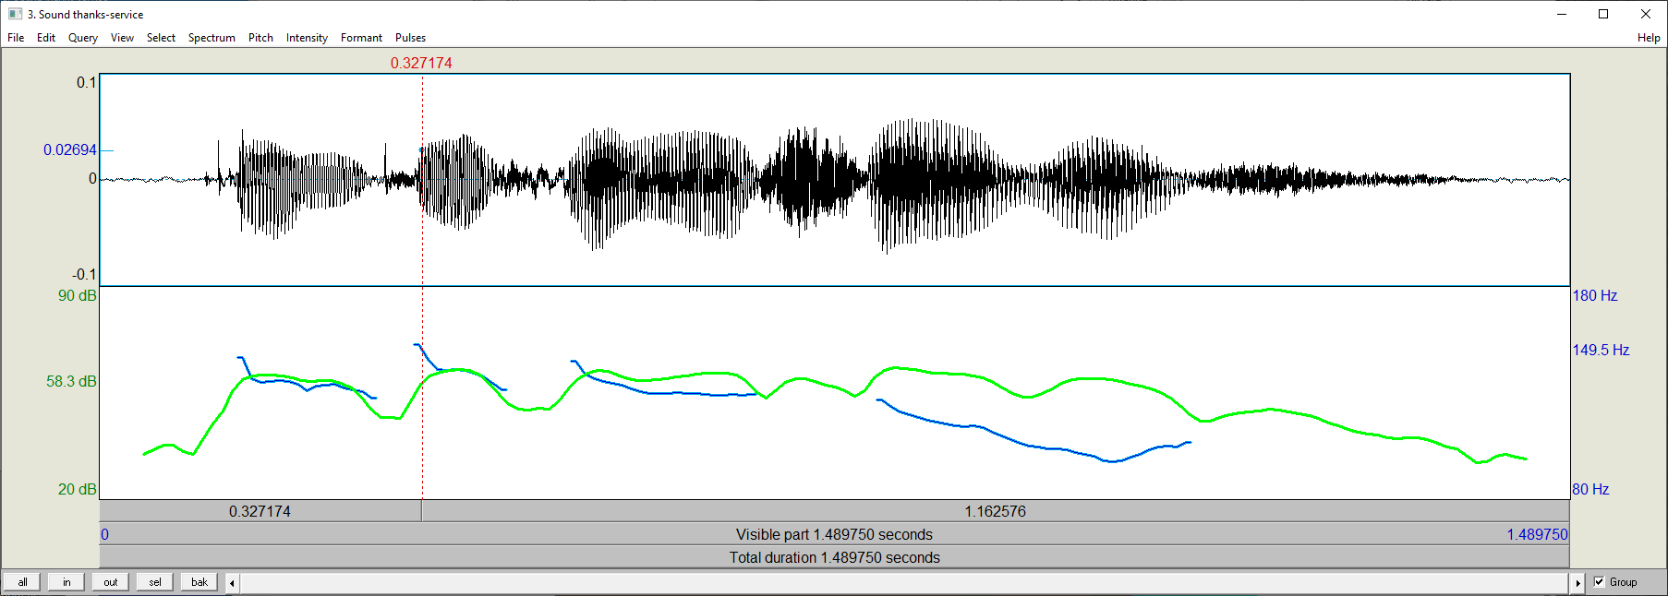
End-to-end Modeling
… talking with Tatsuya Kawahara …
t .W. Qk .tt erbNdlke real trees in …
...T knot eko trefdss in …
... not like real trees in …
training
Deep Model
… geraniums only in …
compare
Notes:
At a high level, these systems work much like machine learning task. They map an input to an output. The learn to do this from the training data, consisting of matched pairs of text sequences and speech signals [click]. The training objective is to handle unseen data correctly. For example, we can feed the model “geraniums only in” [click] and see what it outputs. Then we compare [click] what it output, to what would have been correct. Then we use the difference as the “error” or “loss”, which indicates how to improve the model to do better next time. Computing the “loss” is a major issue [next]

Slide 9
Evaluation
… geraniums only in …
loss
compare
Notes:
since there are many equally valid ways to say any text input. \\ Another complication is that we lack good models of similarity: there is no way to predict whether some little difference will be perceived as insignificant to humans or completely unacceptable. Human judgements are the only way to really evaluate quality. But in practice, it’s common to just compute spectral (MFCC) differences, and sometimes also differences in F0, between actual output and target output., and ometimes using dynamic time warping.
There are many other choices in modeling [next]
[[What’s so special about F0? Why not the other features? I don’t know. It may be about user preferences, or the “noble speaker” myth, or the typical use cases. ]]

Slide 10
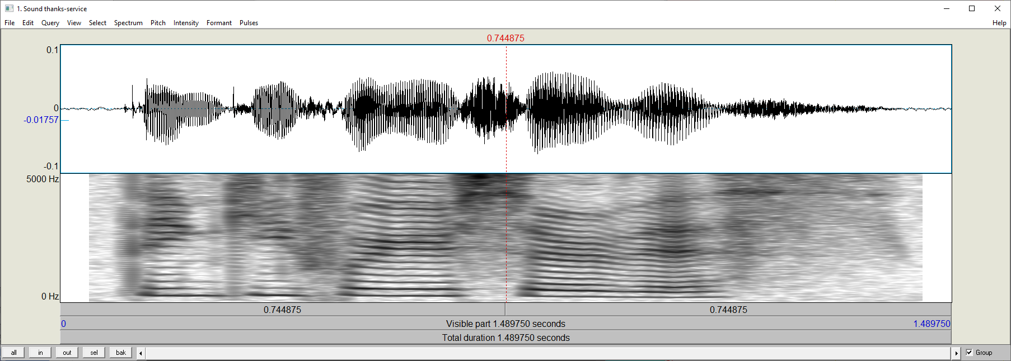
End-to-end Modeling
… talking with Tatsuya Kawahara …
t .W. Qk .tt erbNdlke real trees in …
...T knot eko trefdss in …
... not like real trees in …
training
Deep Model
… geraniums only in …
compare
Notes:
for example, the output for some systems is the signal, directly, but for others the output is [click], a spectral representation [click] which is then converted to an actual speech signal by a vocoder. [next]

Slide 11
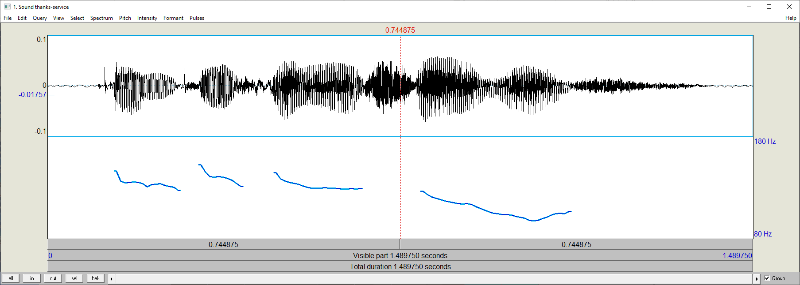
End-to-end Modeling
… talking with Tatsuya Kawahara …
t .W. Qk .tt erbNdlke real trees in …
...T knot eko trefdss in …
... not like real trees in …
training
Deep Model
… geraniums only in …
MFCCs
compare
F₀
_{duration}
vocoder
.
(Tan, Qin, Soong, Liu 2021)
Notes:
[click] Some vocoders take only spectral information; others take also the desired pitch [click] and the per-syllable durations [click] Okay, well that was a very simplified overview. Speech synthesis today is often very good. There are definitately synthesized voices that are better than most human voices, certainly my voice, in intelligibility, naturalness, and aesthetic appeal. However, there is room for improvement [next]

Slide 12
The State of the Art
Coverage of prosodic features
Coverage of prosodic functions
Adequacy for needs
Notes:
We can evaluate speech synthesis technology from three perspectives. [pause] First, [next]

Slide 13
Prosodic feature coverage
The musical aspects of speech
Pitch, loudness, timing, duration, and rate
and things that pattern with them:
Voicing present (binary) or periodicity
Phonation types: creaky / breathy / falsetto …
Reduction / enunciation
Nasalization
Notes:
do they manage to use all the important prosodic features? Well, no. Revisiting our list from the early lectures

Slide 14
Prosodic feature coverage
The musical aspects of speech
Pitch, loudness, timing, duration, and rate
and things that pattern with them:
Voicing present (binary) or periodicity
Phonation types: creaky / breathy / falsetto …
Reduction / enunciation
Nasalization
Phonation types: creaky / breathy / falsetto / harmonic
Notes:
pitch and duration they always handle. The features in pink may be handled by some systems, but I’ve seen little or no evidence, even in research systems, for control of the other features. Since prosodic features are often mutually redundant, the lack of one feature or two may have zero practical impact for many applications, but there are still missed opportunities. And this is likely more important as we move beyond just the “phonological” functions [next]

Slide 15
Prosodic function coverage
Paralinguistic
Phonological
tone
lexical accent
phrasing
. . .
Pragmatic
Notes:
to do more. That is to say, as speech synthesizers start to do more than just “text-to-speech” , that is, just producing a good rendition of a sequence of words, they need more control. Extensions to handle paralinguistic side of things is one interesting direction.

Slide 16
Prosodic function coverage
Paralinguistic
Phonological
emotion
speaker identity
. . .
tone
lexical accent
phrasing
…
Pragmatic
Notes:
such as adding various forms of expressiveness, and towards producing speech in the voice of a new speaker for which there is little data. (Yes, there are ethics concerns there.) But really the big prize is

Slide 17
2. Prosodic function coverage
Paralinguistic
Phonological
emotion
speaker identity
. . .
tone
lexical accent
phrasing
…
turn-taking
stance
topic management
interpersonal
positioning
…
Pragmatic
Notes:
pragmatic functions. The ideal speech synthesizer will produce speech that is dialog-capable; able to produce all the patterns we covered in Lectures 21 and 22, and superimpose them. But this is beyond the abilities of current systems. This is why the voices of so many commercial systems dialog are still produced by human talent. Imagine a banking system that says “thank you for authenticating. Now how may I help you” without marking the topic transition , or positive assessment, nor the clear turn yield. Users would hate it. Instead we’d like something like “thank you for authenticating. Now how may I help you” , but this is far beyond the state of the art. Anyway, we will focus on the needs of dialog in the next lecture.
And this all prefigures my next point …

Slide 18


3. Suitability for Uses
Use Cases
information delivery dubbing (dialog)
screen reading
answering questions
acknowledging commands
factually prompting the user
Training Data
newsreading read sentence lists audio books (dialog)
Notes:
Today’s speech synthesizers are good only for “information delivery” and related functions. This is to be expected, because they are mostly trained on non-dialog data [click]. Clearly we need to instead train them on data taken from real dialogs … but that’s easier said than done. One problem is entanglement [next]

Slide 19
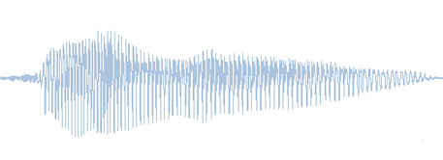
Prosody can be Busy
Paralinguistic
Functions
Paralinguistic functions
Phonological functions
Pragmatic functions
Phonological
Functions
super-position
Pragmatic
Functions
prosody transfer, style transfer, disentanglement
Notes:
which, to re-using a slide from the previous lecture, arises because many different kinds of functions are superimposed in a single speech signal. How can we automatically disentangle these streams of information during learning, to create systems where the intent can be varied independently of the words? Or the speaker properties independently? Or even to change that language, for speech-to-speech translation applications? These are active research topics [click], with every month new papers on prosody transfer, style transfer, and disentanglement.
Okay, so, that’s it for speech synthesis [next] …

Slide 20

Contents
Introduction
Production, Perception
Classic Linguistic Prosody
Technology and Techniques
Paralinguistics, Pragmatics
Technology, Part 2
Perspectives
Speech Synthesis
Dialog Systems
Notes:
In the next lecture

Slide 21
Contents
Introduction
Production, Perception
Classic Linguistic Prosody
Technology and Techniques
Paralinguistics, Pragmatics
Technology, Part 2
Perspectives
Speech Synthesis
Dialog Systems
Notes:
we’ll discuss the uses of prosody in dialog systems. [smile]

Slide 23
A Challenge
Disentanglement … if we can solve this, we’re done…
speaker
speaker state
intent and pragmatics force
language
words
Notes:
Here’s another way to view the problem. Rather than building algorithms to transfer this or extract that, a general model of disentanglement…

Slide 24
Limitations and Prospects
  Large data requirements
  No prosody beyond {pitch, intensity, duration}
  No ability to realize pragmatic functions
  Lack of control
Notes:
Training requires a large, clean single-speaker corpus. This is a very active research topic. Transfer learning. Also cross-speaker fusion “prosody transfer”. Perhaps someday pretrained speech models? Disentanglement
Voice quality variation … not desired? Or in there for free?
3a. Consider for example: producing positive assessment. Some people come close: You can generate “happy” speech, but that’s not the same: emotion is paralinguistic. One project was able to do this, for commercial audio, e.g. “you have just won a million dollars” based on a huge corpus.
3b. Consider as another example contrastive focus. “The busses aren’t the problem, the busses are the solution”. Some projects have addressed this as a kind of phonological function, just limited to the word, then treat it as all CAPS. Then hire a reader to produce a massive corpus. Not great output. For one thing, no post-focal compression. Again, brute-forcing it with massive data collections, rather than looking at how language really works.
4. What we want is the ability to control things. Parameters (control knobs). A very active research area. Including some very uninteresting work. Unfortunately divorced from use cases, and not focusing on pragmatics, like you need for dialog. Which is anyway our next topic.
NB this is a very rapidly changing field.

Slide 25
As a red herring, sentence lists read with various emotions.
Comment re: enormous data sizes. Re: proprietary corpora.
Comment: pitch, intensity, duration are controlled, but voicing quality never, it seems. No one cares. No one’s aware. Perhaps learnable if it were in the training data, but it never is).
Comment re tackling things like contrastive focus by gathering enormous datasets of such data.

Slide 26
Challenges
The controllability issue.
style transfer as one approach. The concept of disentangling.
the issue of the richness of input:
tts -> concept to speech -> whole-context to speech
The historical progression: intelligible, natural (and low cognitive load), expressive … plus the “effective” property, which I advocate for

Slide 28
Prosody in Speech Synthesis
Speech synthesis is a mature* technology
  Produces quite intelligible speech
Goal: Synthesized speech should be
  Natural, expressive, contextually appropriate

Slide 29
Prosody in Speech Synthesis
Challenges:
  “It’s not just what you say, but how you say it!”
    Text string by itself is under-specified for prosody
      Many, many different “correct” ways to say it
  Appropriate prosody depends on many linguistic and paralinguistic factors
  Data-driven methods are very powerful, but
    Not all configurations will be observed
    Ideally would like controllable models, too

Slide 30
Prosody in Speech Synthesis
Speech synthesis models
  Unit selection
  Statistical
    Hidden Markov Models
    End-to-end systems
How is prosody integrated?
    Data-driven approaches learn prosody implicitly

Slide 31
Adapting Prosody
Explicit rule-based controls
  Directly modify prosody of synthetic speech
    E.g. use SSML (Speech Synthesis Markup) directives
Unit selection methods:
    Automatically predict expected prosody for text string
    Extract units with corresponding prosody
    Integrate prosodic match in scoring
HMM approaches:
    Cluster adaptive training (Eyben et al, 2012)
    Learn transformation matrix to transfer style (Nose,’07)

Slide 32
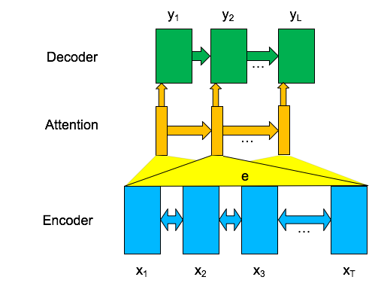
Prosody in End-to-End Synthesis
Sequence-to-sequence modeling
Working Definition: Prosody is the variation in the speech signal not explained by phonetics, speaker identity, and channel effects.
Acoustic Sequence
Character or Phone Sequence
(Skerry-Ryan, Batenberg, et al. 2018) Figure from Andrew Rosenberg

Slide 33

Prosody Capture in
E2E Synthesis
Models capture prosody linked to orthographic cues
  Prosodic phrasing based on punctuation
  “This is your personal assistant, Google Home.”
  “This is your personal assistant Google Home.”
  Emphasis based on capitalization
      Reader is instructed to read caps as stressed
  “The buses aren't the problem, they actually provide a solution.”
  “The buses aren't the PROBLEM, they actually provide a SOLUTION.”
https://google.github.io/tacotron/publications/tacotron/index.html

Slide 34
Prosody Adaptation in
E2E Synthesis
Approaches:
  Style transfer-type approaches
    Learn prosodic embedding space
      Compute embedding for reference prosody
      Combine with text, speaker encodings to generate new form

Slide 35
Prosody Adaptation in
E2E Synthesis
Approaches:
  Transfer-type approaches
    Learn prosodic embedding space
      Compute embedding for reference prosody
      Combine with text, speaker encodings to generate
  Text: I've swallowed a pollywog.
    Reference (female)
    Base (male)
    Adapted (male)
https://google.github.io/tacotron/publications/end_to_end_prosody_transfer/index.html

Slide 36
Potential & Limits
E2E synthesis
  Good baseline prosody, but “generic”
  Learns prosodic factors tied to orthography
  Potential for transfer, adaptation
Still limited
  Most effective with similar text
  Lacks direct, abstract control of the multidimensional factors that affect prosody

Slide 37
Quality of Output
Often amazing*
The Blue Lagoon is a 1980 American romance adventure film.
2017 https://google.github.io/tacotron/publications/tacotron/index.html
Notes:
Of course, you see we have upcoming two slides to explain the asterisk.
Note that here you didn’t even need to see the transcript to understand the audio.
*Highly* intelligible. Probably better than my voice. Certainly more pleasant.
Okay, that wraps up Part 1 of this lecture. Now we’ll start on what speech synthesis SHOULD do, but can’t already.

