Slide 1


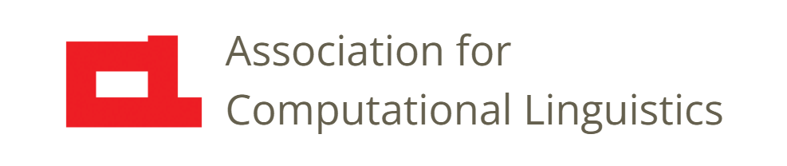

Prosody
Lecture 25: Dialog Systems
Nigel G. Ward, University of Texas at El Paso
Gina-Anne Levow, University of Washington
Tutorial presented at ACL 2021
Notes:
Welcome to Lecture 25 of our Series on Prosody, on the role of prosody in dialog systems.
This lecture will be more about potential uses than about uses in today’s systems. So [next]

Slide 2
Dialog Systems Hopes
Today: we can exchange short monologs with systems
Soon: systems we can interactively engage with
Today: a few dozen genres
(answering questions, obeying commands,
reading bed-time stories, giving driving directions)
Soon: systems for smalltalk, counseling, motivating,
teaching, helping …
(Ward & DeVault, 2016; Marge, Espy-Wilson, Ward 2022)
Notes:
think about you favorite dialog system, maybe an automated telephone banking system, or Siri or Alexa. How could it be better? Now, some of these system are absolutely amazing. But even the best are still very limited. [click] I feel that most of the time you’re talking *at* these systems, and they are talking back *at* you. Rather than engaging in an interactive, flowing dialog. [click] This is a problem: this means that spoken dialog systems today are limited to just a few domains of use [click] : answering questions, obeying commands, reading various texts, giving driving directions, and so on. In future, we can hope to see systems for smalltalk, counseling, motivating, teaching and many other applications. Better handling of prosody will be help make this possible. What’s needed, from the user perspective, is a lot of things [next]

Slide 3

Dialog System
user
Wikimedia Commons
digital world
“robots need not apply”
Sensitive
Empathetic
Expressive
Adaptive
Notes:
recalling Lecture 2, where we noted that the role of dialog systems is usually to enable a human to interact with information in the digital world, today automated systems are for many purposes quite inadequate, so many call centers are still staffed by people. [click] What kind of people? Not just anyone. To use the cliché, “robots need not apply”. [click] I think this means at least the following [click]:
[for each, explain what it means, and how prosody is involved.]
It’s a tall order.
Okay, now let’s break it down another way, in terms of dialog system components and abilities. A classic architecture for these systems [next]
[[Able to perform “emotional labor” ]]

Slide 4

Speech Recognition
Semantic
Decoding
Dialog Management
Speech Synthesis
Language Generation
Notes:
looks like this [walk through every box]
Prosody has many roles.

Slide 5
Speech Recognition
Semantic
Decoding
Dialog Management
reinforcing the message
conveying pragmatic intents
expressing the brand
Speech Synthesis
Language Generation
Notes:
The previous lecture discussed speech synthesis. The value of prosody in dialog applications includes [click] reinforcing the message, to make it easier for the user to even recognize the words, conveying more dimensions of meanin (especially pragmatic functions), and conveying personality or branding. In addition

Slide 6
Speech Recognition
Semantic
Decoding
disambiguation
Dialog Management
Speech Synthesis
Language Generation
Notes:
prosody may have a role in Speech Recognition, but as discussed in Lecture 18, this role is small. In addition [click] it may be useful for structural disambiguation, although this is not too common. Very saliently [next]

Slide 7
Speech Recognition
Semantic
Decoding
reactive turn taking and
turn shaping
Dialog Management
Speech Synthesis
Language Generation
(Skantze, 2021; Nath & Ward, 2022)
Notes:
prosody is important in interactive behaviors. In Lecture 22 we discussed backchanneling, producing attention signals such as “uh-huh”. When these are appropriate depends largely on cues given by the speaker, and these are largely prosodic. Even without recognizing the words, a dialog system can use prosody to tell when to produce a backchannel. This is rarely useful for today’s “arms-length” interaction styles, but is very endearing when done right. However many systems today already use prosody to manage turn-taking: paying attention to the user’s prosody to determine whether they are done speaking, or have more to say. Further,

Slide 8
Speech Recognition
Semantic
Decoding
user state, goals, intentions
Dialog Management
Speech Synthesis
Language Generation
Notes:
in terms of information flow, prosody provides a complementary channel to the lexical channel. Systems that are able to extract this information can perform better. A classic demonstration of this was

Slide 9
User-State Awareness
A response rule in the IT-Spoke Physics Tutor:
When the user’s answer
is correct -> praise and move on
is incorrect -> explain and ask again
is correct, but shows low confidence
-> explain and ask again
Outcome: improved learning
(Forbes-Riley & Litman, 2011)
Notes:
a well-built spoken tutoring system for College Physics. It would use dialog to explain some physics principles, and then ask the student a question, to see if they had understood correctly. If they got it right, the system would praise them, and if wrong, it would explain the principle in a different way, then ask again. However, very cleverly, if the student gave the _right_ answer, but their prosody showed that they were unsure, [click], as in “the keys would fall forward and down?”, the system would give another explanation and then another question. Students which used this version of the system, that was sensitive to their prosody in this way, [click] actually learned more.
Finally, another potential use of prosody in dialog systems [next]

Slide 10
Speech Recognition
Semantic
Decoding
Dialog Management
informative
aware
Speech Synthesis
Language Generation
Notes:
Is in conveying more information to the user, including information showing awareness of the user’s current state. For example,

Slide 11

State-aware and user-aware output
For a tutor quizzing a student …
good job
Situation: {correct on a hard one, next one should be easier … }
User: {lacks confidence, needs more time, getting back on track …}
System wants the user to: {speed up, wait his turn, not give up … }
Ward & Escalante-Ruiz (2009)
Notes:
A few years ago there was a demonstration in another tutoring scenario, where the system always praised a correct answer with the words “good job”, but the prosody varied. [click click click click] Back in Video Number 8 we already discussed the differences in prosody among these. But research has revealed the factors that govern the use of each prosodic variant. These factors were of three kinds [click]: the difficulty of this problem and of the next one; the user’s state, based on prosodic indications of their confidence and feelings about the pace and the game; and whether the system wanted to slow, hurry, or encourage the user. Adjusting prosody in this way, to reflect “micro-intents” like these, can reliably improve user satisfaction and perceived rapport. Okay, so, there a lot of opportunities for

Slide 12
Speech Recognition
Semantic
Decoding
Dialog Management
Speech Synthesis
Language Generation
Notes:
Prosody to improve the utility and usability of dialog systems [click and wait].
But if prosody is so great, why is it not used more already? There are at least two reasons [next]

Slide 13
Success is Elusive …
1. Scaling up is hard
2. Perfection is hard to achieve
Notes:
First, doing it at scale is difficult. The demonstration systems I mentioned were intensely engineered: from data collection to system building to experimentation. Devoting 3-5 person-years to any little feature is probably not cost-effective. Could we learn such behaviors from data? At scale? We don’t yet know how.
Second, people are hyper-sensitive to prosodic nuances. If you ask a system for the weather in Austin and its says “today’s weather for Boston is ”, you’ll likely forgive it. Boston/Austin is an understandable bug. But if it says “rainy” [mocking voice] or “rainy” [controlling voice], due to some prosodic mishap, you’ll likely find it weird, insulting or rude; even though objectively it’s just another kind of bug. Prosody speaks to the heart. Or, more technically, since prosody has attitudinal as well as pragmatic functions, the consequences of error can be dire.
Another issue is, what if we succeed? [next]

Slide 14
Success is Elusive …
1. Scaling up is hard
2. Perfection is hard to achieve
… and scary … super-human prosodic abilities
  May take workers’ jobs
  Will enable new scams
  May increase human alienation
Notes:
Someday researchers will have prosody all figured out. Already today, there are speech recognizers that outperform humans in some tasks. Before too long, we’ll also have dialog systems with super-human abilities. And of course these will take workers’ jobs, and enable new scams, and increase human alienation, as we start talk more to these wonderful machines than we do the people around us.
Somehow, eventually society will adapt. I don’t think that prosody research itself evil, but it certainly does raise issues!
Anyway [next]

Slide 15

Contents
Introduction
Production, Perception
Classic Linguistic Prosody
Technology and Techniques
Paralinguistics, Pragmatics
Technology, Part 2
Perspectives
Speech Synthesis
Dialog Systems
Notes:
this is the last of the technology-focused lectures. In the next

Slide 16
Contents
Introduction
Production, Perception
Classic Linguistic Prosody
Technology and Techniques
Paralinguistics, Pragmatics
Technology, Part 2
Perspectives
Individual Differences
Teaching
Historical Perspective
Prospects
Notes:
four lectures we’ll zoom out to discuss some wider issues, starting with individual differences.

Slide 18
Speech Recognition
Semantic
Decoding
Dialog Management
prosody-informed
next-utterance retrieval
Speech Synthesis
Language Generation
Notes:
For retrieval-based chatbots.
(a potential use)

Slide 19
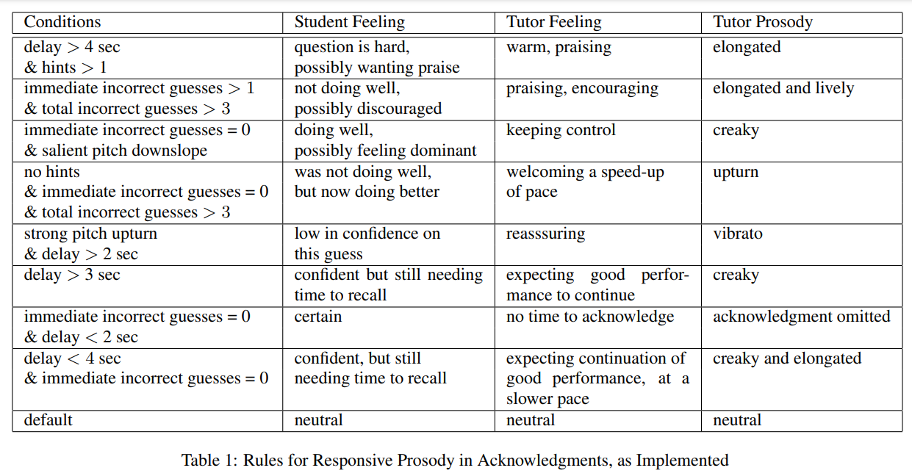
Informative, user-aware, effective output
good job
Ward & Escalante-Ruiz (2009)

Slide 20
Prosody in Dialog Systems
emotional and responsiveness case-studies {accommodation/ responsiveness, confidence
Error correction: narrow focus (contrastive focus)
Signalling that you’re in a correction subdialog

Slide 21
Speech Recognition
Semantic
Decoding
Dialog Management
Speech Synthesis
Language Generation

Slide 22
Related Applications
Summarization (prosody marks importance
Filtering (prosody marks urgency)
Sentiment Detection (prosody marks assessments)
. . .
“speech mining” may become commonplace
Notes:
“Related” in the sense of using knowledge of prosody.
Just show this slide; don’t read it.
Could mention information extraction, but the value is pretty marginal

