Slide 1


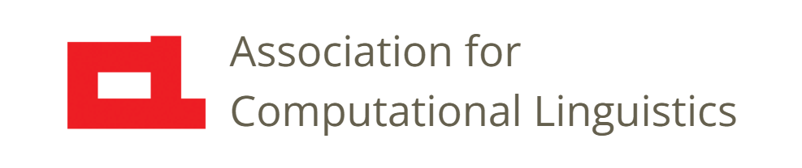

Prosody
Lecture 27: Teaching Prosody
Nigel G. Ward, University of Texas at El Paso
Gina-Anne Levow, University of Washington
Tutorial presented at ACL 2021
Notes:
Welcome to Lecture 27 of our Series on Prosody. In previous lectures we’ve explained lot about the nature and uses and prosody.
But, how can use this knowledge, as teachers or coaches, to help people communicate better?
I’ll start with some general principles, and later discuss the needs of specific populations.
First up, let’s be honest about how hard this is. The successful use of prosody involves a lot of mental operations [next]

Slide 2
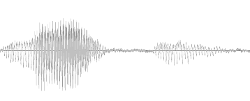
configuration
detection
low-level
perception
attaining
situation
awareness
knowledge
turn
management
communicative intent formulation
interlocutor
meta-cognition
plan execution,
low-level control
plan selection and assembly
Aguirre, Ward, Avila 2022
Notes:
, as we discussed in the previous lecture. Here are just a few. Some are malleable, others less so. And people, as learners, come to us with the brains they have. Some brains are superbly capable of learning new prosodic facts and skills, others much less so. Some brains may be already rigidly tuned to the behavior patterns of some other language. But still, teaching can often make a huge difference. So, what do learners need? One essential is

Slide 3
Learners Needs:
Summary
Awareness
Notes:
awareness: awareness of the importance of prosody. People are very familiar with the importance of learning words --- having a large vocabulary --- and mastering complex grammar, in order to sound educated. But awareness of the importance of prosody is less common. Maybe sharing ideas back from Lectures 2 can help. Then there are

Slide 4
Learners Needs:
Summary
Awareness
Facts
Notes:
the facts, of how prosody works, in its various functions. But in general I think the focus needs to be on the skills,

Slide 5
Learners Needs:
Awareness
Facts
Perception skills
Production skills
Interaction skills
Risk acceptance
Notes:
starting with perception and production skills, each with

Slide 6
Learners Needs
Awareness
Facts
Perception skills
Production skills
Interaction skills
Risk acceptance
Low-Level
Phonological
Pragmatic
Notes:
at least three components. We’ve already said a lot about each component: For the low-level features, in Lecture 3 through 8. For the phonological and structural aspects of prosody, in Lectures 10 through 12. For prosody in the service of pragmatic functions, in Lectures 21 through 23.
But even if your production skills and perception skills are top-notch, for speaking, and for listening, there’s the challenge of interaction.

Slide 7
Learners Needs
Awareness
Facts
Perception skills
Production skills
Interaction skills
Risk acceptance
Notes:
Using prosody in _interaction_ is where it all comes together. You need to put all these component skills together, and learn to perform them at speed and under the stress of having a live interlocutor. Interaction skills are hard to teach, and harder to provide good feedback on. Finally a word on fear [next]

Slide 8
Learners Needs
Awareness
Facts
Perception skills
Production skills
Interaction skills
Risk acceptance
Notes:
the fear of messing up. About which more in a minute.
Okay, so, how do we teach prosody? Well, there are many techniques, but to just mention to two key factors,

Slide 9
Teaching Methods
Explanations
  with visualizations (c.f. Lecture 13)
Practice
  with feedback
. . .
Notes:
first, it’s important to give clear explanations, and for this good visualizations help enormously. And second, tons of practice, with specific, tailored feedback. Very hard to do. No one ever said teaching was easy!
Okay, we’ll wrap it up with a few comments and annecdotes on the needs of native speakers, and then of non-native speakers.

Slide 10
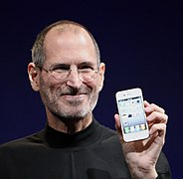
Populations of Interest
Native Speakers in high-stakes situations
  Public speaking
  Job interviews
  Effective listening
  Dating and relationships
Second-Language Learners
Steve Jobs, Wikimedia Commons
Oliver Niebuhr et al, (2017)
Notes:
Native speakers are often thought to be, by definition, competent in their language. But ability levels greatly vary, especially for prosody.
Giving speeches is perhaps the best understood, and likely the most teachable.
Many of us may aspire to be like great _noble speakers_ ; Steve Jobs [click] is often held up as a paragon. Today the benefits of being a great speaker are quantifiable … in dollars, and prosody is known to be a component of this. Oliver Niebuhr, the great phonetician, has been trying to analyze this and to use his findings to help people, starting with businesspeople, improve their prosody, mostly their paralinguistic aspects, to achieve more charisma and other good outcomes.
Now, in the grand scheme of things, teaching these skills is comparatively easy, since the situations are so constrained, and the goals so clear. Not so for [next]

Slide 11
Populations of Interest
Native Speakers in high-stakes situations
  Public speaking
  Job interviews
  Effective listening
  Dating and relationships
Second-Language Learners
Deborah Tannen (1989)
Notes:
the more “free-form” styles of interaction, where the uses of prosody are more varied, and wrapped up in the challenges of face-to-face interaction. The bullets here show some popular waypoints on the continuum from structured to unstructured interaction styles: job interviews, active listening in the workplace and in relationships, and so on.
While there are coaches and teachers willing to help, for most, these require observation, including self-observation, and trial-and error. But be careful [click] [Tannen story]
Okay, so, non-native speakers [next]

Slide 12

Non-Native Speakers
40% of proficiency judgments are explained by prosody
Many instances of friction may be due to prosody
e.g. gravy vs gravy?
paralinguistic
phonological
pragmatic
(Kang 2010, Gumperz 1982)
commons.wikipedia.org
Notes:
also need help with prosody. One reason is intelligibility: beyond just getting the phonemes pronounced right, using proper prosody really helps people understand you. Beyond that, maybe having “no accent” or a minimal accent is important, and, interestingly, judgements of unaccentedness are correlated with the accuracy of word stress placement and the wideness of pitch range. Further, if you’re not just giving classroom presentations or speeches, there are the social dimensions of prosody [click] the pragmatic aspects, which can be confused with the paralinguistic ones [click]. [tell the Gumperz story] .
So, why do non-natives fail to just talk like natives? Why is it so hard? Well, for lots of reasons. First

Slide 13
NNSs’ Special Needs
Overcoming habits
Overcoming associations
Overcoming fear
Notes:
of course there are the habits, the ingrained patterns of prosody from a native language. There also may be powerful associations to overcome. The famed Dutch prosodist Carlos Gussenhoven, speaks the most elegant British English. Sitting in on his class in Berkeley, I just enjoyed hearing his voice, British with a faint “Europoean” overlay. But one day in a discussion of pitch range differences he suddenly shifted to a 100% English-native voice. “and the difference”, he told us, “is in the pitch range. It’s wider in English than in Dutch, but for me that sounds gay, so. ” and returned to his normal voice. There’s a lot of things there to unpack! \\
Finally there is fear. This is justified; if you get the pronunciation wrong, people will think you’re just a foreigner and forgive you. But get the prosody wrong, and they’ll think you have a bad attitude. Some learners adopt risk-free monotone voices. Which works, but is so limiting. I find a good trick is to work towards a classroom environment where people are safe to experiment. Delibrately structuring the exercieses around childish games like Marco Polo, or even “peek-a-boo” frees up the students to be playful and forget their fears. So, here is a generic lesson plan [next]

Slide 14
Teaching Constructions
Specific, memorable examples
e.g. peek-a-boo, excuse me
  reinforce with pairwork
  explain with diagrams
  critique their phonetic accuracy
Generalization
  examples illustrating the range of typical uses
  joint discussion of the social contexts for use
www.nigelward.com/prosody/
Notes:
for teaching pragmatics-related prosody. And a few resources for this are at www.nigelward.com/prosody/ . So. Overall, despite the challenges, I

Slide 15

Perfecting Human Society through Prosody
Empowering individuals
Strengthening relationships
Improving communication across cultures
b
Wikimedia Commons
Notes:
think we can be upbeat about the prospects [read bullets]
Okay, so that wraps it up for our thoughts about

Slide 16

Contents
Introduction
Production, Perception
Classic Linguistic Prosody
Technology and Techniques
Paralinguistics, Pragmatics
Technology, Part 2
Perspectives
Individual Differences
Teaching
Historical Perspective
Prospects
Notes:
teaching prosody. In the next lecture

Slide 17
Contents
Introduction
Production, Perception
Classic Linguistic Prosody
Technology and Techniques
Paralinguistics, Pragmatics
Technology, Part 2
Perspectives
Individual Differences
Teaching
Historical Perspective
Prospects
Notes:
we’ll see the historical context: how teaching prosody (and reseaching prosody) has progressed over the centuries, but some old ideas are still holding us back.

Slide 19
Autism and Prosody
Often perceived as “odd” in some way
Some Types of Intervention:
Superficial corrections
e.g. “don’t talk so loud”, “don’t be so monotone”
2. Perception exercises
3. Production practice
Notes:
Hark back to the previous lecture…
What’s really going on? What’s really different, in comparison to “typically developing” folk? We don’t really know.

Slide 20
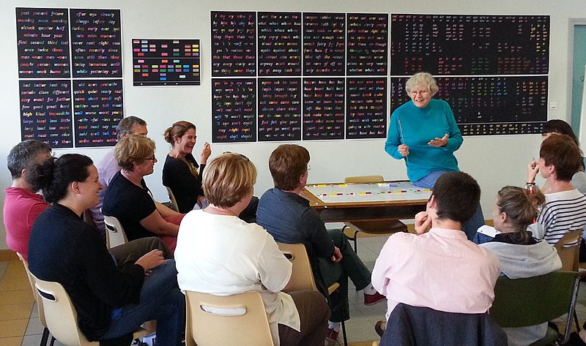
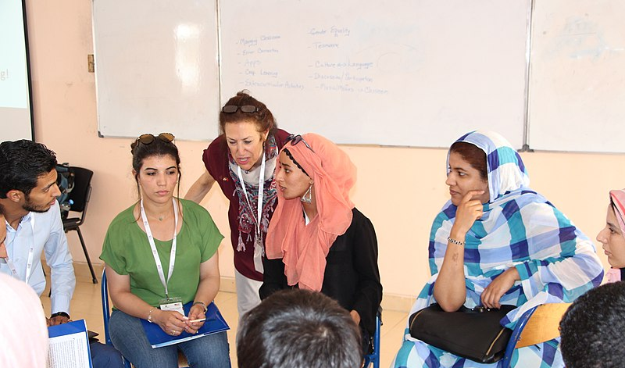
Teaching Needs
Knowledge
Perception skills, production skills
Interaction skills
Risk acceptance
Low-level
Phonological
Pragmatic
Notes:
Knowledge … Standard method: teach the categories (e.g. high-rising)
And then what they are supposed to mean
Have the students memorize. Give them written tests.
This seems largely unsuccessful, And quite unlike how native speakers acquire prosody
Working on skills. Both production and perception require 1) low-level perception of the elements of prosody, as we did in lectures 4-7. 2) the linguistic patterns of word stress and phrasing, 3) pragmatically meaningful prosodic patterns in the new language.

Slide 21
Summary
Teaching prosody: important, diverse, and difficult.
Notes:
Nevertheless … [read slide]

Slide 22
intention
auditory feedback
prosodic specification
phoneme sequence
proprioceptive
feedback
muscle control
glottis
articulators
lungs
[[
sound

Slide 23
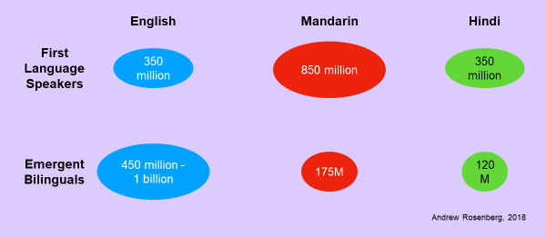
Non-Native Prosody

Slide 24
Automation and Systematization
For Assessment
Dialog ability predictable from what?
For Coaching
Some advice is easy, e.g. “Vary your pitch more”
Well-targeted feedback remains a challenge
NB: every non-native speaker is different

