Slide 1


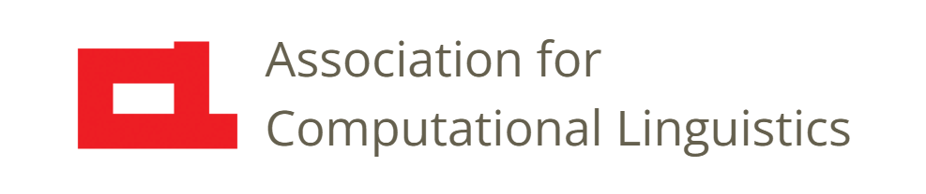

Prosody
Lecture 28: Historical Perspective
Nigel G. Ward, University of Texas at El Paso
Gina-Anne Levow, University of Washington
Tutorial presented at ACL 2021
Notes:
Welcome to Lecture 28 of our Series on Prosody. Now, some of the things we’ve explained in previous lectures _contradict popular ideas_ about prosody. We can call these myths [next]

Slide 2
Prosody Myths
Reality*
It’s mostly pragmatic
Speakers signal ahead
It’s also rate, energy, creakiness …
It’s often gradient
It’s also superpositional
*at least for dialog, at least for English, at least mostly
Notes:
and while generally we like to focus on the reality [click], as revealed by current research, in this lecture we’ll take a historical perspective, and see why the popular view is rather different [next]

Slide 3
Prosody Myths
Myth
It’s mostly lexical and syntactic
It’s largely at turn ends
It’s mostly about pitch
It’s symbolic
It’s concatenative
Reality*
It’s mostly pragmatic
Speakers signal ahead
It’s also rate, energy, creakiness …
It’s often gradient
It’s also superpositional
*at least for dialog, at least for English, at least mostly
Notes:
Many people, even some teachers and scholars, think that prosody is mostly about indicating the words and syntactic structure, that the prosody of turn ends is the most important thing, that pitch phenomena (also known as intonation) are the only important thing, and so on. In previous lectures we’ve already presented a broader view. In this lecture, we’ll consider the sources of these myths … ultimately in the limitations faced by early scholars. Let’s think back a couple of millenia,

Slide 4
Prosody: Etymology
From Latin prosodia, referring to word accent
Which came from Greek προσῳδία, referring to the rhythm of poetry, typically set to music
Q: What aspects of prosody are important for poetry and music?
A: Pitch, duration, loudness …
Notes:
to when people first started talking about prosody. They were not too interested in ordinary speech, let alone dialog, but in poetry and music. Quick quiz question: [click] “What aspects of prosody are important for poetry and music?” Well, pitch and duration [click] and somewhat also loudness. So that’s one reason why pitch-and-intonation has always been top-of-mind when talking about prosody. Another reason is that pitch is the easiest to perceive and describe, not least due to

Slide 5
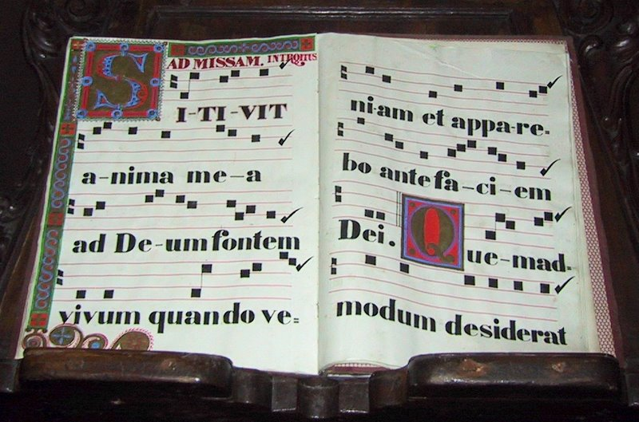
Music Notation
Asiir at Wikimedia Commons
Notes:
its importance in music, and the availability of musical notation as a representation, even in the earliest forms. In general, musical notation is not very useful for speech, but its familiarity may be another reason why prosody beyond pitch has received less attention. Okay, fast-forward … to 1569 [next]

Slide 6
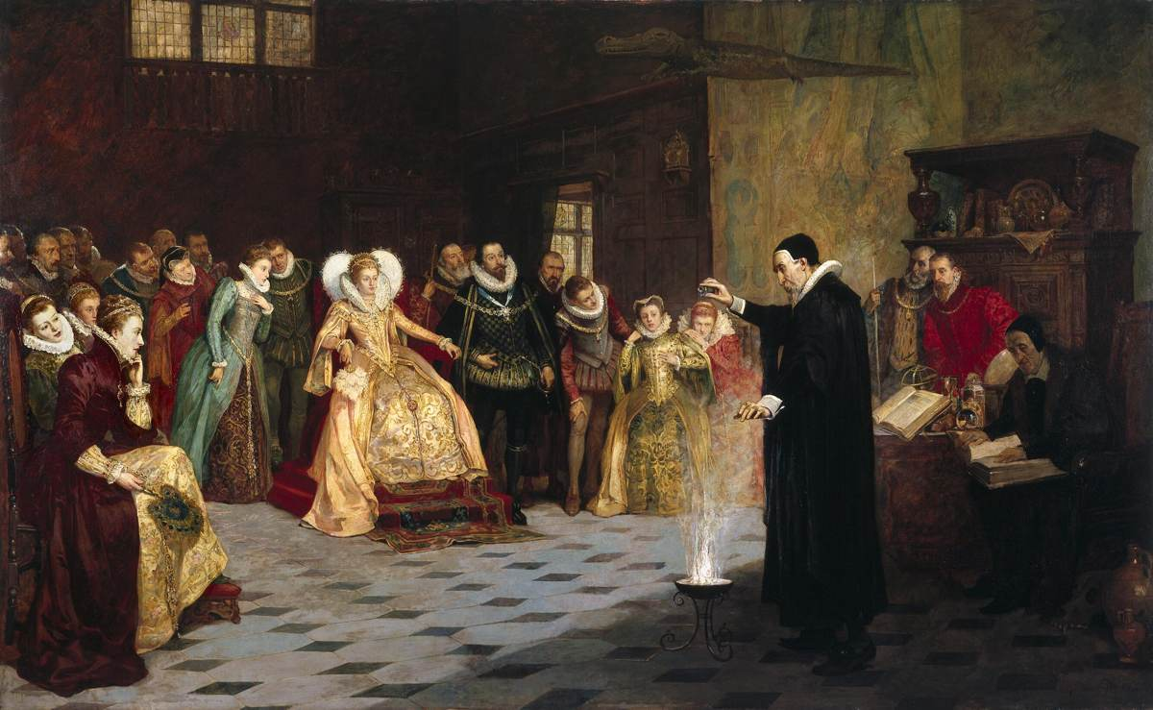
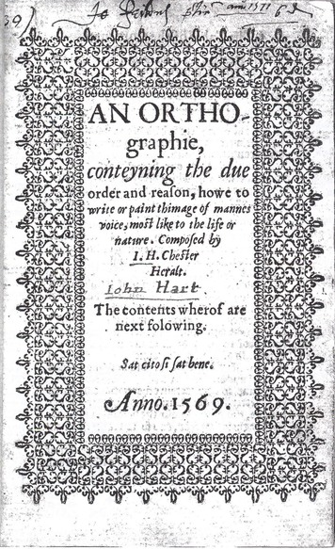
Wanting to Speak Well
Welcome Library, via britannica.com
John Hart
Notes:
when Queen Elizabeth, the First, was on the throne. [click] England was prosperous, and there was a rising merchant class interested in social climbing --- learning how to act and speak well --- and in particular, to speak like the best people, the nobility --- to speak the _Queen’s English_. And there started to appear books [click] to help them. These included rules such as [next]

Slide 7
“Questions go up”
A convenient prescriptive rule
Ties to elegance
Easy to state
Relates prosody to syntax and punctuation
Easy to perceive (only pitch, only final pitch)
Notes:
“questions go up in pitch at the end”. Rules like this met a need. By speaking this way, you could sound educated --- different from those folk who learned English on the streets. Remember the musical, My Fair Lady, and the themes of elegance and mannered politeness. Now twihis rule is very convenient for this purpose: easy to state, it relates prosody to syntax and punctuation, which, by the way, was at the time something of a _new technology_, and final pitch is easy to perceive, as we discussed in Lecture 9. So, a totally useful rule for its purpose. But sadly not true, as a general statement of what really happens in real dialog [click] .

Slide 8
“Questions go up”
A convenient prescriptive rule
Ties to elegance
Easy to state
Relates prosody to syntax and punctuation
Easy to perceive (only pitch, only final pitch)
However
False for most dialects of English
Even in Received Pronunciation, false for most question types
    “would you prefer tea, or coffee?”
Statistically not true in conversation corpora
Notes:
In this sense, it’s a myth. In most dialects of English, other than Southern British, the prosody of questions and statements is interestingly complex. Even in Received Pronunciation, the final rise is not there for many question types, for example choice questions such as “would you prefer tea, or coffee?” And many studies of real conversations, based on large corpora, have shown that, statistically, the correlation is weak at best. So no, “questions go up” is not a valid descriptive rule. ]
But try telling this to anyone who went to middle school in the US, and see whether they’re willing to give up what they _know_ to be true, because their _teacher told_ them, who learned it from _their_ teacher, and so on back across the centuries. Okay,

Slide 9
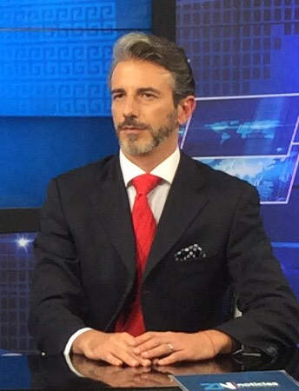
Prestigious Monologue
John Becerra by Mertex at Wikimedia Commons
Notes:
The last factor we’ll mention is the prestige of monologue over dialog. Presumably the nobility in the Queen’s court were mostly giving little speeches – impressive monologues. And more recently, a common model speaker was the newsreader[click], especially a few decades ago, when speech prosody research first started to get quantitative newsreading. It’s clean and easy to study, but really quite atypical.

Slide 10
Prestigious Monologue
Quite unlike speech in dialog
No interactivity, little stance
Complex written sentences
Little variation in loudness,
or voice properties,
so the intonation carries
the burden
John Becerra by Mertex at Wikimedia Commons
Notes:
There is of course, no interactivity, and limited expressions of stance. The content is complex written sentences, requiring the prosody to be devoted mostly to marking the sentence structure. This puts a heavy burden on the intonation, and the other prosodic properties are little used. Quite atypical, but quite influential, and _read speech_ is still the main focus of most descriptions of prosody. Okay, so there’s a lot of historical baggage [next]

Slide 11
Lingering Influences
Pitch-centric
Monologue-centric
Written-language bias
Notes:
and, as a result, if you talk to your friends about the interesting new things you’ve learned in this tutorial, they may not be too receptive. We’ve all been influenced by this pitch-centric, monolog-centric, view, and by the focus on written language over spontaneous speech. Gettting beyond the myths and biases can be a real challenge. But not insurmountable. So,

Slide 12

Contents
Introduction
Production, Perception
Classic Linguistic Prosody
Technology and Techniques
Paralinguistics, Pragmatics
Technology, Part 2
Perspectives
Individual Differences
Teaching
Historical Perspective
Prospects
Notes:
that wraps it up for our brief historical excursion. The past was dark,

Slide 13
Contents
Introduction
Production, Perception
Classic Linguistic Prosody
Technology and Techniques
Paralinguistics, Pragmatics
Technology, Part 2
Perspectives
Individual Differences
Teaching
Historical Perspective
Prospects
Notes:
but the future is bright! In our final lecture, we’ll consider how better understanding of prosody may improve human lives, and discuss some challenges in realizing that vision.

Slide 15
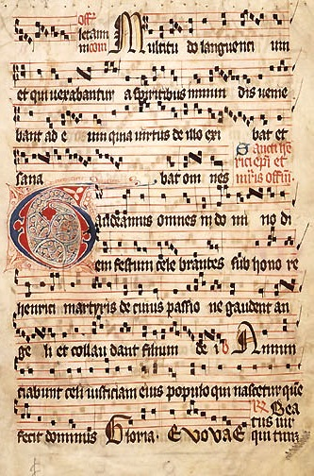
Music Notation

Slide 16

London, 1569

Slide 17
Wanting to Speak Well

Slide 18

Prosodic Notation
cuneiform (~3000 BC)
plays (~500 BC), spaces between words (~900 AD)
. , ? ! (~200BC, ~700 AD, (~1400 AD; ¿ ¡ 1754
˥˩˧ ˥ (~ 1920)
uh:m (1.0) well ↑ (~1972)
L+!H* L- (~1994)
<emph> (1998)

Slide 19
The Dead Weight of History
A focus on intonation
Prescriptive teaching traditions
Notation desires
still constrain our students’ thinking

Slide 21
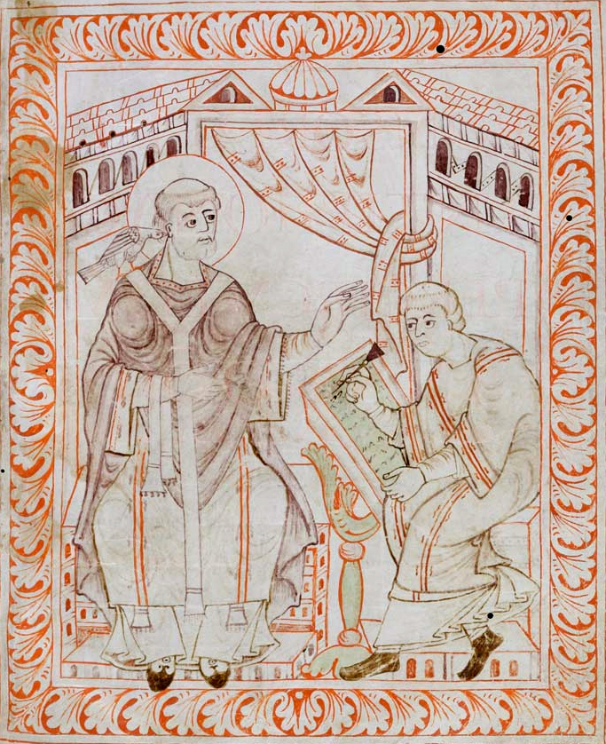

Slide 22
Gregorian Chant

Slide 23
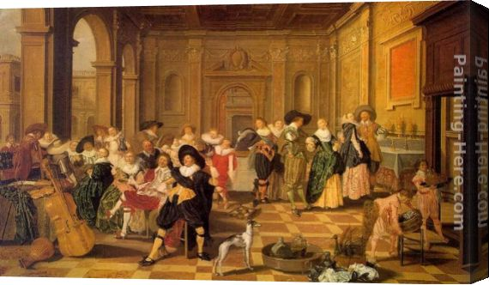

Slide 24
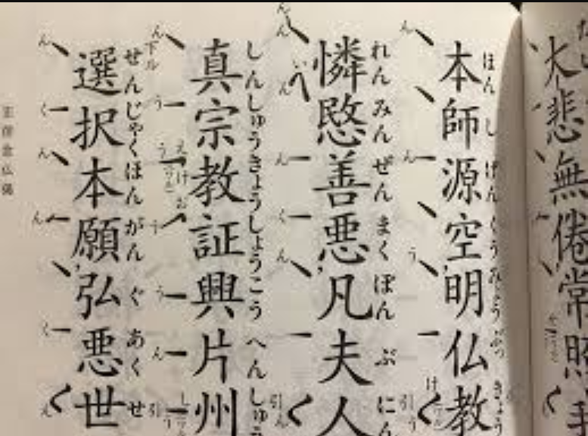
A Buddhist Chant

Slide 25
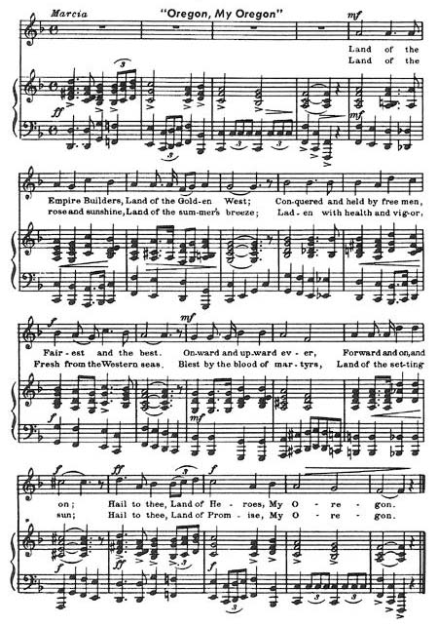
Music Notation

