Slide 1


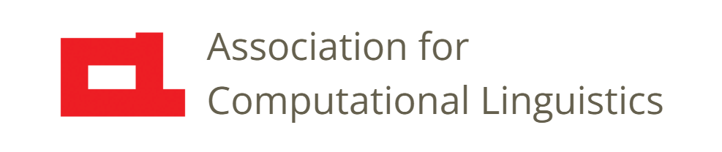

Prosody
Lecture 29: Prospects and Challenges
Nigel G. Ward, University of Texas at El Paso
Gina-Anne Levow, University of Washington
Tutorial presented at ACL 2021
Notes:
Welcome to Lecture 29, the last lecture of our Series on Prosody, on Prospects and Challenges. So, a major aim in prosody

Slide 2

Improving Humanity through Prosody
Empowering individuals
Strengthening relationships
Improving communication across cultures
b
Wikimedia Commons
Notes:
is helping people communicated better: to improve the human condition. Lecture 27 already discussed the role of teaching. Before getting to the big big picture, I’d like to say a few words about the role of technology here.
First, it has the potential to empower people, with dialog systems that can work in more contexts and handle more genres … even cognitive assistants that help us become our best selves.
Second, technology will produce tools for training, and for diagnosis and assessment, of prosodic abilities, to help us become much better communicators, to help us strengthen our relationships, at home, in the workplace, and beyond.
Third, speech-to-speech translation systems will support interactions across languages and cultures. They will go beyond just translating our words, to translate our feelings, intentions, and micro-intentions.
So, how do we get there? We need more knowledge.

Slide 3
Growing our Knowledge
Notes:
If you think about what we know about prosody, it’s almost microscopic. While raising awareness is good, and better use of existing knowledge is good … we need to expand what we know. Zooming in to look closer ...

Slide 4
Growing our Knowledge
Technology
Teaching
Notes:
directions include, certainly, more knowledge on effective teaching methods [click], and advances in technology [click]. But we also need [next]

Slide 5
Growing our Knowledge
Technology
Teaching
Basic
Knowledge
Notes:
more _basic_ knowledge [click] . How does every language work? How does _any_ language work? How does any _single prosodic construction_ work, in full detail? And “What about X?”, where X is any one of the major unknowns we’ve mentioned in previous lectures. So there’s lots we don’t know: there’s lots to do! Now as a side note, we want to avoid [next]

Slide 6

Maintaining Synergy
Notes:
splits [next]. It’s natural for prosody lovers to form smaller groups and go off and focus on different aspects. But there’s an unfortunate tendency for the computationalists and the descriptivists to drift apart. But those who are skilled in achieving high performance on some specific task, and those skilled in developing explainable clear models, have a lot to offer each other, and many shared concerns. In particular, across all approaches [next]

Slide 7
Infrastructure Needs
Technology
Teaching
Infrastructure
Basic
Knowledge
General-purpose models
Discovery tools
Models of variation
Notes:
there is some needed infrastructure [click] that is fundamental for further progress. This includes [click]
the need for models that useful across many tasks, not just for speech synthesis , or just for diagnosis, etc.,
tools for discovering the prosodic patterns and elements, of any unseen language or novel genre
and models of variation, since not all speakers are the same.
Okay, so, to summarize [next]

Slide 8
Prospect and Challenges
Societal Improvements
via uses of prosody
underlain by new knowledge
derived synergistically
supported by new infrastructure
Notes:
The big-big picture is, helping meliorate human society, through better uses of prosody, underlain by new knowledge, derived synergistically , supported by new infrastructure \
So the future is bright, but there’s a lot of work to do.
Okay, that wraps things up [next]

Slide 9
Prosody
A 29-Lecture Tutorial
Nigel G. Ward, Gina-Anne Levow
THE END
Bibliography, etc. at:
www.nigelward.com/prosody/
Notes:
for this lecture series. If you want to dig deeper, you may want to start with our bibliography. [Click] [Smile] Well, that’s it! [click and wait] Thank you for watching! [smile]

Slide 11

Wikimedia Commons

Slide 12
Research Questions
How exactly does superposition work?
Notes:
How exactly does superposition work … more specifically How do constructions align with each other? With words?
Possible retort: “We don’t care, we have deep learning … and so we’re not going to fund your research” ….
Not that anyone’s ever said that to me, but I suspect some NSF panelists have thought that. Not that I’m bitter.☺
This is true to some extent (tech giant companies, well-resourced languages, mainstream applications.
Not true if you want to do other things. Or, more generally, to democratize the construction of speech applications.
** mention the bibliography; put link on the slide **

Slide 13
Infrastructure Needs
Task-agnostic descriptions or models
Tools to discover the prosodic patterns of any language
Notes:
Prosody doesn’t only need hairy-chested research …
there’s a lot of infrastructure needs, in data collection, and in software-development.
Without explanation, I’ll just point out here two unmet needs.
[Models not trained for a specific task. Pretrained models, exist but to unify generative and discriminative is still pending.]
[Not black-box tools, but human-in-the-loop tools]

Slide 14
Challenges
Prosody
varies greatly, with genre, with the individual, etc.
seems easy
exceeds introspection
is semi-independent of the lexical channel

Slide 15
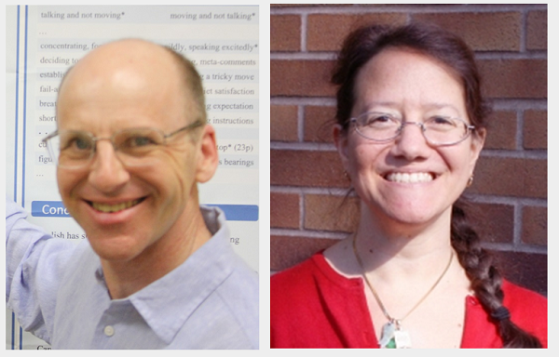
Maintaining Synergy
Prosody research across languages
Descriptive and computational work
Performance-oriented work and explainable models
. . .
There’s lots to do!
Nigel G. Ward
Gina-Anne Levow
Notes:
…
And another challenge is, the prosody community is growing … and splitting into subdisciplines.
Gina and I want to strengthen the connections, with prosody research, and technical applications,
and beyond, to education, neuroscience, clinical applications, and beyond.
There’s lots to do; maybe you can help! We’re hoping you’ll do great things; when you do, please let us know! [silent transition to next slide]

