Slide 1
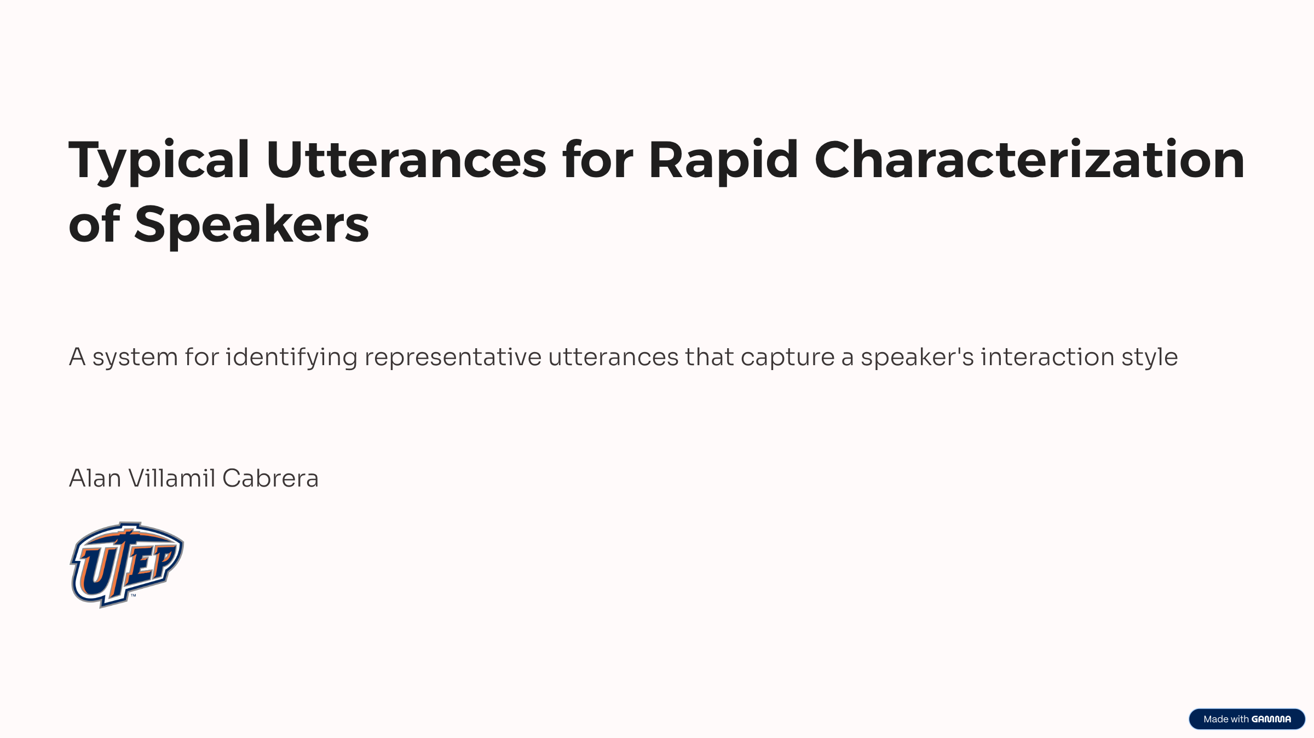

Slide 2
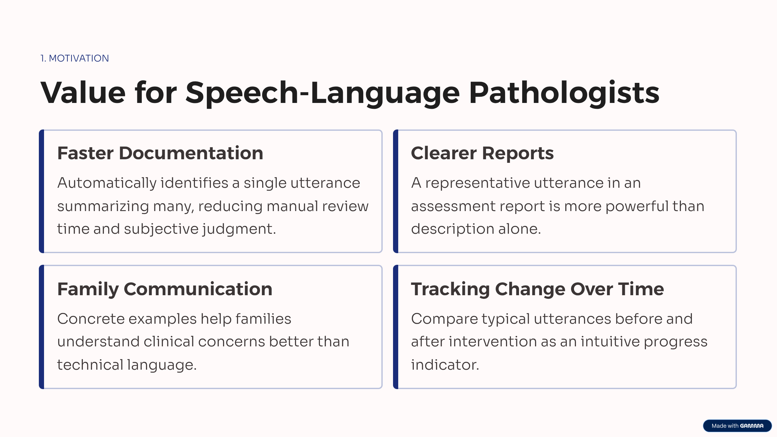


Slide 3
8 of 11 judges saw practical value
Could the ability to quickly find a highly typical utterance be useful?
1
7
3
Strongly agreed
Agreed
Neutral
1 of 11 judges
7 of 11 judges
3 of 11 judges
2
Notes:
The export had 24 response rows. Six early rows were tests. Seven production responses were Started and had no complete Core section, so they were excluded. The final Core sample has 11 valid judges. Terminated is valid here because those judges finished all 30 Core ratings before the survey ended.
[Sources]
- /Users/alan/LocalDocuments/Projects/Buffalo/outputs/core_analysis/core_participant_audit.csv
- /Users/alan/LocalDocuments/Projects/Buffalo/outputs/core_analysis/core_verification_checks.csv
[/Sources]

Slide 4
Core is complete and balanced
Every valid Core judge rated the same 6 children under the same 5 conditions.
11
6 × 5
330
valid judges
Core design
complete ratings
6 Completed + 5 Terminated
6 children × 5 conditions
30 ratings from each judge
3
Notes:
The export had 24 response rows. Six early rows were tests. Seven production responses were Started and had no complete Core section, so they were excluded. The final Core sample has 11 valid judges. Terminated is valid here because those judges finished all 30 Core ratings before the survey ended.
[Sources]
- /Users/alan/LocalDocuments/Projects/Buffalo/outputs/core_analysis/core_participant_audit.csv
- /Users/alan/LocalDocuments/Projects/Buffalo/outputs/core_analysis/core_verification_checks.csv
[/Sources]

Slide 5
Caricature received the highest mean rating
Condition | N | Mean | SD | Median
Caricature | 66 | 3.50 | 1.40 | 4.00
Centroid | 66 | 3.34 | 1.41 | 4.00
Random | 66 | 3.18 | 1.48 | 3.25
Middle | 66 | 2.96 | 1.47 | 3.00
First | 66 | 2.89 | 1.52 | 3.00
Overall (330 ratings)
Mean 3.17 • SD 1.47 • Median 3.00
4
Notes:
Describe this as the raw rating pattern, not yet as proof of statistical differences. Every condition has 66 ratings. The table reports the mean, standard deviation, and median for all five conditions. The 1.5x condition had the highest mean, 3.50. The 0x and Random conditions were relatively close. First and Middle had the lowest means.
[Sources]
- /Users/alan/LocalDocuments/Projects/Buffalo/docs/child_survey_results.pages
- /Users/alan/LocalDocuments/Projects/Buffalo/outputs/core_analysis/core_results_audit.xlsx
[/Sources]

Slide 6
Linear Mixed Model
log(Rating) ~ Condition + (1|Judge) + (1|Child) + (1|Order)
Compared with Caricature | Estimate | Ratio | p | Interpretation
Centroid | −0.052 | 0.949 | .5036 | No evidence of a difference
First utterance | −0.254 | 0.776 | .0013 | Significantly lower
Middle utterance | −0.203 | 0.816 | .0097 | Significantly lower
Random utterance | −0.129 | 0.879 | .1004 | No evidence of a difference
5
Notes:
This is the primary inferential result. The linear mixed model accounts for repeated ratings from the same judge, child, and order position. The overall condition test is significant. Relative to 1.5x, First and Middle are significantly lower. We do not have evidence that 1.5x differs from 0x or Random. Ratio values are exponentiated log-scale estimates: for example, 0.776 means the expected rating for First is about 22 percent lower than for 1.5x within this model.
[Sources]
- /Users/alan/LocalDocuments/Projects/Buffalo/outputs/matlab_lmm/matlab_core_fitlme_anova.csv
- /Users/alan/LocalDocuments/Projects/Buffalo/outputs/matlab_lmm/matlab_core_fitlme_coefficients.csv
[/Sources]

Slide 7
All three analyses find a condition effect
PRIMARY
SUPPORTING
SUPPORTING
All valid Core
Data from the 6 judges who also completed the optional part
All available data
11 judges • 330 ratings
Core + Optional • 360 ratings
330 Core + 180 Optional
Comparison | Completed | All-data p | Interpretation
Closest to 0x | 0.7159 | 0.7703 | Not statistically different from 1.5x
First utterance | < .001 | < .001 | Significantly lower than 1.5x in both analyses
Middle utterance | 0.0178 | 0.0256 | Significantly lower than 1.5x in both analyses
Random utterance | 0.1475 | 0.1127 | Not statistically different from 1.5x
6
Notes:
All three analyses find an overall condition effect. Core is the cleanest primary result because all 11 valid judges completed exactly the same ratings. The Completed-only analysis adds the Optional section for the six judges who finished the entire survey. The all-available analysis uses every valid rating and adjusts for survey status, but it is unbalanced because Terminated judges have no Optional ratings. Present that last analysis as a sensitivity check, not as the main result.
[Sources]
- /Users/alan/LocalDocuments/Projects/Buffalo/outputs/matlab_lmm/matlab_core_fitlme_anova.csv
- /Users/alan/LocalDocuments/Projects/Buffalo/outputs/two_experiments/two_experiments_summary.csv
- /Users/alan/LocalDocuments/Projects/Buffalo/outputs/two_experiments/data_balance.csv
[/Sources]

