Slide 1
Introduction to Security
CS 409 Ethical Hacking
Lecture note
Dr. Sajedul Talukder

Slide 2
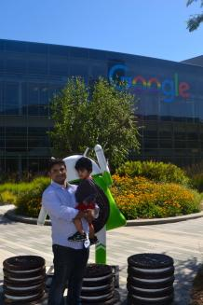
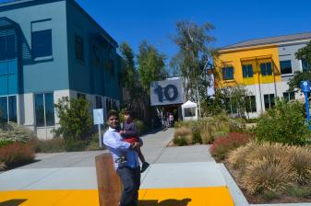
Let Me Introduce Myself
Dr. Sajedul Talukder
Director: SUPREME LAB @ SIU
Sajedul.talukder@siu.edu

Slide 3
Why This Class?
There aren't enough people to fight cybercrime
There are plenty of cybersecurity jobs
This job can be hard to outsource
Job opportunities are projected to grow substantially
Anyone can learn cybersecurity
Cybersecurity is a challenging but enjoying job
You get to be a hero sometimes
Most importantly, earn more money..

Slide 4
Learning objectives
Describe the key security requirements of confidentiality, integrity and availability.
Discuss the types security threats and attacks that must be dealt with and develop a set of solutions for specific threat scenarios.
Identify security tools including, but not limited to intrusion detection and firewall software.
Exhibit an understanding of the threats posed by viruses to networks through the development of appropriate protection plans.
Find and utilize available online resources as they pertain to developing a secure system.
Develop comprehensive plans for Computer security using a full range of available tools.
Understand the principle aspects of a comprehensive security strategy.

Slide 5

Introduction
Computers and digital devices
are becoming integral to
conducting business
  Which also makes them a target of attack
Devices needs to be secured
Networks that computers and
devices use should also be secured

Slide 6
Some lessons from recent history
What’s the worst that can happen?

Slide 7
Mar 2019 –Capital One Hack
Hacker broke into a server by exploiting a configuration vulnerability in a web application firewall
106 million users details leaked
  Including partial CC#
Records Exposed: 1066 Million

Slide 8

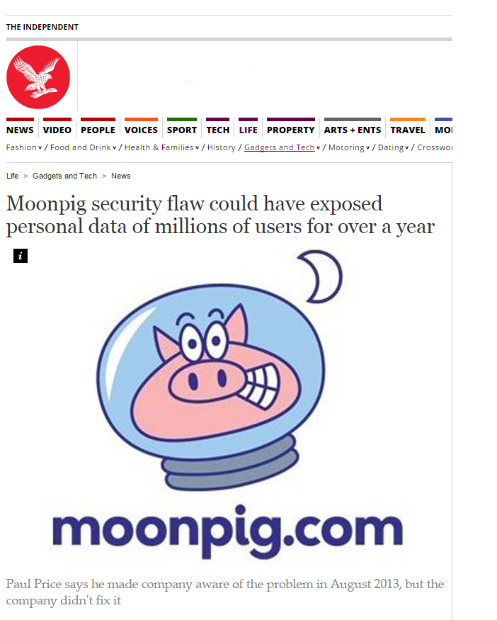
Jan 2015 – Broken Authentication
3 million users details leaked
  Including partial CC#
Unpatched for over a year

Slide 9

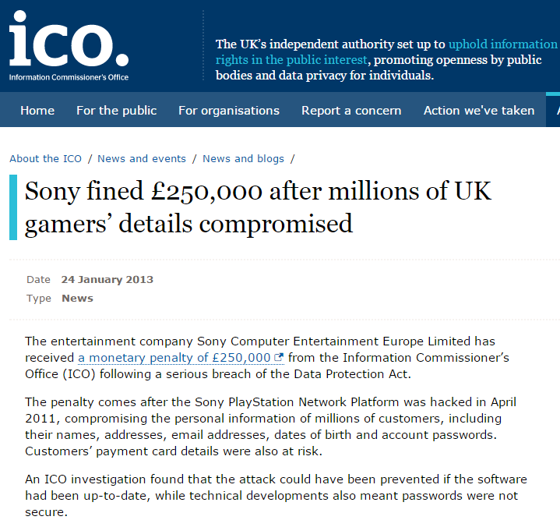
April 2011 – Security Misconfiguration
77 million accounts compromised
  Personally identifiable info & passwords
3 days offline
Class action law suits

Slide 10

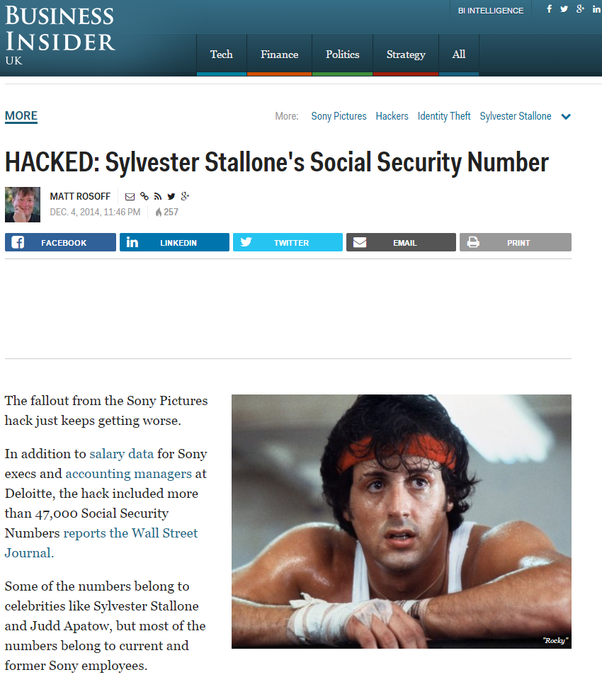
Dec 2014 – Broken Access Control
Personal details of 47000 leaked
  Including Rambo ☺
  Confidential emails
100TB+ of data
  Major IP leak
  Data Loss
Estimated $15m cost
Exec resignations
State sponsored?

Slide 11

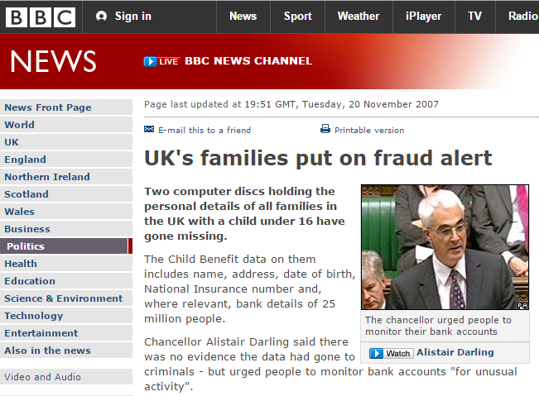
Nov 2007 – Sensitive Data Exposure?
A local story…
25m personal details potentially leaked
Large volumes of confidential data un-encrypted
Huge political embarrassment

Slide 12
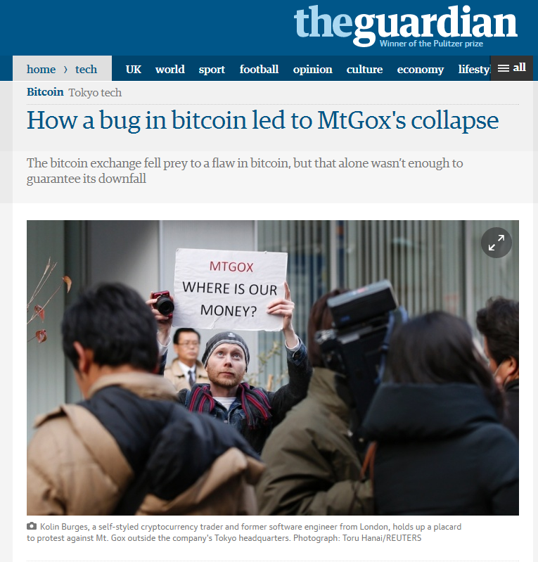
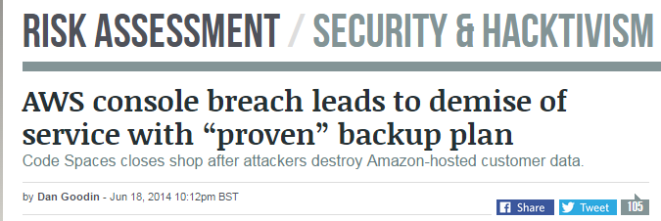
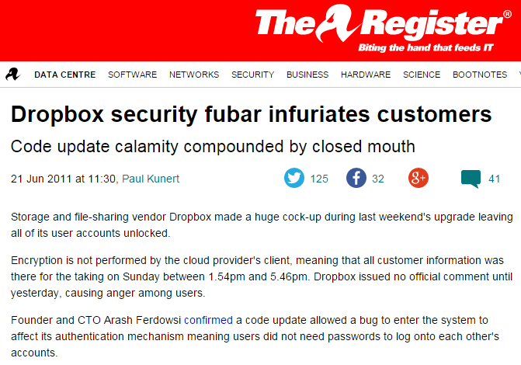
And so many others…

Slide 13
Who are we defending against – “Agents”
Hackers
Malware authors
Organised Criminals
Activists / Media
Competitors
Foreign Intelligence
Domestic Intelligence
Malicious Users
Malicious Employees
Nature & Environment
Ourselves
  Accidents
  Carelessness
  Bugs

Slide 14
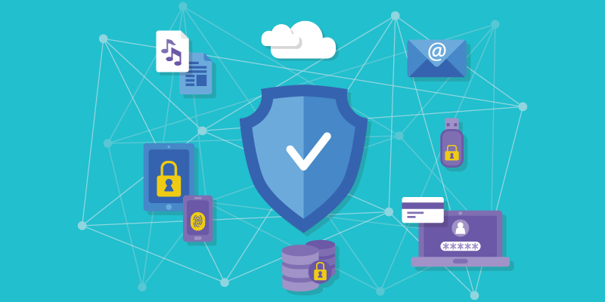
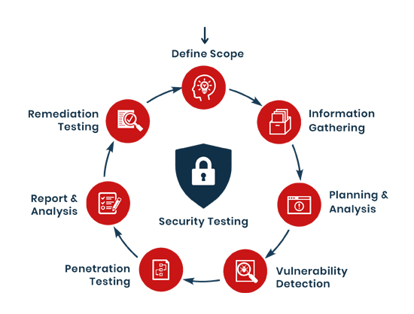
Recall: Security Testing
Primary job of ‘ethical hacker’
Systematic examination of organization network, policies, and security controls
  Test, evaluate, and measure system’s potential vulnerabilities

Slide 15
Different Motivations of Penetration Test
What is the driving motivation behind the penetration test?
  General concerns?
  Compliance (Payment Card Industry Data Security Standard)?
  In response to an incident?

Slide 16
Approaches – General concern
The pentester will have to do some preliminary investigation to find out
  What sort of breaches occur in that industry
  Which attacks the organization most likely to be subjected depending on size, and other factors
Drawback is having a lack of focus
  Pentester should talk to client to set goals

Slide 17
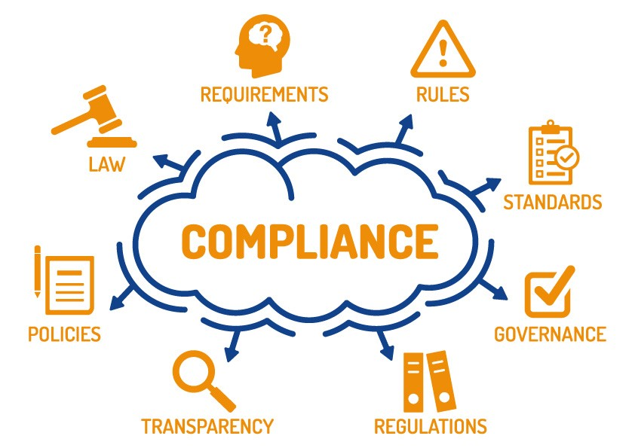
Approaches – Compliance
If the test is carried out for a compliance with specific standards
  You have defined goals
Pentester should review all of the requirements of the standard
Standards define the minimum security level not the maximum
You can do more tests for better/more coverage

Slide 18
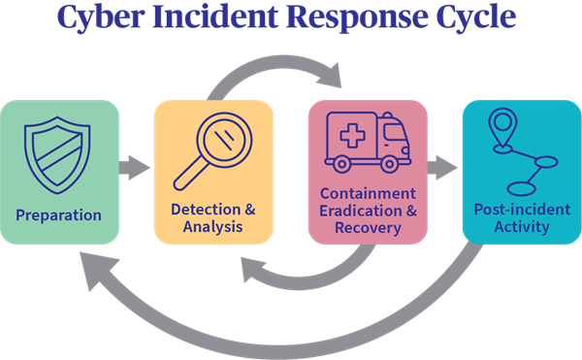
Approaches – Response to an incident
Goal is clear
  You must test the attacks similar to that incident
The security level obtained by this approach is again minimum
  Further different tests are needed to strengthen the system

Slide 19
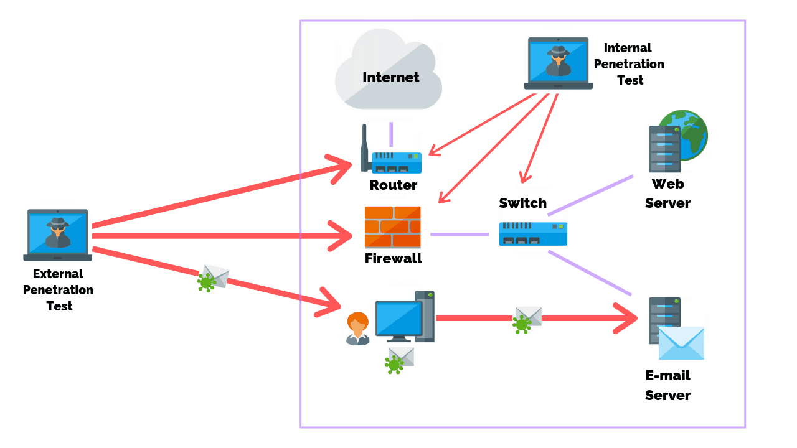
Ethical Hacking Modes
Information gathering
  What type of information is leaked and how it can be used against
External penetration test
  Simulates attacks across Internet
  HTTP, SMTP (Simple Mail Transfer Protocol), etc.
Internal penetration test
  Attack that can be carried by authorized individual to company’s network

Slide 20
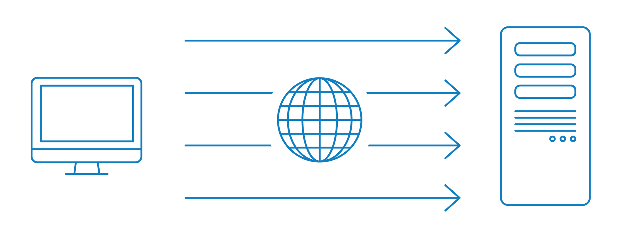
Ethical Hacking Modes
Network device test
  Firewall, router, switch, etc.
DoS (Denial of Service) test
  Would system be able to withstand against DoS
Social engineering
  Target employee to gain access

Slide 21
Ethical Hacking Modes
Authentication test
  If this is passed, then what can you do after?
Database test
  SQL server is targeted
Stolen equipment test
  What can you do if the equipment is in your hand (in hacker’s hand)

Slide 22

Terminology on Hacking
Hacker:
  One who tries to learn about a system by examining it in detail by reverse-engineering or probing the system
  Are not necessarily criminals
    One can be a hacker and never break the law, nor do anything unethical

Slide 23

Terminology on Hacking
Script kiddy:
  A slang term for an unskilled person who purports to be a skilled hacker
  Some people download a tool and learn to use that, then consider themselves great hackers, when they are not
  Example;
    Nigerian hacker

Slide 24

Terminology on Hacking
White hat hacker:
  A hacker who does not break the law, often synonymous with ethical hacker
  A person who uses hacking skills in a legal and ethical manner
Gray hat hacker:
  A hacker who usually obeys the law but in some instances will cross the line into black hat hacking

Slide 25
Terminology on Hacking
Black hat hacker:
  A hacker who does break the law
  Synonymous with cracker, but the term black hat hacker is far more common
  Is not necessarily any more skilled
    Someone can break the law and still have only minimal skill
https://www.techworm.net/2014/04/notorious-at-hacker-andrew-weev.html

Slide 26
Hackers
There is not an organized, uniform “hacking community”
  It is diverse and amorphous
Driving force is the desire for knowledge
Degrees or the certifications are not the real merit
  What you know and can do define your level

Slide 27
Required Skills of Ethical Hacker
Operating Systems
Network devices and protocols
  Also, security devices (firewall, etc.)
Programming
Overall computer security fundamentals

Slide 28
Legal Aspects
International Laws
US Laws
State laws
  Sometimes even city laws

Slide 29
Legal Aspects
Fraud and Related Activity in Connection with Access Devices: 18 U.S. Code § 1029
Computer Fraud and Abuse Act (CFAA): 18 U.S. Code § 1030
Unlawful Access to Stored Communications: 18 U.S. Code § 2701
And a few others

Slide 30
Compliance Regulations
Fines against companies that are found in noncompliance
One example: Payment Card Industry Data Security Standard (PCI-DSS)
  Build and maintain secure network
  Protect cardholder data
  Implement strong access control mechanisms
  Regularly monitor and test networks

Slide 31
Cyber Competitions
Cyberforce by Dept. of Energy
  Oct 1 Registration closes – Nov 12/13 Competition
National Collegiate Cyber Defense Competition
  Jan 15, 2022 Registration Deadline - April 21-23, 2022 National Competition
Global Collegiate Penetration Testing Competition
  Oct 1 Finalize – Oct 22 regional competition
https://cyberforcecompetition.com/
https://www.nationalccdc.org/index.php
https://globalcptc.org/
https://static1.squarespace.com/static/5e6bcc318d06046f83fb993b/t/610893603294b90ab7cb0dbb/1627951968790/CPTC2021+-+Le+Bonbon+Croissant+RFP.pdf

Slide 32
Cyber Competitions
National Cyber League
  Register by Oct 8
  Individual game Oct 22-24
  Team setup by Nov. 4, game Nov. 5
Capture the Flag (CTF)
https://nationalcyberleague.org/competition
https://ctftime.org/event/list/?year=2021&online=-1&format=0&restrictions=-1&upcoming=true

Slide 33
Certificates
CEH - The Certified Ethical Hacker is the flagship certification of the EC-Council
  4-hour exam with 125 multiple choice questions
GPEN - GIAC Penetration Tester (GPEN) is the basic penetration testing course/certification from the SANS Institute
OSCP - The Offensive Security Certified Professional (OSCP) certification from Offensive Security

Slide 34
Let’s start with computer security fundamentals
Important knowledge an ethical hacker needs to know

Slide 35
What is Computer Security
There is no single definition of security. Broadly speaking: Computer Security deals with the prevention and detection of unauthorised actions by users of a computer system.
Differences between traditional security and information security
Information can be stolen - but you still have it
Confidential information may be copied and sold - but the theft might not be detected
The criminals may be on the other side of the world

Slide 36
Information Security – CIA Triad
CIA
  Confidentiality: Who is authorized to use data?
  Integrity: Is data good?
  Availability: Can access data whenever need it?
C
I
S
A
Confidentiality
Integrity
Availability
Information Security
S = Secure

Slide 37
Three key objectives (the CIA triad)
Confidentiality
  Data confidentiality: Assures that confidential information is not disclosed to unauthorized individuals
  Privacy: Assures that individual control or influence what information may be collected and stored
Integrity
  Data integrity: assures that information and programs are changed only in a specified and authorized manner
  System integrity: Assures that a system performs its operations in unimpaired manner
Availability: assure that systems works promptly and service is not denied to authorized users

Slide 38
Need to Balance CIA
Example 1: C vs. I+A
  Disconnect computer from Internet to increase confidentiality
  Availability suffers, integrity suffers due to lost updates
Example 2: I vs. C+A
  Have extensive data checks by different people/systems to increase integrity
  Confidentiality suffers as more people see data, availability suffers due to locks on data under verification)
Notes:
In addition to all the rules and regulations, policies and procedures and the related system specific documentation, there are some current computer security issues of which you as the Executive should be made aware.

Slide 39
Levels of security breach impact
Low: the loss will have a limited impact, e.g., a degradation in mission or minor damage or minor financial loss or minor harm
Moderate: the loss has a serious effect, e.g., significance degradation on mission or significant harm to individuals but no loss of life or threatening injuries
High: the loss has severe or catastrophic adverse effect on operations, organizational assets or on individuals (e.g., loss of life)

Slide 40
Vulnerabilities, Threats, and Controls
Understanding Vulnerabilities, Threats, and Controls
  Vulnerability = a weakness in a security system
  Threat = circumstances that have a potential to cause harm
  Controls = means and ways to block a threat, which tries to exploit one or more vulnerabilities
    Most of the class discusses various controls and their effectiveness
  [Pfleeger & Pfleeger]
Example - New Orleans disaster (Hurricane Katrina)
  Q: What were city vulnerabilities, threats, and controls?
  A: Vulnerabilities: location below water level, geographical location in hurricane area, …
  Threats: hurricane, dam damage, terrorist attack, …
  Controls: dams and other civil infrastructures, emergency response
  plan, …

Slide 41
Tools for Information Security
Authentication
Access Control
Encryption
Passwords
Backup
Firewalls
Virtual Private Networks (VPN)
Physical Security
Security Policies

Slide 42
What do Ethical Hackers do?
“If you know the enemy and know yourself, you need not fear the result of a hundred battles.”
– – Sun Tzu, Art of War
Ethical hackers tries to answer:
  What can the intruder see on the target system? (Reconnaissance and Scanning phase of hacking)
  What can an intruder do with that information? (Gaining Access and Maintaining Access phases)
  Does anyone at the target notice the intruders attempts or success? (Reconnaissance and Covering Tracks phases)
If hired by any organization, an ethical hacker asks the organization what it is trying to protect, against whom and what resources it is willing to expend in order to gain protection.

Slide 43
The Hacking Process
Reconnaissance and Footprinting
Scanning and enumeration
Gaining access
Escalation of privilege
Maintaining access
Covering tracks and placing backdoors

Slide 44
Reconnaissance and Footprinting
First pre-attack phase
Systematic attempt to locate, gather, identify, and record information about target
Starts passively
  Can utilize Internet
  Can go as far as physical interactions
Information obtained allows to formulate a plan of attack

Slide 45
Footprinting Methodologies
Search engines
Social networks
Websites
Articles/Magazines
Competitive intelligence
WHOIS
DNS
NSLookup
Social engineering
Dumpster diving

Slide 46
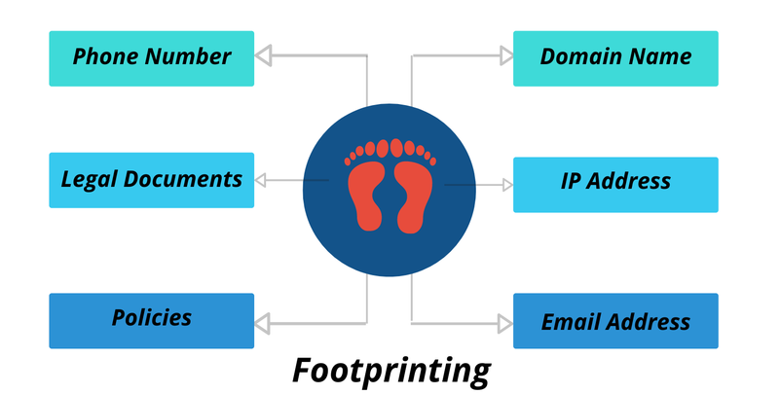
Reconnaissance and Footprinting

Slide 47
Scanning and enumeration
Second pre-attack phase
Enumeration is used to gather more in-depth info
Active step – attempting to connect to system to elicit response
  Injecting packets into network
  Using scanning tools (i.e., Nmap)

Slide 48
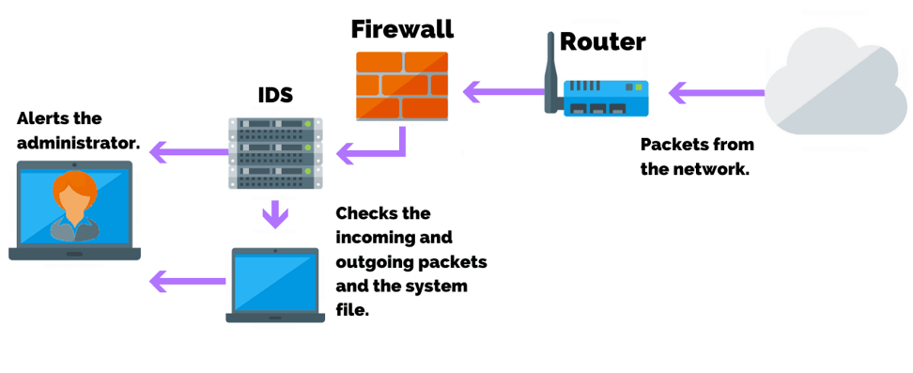
Scanning and enumeration
Organization may use tools to detect port scan
  Example: IDS (Intrusion Detection System)

Slide 49
Scanning and enumeration
More advanced hackers may use technique to lessen the chance to be detected
  Slow rate scanning
Hacker will not stop here
  S/he will want to get more idea what type/version software running at target
  Down-level software is good (easier) target
  Exploit database to check (e.g., www.exploit-db.com)

Slide 50
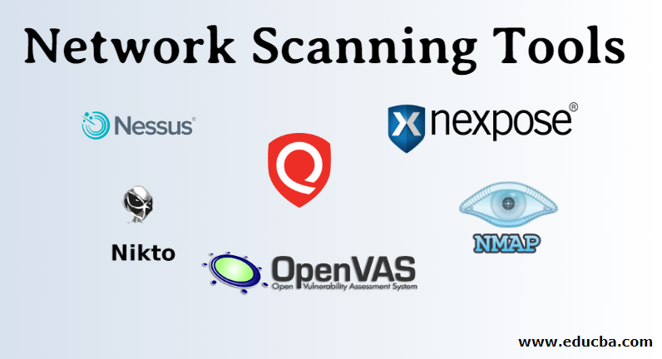
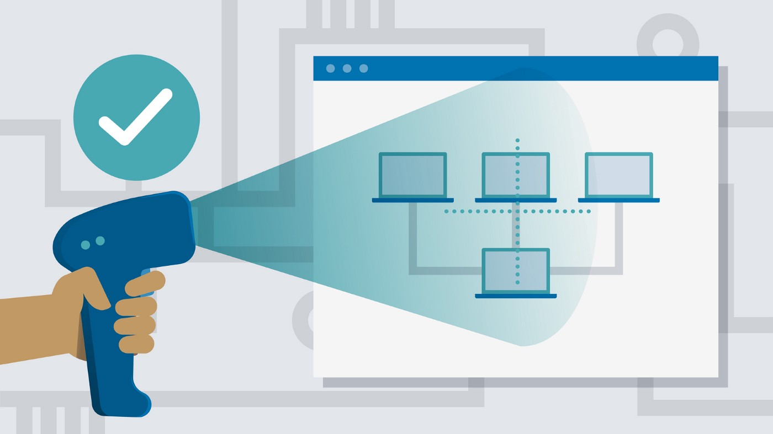
Network Scanning
Identify the active hosts (Clients and servers) on a network
  Identifying filtering systems between two active hosts
  Port scanning to determine which ports on a network are open and could be receiving or sending data

Slide 51
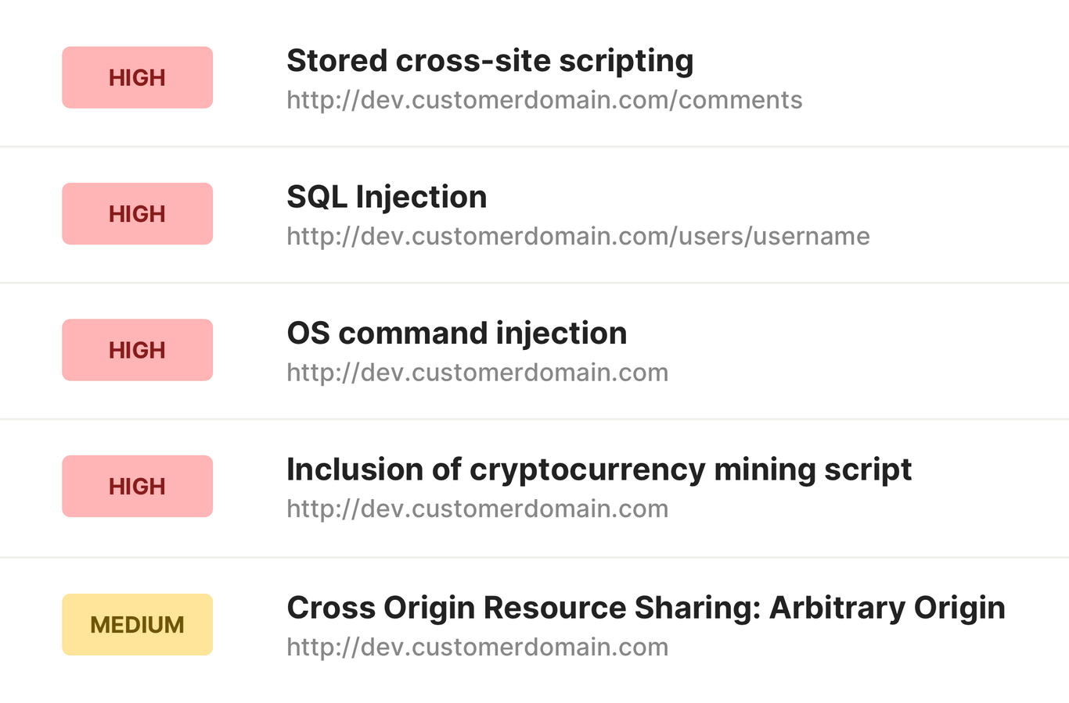
Vulnerability Scanning
An activity that identifies network vulnerabilities and the loopholes that can harm a system
Script kiddy might use vulnerability scanners (e.g., OpenVAS)
  That is designed to find vulnerability
  Yet, not for hacking
  Large packet generated of detectable network traffic

Slide 52
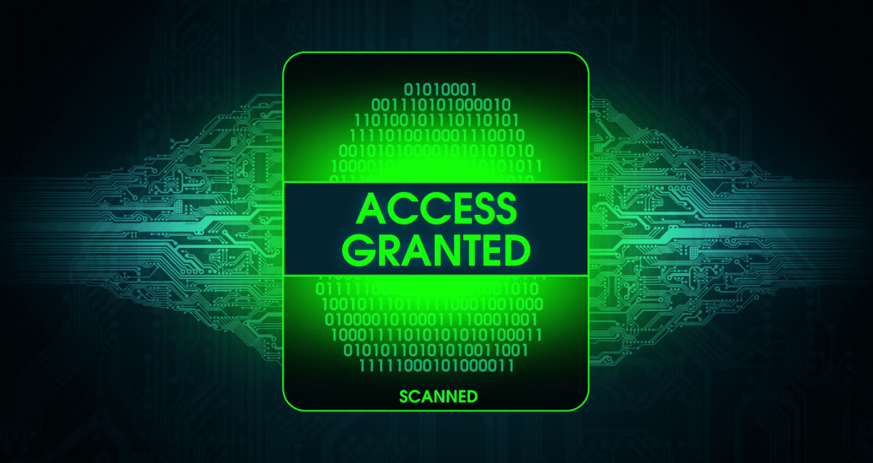
Gaining access
The real damage
  From probing to real attack
After gaining access, hacker can spread the damage as s/he progresses
Many ways:
  Open wireless access point
  Vulnerability in the web application
  Walk into meeting room by tricking the front desk

Slide 53
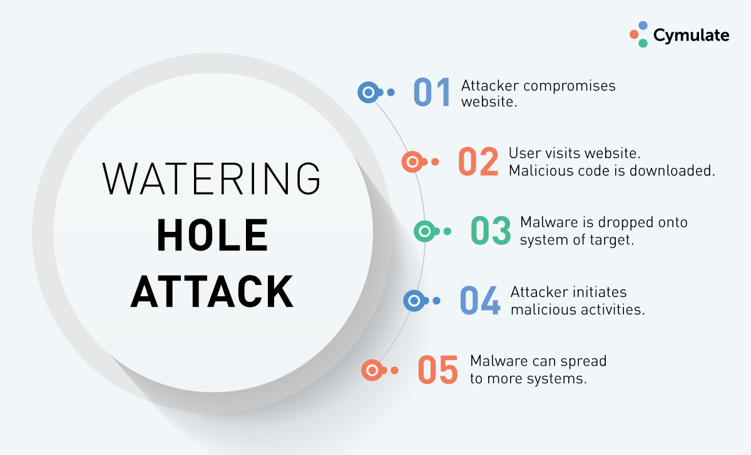
Gaining access
Hackers’ method depend on
  Skill levels
  Network architecture
  Configuration of target, etc.
Watering-hole attack
  Infect the web service with malware
  The targeted group will eventually get infected

Slide 54
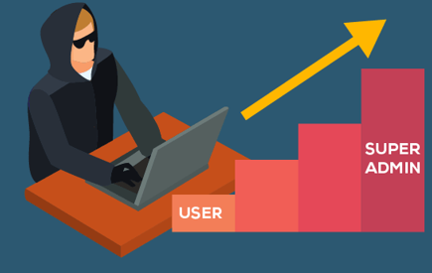
Escalation of privilege
Sometimes (probably even more often) hackers need more access
  Regular user account might not give enough access/control
  Become privileged
    Like root/administrator
Can occur due to;
  Bug, misconfiguration, vulnerability
Results in privileged access that the security policies may not be applied against

Slide 55

Maintaining Access
Keep the access that is compromised
Rootkits
  Capability to mask hacker and hide her/his presence
Hacker may even fix the bug s/he exploited to gain access
  Don’t let other hackers to join her/him
Monitor legitimate users

Slide 56

Covering Tracks and Planting Backdoors
Like other criminals
  No evidence left
Hunt the Log files
  Alter or erase them
The files or programs the hacker created in the system to be worried;
  File-hiding techniques (hidden directories, hidden attributes, etc.)

Slide 57

Covering Tracks and Planting Backdoors
Backdoors:
  Methods that hacker can use to come back at will!
https://www.trendmicro.com/en_us/research/16/a/android-based-smart-tvs-hit-by-backdoor-spread-via-malicious-app.html?_ga=2.41248482.1502707963.1630030186-358843086.1630030186

Slide 58
Ethical Hacker’s Process
Similar to the attacker, but with permission and strive to do no harm
Steps:
  Permission: written permission from authorized person
  Scanning: both passive and active
  Gaining access and maintaining: Similar to attacker’s techniques
  Covering tracks: Clearing logs
  Reporting: List your findings

Slide 59
Ethical Hacking Methodology
Assessment:
  Ethical hacking (as defined earlier), hands-on security tests
Policy Development:
  Based on organization’s goals and mission
  Focus on critical assets
Implementation:
  Building technical, operational, and managerial controls to secure key assets

Slide 60
Ethical Hacking Methodology
Training:
  Train the employees to follow policies
Audit:
  Periodic reviews of controls that put in place
  Done yearly for some regulations (HIPAA)

Slide 61
Questions?

