Slide 1
Cryptography
CS 5352/6352 Computer Security
Lecture note
Dr. Sajedul Talukder

Slide 2
Outline
Basic Terminology
Cryptosystem
Classical Cryptography
Algorithm Types and Modes
Data Encryption Standard
Other Stream & Block Ciphers

Slide 3
Basic Terminology
plaintext - the original message
ciphertext - the coded message
cipher - algorithm for transforming plaintext to ciphertext key - info used in cipher known only to sender/receiver encipher (encrypt) - converting plaintext to ciphertext decipher (decrypt) - recovering ciphertext from plaintext cryptography - study of encryption principles/methods
cryptanalysis (codebreaking) - the study of principles/ methods of deciphering ciphertext without knowing key
cryptology - the field of both cryptography and cryptanalysis

Slide 4
Conventional Encryption Principles
An encryption scheme (cryptosystem) has five ingredients:
  Plaintext
  Encryption algorithm
  Secret Key
  Ciphertext
  Decryption algorithm
Security depends on the secrecy of the key, not the secrecy of the algorithm

Slide 5
Types of Cryptanalytic Attacks
ciphertext only :
only know algorithm / ciphertext, statistical, can identify plaintext, or worse: the key
known plaintext:
know/suspect plaintext & ciphertext to attack cipher
chosen plaintext:
select plaintext and obtain ciphertext to attack cipher
chosen ciphertext:
select ciphertext and obtain plaintext to attack cipher
chosen text:
select either plaintext or ciphertext to en/decrypt to attack cipher

Slide 6
Cryptographic Ciphers
Transposition Techniques
  Rail Fence Cipher
  Interleaving Transposition Cipher
Substitution Techniques
  Caesar Cipher
  Monoalphabetic Cipher
  Polyalphabetic Cipher
  Playfair Cipher
  Vigenère Cipher
  One time pad (vernam) Cipher

Slide 7
Types of Cryptanalytic Attacks
adversary needs
strongest attack
λ
ciphertext only
only know algorithm / ciphertext, statistical, can identify plaintext, or worse: the key
known plaintext
λ
λ
know/suspect plaintext & ciphertext to attack cipher
chosen plaintext
λ
λ
select plaintext and obtain ciphertext to attack cipher
chosen ciphertext
λ
λ
select ciphertext and obtain plaintext to attack cipher
chosen text
λ
adversary’s attacks can be weaker
April 9, 2013
λ
λ
select either plaintext or ciphertext to en/decrypt attack cipher

Slide 8
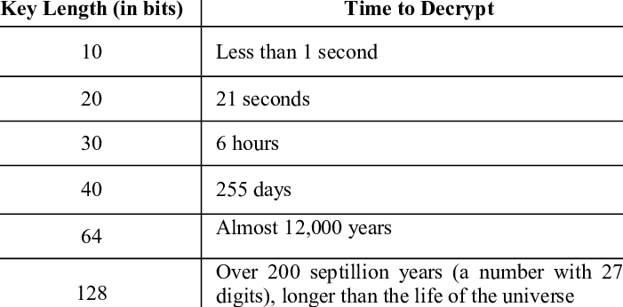
Brute Force Decryption
always possible to simply try every key
most basic attack, proportional to size of key space
assume either know / recognise plaintext

Slide 9
Encryption Techniques
(Ciphers)

Slide 10
Transposition Ciphers
Consider classical transposition or
permutation ciphers
these hide the message by rearranging the letter order
without altering the actual letters used
can recognise these since have the same frequency distribution as the original text

Slide 11
Transposition Ciphers
write message letters out vertically over a number of rows
then read off cipher row by row
Key = 3

Slide 12
Rail Fence cipher
write message letters out diagonally over a number of rows
then read off cipher row by row

Slide 13
Interleaving Transposition Ciphers
a more complex scheme
write letters of message out in rows over a specified number of columns
then reorder the columns according to some key before reading off the rows
^{λ} Let's consider a two-interleaving:

Slide 14
Classical Substitution Ciphers
where letters of plaintext are replaced by other letters or by numbers or symbols
or if plaintext is viewed as a sequence of bits, then substitution involves replacing plaintext bit patterns with ciphertext bit patterns

Slide 15
Caesar Cipher
earliest known substitution cipher
by Julius Caesar
first attested use in military affairs
replaces each letter by 3rd letter after it
example:
meet | me | after | the | toga | party
PHHW | PH | DIWHU | WKH | WRJD | SDUWB

Slide 16
Caesar Cipher Example
Substitution cipher
  Key k ∈ N
  Formula:
    y = (x + k) mod 26
  26 → size of the alphabe
Cryptanalisis?
  Brute force!
Popular culture
  2001: Space Odyssey
  HAL 9000
A → B
B → C
C → D
D → E
E → F
F → G
G → H
H → I
I → J
J → K
K → L
L → M
M → N

Slide 17
Caesar Cipher
can define transformation as:
a b c d e f g h i j k l m n o p q r s t u v w x y z D E F G H I J K L M N O P Q R S T U V W X Y Z A B C
mathematically give each letter a number
a | b c | d | e f | g | h i | j | k | l | m
0 | 1 2 | 3 | 4 5 | 6 | 7 8 | 9 | 10 | 11 | 12
n | o | p | q | r | s | t | u | v | w x y Z
13 14 15 16 17 18 19 20 21 22 23 24 25

Slide 18
General Substitution Cipher Limitation
Key
  Permutation of the alphabet
  Large key space!
    … but not used efficiently!
    Does not hide various properties of the underlying text!
How to attack a substitution cipher?
  Frequency attack
    Digrams, trigrams
  “fingerprint” of a language

Slide 19
Frequency Attack
Frequencies of letters
  Letters appear with different frequencies in natural texts
  Exceptions:
    Gadsby by E.V. Wright
    Disparation by George Perec (A Void, translation G. Adair)
  Breaking substitution ciphers
A → 0.082 N → 0.067
B → 0.015 O → 0.075
C → 0.028 P → 0.019
D → 0.043 Q → 0.001
E → 0.127 R → 0.060
F → 0.022 S → 0.063
G → 0.020 T → 0.091
H → 0.061 U → 0.028
I → 0.070 V → 0.010
J → 0.002 W → 0.023
K → 0.008 X → 0.001
L → 0.040 Y → 0.020
M → 0.024 Z → 0.001

Slide 20
Frequencies vs Subst’n Cipher
Shift and affine cipher
  usually enough to locate ‘E’ ← gives the key
  for affine cipher: One more letter can be helpful
Full substitution cipher
  Might need digram and trigram frequencies
A → 0.082 N → 0.067
B → 0.015 O → 0.075
C → 0.028 P → 0.019
D → 0.043 Q → 0.001
E → 0.127 R → 0.060
F → 0.022 S → 0.063
G → 0.020 T → 0.091
H → 0.061 U → 0.028
I → 0.070 V → 0.010
J → 0.002 W → 0.023
K → 0.008 X → 0.001
L → 0.040 Y → 0.020
M → 0.024 Z → 0.001

Slide 21
Example: Frequency Attack
Let’s say we found a 216 characters ciphertext
The following frequencies were found:
  Count the letters
  Normalize the frequencies
  Compare to the natural one
A : 27
B : 6
C : 5
D : 12
E : 14
F : 1
G : 2
H : 8
I : 5
J : 14
K : 16
L : 5
M : 2
N : 13
O : 14
P : 19
Q : 6
R : 3
S : 5
T : 0
U : 4
V : 0
W : 17
X : 4
Y : 6
Z : 8

Slide 22
Example: Frequency Attack
There are 216 letters
  Divide counts by 216
A : 0.125
B : 0.027
C : 0.023
D : 0.055
E : 0.064
F : 0.004
G : 0.009
H : 0.037
I : 0.0231
J : 0.064
K : 0.074
L : 0.023
M : 0.009

Slide 23
Example: Frequency Attack
There are 216 letters
  Divide counts by 216
Compare to natural frequencies
  Natural guess: shift -2
  Others plausible
    shift
A : 0.125
B : 0.027
C : 0.023
D : 0.055
E : 0.064
F : 0.004
G : 0.009
H : 0.037
I : 0.0231
J : 0.064
K : 0.074
L : 0.023
M : 0.009
A : 0.082
B : 0.015
C : 0.028
D : 0.043
E : 0.127
F : 0.022
G : 0.02
H : 0.061
I : 0.07
J : 0.002
K : 0.008
L : 0.04
M : 0.024

Slide 24
Example: Frequency Attack
There are 216 letters
  Divide counts by 216
Compare to natural frequencies
  Natural guess: shift -2
    but the rest of frequencies mismatch
A : 0.125
B : 0.027
C : 0.023
D : 0.055
E : 0.064
F : 0.004
G : 0.009
H : 0.037
I : 0.0231
J : 0.064
K : 0.074
L : 0.023
M : 0.009
A : 0.082
B : 0.015
C : 0.028
D : 0.043
E : 0.127
F : 0.022
G : 0.02
H : 0.061
I : 0.07
J : 0.002
K : 0.008
L : 0.04
M : 0.024

Slide 25
Example: Frequency Attack
There are 216 letters
  Divide counts by 216
Compare to natural frequencies
    shift 4
A : 0.082
B : 0.015
C : 0.028
D : 0.043
E : 0.127
F : 0.022
G : 0.02
H : 0.061
I : 0.07
J : 0.002
K : 0.008
L : 0.04
M : 0.024
A : 0.125
B : 0.027
C : 0.023
D : 0.055
E : 0.064
F : 0.004
G : 0.009
H : 0.037
I : 0.0231
J : 0.064
K : 0.074
L : 0.023
M : 0.009
Pretty Close Matching!

Slide 26
Monoalphabetic Cipher
rather than just shifting the alphabet
could shuffle (jumble) the letters arbitrarily
each plaintext letter maps to a different random ciphertext letter
hence key is 26 letters long
Plain: abcdefghijklmnopqrstuvwxyz Key: DKVQFIBJWPESCXHTMYAUOLRGZN
Plaintext: ifwewishtoreplaceletters Ciphertext: WIRFRWAJUHYFTSDVFSFUUFYA

Slide 27
Playfair Cipher
not even the large number of keys in a monoalphabetic cipher provides security
one approach to improving security was to encrypt multiple letters
the Playfair Cipher is an example
invented by Charles Wheatstone in 1854, but named after his friend Baron Playfair

Slide 28
Playfair Key Matrix
a 5X5 matrix of letters based on a keyword
fill in letters of keyword (minus duplicates)
fill rest of matrix with other letters (except J)
eg. using the keyword MONARCHY

Slide 29
Encrypting and Decrypting Rules
plaintext is encrypted two letters at a time
if a pair is a repeated letter, insert filler like 'X’
"balloon" transformed to "ba lx lo on”
If there is an odd number of letters, a Z is added to the last letter.
if both letters fall in the same row, replace
each with letter to right (wrapping back to start from end)
if both letters fall in the same column, replace
each with the letter below it (again wrapping to top from bottom)
otherwise each letter is replaced by the letter
in the same row and in the column of the other letter of the pair
Wireless Wi re le sx sz XG MK UL XA TX

Slide 30
Encrypting and Decrypting
PlainText: "instruments" After Split: 'in' 'st' 'ru' 'me' 'nt' 'sz'

Slide 31
Encrypting and Decrypting
Diagraph: "me" Encrypted Text: "cl" Encryption: m -> c, e -> l
Same Column

Slide 32
Encrypting and Decrypting
Diagraph: "st" Encrypted Text: "tl" Encryption: s -> t, t -> l
Same Row

Slide 33
Encrypting and Decrypting
Diagraph: "nt" Encrypted Text: "rq" Encryption: n -> r, t -> q
Form Rectangle

Slide 34
Encrypting and Decrypting

Slide 35
Polyalphabetic Ciphers
another approach to improving security is to use multiple cipher alphabets
called polyalphabetic substitution ciphers
makes cryptanalysis harder with more alphabets to guess and flatter frequency distribution
use a key to select which alphabet is used for each letter of the message
use each alphabet in turn
repeat from start after end of key is reached

Slide 36
Vigenère Cipher
simplest polyalphabetic substitution cipher is the Vigenère Cipher
effectively multiple caesar ciphers
key is multiple letters long K = k1 k2 ... kd
i^{th} letter specifies i^{th} alphabet to use
use each alphabet in turn
repeat from start after d letters in message
decryption simply works in reverse

Slide 37
Example
shifts are numbers between 0 and 25.
a shift can be encoded as a letter!
use each key letter as a caesar cipher key
thus, a "shift of 3" can be expressed as a "shift by 'd'".
encrypt the corresponding plaintext letter
eg using keyword deceptive as key
key: deceptivedeceptivedeceptive plaintext: wearediscoveredsaveyourself ciphertext:ZICVTWQNGRZGVTWAVZHCQYGLMGJ

Slide 38
Example

Slide 39
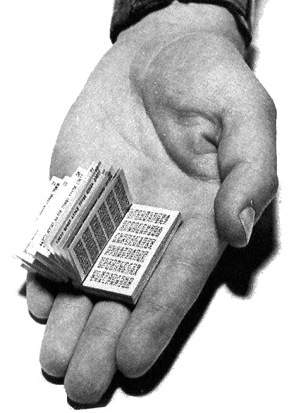
Vernam Cipher (One-Time Pad)
Also known as One-time Pad
Developed by Gilbert Vernam (AT&T engineer) in 1917
Uses a set of characters only one time for each encryption process
To use a one-time pad, you need 2 copies of the "pad" which is a block of random data equal in length to the message you wish to encode.
A RUSSIAN ONE-TIME PAD, CAPTURED BY MI5
Image source: http://www.ranum.com/security/computer_security/papers/otp-faq/otp.jpg

Slide 40
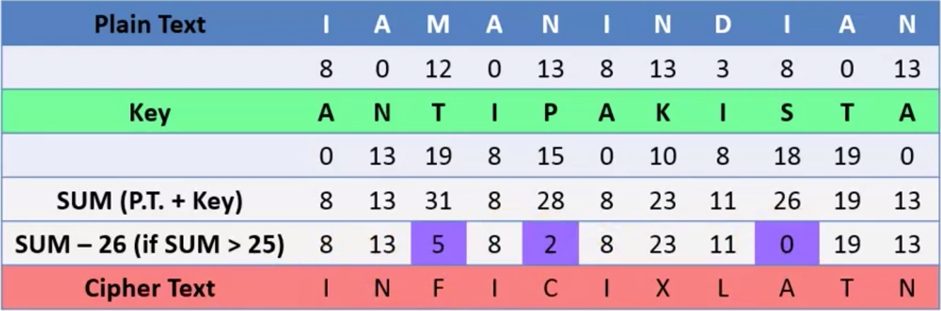
One-time Pad: Encryption

Slide 41
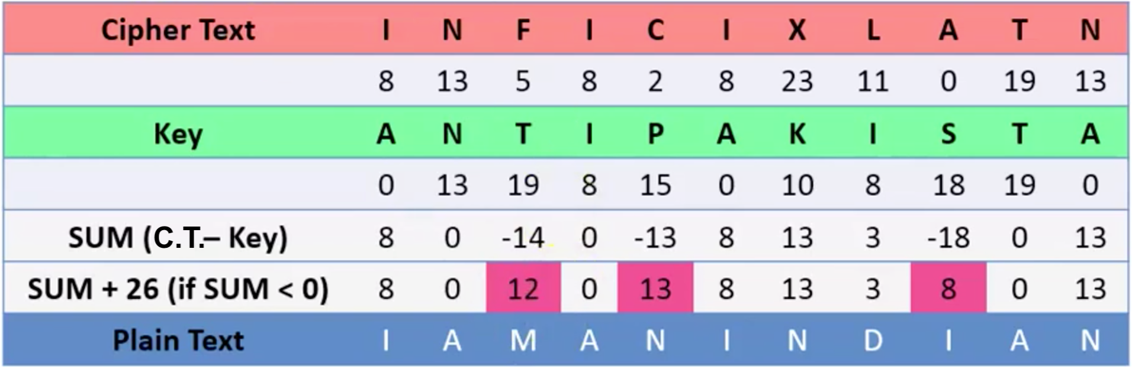
One-time Pad: Decryption

Slide 42
One-time Pad Summary
Provably secure…
  Ciphertext provides no info about plaintext
  is unbreakable since ciphertext bears no statistical relationship to the plaintext
  All plaintexts are equally likely
…but, only when be used correctly
  Pad must be random, used only once
  Pad is known only to sender and receiver
Note: pad (key) is same size as message
unconditional security! why look any further??

Slide 43
Other Techniques

Slide 44
Product Ciphers
ciphers using substitutions or transpositions are not secure because of language characteristics
hence consider using several ciphers in succession to make harder (Shannon)
λ
λ
λ
two substitutions make a more complex substitution two transpositions make more complex transposition
but a substitution followed by a transposition makes a new much harder cipher
^{λ} this is bridge from classical to modern ciphers

Slide 45
Product Ciphers

Slide 46
Rotor Machines
before modern ciphers, rotor machines were most common product cipher
were widely used in WW2
λ
German Enigma, Allied Hagelin, Japanese Purple
implemented a very complex, varying substitution cipher
used a series of cylinders, each giving one substitution, which rotated and changed after each letter was encrypted
with 3 cylinders have 26³=17576 alphabets
λ
3! rearrangements of cylinders in Enigma

Slide 47
Rotor Machines

Slide 48
Steganography
an alternative to encryption
hides existence of message
  using only a subset of letters/words in a longer message marked in some way
  using invisible ink
  hiding in LSB in graphic image or sound file
has drawbacks
  high overhead to hide relatively few info bits

Slide 49
Image Steganography
Data Hidden: 00101001000001100000111100000001110000111100000111000…

Slide 50
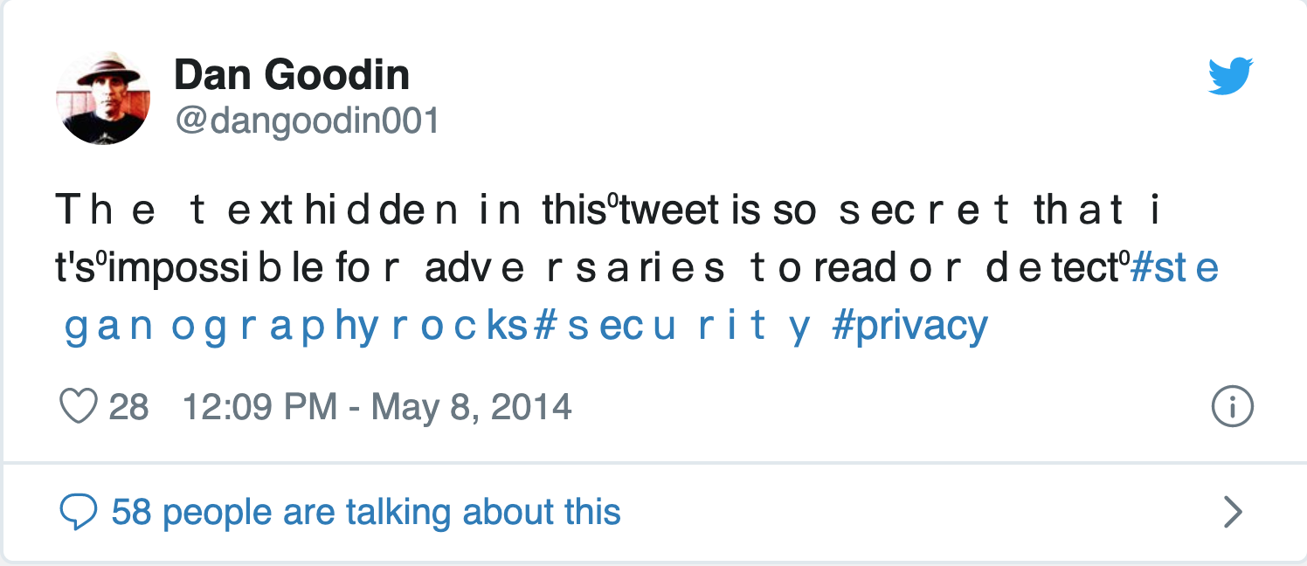
Text Steganography: Twitter?
Can you find the hidden text?

Slide 51
Questions?

