Slide 1
Introduction to Security
CS 5352/6352 Computer Security
Lecture note
Dr. Sajedul Talukder

Slide 2
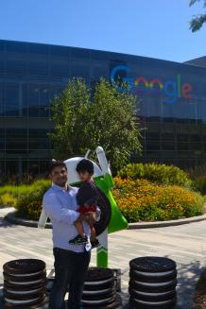
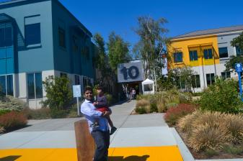
Let Me Introduce Myself
Dr. Sajedul Talukder
stalukder@utep.edu

Slide 3
Why This Class?
There aren't enough people to fight cybercrime
There are plenty of cybersecurity jobs
This job can be hard to outsource
Job opportunities are projected to grow substantially
Anyone can learn cybersecurity
Cybersecurity is a challenging but enjoying job
You get to be a hero sometimes
Most importantly, earn more money..

Slide 4
Goals for this Class
Describe basic concepts involved with cybersecurity
Describe the steps required to produce secure software.
Explain how components impact the overall security of a system.
Describe basic security issues involved in data communications.
Describe methods for accessing a system and their impact on system security.
Discuss issues involved in human security.
Identify major tools available to organizations to manage cybersecurity.
Identify and describe major impacts of cybersecurity on society.

Slide 5
What’s in this Class
Crosscutting Concepts in Cybersecurity
  Confidentiality, integrity, availability
  Risk
  Adversarial thinking
  Systems thinking
Software Security
  Fundamental design principles for secure software
  Security requirements and their role in system design
  Implementation issues
  Software Testing
  Ethics related to development, testing and vulnerability disclosure
Component Security
  Vulnerabilities of system components
  Component life cycle
Connection Security
  Introduction to data communications
  Network architectures and models
  Connection and transmission attacks
System access and authentication
  Basic Cryptographic Concepts
  Authentication Methods
  Identity
  Attacks and mitigation measures
Human Security
  Social engineering
  Awareness and understanding of security issues
    System misuse and user misbehavior
    Enforcement and rules of behavior
  Privacy
    Social and Behavioral Privacy
    Social Media Privacy and Security
Organizational Security
  Risk and risk management
  Secure governance and policy
  Systems administration
Societal Security
  Cybercrime
  Cyber ethics

Slide 6
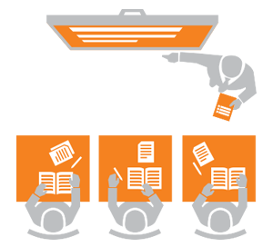
Course Structure

Slide 7


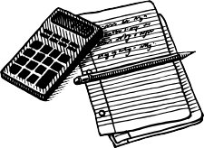


Class Lectures
Class structures will look like this:
Lecture Hands On Textbook Homework Exam
First Exposure
Practice Labs
Read Stuff
See if You Know this Stuff
Show Knowledge Mastery
This structure requires your effort
  You see things for the first time in class
  You practice the things with hands on in the labs
  Then you study and appear for exam

Slide 8
Students say discussion is helpful…
It really makes you realize exactly what mistakes you are making and sometimes you don’t feel as bad if you are wrong because
you can see that fellow classmates think the same way.
Discussion is really helpful as sometimes when you get lost in other classes, you are lost for the rest of the lecture. Discussion and clicker questions help make students realize when they are getting confused before it is too late and the discussions with classmates helps get us back on track

Slide 9
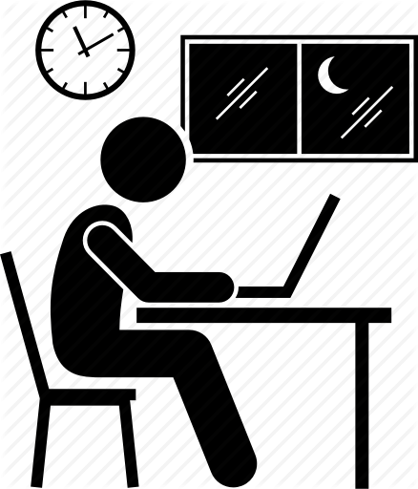
Your Tasks
Homework and lab assignments: 40%
Midterm exam: 30%
Final exam: 30%

Slide 10
Homeworks
Assigned at the end of the week
Partly from the book
These are the best way to prepare for the tests
I will post the homework assignments in the course webpage:
http://stalukder.cs.edinboro.edu/spring2020/csci277/index.html

Slide 11
Grading
Following is a rough guide to how course grades will be established, not a precise formula
Grading is on a 12 point scale -- A through F
93-100% : A
90-92% : A-
87-89% : B+
83-86% : B
80-82% : B-
77-79% : C+
73-76% : C
70-72% : C-
67-69% : D+
63-66% : D
60-62% : D-
0-59% : F

Slide 12
Academic Honesty
Don’t cheat.
  Cheating on a test will get you an F in the class and no option to drop, and a visit with your college dean.
  Cheating on homeworks means you don’t have to turn them in any more, but you don’t get points either. You will also take at least 25% penalty on
the exam grades.
Copying solutions of the internet or a solutions manual is cheating.
Review the UTEP student handbook or policy
When in doubt, ask.

Slide 13
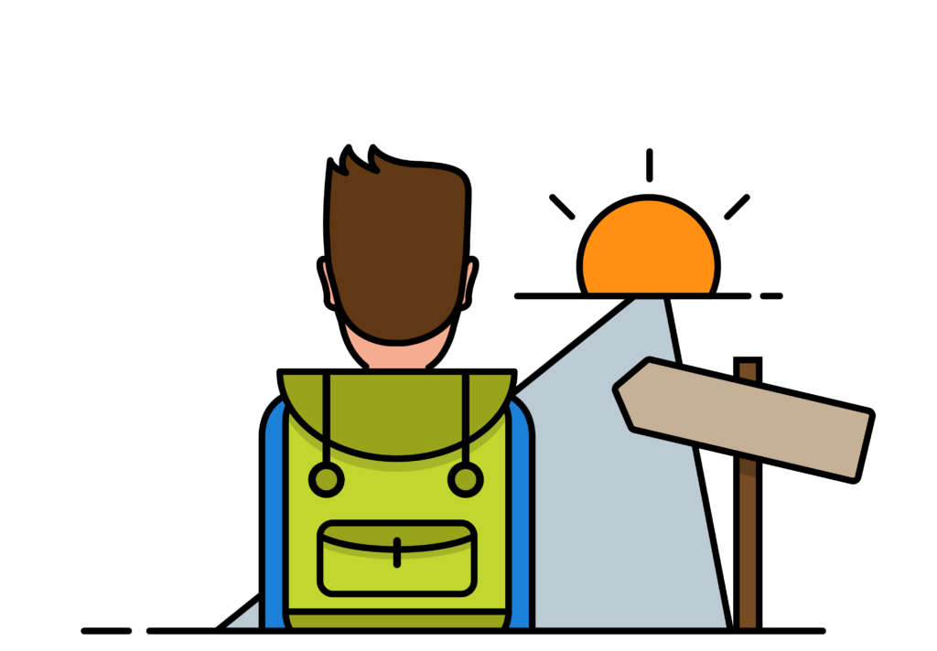
Now Let’s Start Our Journey With Computing Concepts

Slide 14
Learning objectives
Describe the key security requirements of confidentiality, integrity and availability
Discuss the types security threats and attacks that must be dealt with
Summarize the functional requirements for computer security
Explain the fundamental security design principles
Discuss the use of attack surfaces and attack trees
Understand the principle aspects of a comprehensive security strategy

Slide 15
Outline
Components of computer security
Threats
Policies and mechanisms
The role of trust
Assurance
Operational Issues
Human Issues

Slide 16
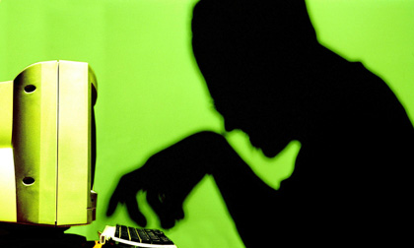
Introduction
Computers and digital devices
are becoming integral to
conducting business
  Which also makes them a target of attack
Devices needs to be secured
Networks that computers and
devices use should also be secured

Slide 17
Some lessons from recent history
What’s the worst that can happen?

Slide 18
Mar 2019 –Capital One Hack
Hacker broke into a server by exploiting a configuration vulnerability in a web application firewall
106 million users details leaked
  Including partial CC#
Records Exposed: 1066 Million

Slide 19

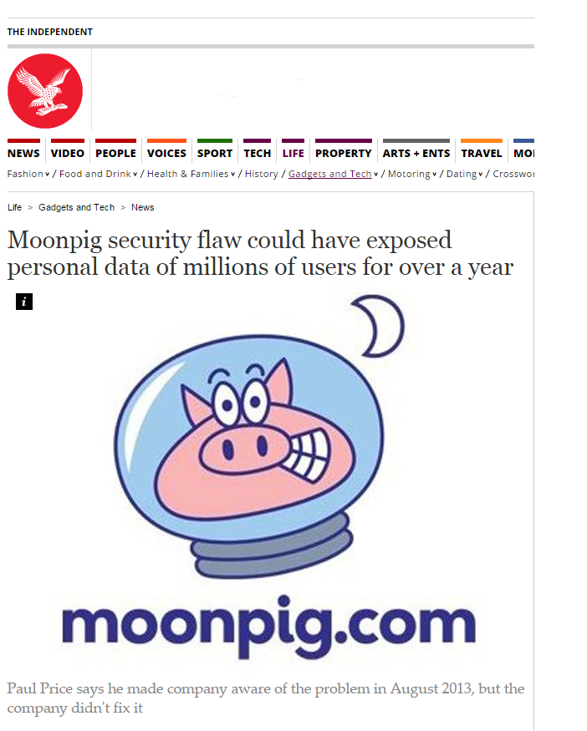
Jan 2015 – Broken Authentication
3 million users details leaked
  Including partial CC#
Unpatched for over a year

Slide 20
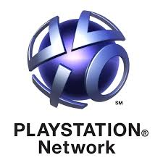
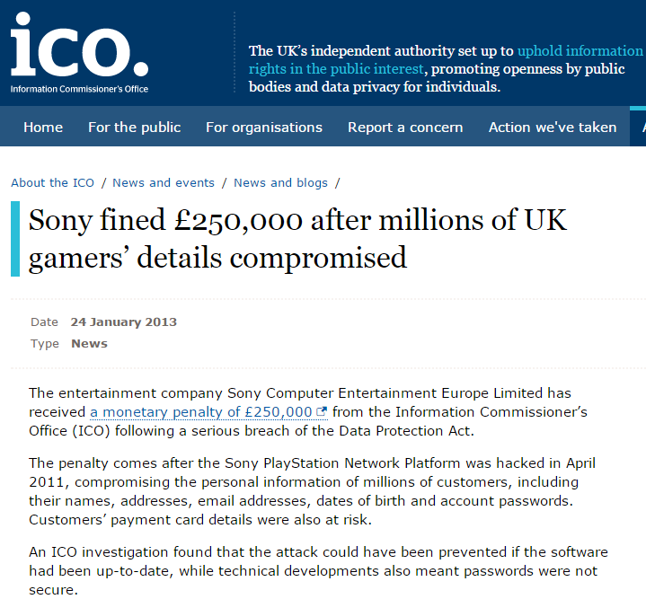
April 2011 – Security Misconfiguration
77 million accounts compromised
  Personally identifiable info & passwords
3 days offline
Class action law suits

Slide 21

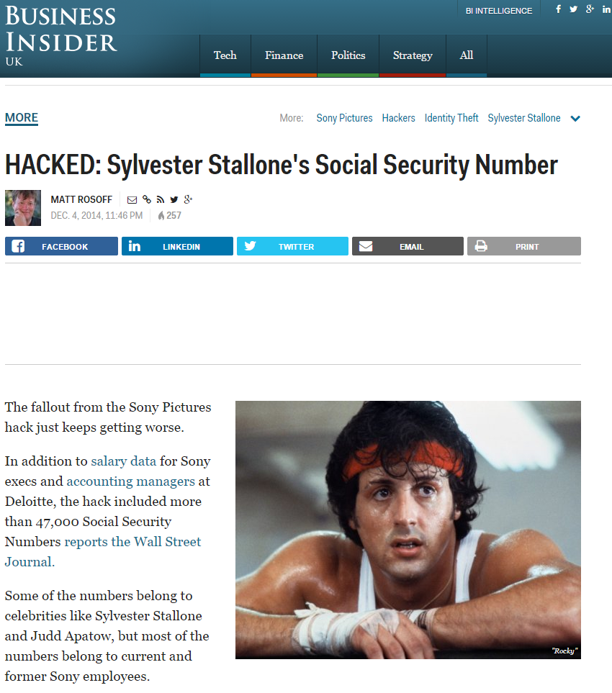
Dec 2014 – Broken Access Control
Personal details of 47000 leaked
  Including Rambo ☺
  Confidential emails
100TB+ of data
  Major IP leak
  Data Loss
Estimated $15m cost
Exec resignations
State sponsored?

Slide 22

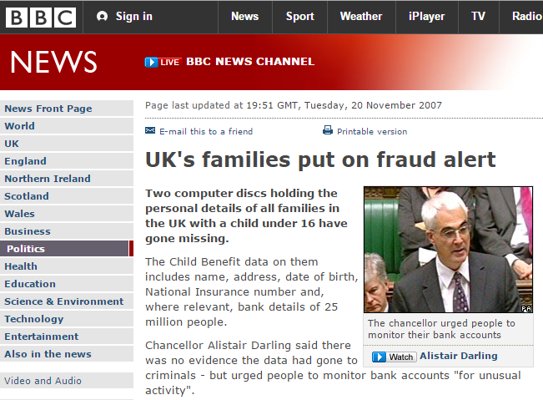
Nov 2007 – Sensitive Data Exposure?
A local story…
25m personal details potentially leaked
Large volumes of confidential data un-encrypted
Huge political embarrassment

Slide 23
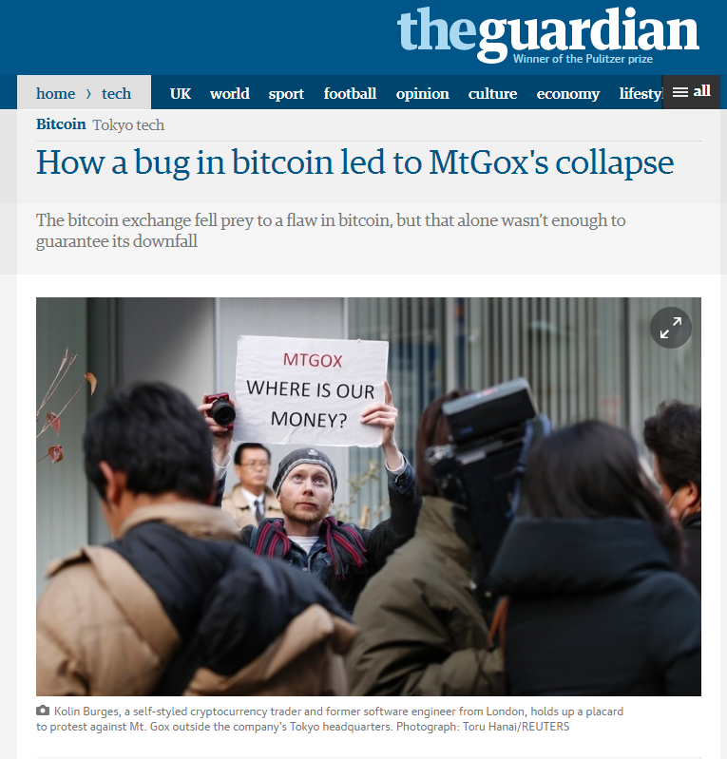
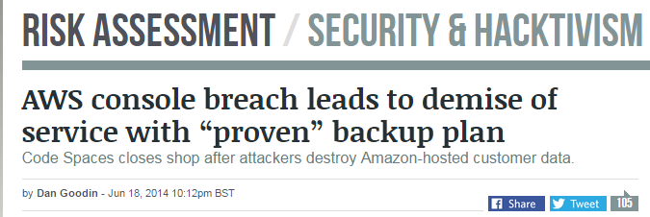
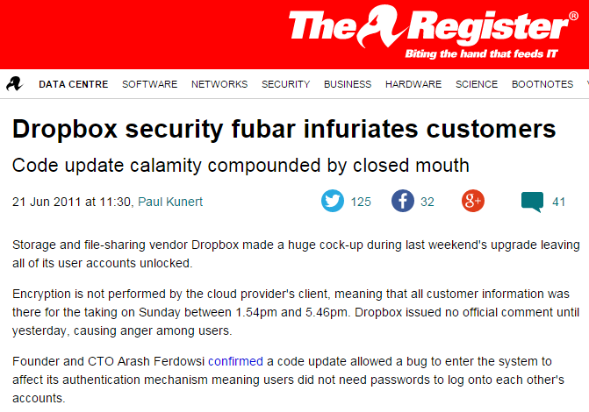
And so many others…

Slide 24
Who are we defending against – “Agents”
Hackers
Malware authors
Organised Criminals
Activists / Media
Competitors
Foreign Intelligence
Domestic Intelligence
Malicious Users
Malicious Employees
Nature & Environment
Ourselves
  Accidents
  Carelessness
  Bugs

Slide 25
What is Computer Security
There is no single definition of security. Broadly speaking: Computer Security deals with the prevention and detection of unauthorised actions by users of a computer system.
Differences between traditional security and information security
Information can be stolen - but you still have it
Confidential information may be copied and sold - but the theft might not be detected
The criminals may be on the other side of the world

Slide 26
Information Security – CIA Triad
CIA
  Confidentiality: Who is authorized to use data?
  Integrity: Is data good?
  Availability: Can access data whenever need it?
C
I
S
A
Confidentiality
Integrity
Availability
Information Security
S = Secure

Slide 27
Three key objectives (the CIA triad)
Confidentiality
  Data confidentiality: Assures that confidential information is not disclosed to unauthorized individuals
  Privacy: Assures that individual control or influence what information may be collected and stored
Integrity
  Data integrity: assures that information and programs are changed only in a specified and authorized manner
  System integrity: Assures that a system performs its operations in unimpaired manner
Availability: assure that systems works promptly and service is not denied to authorized users

Slide 28
Need to Balance CIA
Example 1: C vs. I+A
  Disconnect computer from Internet to increase confidentiality
  Availability suffers, integrity suffers due to lost updates
Example 2: I vs. C+A
  Have extensive data checks by different people/systems to increase integrity
  Confidentiality suffers as more people see data, availability suffers due to locks on data under verification)
Notes:
In addition to all the rules and regulations, policies and procedures and the related system specific documentation, there are some current computer security issues of which you as the Executive should be made aware.

Slide 29
Confidentiality
The prevention of unauthorized disclosure of information.
Confidentiality is keeping information secret or private.
Confidentiality might be important for military, business or personal reasons.
Confidentiality is:
  difficult to ensure
  easiest to assess in terms of success (binary in nature: Yes / No)

Slide 30
Examples of security requirements: Confidentiality
Student grade information is an asset whose confidentiality is considered to be very high
  The US FERPA Act: grades should only be available to students, their parents, and their employers (when required for the job)
Student enrollment information: may have moderate confidentiality rating; less damage if enclosed
Directory information: low confidentiality rating; often available publicly
Notes:
FERPA: Family Education Right and Privacy Act

Slide 31
Integrity
Integrity is the unauthorised writing or modification of information.
Integrity means that there is an external consistency in the system - everything is as it is expected to be.
Data integrity means that the data stored on a computer is the same as the source documents.

Slide 32
Examples of security requirements: Integrity
A hospital patient’s allergy information (high integrity data): a doctor should be able to trust that the info is correct and current
  If a nurse deliberately falsifies the data, the database should be restored to a trusted basis and the falsified information traced back to the person who did it
An online newsgroup registration data: moderate level of integrity
An example of low integrity requirement: anonymous online poll (inaccuracy is well understood)
Notes:
FERPA: Family Education Right and Privacy Act

Slide 33
Availability
Information should be accessible and useable upon appropriate demand by an authorised user.
Availability is the prevention of unauthorised withholding of information.
Denial of service attacks are a common form of attack.

Slide 34
Examples of security requirements: Availability
A system that provides authentication: high availability requirement
  If customers cannot access resources, the loss of services could result in financial loss
A public website for a university: a moderate availably requirement; not critical but causes embarrassment
An online telephone directory lookup: a low availability requirement because unavailability is mostly annoyance (there are alternative sources)
Notes:
FERPA: Family Education Right and Privacy Act

Slide 35
Other concepts to a complete security picture
Authenticity: the property of being genuine and being able to be verified and trusted; confident in the validity of a transmission, or a message, or its originator
Accountability: generates the requirement for actions of an entity to be traced uniquely to that individual to support nonrepudiation, deference, fault isolation, etc.

Slide 36
Non-repudiation
Non-repudiation is the prevention of either the sender or the receiver denying a transmitted message.
A system must be able to prove that certain messages were sent and received.
Non-repudiation is often implemented by using digital signatures.

Slide 37
Challenges of computer security
Computer security is not simple
One must consider potential (unexpected) attacks
Procedures used are often counter-intuitive
Must decide where to deploy mechanisms
Involve algorithms and secret info (keys)
A battle of wits between attacker / admin
It is not perceived on benefit until fails
Requires constant monitoring
Too often an after-thought (not integral)
Regarded as impediment to using system

Slide 38
The Security Mindset
Thinking like an attacker
  Understand techniques for circumventing security
  Look for ways security can break, not why it won’t

Slide 39
The Security Mindset
Thinking like an attacker
  Understand techniques for circumventing security
  Look for ways security can break, not why it won’t
Thinking like a defender
  Know what you’re defending, and against whom.
  Weigh benefits vs. costs: No system is ever completely secure.
  Rational paranoia

Slide 40
Thinking like an Attacker
Look for weakest links
Identify assumptions that security depends on Are they false?

Slide 41
Thinking like an Attacker
Look for weakest links
Identify assumptions that security depends on Are they false?
Think outside the box

Slide 42
Thinking like an Attacker
Look for weakest links
Identify assumptions that security depends on Are they false?
Think outside the box
Not constrained by system designer’s worldview!

Slide 43
Thinking like an Attacker
Look for weakest links
Identify assumptions that security depends on Are they false?
Think outside the box
Not constrained by system designer’s worldview!
Start practicing: When you interact with a system, think about what it means to be secure, and how it might be exploited.

Slide 44
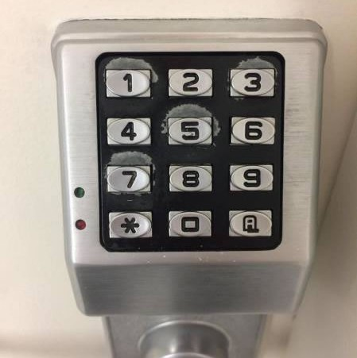

Slide 45
Exercise
How would you break into the CSE building?

Slide 46
Exercise
How would you identify who was at a protest?

Slide 47
Exercise
How would you steal my email password?

Slide 48
Exercise
What security systems do you interact with?

Slide 49
Exercise
How would you steal an election?

Slide 50
Thinking like a Defender
Security policy
  What are we trying to protect?
  What properties are we trying to enforce?
Threat model
  Who are the attackers? Capabilities? Motivation?
  What kind of attack are we trying to prevent?
Risk assessment
  What are the weaknesses of the system?
  What will successful attacks cost us?
  How likely?
Countermeasures
  Costs vs. benefits?
  Technical vs. nontechnical?

Slide 51
Assessing Cost
What would security breaches cost us?
  Direct costs: Money, property, safety, . . .
  Indirect costs: Reputation, future business, well being,
...
How likely are these costs?
  Probability of attacks?
  Probability of success?

Slide 52
Countermeasures
Technical countermeasures
Nontechnical countermeasures
Law, policy (government, institutional), procedures, training, auditing, incentives, etc.

Slide 53
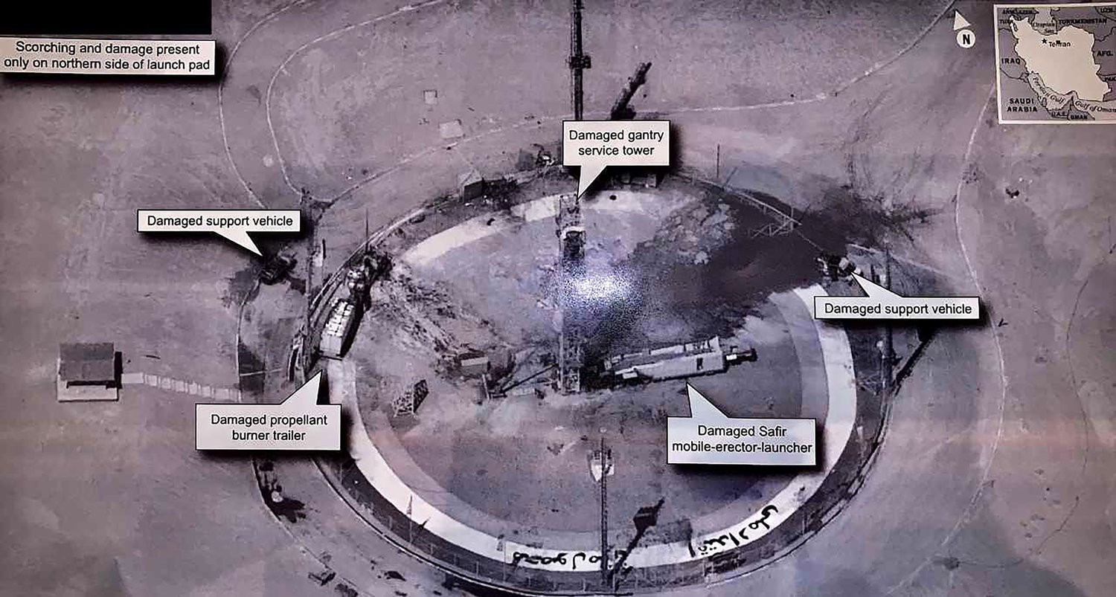
How do we protect classified satellites?

Slide 54
Security Costs
No security mechanism is free
  Direct costs:
Design, implementation, enforcement, false positives
  Indirect costs:
Lost productivity, added complexity
Challenge is to rationally weigh costs vs. risk
  Human psychology makes reasoning about high cost/low probability events hard

Slide 55
Exercise
Should you lock your door?
Assets?
Adversaries?
Risk assessment?
Countermeasures?
Costs/benefits?

Slide 56
Exercise
Should you use automatic software updates?
Assets?
Adversaries?
Risk assessment?
Countermeasures?
Costs/benefits?

Slide 57
Exercise
Should we protect the CS building?
Assets?
Adversaries?
Risk assessment?
Countermeasures?
Costs/benefits?

Slide 58
Secure Design
Common mistake:
Convince yourself that the system is secure
Better approach:
Identify weaknesses of design, focus on correcting them Formally prove that design is secure (soon)
Secure design is a process
Must be practiced continuously Retrofitting security is super hard

Slide 59
Where to focus defenses
Trusted components
Parts that must function correctly for the system to be secure.
Attack surface
Parts of the system exposed to the attacker
Security Principles
Simplicity, open design, and maintainability
Privilege separation and least privilege
Defense-in-depth and diversity
Complete mediation and fail-safe

Slide 60
Characteristics of Computer Intrusion
A computing system: a collection of hardware, software, data, and people that an organization uses to do computing tasks
Any piece of the computing system can become the target of a computing crime.
The weakest point is the most serious vulnerability.
The principles of easiest penetration

Slide 61
Security Breaches - Terminology
Exposure
  a form of possible loss or harm
Attack
Assets – h/w, s/w, data
Information Asset
Physical Asset
People Asset
Critical Assets vs disaster

Slide 62
Types of Security Breaches
Disclosure: unauthorized access to info
  Snooping
Deception: acceptance of false data
  Modification, spoofing, repudiation of origin, denial of receipt
Disruption: prevention of correct operation
  Modification, man-in-the-middle attack
Usurpation: unauthorized control of some part of the system (usurp: take by force or without right)
  Modification, spoofing, delay, denial of service

Slide 63
Levels of security breach impact
Low: the loss will have a limited impact, e.g., a degradation in mission or minor damage or minor financial loss or minor harm
Moderate: the loss has a serious effect, e.g., significance degradation on mission or significant harm to individuals but no loss of life or threatening injuries
High: the loss has severe or catastrophic adverse effect on operations, organizational assets or on individuals (e.g., loss of life)

Slide 64
Goals of Security
Prevention
  Prevent attackers from violating security policy
Detection
  Detect attackers’ violation of security policy
Recovery
  Stop attack, assess and repair damage
  Continue to function correctly even if attack succeeds
Notes:
Prevention is ideal, because then there are no successful attacks.
Detection occurs after someone violates the policy. The mechanism determines that a violation of the policy has occurred (or is underway), and reports it. The system (or system security officer) must then respond appropriately.
Recovery means that the system continues to function correctly, possibly after a period during which it fails to function correctly. If the system functions correctly always, but possibly with degraded services, it is said to be intrusion tolerant. This is very difficult to do correctly; usually, recovery means that the attack is stopped, the system fixed (which may involve shutting down the system for some time, or making it unavailable to all users except the system security officers), and then the system resumes correct operations.

Slide 65
Risk Analysis
The disadvantages of a security system are that they are time-consuming, costly, often clumsy, and impede management and smooth running of the organisation.
Risk analysis is the study of the cost of a particular system against the benefits of the system.

Slide 66
Vulnerabilities, Threats, and Controls
Understanding Vulnerabilities, Threats, and Controls
  Vulnerability = a weakness in a security system
  Threat = circumstances that have a potential to cause harm
  Controls = means and ways to block a threat, which tries to exploit one or more vulnerabilities
    Most of the class discusses various controls and their effectiveness
  [Pfleeger & Pfleeger]
Example - New Orleans disaster (Hurricane Katrina)
  Q: What were city vulnerabilities, threats, and controls?
  A: Vulnerabilities: location below water level, geographical location in hurricane area, …
  Threats: hurricane, dam damage, terrorist attack, …
  Controls: dams and other civil infrastructures, emergency response
  plan, …

Slide 67
Threat Spectrum
Local threats
  Recreational hackers
  Institutional hackers
Shared threats
  Organized crime
  Industrial espionage
  Terrorism
National security threats
  National intelligence
  Info warriors

Slide 68
Kinds of Threats
Kinds of threats:
  Interception
    an unauthorized party (human or not) gains access to an asset
  Interruption
    an asset becomes lost, unavailable, or unusable
  Modification
    an unauthorized party changes the state of an asset
  Fabrication
    an unauthorized party counterfeits an asset
Examples?

Slide 69
Types of Attacks on Data CIA
Disclosure
  Attack on data confidentiality
Unauthorized modification / deception
  E.g., providing wrong data (attack on data integrity)
Disruption
  DoS (attack on data availability)
Usurpation
  Unauthorized use of services (attack on data confidentiality, integrity or availability)

Slide 70
Methods of Defense
Five basic approaches to defense of computing systems
  Prevent attack
    Block attack / Close vulnerability
  Deter attack
    Make attack harder (can’t make it impossible ☹)
  Deflect attack
    Make another target more attractive than this target
  Detect attack
    During or after
  Recover from attack

Slide 71
A Layered Security Strategy
Policies, Procedures, Awareness
Physical
Perimeter
Internal Network
Host
Application
Data
Don’t stop here!
Notes:
Strength in depth
Compliance can be at different layers of this stack.

Slide 72
Tools for Information Security
Authentication
Access Control
Encryption
Passwords
Backup
Firewalls
Virtual Private Networks (VPN)
Physical Security
Security Policies

Slide 73
Authentication
Persons accessing the information is who they say they are
Factors of identification:
  Something you know – user ID and password
    User ID identifies you while the password authenticates you
    Easy to compromise if weak password
  Something you have – key or card
    Can be lost or stolen
  Something you are – physical
  characteristics (i.e., biometrics)
    Much harder to compromise
A combination of at least 2 factors
is recommended

Slide 74
Access Control
Once authenticated – only provide access to information necessary to perform their job duties to read, modify, add, and/or delete information by:
  Access control list (ACL) created for each resource (information)
    List of users that can read, write, delete or add information
    Difficult to maintain all the lists
  Role-based access control (RBAC)
    Rather than individual lists
    Users are assigned to roles
    Roles define what they can access
    Simplifies administration

Slide 75
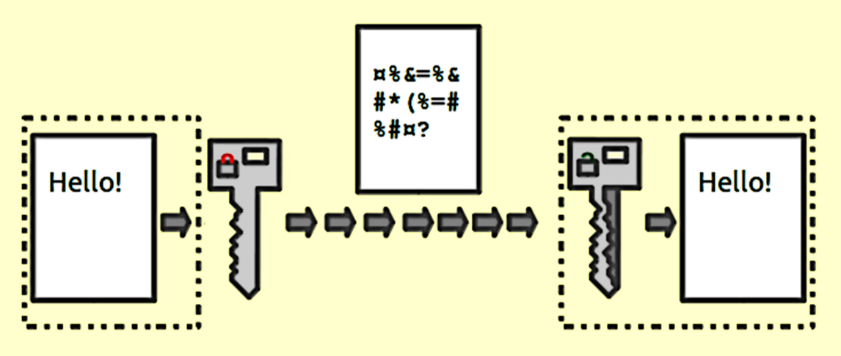
Encryption
An algorithm (program) encodes or scrambles information during transmission or storage
Decoded/unscrambled by only authorized individuals to read it
How is this done?
  Both parties agree on the encryption method (there are many) using keys
    Symmetric key – sender and receiver have the
    key which can be risky
    Public Key – use a public and private key
    where the public key is used to send an
    encrypted message and a private key that the
    receiver uses to decode the message

Slide 76
Passwords
Single-factor authentication (user ID/password) is the easiest to break
Password policies ensure that this risk is minimized by requiring:
  A certain length to make it harder to guess
  Contain certain characters – such as upper and lower case, one number, and a special character
  Changing passwords regularly and do not a password to be reused
  Employees do not share their password
  Notifying the security department if they
  feel their password has been compromised.
  Yearly confirmation from employees that
  they understand their responsibilities

Slide 77
Backup
Important information should be backed up and store in a separate location
  Very useful in the event that the primary computer systems become unavailable
A good backup plan requires:
  Understanding of the organizational information resources
  Regular backups of all data
  Offsite storage of backups
  Test of the data restoration
Complementary practices:
  UPS systems
  Backup processing sites

Slide 78
Firewalls
Can be a piece of hardware and/or software
Inspects and stops packets of information that don’t apply to a strict set of rules
  Inbound and outbound
Hardware firewalls are connected to the network
Software firewalls run on the operating system and intercepts packets as they arrive to a computer
Can implement multiple firewalls to allow segments of the network to be partially secured to conduct business
Intrusion Detection Systems (IDS)
watch for specific types of activities
to alert security personnel of potential
network attack

Slide 79
Virtual Private Networks (VPN)
Some systems can be made private using an internal network to limit access to them
  Can’t be accessed remotely and are more secure
  Requires specific connections such as being onsite
VPN allows users to remotely access these systems over a public network like the Internet
  Bypasses the firewall
  Encrypts the communication or the data exchanged
  Instructions to establish a VPN connection
  can be found at https://ehelp.wiki.cpp.edu/VPN_(Virtual_Private_Network):_Requirements

Slide 80
Physical Security
Protection of the actual equipment
  Hardware
  Networking components
Organizations need to identify assets that need to be physically secured:
  Locked doors
  Physical intrusion detection - e.g., using security cameras
  Secured equipment
  Environmental monitoring –
  temperature, humidity, and airflow
  for computer equipment
  Employee training

Slide 81
Security Policies
Starting point in developing an overall security plan
Formal, brief, and high-level statement issued by senior management
  Guidelines for employee use of the information resources
  Embraces general beliefs, goals, objectives, and acceptable procedures
  Includes company recourse if employees violate the policy
Security policies focus on confidentiality, integrity, and availability
  Includes applicable government or industry regulations
Bring Your Own Device (BYOD) policies for mobile devices
  Use when accessing/storing company information
  Intellectual property implications
Difficult to balance the need for security and
users’ needs

Slide 82
Personal Information Security
Simple steps that individuals can take to be more secure:
  Keep your software up to date
  Install antivirus software
  Use public networks carefully
  Backup your data
  Secure your accounts with two-factor authentication
  Make your passwords long, unique, and strong
  Be suspicious of strange links and attachments
For more information on personal
information security, visit the Stop,
Think, Connect website at http://www.stopthinkconnect.org/

Slide 83
Questions?

