Slide 1
Networking Basics
CS 5352/6352 Computer Security
Lecture note
Dr. Sajedul Talukder

Slide 2
What is a Computer Network
net·work: [net-wurk] – noun, a system containing any combination of computers, computer terminals, printers, audio or visual display devices, or telephones interconnected by telecommunication equipment or cables: used to transmit or receive information.

Slide 3
Why Networking is Important?
Indispensable part of modern society
  Commercial – e-commerce, banking, inventorying, telecommunications, archiving, health
  Social – critical infrastructure, homeland security, policing
  Human interaction/communication – email, chat, videoconferencing, social networking, entertainment
Appears in every facet of engineering
  Modern trend – Network every (electronic) device (computers, phones, sensors, planes, cars, TVs, appliances, heart monitors, …)
Most frequent targets of attacks!

Slide 4
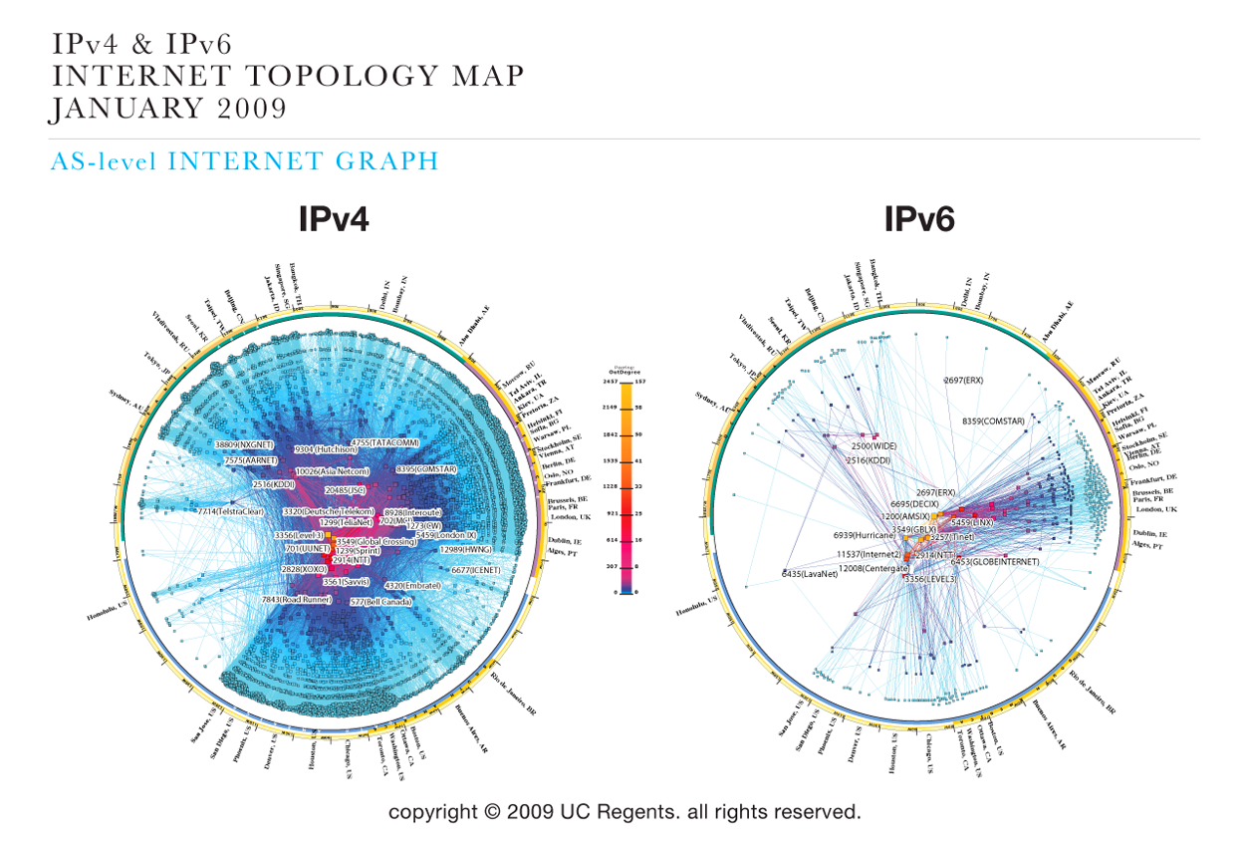
How does the Internet Look Like?

Slide 5
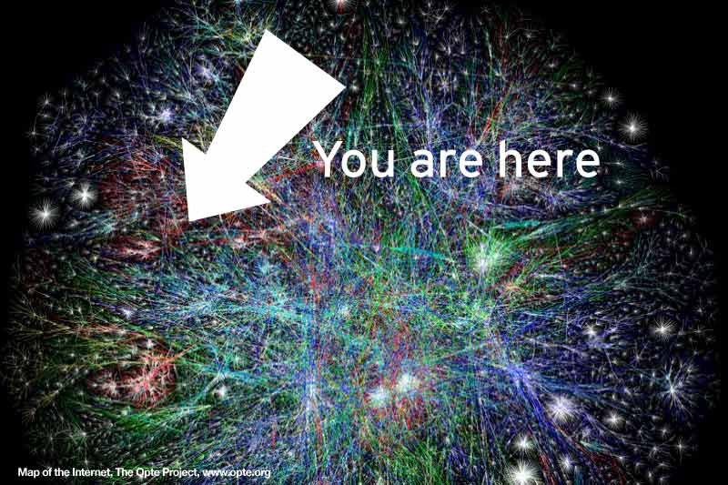
How does the Internet Look Like?

Slide 6
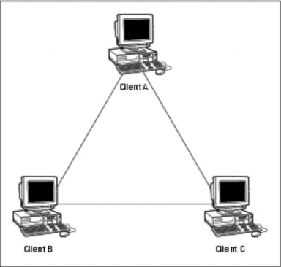
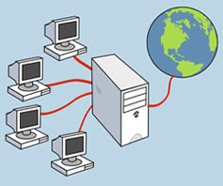

The Three Types of Networks
PEER TO PEER
LOCAL AREA
WIDE AREA

Slide 7
Peer to Peer Network
Usually very small networks
Each workstation has equivalent capabilities and responsibilities
Requires a switch or a hub.
These types of networks do not perform well under heavy data loads.

Slide 8
Local Area Network (LAN)
A Local Area Network spans a relatively small area
LAN are usually confined to one building or a group of buildings
Data travel between network devices via Ethernet cables or Wi-Fi.

Slide 9
WLAN (Wireless LAN)
Local Area Network created over Wi-Fi.
Wi-Fi (Wireless Fidelity)
  A wireless technology that connects computers without cables
Access Point (AP)
  A device (base station) that connects wireless devices together
  Usually connected to a wired-network
ESSID (Extended Service Set ID)
  A “name” for the AP, eg. EU-NET
Hotspot
  The area covered by wireless access points

Slide 10
WLAN (Wireless LAN)
Standard
  802.11b - 11Mbps
  802.11g - 54Mbps
  802.11a - 54Mbps
Security
  WEP (Wired Equivalen Privacy)
  WPA (Wi-Fi Protected Access)
  To prevent wardriving
2.4G
5G

Slide 11
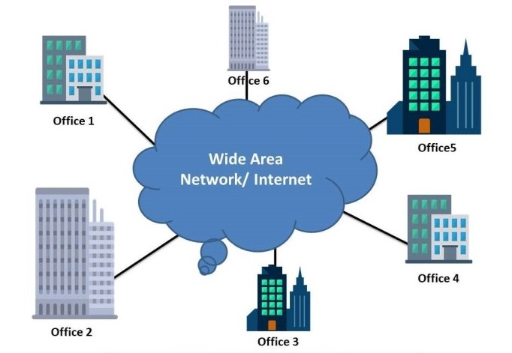
Wide Area Network (WAN)
A Wide Area Network exist over a large area
Usually connects multiple LANS together
The world’s largest Wide Area Network is the Internet

Slide 12
LAN vs WAN
WAN connects multiple LANS together

Slide 13
Network Hardware
The most essential networking hardware devices for us to learn about are:
  Cables
  NICs
  Hubs
  Switches
  Routers

Slide 14
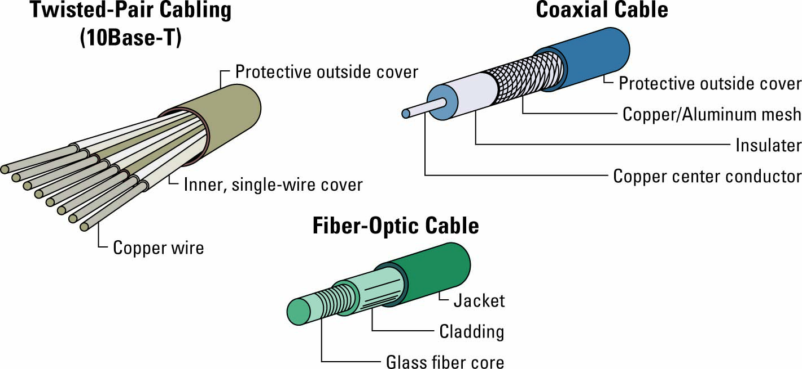
Cables

Slide 15
NIC – a “Network Interface Card”
Every networked device must have a NIC
  Most laptops today have both a wired NIC and a wireless NIC
Each NIC has an IP address (it’s “logical address”) and a physical address called a MAC address.
  Each NIC is given an address at the factory that is the device’s physical address or MAC address.
  No two NIC devices will ever have the same MAC address.
MAC Addresses are used within a LAN
  IP addresses allow routers to route a message across different networks
  when a message reaches the correct destination network, the correct NIC is identified via its MAC address.

Slide 16
Hubs
A “hub” is a networking component into which you can plug in multiple network devices
  Connect computers, printers, scanners, etc.
Anytime a connected device sends a network message, the hub forwards the message to all other connected devices (not just the intended recipient!)
  Unintended recipients should ignore bogus network traffic (akin to “screening” telephone calls)
  Creates opportunities for deviant “packet sniffers”
Hub can only deal with one message at a time, since it is broadcast over all connections

Slide 17
Switches
A switch is a network device which directs traffic only to its intended destination(s) rather than to all devices on the network.
  sometimes referred to as an “intelligent hub”
Provide a dedicated connection between individual devices
  multiple devices can send data at once
Consider packet sniffing software threat for people who share a hub and have not activated network encryption
  Data sent “in the clear” means it has not been encrypted, and therefore is vulnerable to eavesdropping via a hub
As the prices for switches have dropped tremendously over time, most companies have replaced hubs with switches
  Switch protects from eavesdropping by sending data on the LAN only to the intended recipient

Slide 18
A Network Switch
Switch receives
data
and sends
it back out
Switch
Switch sends
signal out to a
single Port
Station A
Transmits
to Station C
Station
A
Station
B
Station
C
Station
D

Slide 19
Routers
Different networks connect via routers (not switches or hubs)
Routers even connect networks based on different protocols, which is important since not all networks use the same protocol.
Network A
Switches
Routers
Network B
Switches

Slide 20
Firewall
A firewall is a hw/sw that can be loaded on to a network that can serve as a barrier that keeps destructive forces away from a network of computers.
Packets of data are analyzed against a set of criteria or standards called filters.
Filters block certain designated IP addresses.

Slide 21
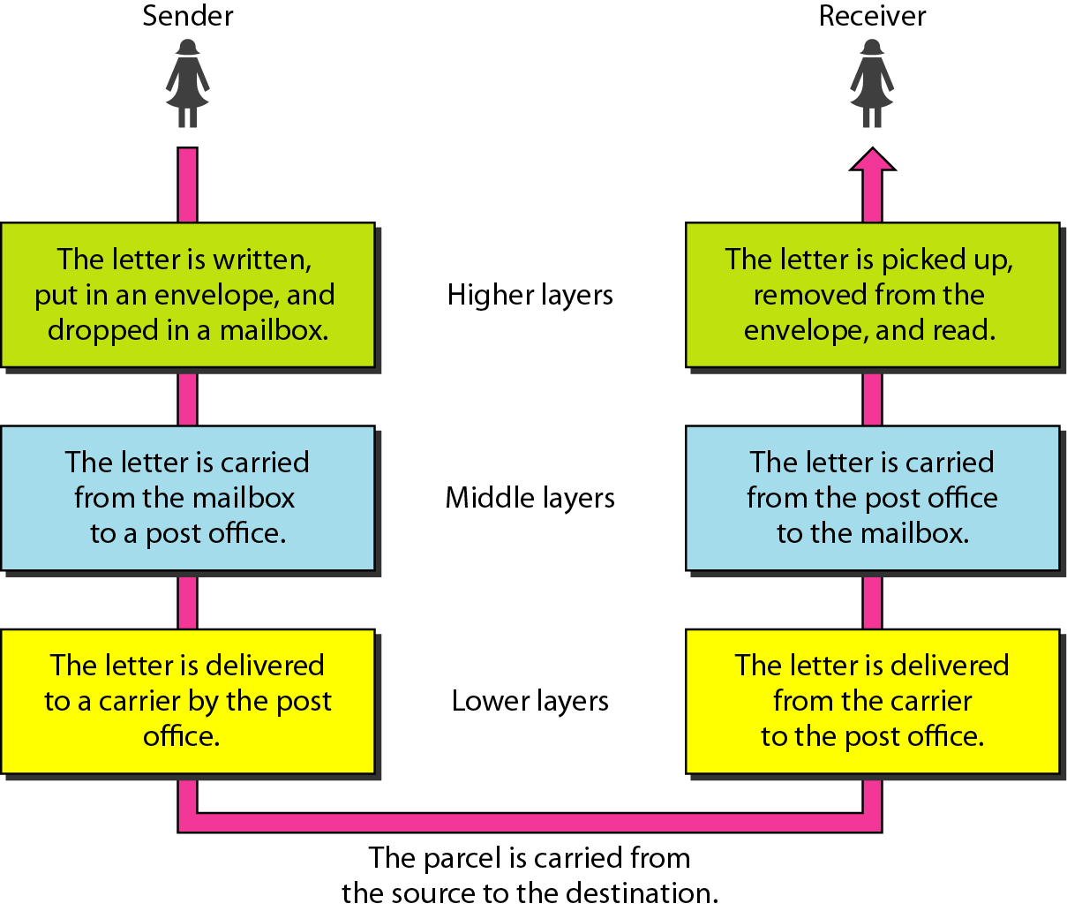
Layered Tasks, Example

Slide 22
7-Layer OSI Model

Slide 23
7-Layer OSI Model
Data
Layer 7
Application Layer
Data
Layer 6
Presentation Layer
Software Layers
Data
Layer 5
Session Layer
Segments
Layer 4
Transport Layer
Packets
Layer 3
Network Layer
Frames
Layer 2
Data Link Layer
Hardware Layers
Bits
Layer 1
Physical Layer

Slide 24
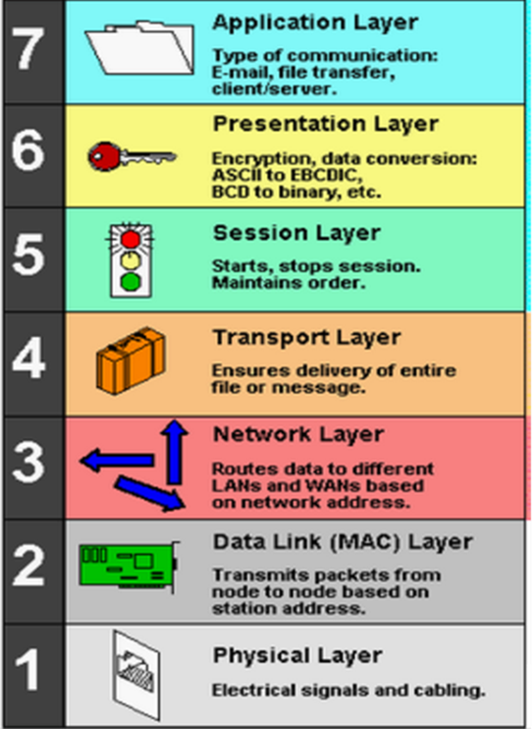
Layer 7: Application Layer
Users and applications are provided access to network services through the Application layer.
Functionality provided:
Remote file and printer access
Resource sharing
Communications between processes
Electronic messaging and e-mail
Directory services
Virtual devices and virtual communications
Web browsing

Slide 25
Layer 7: Application Layer Protocols
Level at which applications access network services

Slide 26

Layer 6: Presentation Layer
The Presentation layer is responsible for formatting data from the Application layer so that the data can be transmitted or so that the data can be recognized by the Application layer.
Functionality provided:
Character translation
ASCII
EBCDIC
Conversion
Compression
Encryption

Slide 27
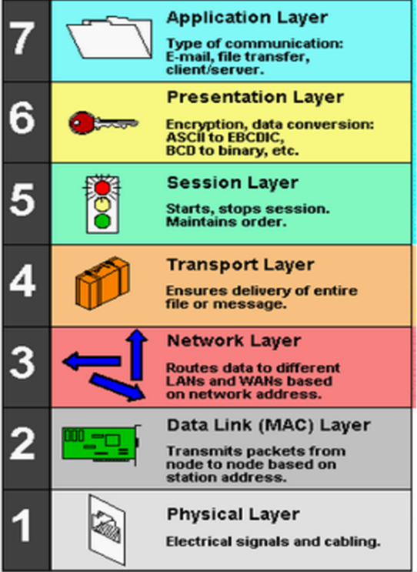
Layer 5: Session Layer
Session Layer protocols also provide functions to support the session, including security, recognition between hosts, and session logging.
Functionality provided:
Establishing sessions between hosts
Managing/maintaining sessions and tokens
Terminating sessions when it is no longer needed.

Slide 28

Layer 4: Transport Layer
The Transport layer is responsible for error‐free delivery message. Retransmission of data to recover errors or lost data will occur in software managing this layer.
The basic functions are similar to those provided for frames by the Data Link layer, but at a higher level.
Functionality provided:
Segmentation
Acknowledgement
Traffic control
Multiplexing

Slide 29

Layer 3: Network Layer
The Network layer makes routed networks possible.
Functionality provided:
Network address
Traffic routing
Fragmentation/ reassembly

Slide 30
Layer 3: Network Layer
Manages addressing/routing of data within the subnet
  Addresses messages and translates logical addresses and names into physical addresses.
  Determines the route from the source to the destination computer
  Manages traffic problems, such as switching, routing, and controlling the congestion of data packets.
Routing can be:
  Based on static tables
  determined at start of each session
  Individually determined for each packet, reflecting the current network load.
Notes:
The Network Layer controls the subnet.
The key design issue is routing of data within the subnet. Routing can be:
based on static tables (rarely changed),
determined at the start of each session, or
highly dynamic: individually determined for each packet, reflecting the current network load.
Too many packets in the subnet simultaneously can form bottlenecks; this is dealt with by congestion control procedures in the Network Layer.
Accounting for subnet use is also typically the responsibility of the Network Layer.
When a packet travels from one network to another, address conversion may be necessary; this is also performed by the Network Layer.
In Broadcast networks (e.g. many LANs), the routing problem is very straightforward, and hence Layer 3 will be very simple, or even non-existent.

Slide 31

Layer 2: Data Link Layer
The Data Link layer is responsible for ensuring that data is transmitted between nodes without errors. This accuracy is accomplished through the following practices:
Functionality provided:
Link control
Traffic control
Sequencing
Acknowledgement
Delimiting
Error correction
Access management

Slide 32
Data Link Layer: MAC address
Each node is uniquely identified at the Data Link layer through a unique address known as the Media Access Control (MAC) address.
The standard format for printing MAC addresses in human-friendly form is six groups of two hexadecimal digits (six bytes), for example: 00-C0-26-A9-42-F7.
The first three octets (in transmission order) identify the organization that issued the identifier and are known as the Organizationally Unique Identifier (OUI).
The remaining three octets represent a unique adapter address – Network Interface Controller (NIC) Specific.

Slide 33
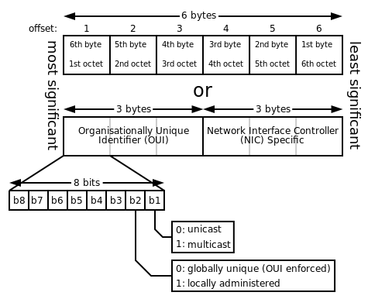
Data Link Layer: MAC address

Slide 34
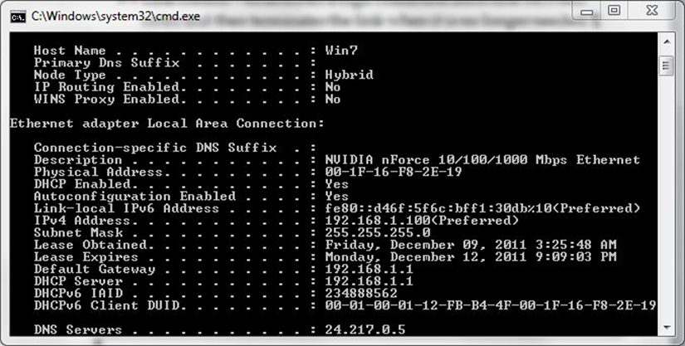
Data Link Layer: MAC address
You can retrieve the MAC address for an Ethernet network adapter in a Windows computer by running the ipconfig/all command or in Linux by running the ifconfig -a. The MAC address is listed with the Ethernet adapter configuration. It is listed as the adapter’s physical address.

Slide 35
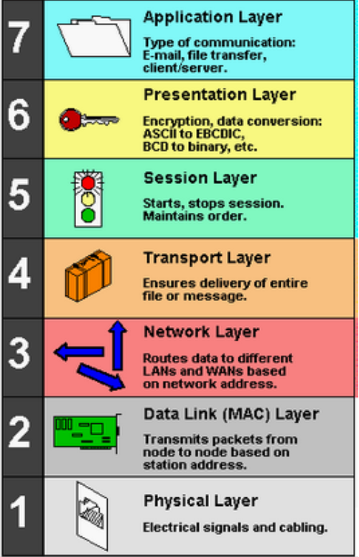
Layer 1: Physical Layer
The Physical layer is responsible for transmitting and receiving data over a transmission media. Data is treated as an unstructured raw data stream.
Functionality provided:
Transmission media
Connector
Data encoding and synchronization
Transmission technique

Slide 36
Layer 1: Physical Layer
The physical layer is responsible for movements of individual bits from one hop (node) to the next.
Regulates the transmission of a stream of bits over a physical medium.
Defines how the cable is attached to the network adapter and what transmission technique is used to send data over the cable. Deals with issues like
  The definition of 0 and 1, e.g. how many volts represents a 1, and how long a bit lasts? Data rate?
  Whether the channel is simplex, half-duplex, full-duplex?
  Physical characteristics of interface and medium: How many pins a connector has, and what the function of each pin is?

Slide 37
Services in the OSI Model
In OSI model, each layer provide services to layer above, and ‘consumes’ services provided by layer below.
Active elements in a layer called entities.
Entities in same layer in different machines called peer entities.

Slide 38
Layering Principles
N+1
PDU
(N+1) Entity
Service User
(N+1) Entity
Service User
Layer N+1 protocol
Layer N Service
Access Point (SAP)
SDU
(N) Entity
Service Provider
(N) Entity
Service Provider
Layer N protocol
N
PDU
N
PDU
PDU - Protocol Data Unit
SDU - Service Data Unit
Layer N provides service to layer N+1

Slide 39
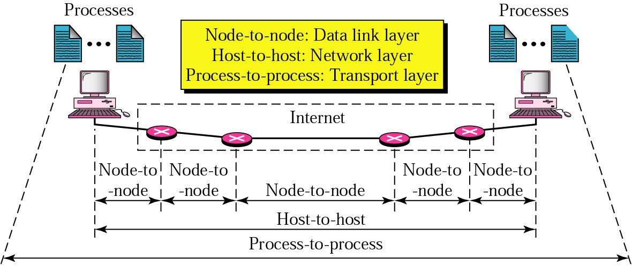
Layer-to-layer Communication
Process-to-process delivery

Slide 40
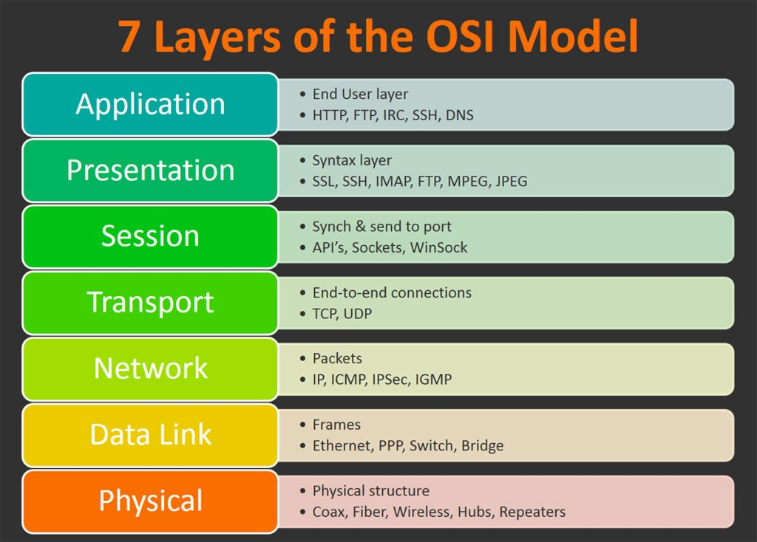
Network Protocols

Slide 41
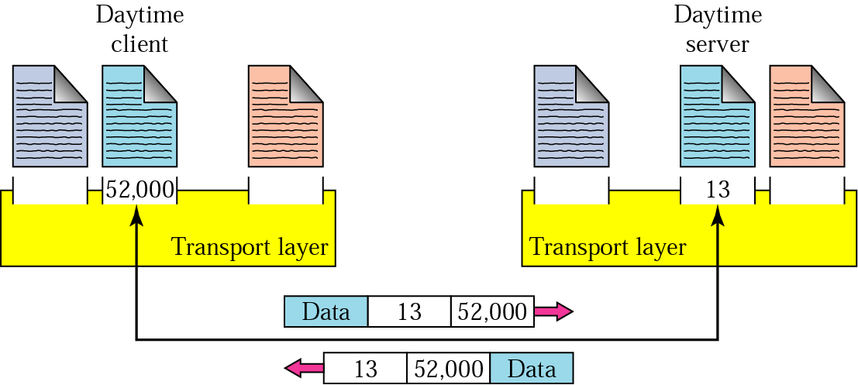
Communication Identifier
Addresses
  Data link layer → MAC address
  Network layer → IP address
  Transport layer → Port number (choose among multiple processes running on destination host)

Slide 42
Network Addresses
Hostname A unique identification that specifies a particular computer on the Internet
For example
  buba.cs.edinboro.edu
  condor.develocorp.com

Slide 43
Port Numbers
A port number is a way to identify a specific process to which an Internet or other network message is to be forwarded when it arrives at a server.
Port numbers are 16-bit integers (0 → 65,535)
  Servers use well known ports, 0-1023 are privileged
  Clients use ephemeral (short-lived) ports
Internet Assigned Numbers Authority (IANA) maintains a list of port number assignment
  Well-known ports (0-1023) → controlled and assigned by IANA
  Registered ports (1024-49151) → IANA registers and lists use of ports as a convenience (49151 is ¾ of 65536)
  Dynamic ports (49152-65535) → ephemeral ports
For well-known port numbers, see /etc/services on a UNIX or Linux machine

Slide 44
Domain Name System
A hostname consists of the computer name followed by the domain name
cs.siu.edu is the domain name
  A domain name is separated into two or more sections that specify the organization, and possibly a subset of an organization, of which the computer is a part
The Domain Name System (DNS) is a hierarchical and decentralized naming system for computers, services, or other resources connected to the Internet or a private network.
DNS Server translates domain names to IP addresses.

Slide 45
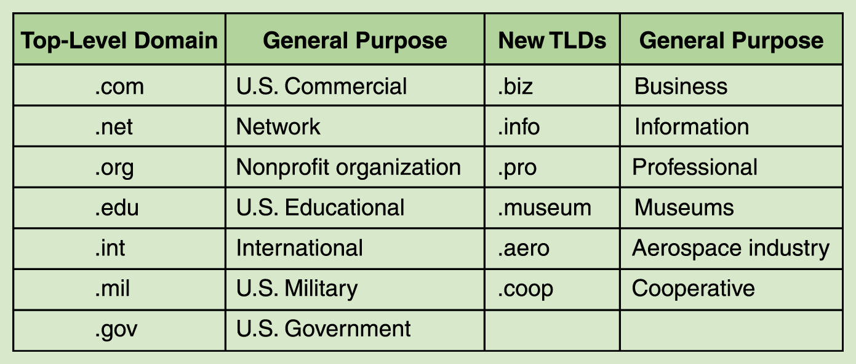
Domain Name System
The very last section of the domain is called its top-level domain (TLD) name
Top-level domains, including some relatively new ones

Slide 46
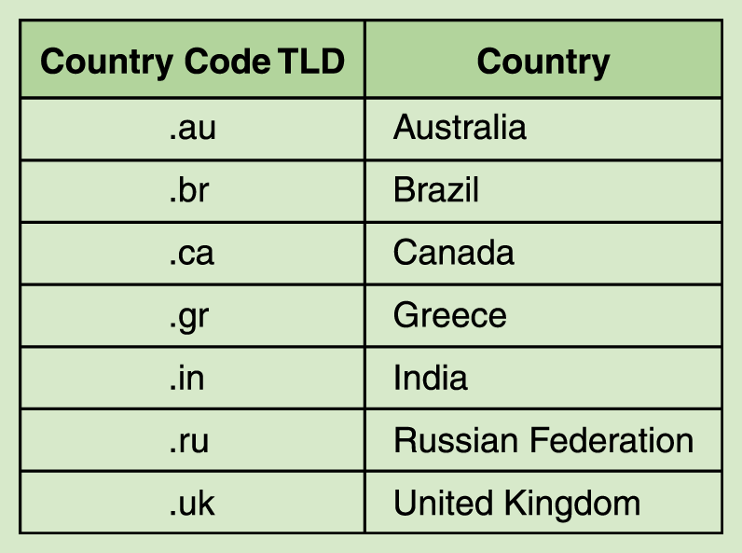
Domain Name System
Organizations based in countries other than the United States use a top-level domain that corresponds to their two-letter country codes
Some of the top-level domain names based on country codes

Slide 47
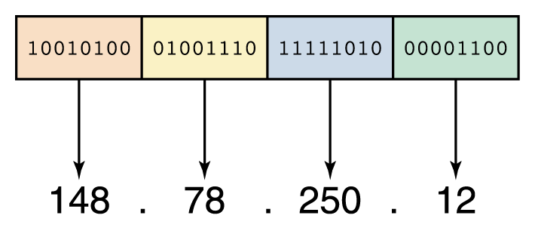
IP Addresses
IP address: A way to uniquely identify machines on a network
  IP addresses consist of four sections
  Each section is 8 bits long
  Each section can range from 0 to 255
  Written, for example, 148.78.250.12
An IP address is stored in four bytes

Slide 48
IP Protocol: Architecture of IP address
Historical classful network architecture: Classful network design allowed for a larger number of individual network assignments and fine-grained subnetwork design. Three classes (A, B, and C) were defined for universal unicast addressing. Each class used successively additional octets in the network identifier.
Historical classful network architecture
Class | Leading bits | Size of network number bit field | Size of rest bit field | Number of networks | Addresses per network | Start address | End address
A | 0 | 8 | 24 | 128 (2⁷) | 16,777,216 (2²⁴) | 0.0.0.0 | 127.255.255.255
B | 10 | 16 | 16 | 16,384 (2¹⁴) | 65,536 (2¹⁶) | 128.0.0.0 | 191.255.255.255
C | 110 | 24 | 8 | 2,097,152 (2²¹) | 256 (2⁸) | 192.0.0.0 | 223.255.255.255
First 8 bits:
A: 00000000 – 01111111 0 – 127
B: 10000000 – 10111111 128 – 191
C: 11000000 – 11011111 192 – 223

Slide 49
IP Protocol: Private IP addresses
Is anyone here using this IP address at home?
  192.168.0.1
How can many people use the same IP address?
  “I thought each computer on the internet required a different IP address?”
Recall: the IT industry decided that the following ranges of IP addresses would be non-routable (i.e., a router will not pass along packets with such destinations to another network)
IANA-reserved private IPv4 network ranges
 | Start | End | No. of addresses
24-bit block (/8 prefix, 1 × A) | 10.0.0.0 | 10.255.255.255 | 16777216
20-bit block (/12 prefix, 16 × B) | 172.16.0.0 | 172.31.255.255 | 1048576
16-bit block (/16 prefix, 256 × C) | 192.168.0.0 | 192.168.255.255 | 65536

Slide 50
Network prefix and Host number
IP address has 2 parts: the network prefix identifies a network and the host number identifies a specific host (actually, interface on the network).
How do we know how long the network prefix is?
  The network prefix used to be implicitly defined (class-based addressing, A,B,C,D…)
  The network prefix now is flexible and is indicated by a prefix/netmask (classless).
32-bit IP Address
network prefix
host number

Slide 51
Example
Example: buba.cs.edinboro.edu
IP address is 147.64.242.9
  Is that enough info to route datagram??? -> No, need netmask or prefix at every IP device (host and router)
Using Prefix notation IP address is: 147.64.242.9/16
  Network prefix is 16 bits long
Network mask is: 255.255.0.0 or hex format: ffff0000
  -----> Network id (IP address AND Netmask) is: 147.64.0.0
  -----> Host number (IP address AND inverse of Netmask) is: 242.9
147.64
242.9
network prefix
host number

Slide 52
Subnetting
Problem: Organizations have multiple networks which are independently managed
  Solution 1: Allocate an address for each network
    Difficult to manage
    From the outside of the organization, each network must be addressable.
  Solution 2: Add another level of hierarchy to the IP addressing structure
University Network
Engineering
School
Medical
School
Library
Subnetting

Slide 53
Basic Idea of Subnetting
Split the host number portion of an IP address into a subnet number and a (smaller) host number.
Result is a 3-layer hierarchy
Then:
    Subnets can be freely assigned within the organization
    Internally, subnets are treated as separate networks
    Subnet structure is not visible outside the organization
network prefix
host number
network prefix
subnet number
host number
extended network prefix

Slide 54
Subnetting Example
An organization with 4 departments has the following IP address space: 10.2.22.0/23. As the systems manager, you are required to create subnets to accommodate the IT needs of 4 departments. The subnets have to support to 200, 61, 55, and 41 hosts respectively. What are the 4 subnet network numbers?
Solution:
  10.2.22.0/24 (256 addresses > 200)
  10.2.23.0/26 (64 addresses >61)
  10.2.23.64/26 (64 addresses > 55)
  10.2.23.128/26 (64 addresses > 41)

Slide 55
Advantages of Subnetting
With subnetting, IP addresses use a 3-layer hierarchy:
        Network
        Subnet
        Host
Improves efficiency of IP addresses by not consuming an entire address space for each physical network.
Reduces router complexity. Since external routers do not know about subnetting, the complexity of routing tables at external routers is reduced.
Note: Length of the subnet mask need not be identical at all subnetworks.

Slide 56
IPv6 - IP Version 6
IP Version 6
  Is the successor to the currently used IPv4
  Specification completed in 1994
  Makes improvements to IPv4 (no revolutionary changes)
One (not the only !) feature of IPv6 is a significant increase in size of the IP address to 128 bits (16 bytes)
    IPv6 will solve – for the foreseeable future – the problems with IP addressing
IPv4 has a maximum of
    2³² ≈ 4 billion addresses
IPv6 has a maximum of
  2¹²⁸ = (2³²)⁴ ≈ 4 billion x 4 billion x 4 billion x 4 billion addresses

Slide 57
IPv6 Provider-Based Addresses
Convention: The 128-bit IPv6 address is written as eight 16-bit integers (using hexadecimal digits for each integer)
CEDF:BP76:3245:4464:FACE:2E50:3025:DF12

Slide 58
The Transmission Control Protocol (TCP)
TCP is a protocol that specifies:
  How to distinguish among multiple destinations on a given machine
  How to initiate and terminate a stream transfer
  Format of the data and acknowledgments that two computers exchange to achieve a reliable transfer
  Procedures the computers use to ensure that the data arrives correctly

Slide 59

Establishing a TCP Connection
The 3-way handshake
  Guarantee that both sides are ready for connection
  Allows both sides to agree on initial sequence numbers
client state
server state
LISTEN
LISTEN
Network
Send SYN seq=x
Receive SYN
Send SYN seq=y, ACK x+1
Receive SYN&ACK
Send ACK y+1
Receive ACK

Slide 60
Closing a TCP Connection
client state
server state
LISTEN
LISTEN
Network
(app closes connection)
Send FIN seq=x
Receive FIN Send ACK x+1
Receive ACK
(inform application)
(app closes connection)
Send FIN seq=y, ACK x+1
Receive FIN&ACK
Send ACK y+1
Receive ACK

Slide 61
TCP Connection Reset
Applications normally close connections
Sometimes abnormal conditions arise that break a connection
Broken connections can be reset:
  Site 1 sends a segment with the RST bit set
  Site 2 receives segment and aborts the connection
  Transfers in both directions cease immediately
  Resources for the connection are released
  Applications programs are informed

Slide 62
TCP Socket
TCP socket identified by 4-tuple: source IP address, source port number, dest IP address, dest port number
Receiving host uses all four values to direct segment to appropriate socket
P1
P4
P5
P2
P1
P3
9157
21
80
5775
9157
SP: 5775
DP: 80
S-IP: B
D-IP:C
SP: 9157
SP: 9157
client
IP: A
DP: 21
server
IP: C
DP: 80
Client
IP:B
S-IP: A
S-IP: B
D-IP:C
D-IP:C
A port is a unit door of an apartment building.
A socket is a path to a port.
A process is a person in the unit.
An IP address is the street address of the building.

Slide 63
Packets
To improve the efficiency of transferring information over a shared communication line, messages are divided into fixed-sized, numbered packets
A packet is the unit of data that is routed between a source and a destination on the Internet or any other packet-switched network.
Network devices called routers are used to direct packets between networks
source
destination

Slide 64
Encapsulation/De-encapsulation

Slide 65
UDP: User Datagram Protocol
In TCP/IP protocol suite, using IP to transport datagram (similar to IP datagram).
Allows an application to send datagram to other application on the remote machine.
Delivery and duplicate detection are not guaranteed.
Low overhead: faster than TCP

Slide 66
UDP Characteristics
End-to-End: an application sends/receives data to/from another application.
Connectionless: Application does not need to preestablish communication before sending data; application does not need to terminate communication when finished.
Message-oriented: application sends/receives individual messages (UDP datagram), not packets.
Best-effort: same best-effort delivery semantics as IP. I.e. message can be lost, duplicated, and corrupted.
Arbitrary interaction: application communicates with many or one other applications.
Operating system independent: identifying application does not depend on O/S.

Slide 67
Identifying An Application
UDP cannot extend IP address
  No unused bits
Cannot use OS-dependent quantity
  Process ID, Task number, Job name
Must work on all computer systems
Technique
  Each application assigned unique integer
  Called protocol port number

Slide 68
Protocol Port Number
UDP uses Port Number to identify an application as an endpoint.
UDP messages are delivered to the port specified in the message by the sending application
In general, a port can be used for any datagram, as long as the sender and the receiver agrees
In practice, a collection of well-known ports are used for special purposes such as telnet, ftp, and email. E.g. port 7 for Echo application.
Local operating system provides an interface for processes to specify and access a port.

Slide 69
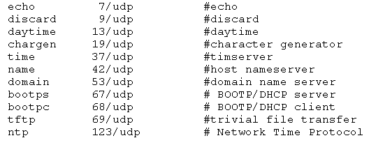
Well-known Port Numbers
list of UDP ports copied from /etc/services on Solaris 2.5:

Slide 70
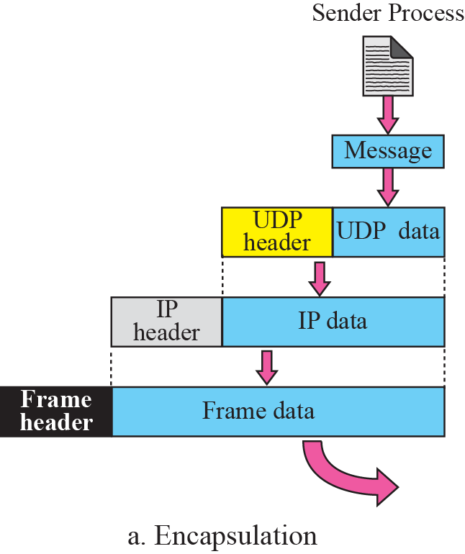
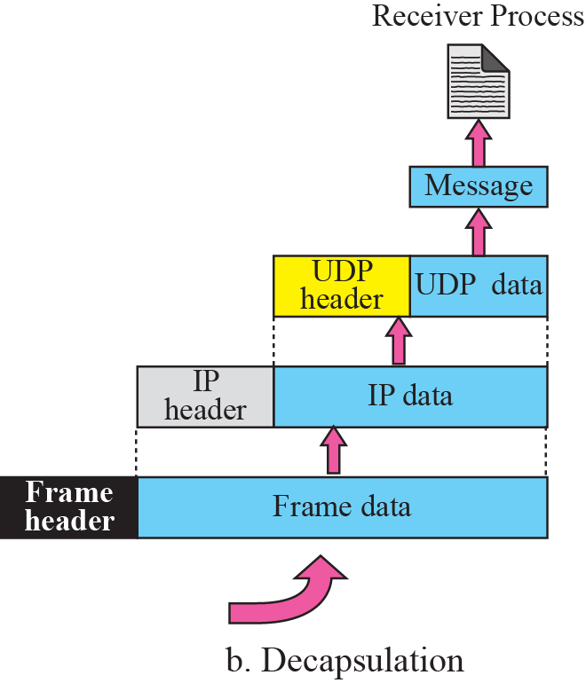

Encapsulation/De-encapsulation

Slide 71
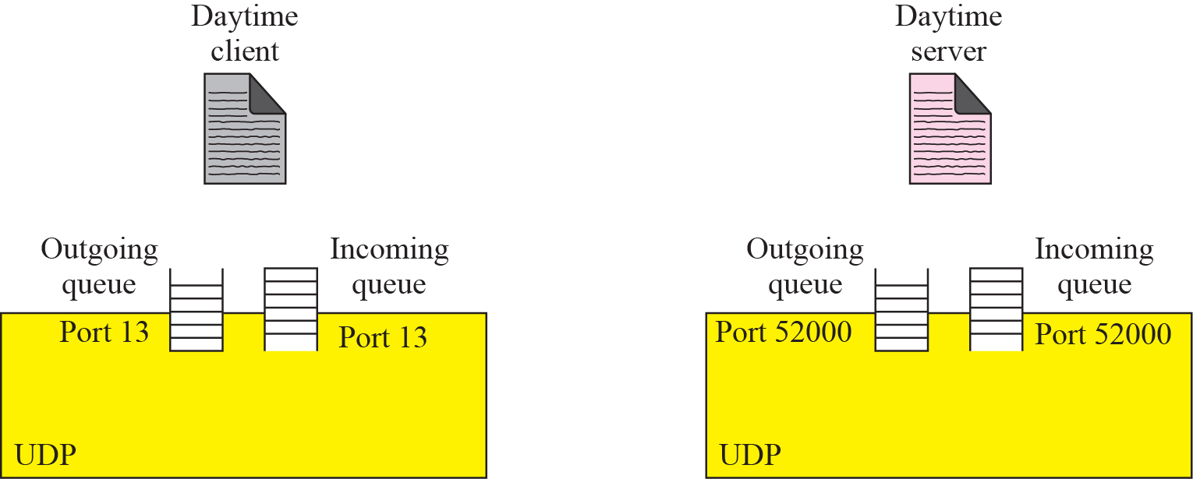
UDP Socket

Slide 72
Questions?

