Slide 1
Feasible and NP

Slide 2
What is feasible algorithm?
Until now we considered whether there is algorithm or no algorithm for solving a problem;
Ex., for halting problem we proved that there is no algorithm;
In some cases, there is an algorithm, but it takes too long t
For ex., some algorithms require exponential time 2^n, where n is the length of input.
What happens when n is 1,000? How big is that?

Slide 3


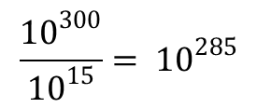

Everybody knows how much is
2^10
1024 = kbyte
So,
$$2^{10}= {10}^{3}$$
$$2^{1000}={{(2}^{10})}^{100}$$
It is approximately equal
$${{(10}^{3})}^{100}= {10}^{300}$$
With the superfast computer we get 10^15 operations per second.
So we need (seconds)
$$\frac{{10}^{300}}{{10}^{15}}= {10}^{285}$$

Slide 4

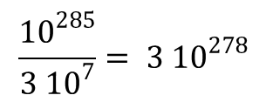
How much is that? 1 year = 365 days
Day is 24 hours
1 year = 365 x 24 x 60 x 60 seconds
Please, calculate
1 year is approximately 3 x (10 ^ 7) seconds
How many years do we need to compute?
$$\frac{{10}^{285}}{{3 10}^{7}}= {3 10}^{278}$$
How many years do we have in the universe (until the sun stops shining, etc.)?
20 billion years
$${2 10}^{10}$$

Slide 5
How many years do we have in the universe?
Clearly, there is no way that we can perform these computations. So we have an algorithm, but it is not practically feasible.
How can we formally describe which algorithms are feasible and which are not? The correct answer is: no one knows.
This is an important open problem (it has been open for 50 years). Joke: if one of you solve this problem, we will switch places – you will be a professor, and I will be a student.
We do not have an exact solution to this problem, but we have a good approximate solution.
You may remember it from CS 1, CS 2, CS 3, namely, if an algorithm requires linear time, quadratic time, cubic time (in relation to the size of the input), it is usually feasible.
Notes:
p3

Slide 6
For example, selection sort or bubble sort. They may be slow, but their computation time is O(n^2) < C x n^2.
So it is feasible.
On the other hand, if an algorithm requires exponential time, it is usually not feasible.
Definition: We call an algorithm A feasible, if it is polynomial time. In other words, if there exists a polynomial p(n) such that for every input x the running time t(x) of algorithm on this input cannot exceed P(len(x)) such that
t(x) <= P(len(x))
This definition is not perfect. Let me give you two examples.
Notes:
p4

Slide 7
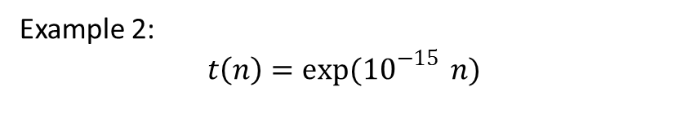
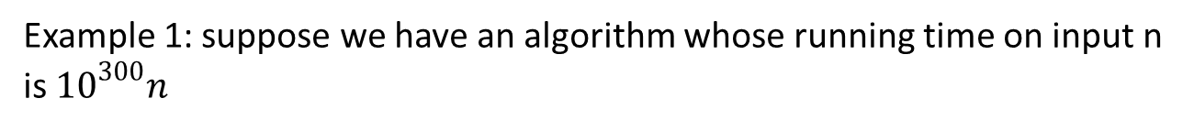
Example 1: suppose we have an algorithm whose running time on input n is ${10}^{300}n$
Question: is this polynomial time?
Answer: Of course, it is linear function of n.
Is it feasible?
Answer: from the practical viewpoint, it is not feasible, it takes longer time than the life of the universe. But according to our definition it is perfectly feasible.
Example 2:
$$t\left(n\right)=\exp{({10}^{−15}} n)$$
Is it feasible?
From the formal viewpoint, according to the definition, it is exponential;
it grows faster than any polynomial. So, formally, it is not feasible.

Slide 8
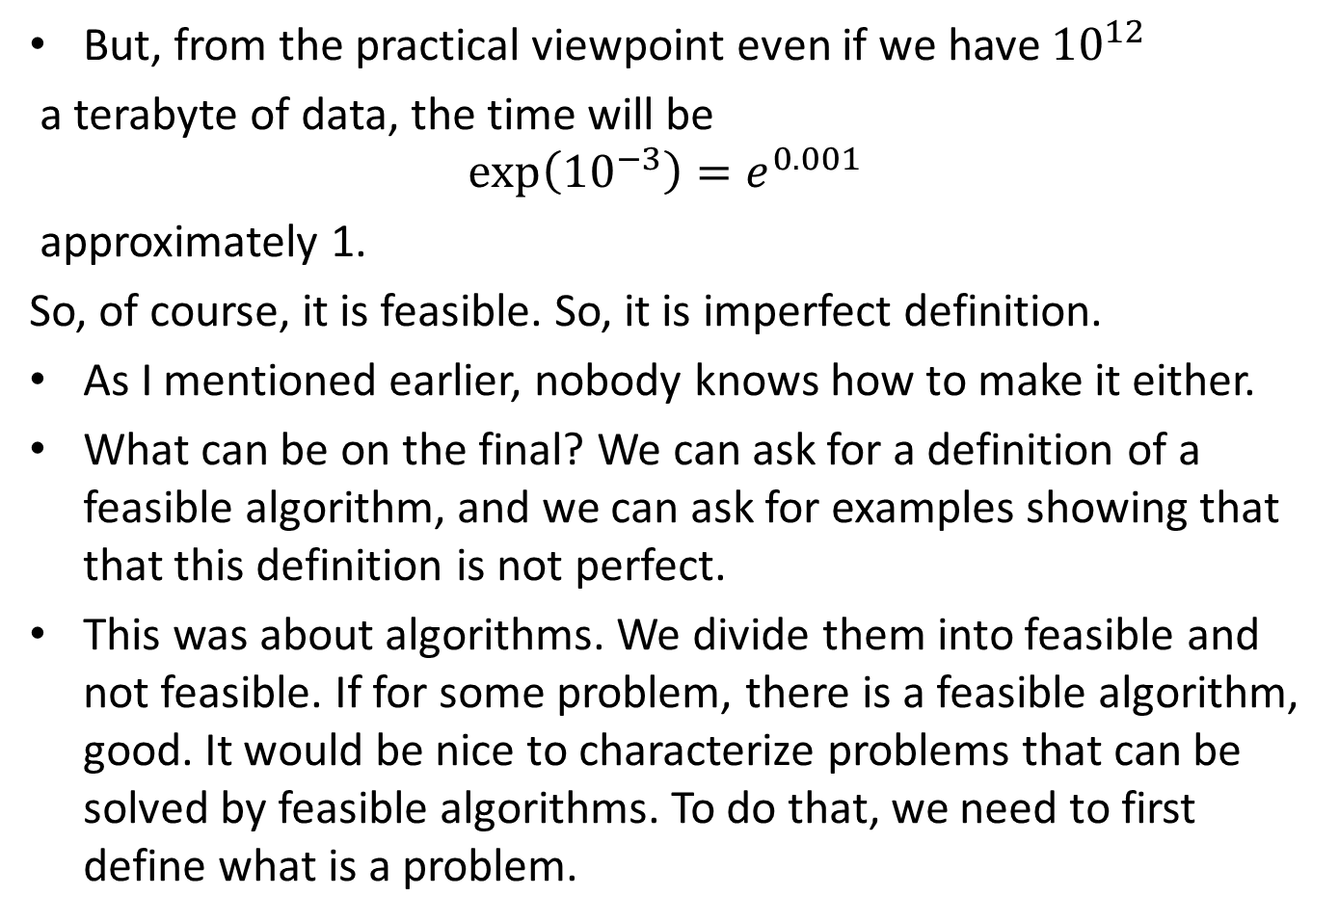
But, from the practical viewpoint even if we have ${10}^{12}$
a terabyte of data, the time will be
$$\exp\left({10}^{−3}\right)=e^{0.001}$$
approximately 1.
So, of course, it is feasible. So, it is imperfect definition.
As I mentioned earlier, nobody knows how to make it either.
What can be on the final? We can ask for a definition of a feasible algorithm, and we can ask for examples showing that that this definition is not perfect.
This was about algorithms. We divide them into feasible and not feasible. If for some problem, there is a feasible algorithm, good. It would be nice to characterize problems that can be solved by feasible algorithms. To do that, we need to first define what is a problem.

Slide 9
Question: let’s start with mathematics. What do mathematicians do?
Mathematicians prove theorems.
Given: a statement x
Find: a proof y of x or a proof of its negation (not x)
This is a mathematical problem.
Question: Once we have a detailed proof, can we check that every step in y is correct.
In other words, we have a feasible algorithm C(x, y) that, given a statement x and proof y that checks whether y is a correct proof of x.
Finding of a proof is often difficult but checking is straightforward. Computers were doing this already in 80’s.

Slide 10
Question: what do physicists do?
Answer: What we have? We have observations x, we have results of experiments.
What we want? We want to find a formula or an algorithm y that explains these
observations.
Example: Ohm’s Law.
Ohm made many experiments and collected data:
I | R | V
1.0 | 2.0 | 2.0
2.0 | 1.5 | 3.0
4.0 | 2.0 | 8.0

Slide 11
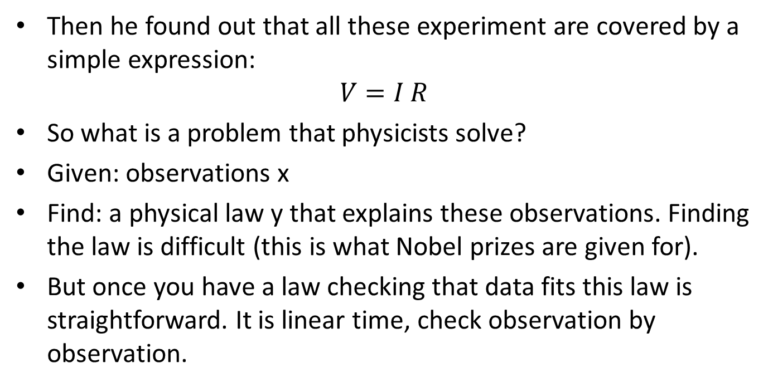
Then he found out that all these experiment are covered by a simple expression:
$$V=I R$$
So what is a problem that physicists solve?
Given: observations x
Find: a physical law y that explains these observations. Finding the law is difficult (this is what Nobel prizes are given for).
But once you have a law checking that data fits this law is straightforward. It is linear time, check observation by observation.
Question: Can y be of any length?
Answer: not really, if the formulation is too long, we can as well list all the cases
and formulate a “law.”

Slide 12

If I = 1.0 and R=2.0, then V = 2.0
If I = 2.0 and R=1.5, then V = 3.0, etc.
Question: Does it make any sense as a physical law? Will you get a Nobel prize for this law?
Answer: no way. So
- len(y) < len(x), where y is law, x is observations.
Same thing in mathematics: if a proof is too long, no one can check it, so it is
useless. This by the way is what happened to first computer proofs.
For example, there was a famous hypothesis that every map can be colored in 4 colors
So that no two neighbors have the same color.
It was at first proved by a computer, but the proof was so long that no one could check it.
And when they eventually checked it, they found a bug in the program.
Now there is another proof which is much shorter and thus checkable. In general, the
Proof must be of feasible length; usually this means that
$$len\left(y\right)≤P(len\left(x\right))$$

Slide 13

Final example: what do engineers do? For example, when they design a bridge?
What they are given is a specification: how many trucks it can carry,
how long it will serve, how much it will cost, etc.
Once you have a design y, there are programs C(x,y) that check whether
it fits the specifications. Coming up with a design may be tough, but checking
Is feasible.
Given: Specifications x
Find: Design y for which C(x,y) returns true and
$$len\left(y\right)≤P(len\left(x\right))$$
If design is too complicated it is not practical.
Now we have a general definition of a problem:

Slide 14

Definition: We have a feasible property C(x,y) and a polynomial P(n).
An instance of a problem has the following form:
Given: a string x
Find: a string y such that C(x,y) is true and
$$len\left(y\right)≤P(len\left(x\right))$$
In such problems, once we guess a solution y, we can feasibly check that
It is indeed a solution.

Slide 15
Question: how do we call computations that involve guesses?
Do you remember non-deterministic finite automata? Such an automaton accepts
a string if there is a path that leads to a final state. So, if we guess this path,
we can easily check that the string is accepted; similarly, non-deterministic
pushdown automata.
In general, computations involving guesses are called non-deterministic.
So problems are called Non-deterministic Polynomial, because with guesses we
can solve them feasibly, that is is polynomial time.
A short of Non-deterministic Polynomial is NP.
Some problems from the class NP can be solved in polynomial time. The class
Of such problems is called P.

Slide 16
Question: what do you think, are there problems that cannot be solved in polynomial time?
Answer: nobody knows. It is an open problem to check whether P = NP.

