Slide 1
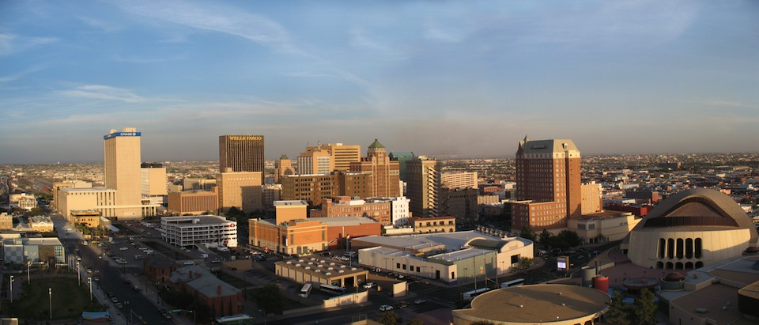
NAFIPS’2011 – March 18-20 El Paso, Texas
Organizers: Vladik Kreinovich and Martine Ceberio

Slide 2
Conference venue: El Paso, Texas
A city that stretches the imagination…
Texas‘ westernmost city
Surprisingly closer to San Diego than to Houston
Tucked between New Mexico and Mexico: from the campus you can see both states and both countries.
A city of nearly three-quarters of a million people…
It spreads across hundreds of square miles of desert and rambling foothills
The Franklin Mountains, southern tip of the Rockies, slice it nearly in two.
A city whose climate earned it the nickname "Sun City“…
It is easy to enjoy the outdoor activities that abound in the area, including hiking in
the Franklin Mountains, which rise to over 7,000 feet inside the city limits.
… An intriguing place to visit

Slide 3
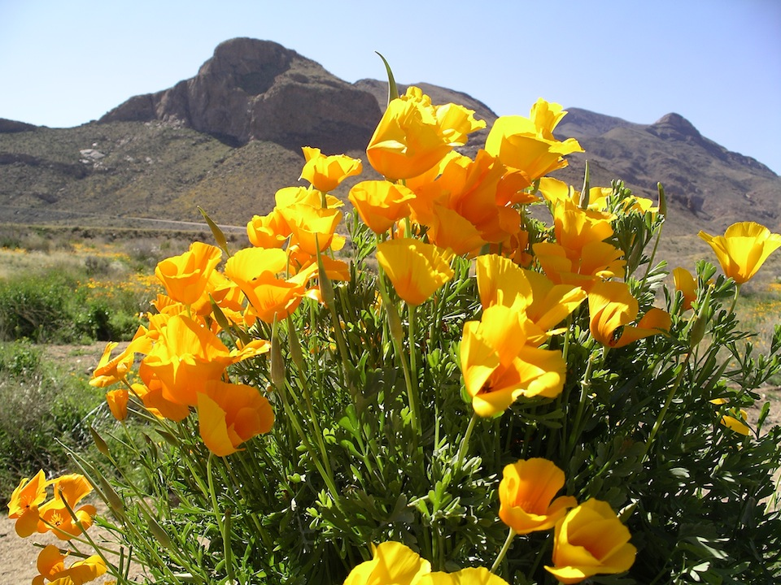
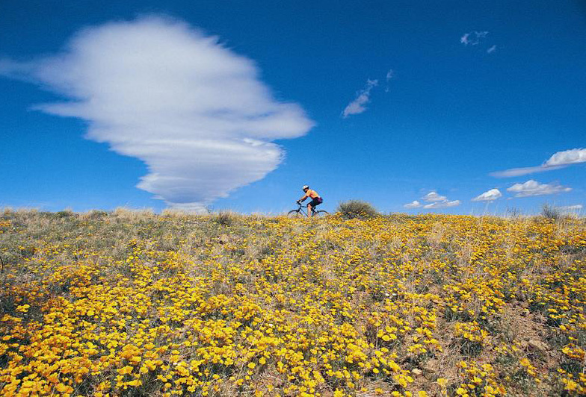
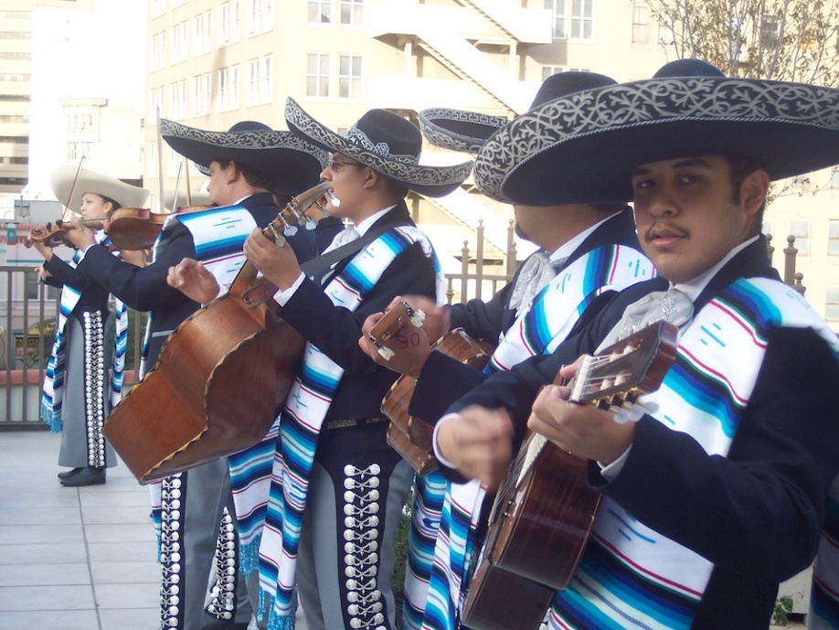

Some highlights of El Paso: the Franklin Mountains, the Ysleta mission, mariachis…

Slide 4
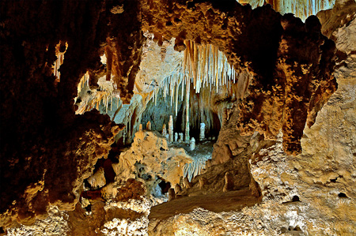
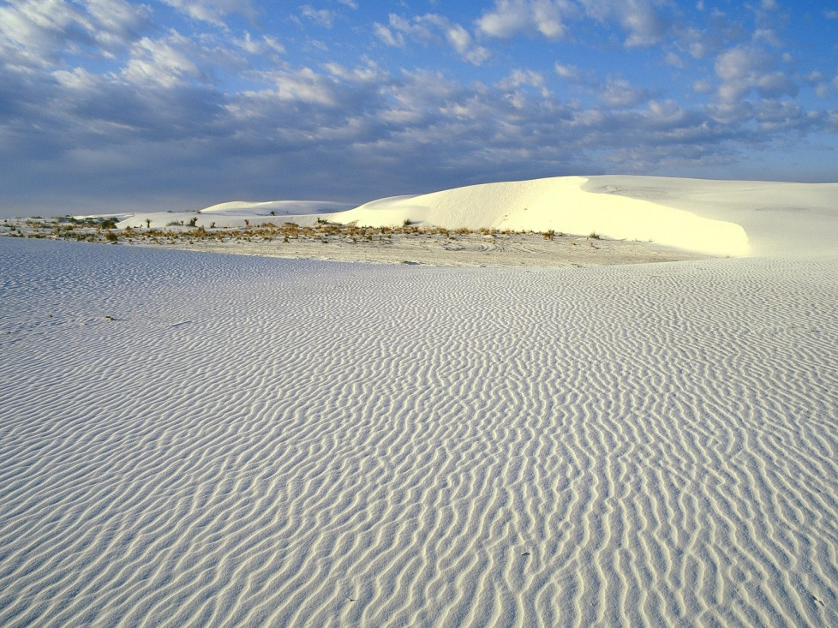
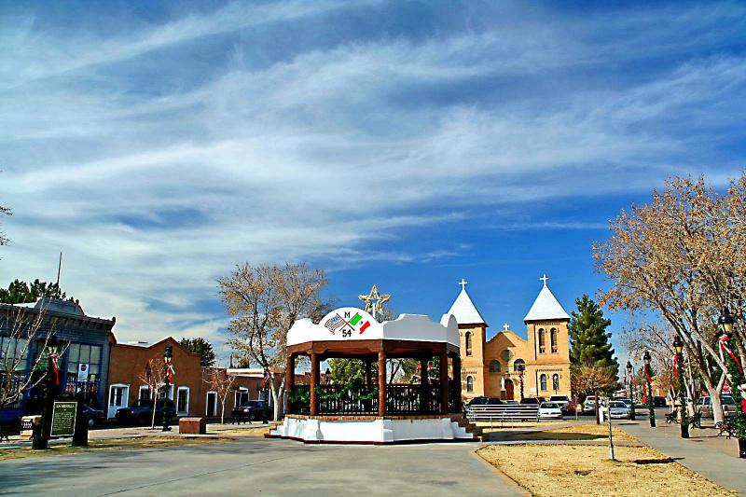
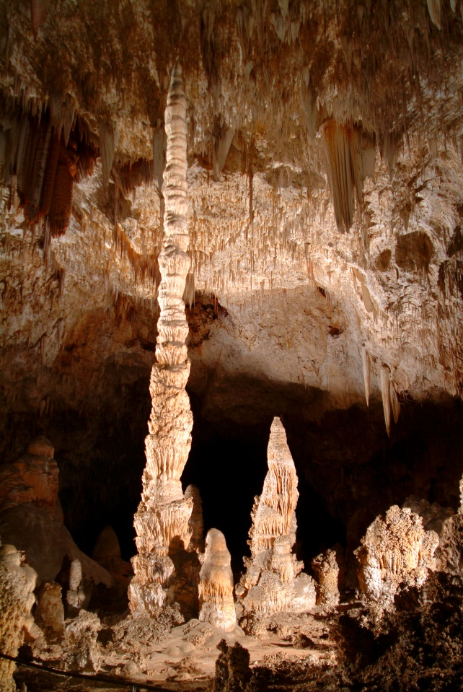

Places of interest around El Paso: Carlsbad caverns, la Mesilla, White Sands…

Slide 5
NAFIPS will take place at UTEP, the University of Texas at El Paso
UTEP
Approaching its centennial celebration,
The second oldest academic component of the University of Texas system
A major urban research university in the heart of a thriving international metropolis
Experiencing an unprecedented growth with:
A record enrollment of more than 21,000 students in 2009
A $180-million building boom
New labs and classrooms to support its rapidly expanding academic and research programs
Striving to become one of the next top-tier research universities in Texas
Changing the face of higher education
Ranked second in the nation in awarding undergraduate degrees to Hispanics
Committed to providing access and excellence in higher education
Moreover: UTEP's beautiful campus features a distinctive architectural style derived from the buildings in the Himalayan kingdom of Bhutan.
You can take a virtual tour of the campus at http://www.utep.edu/tour

Slide 6
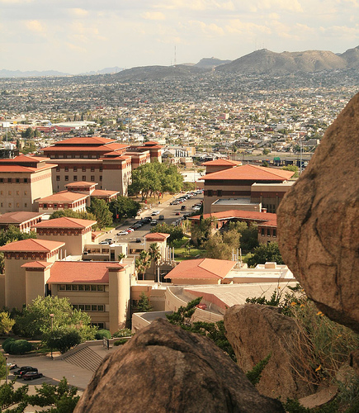
UTEP is tucked between the
mountains, downtown El Paso,
and Mexico
View of UTEP’s campus and Mexico

Slide 7
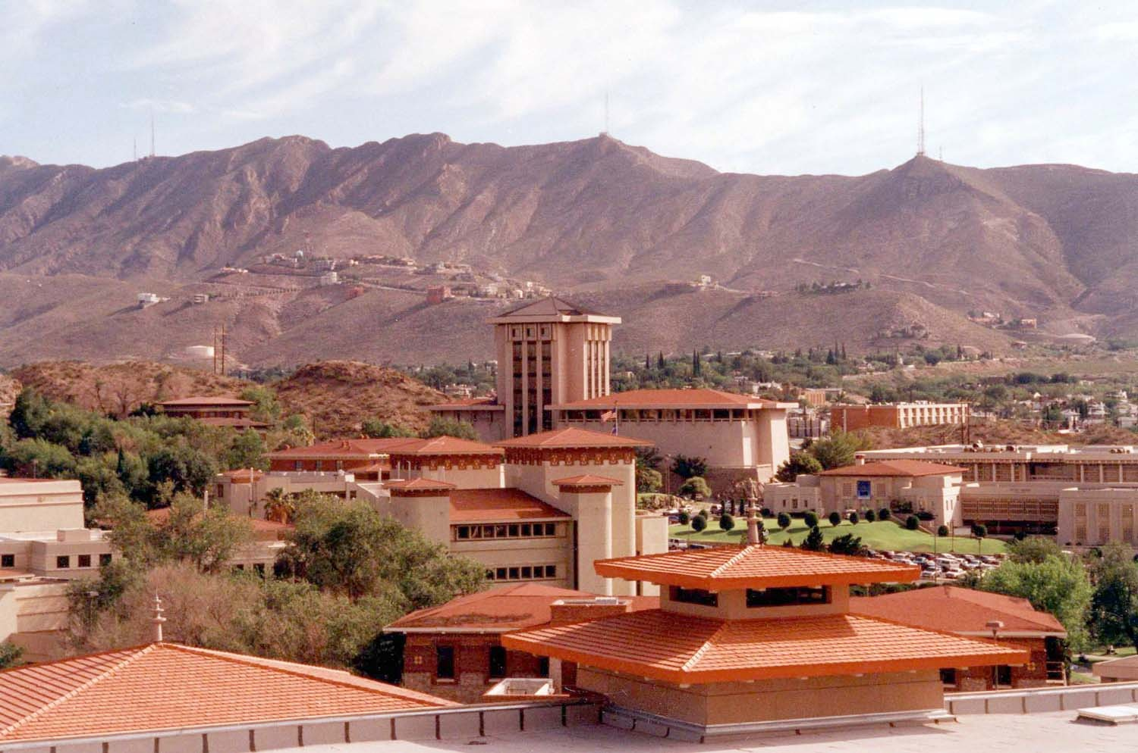

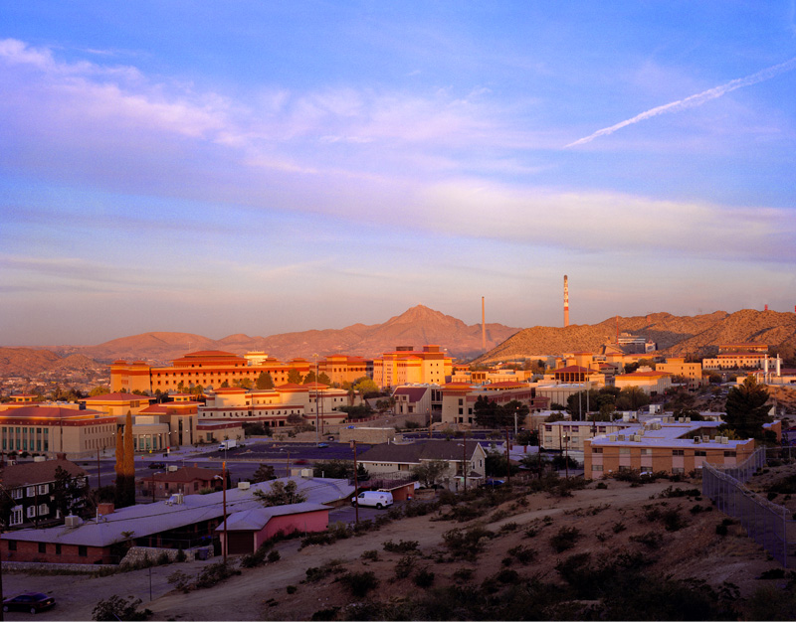
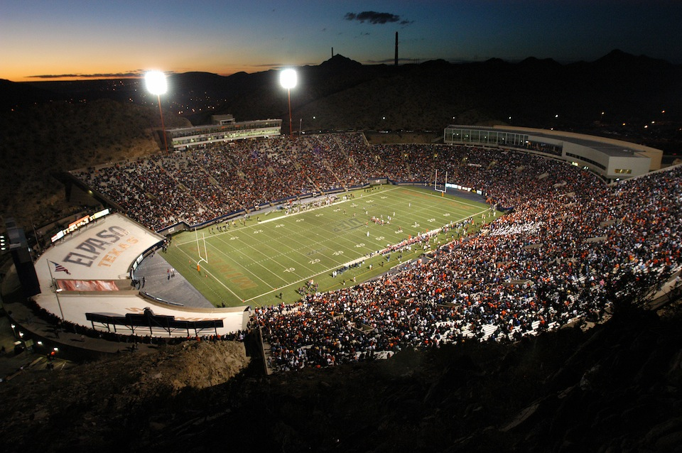
UTEP’s campus and football field, Sun Bowl

Slide 8
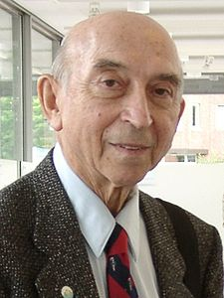
Special event honoring Lotfi A. Zadeh
At the conference, a special invited session will be devoted to the 45-th anniversary of the publication of the 1965 paper by Lotfi A. Zadeh that s started the field of fuzzy logic.

Slide 9
Satellite events
International Workshop on Analysis of Structures with
Uncertainties
CoProD’11: the 4th International Workshop on Constraint Programming and Decision Making
To be held on March 17, 2011
Deadline for abstract submission: January 15, 2011
More information at: http://coprod.constraintsolving.com

Slide 10
Important dates
Special session proposals September 11, 2010
Papers due October 11, 2010
Notification of acceptance of papers December 17, 2010
Final papers submission and early
registration February 15, 2011
Conference March 18-20, 2011

Slide 11
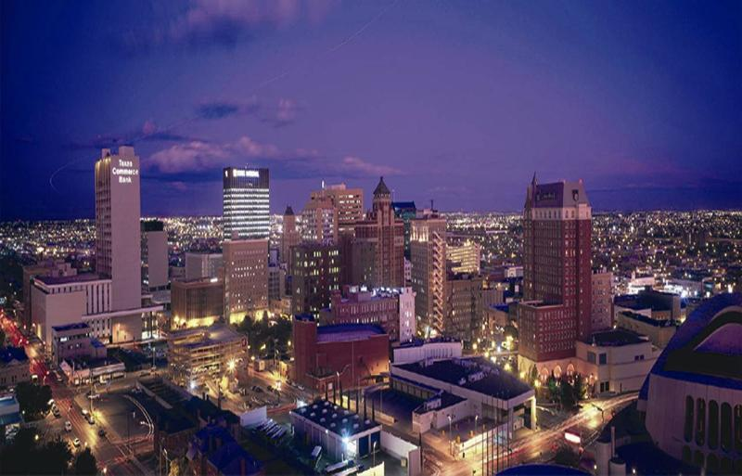
Contact information
Vladik Kreinovich
vladik@utep.edu
http://cs.utep.edu/vladik
Martine Ceberio
mceberio@utep.edu
http://www.martineceberio.fr

Slide 12
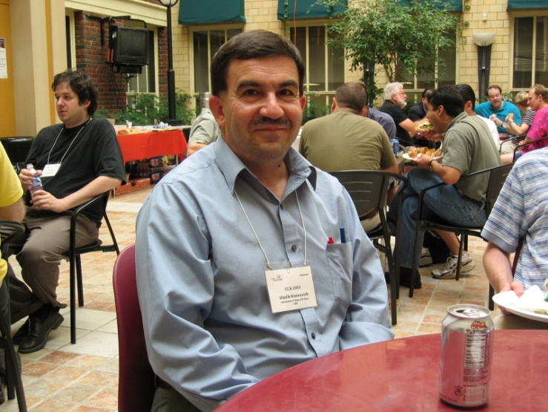
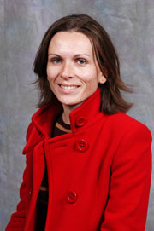
Looking forward to seeing you
in El Paso in March 2011!!!
--- Vladik and Martine

