Slide 1


Multiple Hidden Layer CEFYDRA: Cluster-first Explainable
FuzzY-based Deep self-Reorganizing Algorithm
Javier Viaña, Stephan Ralescu, Vladik Kreinovich, Anca Ralescu, Kelly Cohen
Department of Aerospace Engineering and Engineering Mechanics
University of Cincinnati, Ohio
Annual Conference of
NAFIPS – North American Fuzzy Information Processing Society
May 31st – June 3rd
Saint Mary's University, Halifax, Nova Scotia, Canada

Slide 2
Index
    Introduction
    Preliminary Consideration
    Update Rules for the First Hidden Layer Parameters
    Overview
    The 3 Laws for the Generalization
    Learning Formulas for Deep Parameters
    Results
    Explainability
    Conclusions
    Covered in other NAFIPS papers
    References
    Acknowledgements

Slide 3



Introduction
Initialization
Gradient Descent Optimization
We are extending the algorithm presented in:
  Viaña et al. 2021^{[1]}
  Viaña and Cohen 2022 ^{[2]}
to deep learning architectures while preserving its explainability
User defined Parameters:
Number of Clusters
User defined Training Parameters:
Epochs / Optimality Conditions
Learning Rates
UL: Unsupervised Learning
SL: Supervised Learning
Hierarchical Clustering (UL)
Predict using Takagi-Sugeno-Kang
for each cluster c
Update ${}_{ }^{ }{n_{c}}$, ${}_{ }^{i}{m_{c}}$, ${}_{ }^{i}{a_{c}}$, ${}_{ }^{i}{b_{c}}$ (SL)
N-dim Linear Function (SL)
N-dim Membership Functions (SL)
Refined Model
Get ${}_{ }^{ }{n_{c}}$, ${}_{ }^{i}{m_{c}}$ from
$$y=X β$$
$β={\left(X′ X\right)}^{−1}X^{′}$ $y$
Get ${}_{ }^{ i}{a_{c}}$, ${}_{ }^{i}{b_{c}}$ from
${}_{ }^{i}{a_{c}}=μ_{{}_{ }^{i}{x_{c}}}$ (Mean)
${}_{ }^{i}{b_{c}}=σ_{{}_{ }^{i}{x_{c}}}$ (Stdv)
Figures of Merit
Optimal?
No
Initialized Model
Yes
Optimized Model
Viaña, J., Cohen, K.: Fuzzy-Based, Noise-Resilient, Explainable Algorithm for Regression. In: Explainable AI and Other Applications of Fuzzy Techniques. 1st edn. Springer, Cham (2022).
Viaña, J., Ralescu, S., Cohen, K., Ralescu, A., Kreinovich, V.: Extension to multi-dimensional problems of a fuzzy-based explainable and noise-resilient algorithm”. In: Proceedings of the 14th International Workshop on Constraint Programming and Decision Making CoProd’2021, Szeged, Hungary (2021).

Slide 4
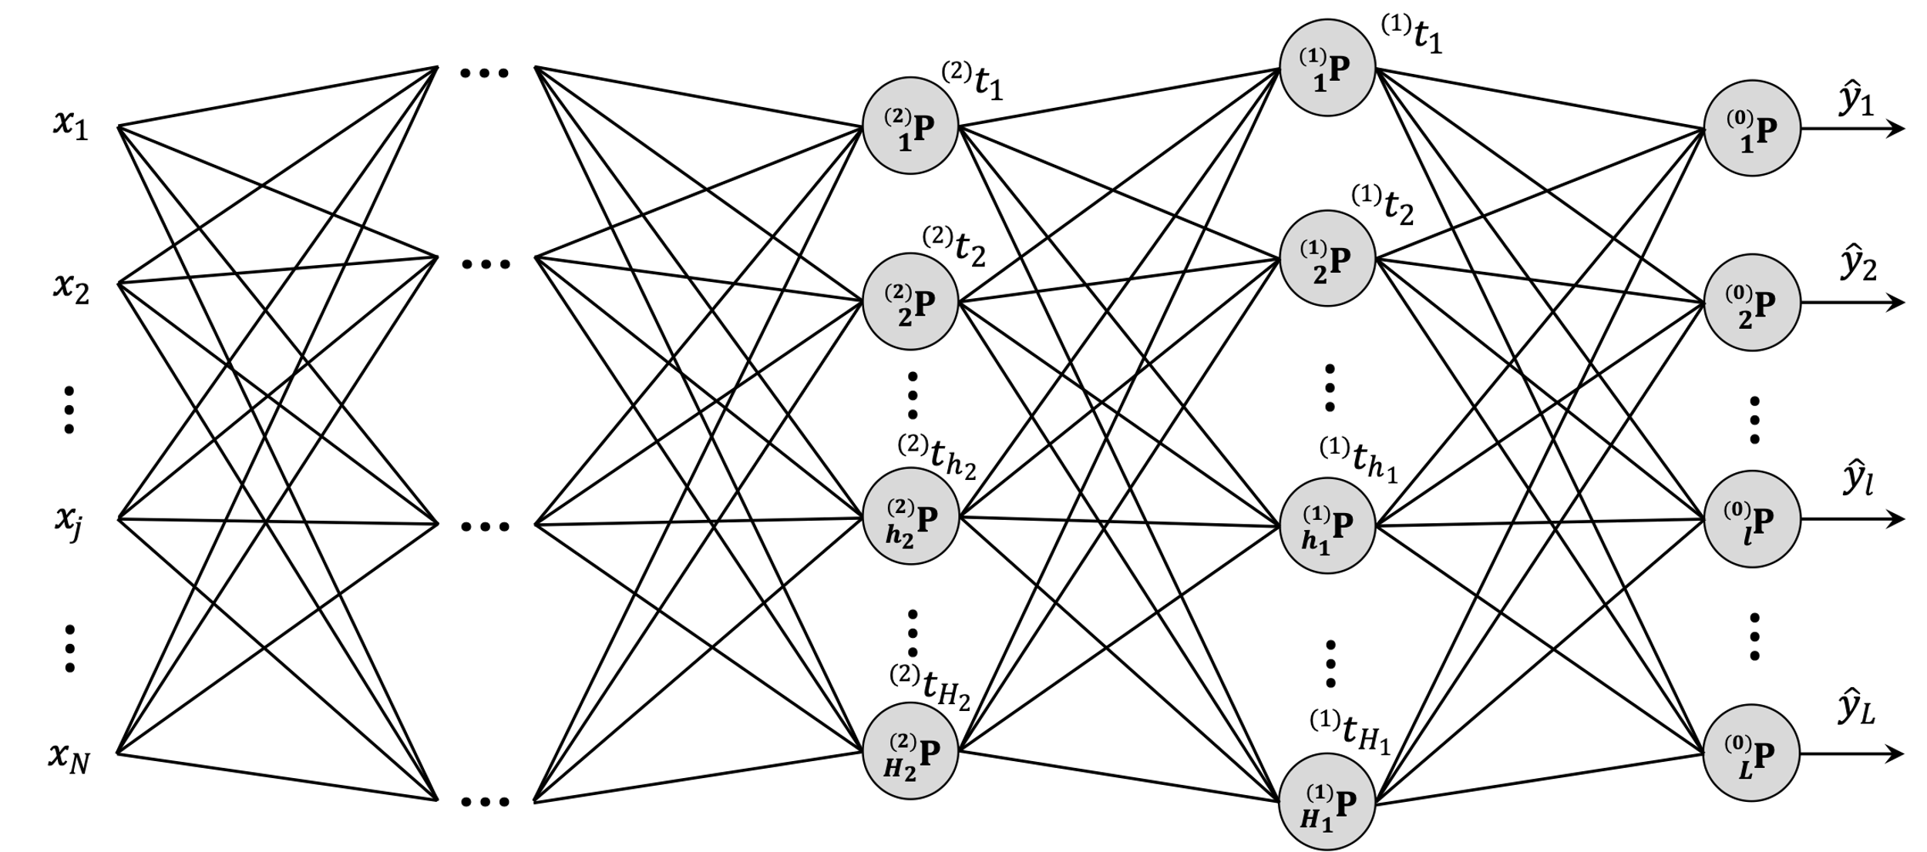
Introduction
Changes with respect to the previous algorithm:
  Network of units where each unit has this algorithm inside.
  Instead of linear functions we use logistic functions to bound the outputs of the units.
  Different initialization criteria needed for the clusters of the hidden units.

Slide 5
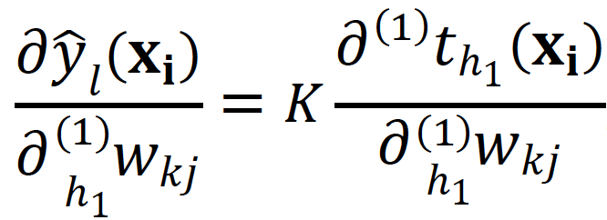

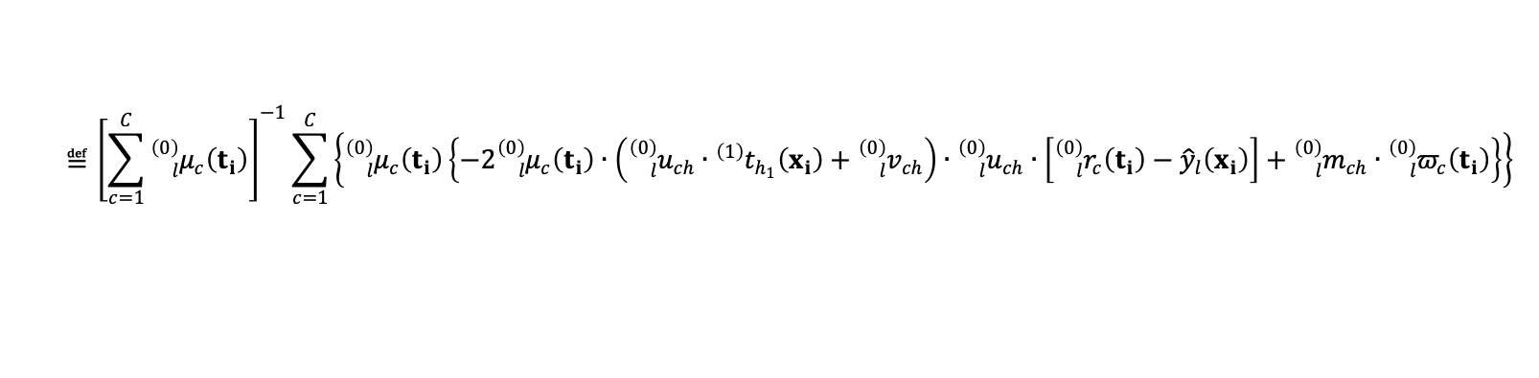
Preliminary Consideration
Developed in a different NAFIPS 2022 paper:
Between any output of a unit from the output layer and any other output of a unit from the first hidden layer there exists a linear proportionality:
where 𝛫 is a parameter that depends on the connection between these two units. It can be demonstrated that
$$≝{\left[\sum_{c=1}^{C}{{}_{l}^{\left(0\right)}{μ_{c}}\left(t_{i}\right)}\right]}^{−1}\sum_{c=1}^{C}{\left\{{}_{l}^{\left(0\right)}{μ_{c}}\left(t_{i}\right)\left\{−2{}_{l}^{\left(0\right)}{μ_{c}}\left(t_{i}\right)∙\left({}_{l}^{\left(0\right)}{u_{ch}}∙{}_{ }^{\left(1\right)}{t_{h_{1}}}\left(x_{i}\right)+{}_{l}^{\left(0\right)}{v_{ch}}\right)∙{}_{l}^{\left(0\right)}{u_{ch}}∙\left[{}_{l}^{\left(0\right)}{r_{c}}\left(t_{i}\right)−{\hat{y}}_{l}\left(x_{i}\right)\right]+{}_{l}^{\left(0\right)}{m_{ch}}∙{}_{l}^{\left(0\right)}{π_{c}}\left(t_{i}\right)\right\}\right\}}$$
$$Κ=\left[\begin{matrix}\begin{matrix}(1) \\ h_{1}\end{matrix} & \begin{matrix}(0) \\ l\end{matrix}\end{matrix}\right]φ\left(x_{i}\right)$$

Slide 6
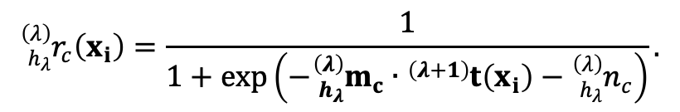
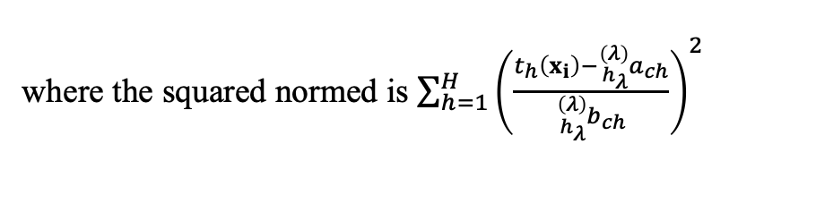
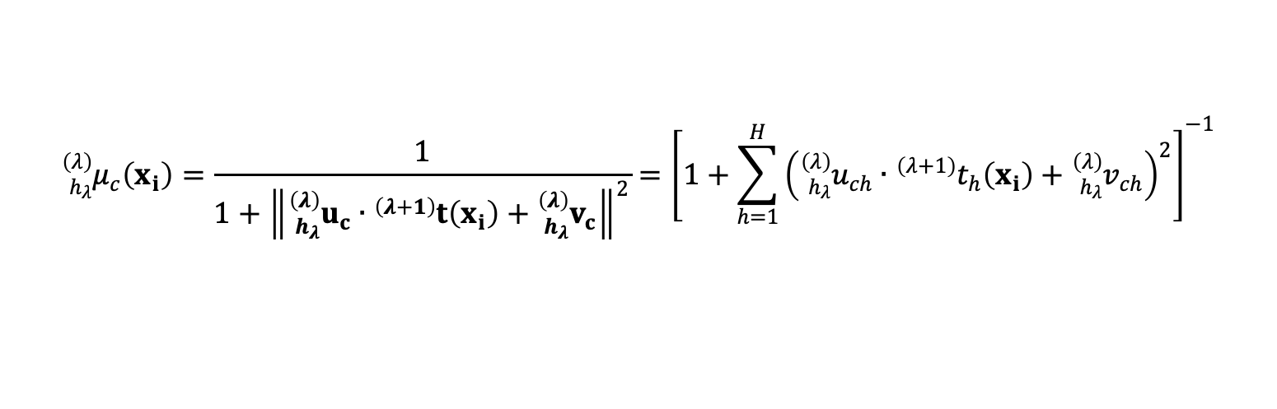
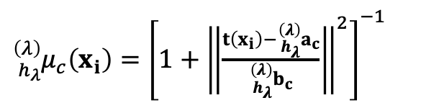
Update Rules for the First Hidden Layer Parameters
For a generic layer $λ$and unit $h_{λ}$ and a generic cluster $c:$
${}_{h_{λ}}^{\left(λ\right)}{μ_{c}}\left(x_{i}\right)={\left[1+{\left\|\frac{t\left(x_{i}\right)−{}_{h_{λ}}^{\left(λ\right)}{a_{c}}}{{}_{h_{λ}}^{\left(λ\right)}{b_{c}}}\right\|}^{2}\right]}^{−1}$
where the squared normed is $\sum_{h=1}^{H}{{\left(\frac{t_{h}\left(x_{i}\right)−{}_{h_{λ}}^{\left(λ\right)}{a_{ch}}}{{}_{h_{λ}}^{\left(λ\right)}{b_{ch}}}\right)}^{2}}$
Cauchy
Membership
Function
For simplicity in the optimization we will denote${}_{h_{λ}}^{\left(λ\right)}{u_{ch}}≝\frac{1}{{}_{h_{λ}}^{\left(λ\right)}{b_{ch}}}$ and${}_{h_{λ}}^{\left(λ\right)}{v_{ch}}≝−\frac{{}_{h_{λ}}^{\left(λ\right)}{a_{ch}}}{{}_{h_{λ}}^{\left(λ\right)}{b_{ch}}}$
$${}_{h_{λ}}^{\left(λ\right)}{μ_{c}}\left(x_{i}\right)=\frac{1}{1+{\left\|{}_{h_{λ}}^{\left(λ\right)}{u_{c}}∙{}_{ }^{\left(λ+1\right)}t\left(x_{i}\right)+{}_{h_{λ}}^{\left(λ\right)}{v_{c}}\right\|}^{2}}={\left[1+\sum_{h=1}^{H}{{\left({}_{h_{λ}}^{\left(λ\right)}{u_{ch}}∙{{}_{ }^{\left(λ+1\right)}t}_{h}\left(x_{i}\right)+{}_{h_{λ}}^{\left(λ\right)}{v_{ch}}\right)}^{2}}\right]}^{−1}$$
Logistic
Function
$${}_{h_{λ}}^{\left(λ\right)}{r_{c}}\left(x_{i}\right)=\frac{1}{1+exp\left(−{}_{h_{λ}}^{\left(λ\right)}{m_{c}}∙{}_{ }^{\left(λ+1\right)}t\left(x_{i}\right)−{}_{h_{λ}}^{\left(λ\right)}{n_{c}}\right)}.$$

Slide 7
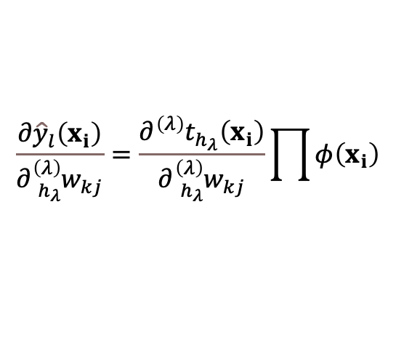
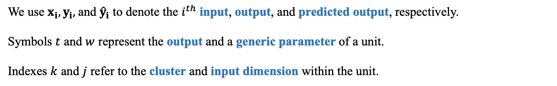
Overview
We use $x_{i}, y_{i},$and ${\hat{y}}_{i}$ to denote the $i^{th}$ input, output, and predicted output, respectively.
Symbols $t$ and $w$ represent the output and a generic parameter of a unit.
Indexes $k$ and $j$ refer to the cluster and input dimension within the unit.
Due to this decoupling in the consecutive outputs
we expect a generalized formula that relates any non-consecutive outputs as
$$\frac{∂{\hat{y}}_{l}\left(x_{i}\right)}{∂{}_{h_{λ}}^{\left(λ\right)}{w_{kj}}}=\frac{∂{}_{ }^{\left(λ\right)}{t_{h_{λ}}}\left(x_{i}\right)}{∂{}_{h_{λ}}^{\left(λ\right)}{w_{kj}}}\prod{φ\left(x_{i}\right)}$$
In order to get there, we will use 3 laws:
  Displacement Law
  Substitution Law
  Composition Law

Slide 8

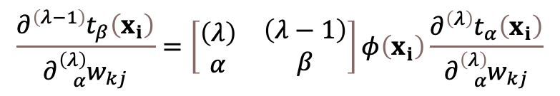



The 3 Laws for the Generalization
Displacement Law: We can consider the proportionality equation between every two consecutive layers.
Output of unit $β$
$$\frac{∂{}_{ }^{\left(λ−1\right)}{t_{β}}\left(x_{i}\right)}{∂{}_{α}^{\left(λ\right)}{w_{kj}}}=\left[\begin{matrix}\begin{matrix}\left(λ\right) \\ α\end{matrix} & \begin{matrix}\left(λ−1\right) \\ β\end{matrix}\end{matrix}\right]φ\left(x_{i}\right)\frac{∂{}_{ }^{\left(λ\right)}{t_{α}}\left(x_{i}\right)}{∂{}_{α}^{\left(λ\right)}{w_{kj}}}$$
Output of unit $α$
Parameter of unit $α$
Parameter of unit $α$
Proportionality Factor dependent on unit $α$ and unit $β$

Slide 9

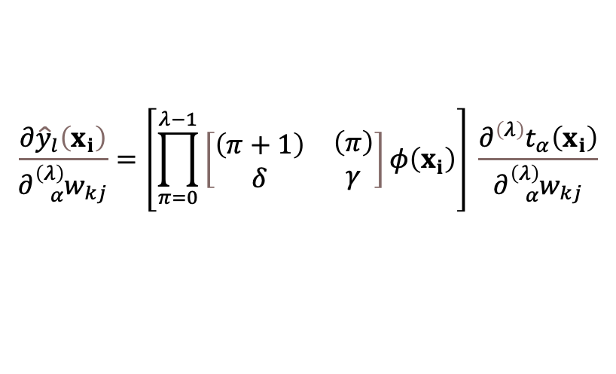


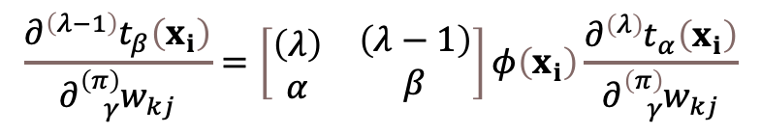





The 3 Laws for the Generalization
Substitution Law: This Law comes from the application of the chain rule in the derivatives of the proportionality equation to consider any other parameter of the system
Output of unit $β$
$$\frac{∂{}_{ }^{\left(λ−1\right)}{t_{β}}\left(x_{i}\right)}{∂{}_{γ}^{\left(π\right)}{w_{kj}}}=\left[\begin{matrix}\begin{matrix}\left(λ\right) \\ α\end{matrix} & \begin{matrix}\left(λ−1\right) \\ β\end{matrix}\end{matrix}\right]φ\left(x_{i}\right)\frac{∂{}_{ }^{\left(λ\right)}{t_{α}}\left(x_{i}\right)}{∂{}_{γ}^{\left(π\right)}{w_{kj}}}$$
Output of unit $α$
Parameter of unit $γ$
Parameter of unit $γ$
Proportionality Factor dependent on unit $α$ and unit $β$
Composition Law: The Composition Law is achieved from the combination of both the Displacement and Substitution Laws.
Output of output unit $l$
$$\frac{∂{\hat{y}}_{l}\left(x_{i}\right)}{∂{}_{α}^{\left(λ\right)}{w_{kj}}}=\left[\prod_{π=0}^{λ−1}{\left[\begin{matrix}\begin{matrix}\left(π+1\right) \\ δ\end{matrix} & \begin{matrix}\left(π\right) \\ γ\end{matrix}\end{matrix}\right]φ\left(x_{i}\right)}\right] \frac{∂{}_{ }^{\left(λ\right)}{t_{α}}\left(x_{i}\right)}{∂{}_{α}^{\left(λ\right)}{w_{kj}}}$$
Output of unit $α$
Parameter of unit $α$
Parameter of unit $α$
Proportionality Factor

Slide 10
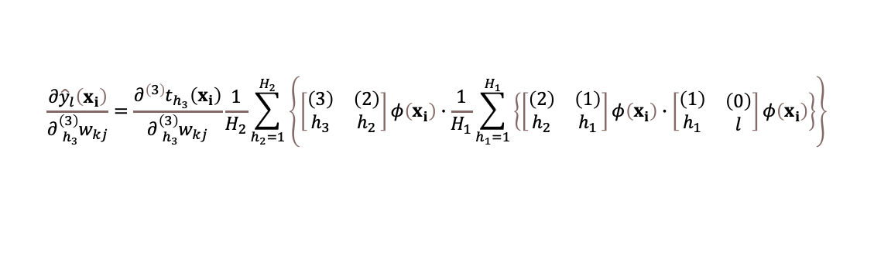
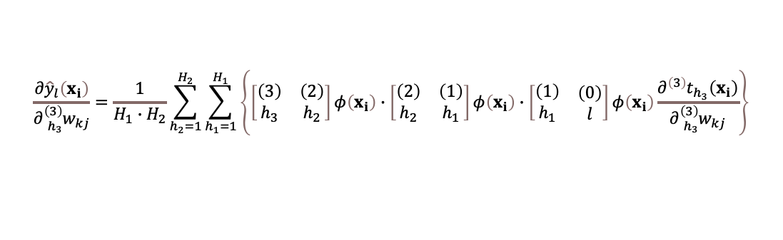
Learning Formulas for Deep Parameters
As seen in the Composition Law the equation that relates any two outputs depends on the the path and the connections chosen. Thus, we use the average of all the possible paths.
$$\frac{∂{\hat{y}}_{l}\left(x_{i}\right)}{∂{}_{h_{3}}^{\left(3\right)}{w_{kj}}}=\frac{1}{H_{1}∙H_{2}}\sum_{h_{2}=1}^{H_{2}}{\sum_{h_{1}=1}^{H_{1}}{\left\{\left[\begin{matrix}\begin{matrix}\left(3\right) \\ h_{3}\end{matrix} & \begin{matrix}\left(2\right) \\ h_{2}\end{matrix}\end{matrix}\right]φ\left(x_{i}\right)∙\left[\begin{matrix}\begin{matrix}\left(2\right) \\ h_{2}\end{matrix} & \begin{matrix}\left(1\right) \\ h_{1}\end{matrix}\end{matrix}\right]φ\left(x_{i}\right)∙\left[\begin{matrix}\begin{matrix}\left(1\right) \\ h_{1}\end{matrix} & \begin{matrix}\left(0\right) \\ l\end{matrix}\end{matrix}\right]φ\left(x_{i}\right)\frac{∂{}_{ }^{\left(3\right)}{t_{h_{3}}}\left(x_{i}\right)}{∂{}_{h_{3}}^{\left(3\right)}{w_{kj}}}\right\}}}$$
$$\frac{∂{\hat{y}}_{l}\left(x_{i}\right)}{∂{}_{h_{3}}^{\left(3\right)}{w_{kj}}}=\frac{∂{}_{ }^{\left(3\right)}{t_{h_{3}}}\left(x_{i}\right)}{∂{}_{h_{3}}^{\left(3\right)}{w_{kj}}}\frac{1}{H_{2}}\sum_{h_{2}=1}^{H_{2}}{\left\{\left[\begin{matrix}\begin{matrix}\left(3\right) \\ h_{3}\end{matrix} & \begin{matrix}\left(2\right) \\ h_{2}\end{matrix}\end{matrix}\right]φ\left(x_{i}\right)∙\frac{1}{H_{1}}\sum_{h_{1}=1}^{H_{1}}{\left\{\left[\begin{matrix}\begin{matrix}\left(2\right) \\ h_{2}\end{matrix} & \begin{matrix}\left(1\right) \\ h_{1}\end{matrix}\end{matrix}\right]φ\left(x_{i}\right)∙\left[\begin{matrix}\begin{matrix}\left(1\right) \\ h_{1}\end{matrix} & \begin{matrix}\left(0\right) \\ l\end{matrix}\end{matrix}\right]φ\left(x_{i}\right)\right\}}\right\}}$$

Slide 11
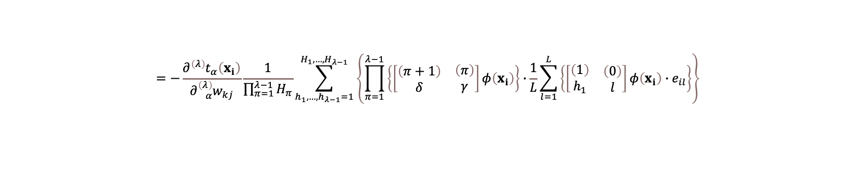
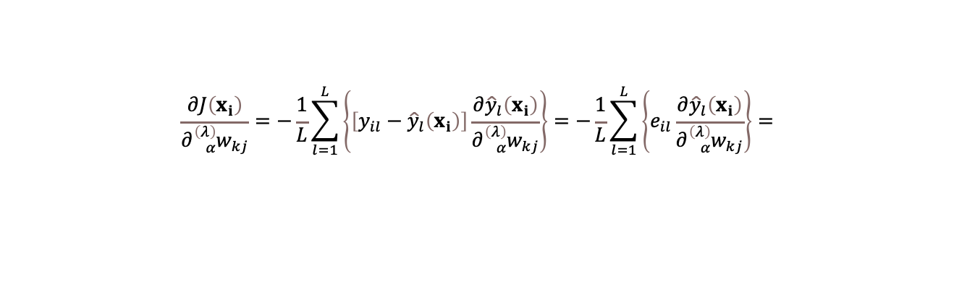
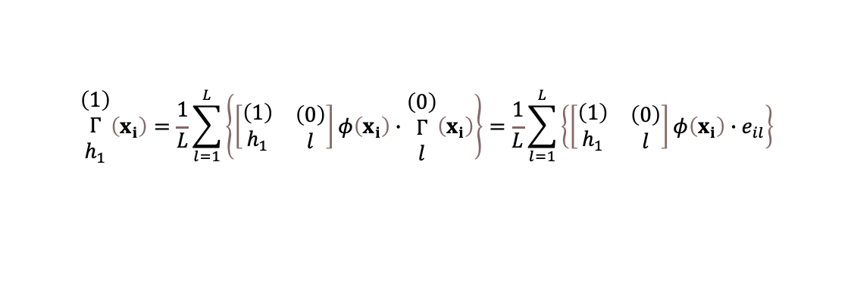
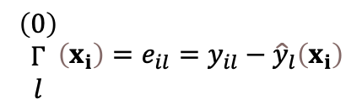
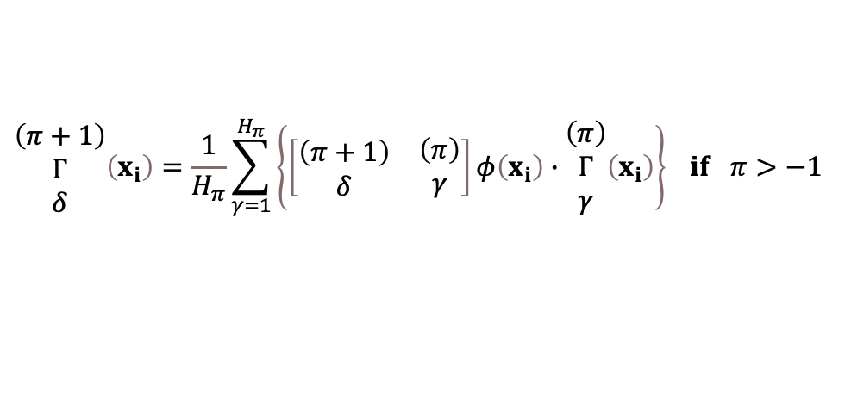
Learning Formulas for Deep Parameters
We utilize the Composition Law to solve the gradient of the loss function,
$$\frac{∂J\left(x_{i}\right)}{∂{}_{α}^{\left(λ\right)}{w_{kj}}}=−\frac{1}{L}\sum_{l=1}^{L}{\left\{\left[y_{il}−{\hat{y}}_{l}\left(x_{i}\right)\right]\frac{∂{\hat{y}}_{l}\left(x_{i}\right)}{∂{}_{α}^{\left(λ\right)}{w_{kj}}}\right\}=−\frac{1}{L}\sum_{l=1}^{L}{\left\{e_{il}\frac{∂{\hat{y}}_{l}\left(x_{i}\right)}{∂{}_{α}^{\left(λ\right)}{w_{kj}}}\right\}=}}$$
$$=−\frac{∂{}_{ }^{\left(λ\right)}{t_{α}}\left(x_{i}\right)}{∂{}_{α}^{\left(λ\right)}{w_{kj}}}\frac{1}{\prod_{π=1}^{λ−1}{H_{π}}}\sum_{h_{1},…, h_{λ−1}=1}^{H_{1},…, H_{λ−1}}{\left\{\prod_{π=1}^{λ−1}{\left\{\left[\begin{matrix}\begin{matrix}\left(π+1\right) \\ δ\end{matrix} & \begin{matrix}\left(π\right) \\ γ\end{matrix}\end{matrix}\right]φ\left(x_{i}\right)\right\}∙\frac{1}{L}\sum_{l=1}^{L}{\left\{\left[\begin{matrix}\begin{matrix}\left(1\right) \\ h_{1}\end{matrix} & \begin{matrix}\left(0\right) \\ l\end{matrix}\end{matrix}\right]φ\left(x_{i}\right)∙e_{il}\right\}}}\right\}}$$
At this point, we can define a recursive function as follows,
$$\begin{matrix}\left(π+1\right) \\ Γ \\ δ\end{matrix}\left(x_{i}\right)=\frac{1}{H_{π}}\sum_{γ=1}^{H_{π}}{\left\{\left[\begin{matrix}\begin{matrix}\left(π+1\right) \\ δ\end{matrix} & \begin{matrix}\left(π\right) \\ γ\end{matrix}\end{matrix}\right]φ\left(x_{i}\right)∙\begin{matrix}\left(π\right) \\ Γ \\ γ\end{matrix}\left(x_{i}\right)\right\}} if π>−1$$
$$\begin{matrix}\left(0\right) \\ Γ \\ l\end{matrix}\left(x_{i}\right)=e_{il}=y_{il}−{\hat{y}}_{l}\left(x_{i}\right)$$
so that
$$\begin{matrix}\left(1\right) \\ Γ \\ h_{1}\end{matrix}\left(x_{i}\right)=\frac{1}{L}\sum_{l=1}^{L}{\left\{\left[\begin{matrix}\begin{matrix}\left(1\right) \\ h_{1}\end{matrix} & \begin{matrix}\left(0\right) \\ l\end{matrix}\end{matrix}\right]φ\left(x_{i}\right)∙\begin{matrix}\left(0\right) \\ Γ \\ l\end{matrix}\left(x_{i}\right)\right\}}=\frac{1}{L}\sum_{l=1}^{L}{\left\{\left[\begin{matrix}\begin{matrix}\left(1\right) \\ h_{1}\end{matrix} & \begin{matrix}\left(0\right) \\ l\end{matrix}\end{matrix}\right]φ\left(x_{i}\right)∙e_{il}\right\}}$$

Slide 12
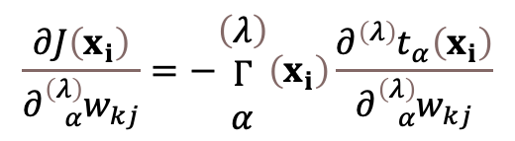
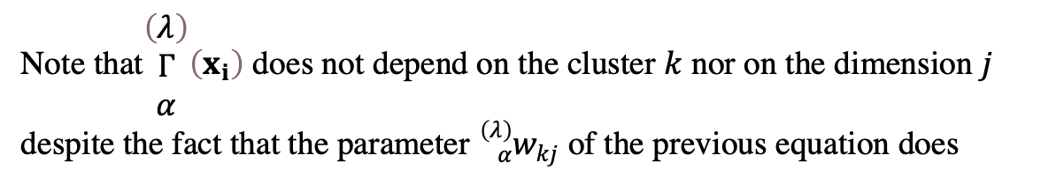
Learning Formulas for Deep Parameters
Finally, using the recursive function the formula of $\frac{∂J\left(x_{i}\right)}{∂{}_{α}^{\left(λ\right)}{w_{kj}}}$ becomes
$$\frac{∂J\left(x_{i}\right)}{∂{}_{α}^{\left(λ\right)}{w_{kj}}}=−\begin{matrix}\left(λ\right) \\ Γ \\ α\end{matrix}\left(x_{i}\right)\frac{∂{}_{ }^{\left(λ\right)}{t_{α}}\left(x_{i}\right)}{∂{}_{α}^{\left(λ\right)}{w_{kj}}}$$
Note that$\begin{matrix}\left(λ\right) \\ Γ \\ α\end{matrix}\left(x_{i}\right)$ does not depend on the cluster $k$ nor on the dimension $j$ despite the fact that the parameter ${}_{α}^{\left(λ\right)}{w_{kj}}$ of the previous equation does

Slide 13
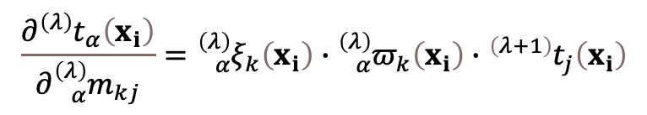
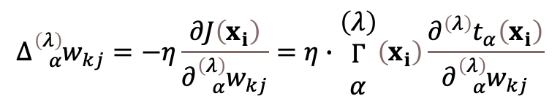
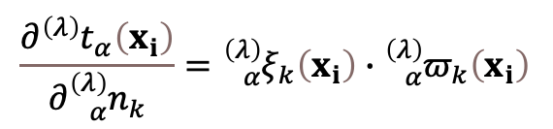
Learning Formulas for Deep Parameters
Developing, we obtain the partial derivatives of ${}_{ }^{\left(λ\right)}{t_{α}}\left(x_{i}\right)$
$$\frac{∂{}_{ }^{\left(λ\right)}{t_{α}}\left(x_{i}\right)}{∂{}_{α}^{\left(λ\right)}{m_{kj}}}={}_{α}^{\left(λ\right)}{ξ_{k}}\left(x_{i}\right)∙{}_{α}^{\left(λ\right)}{π_{k}}\left(x_{i}\right)∙{}_{ }^{\left(λ+1\right)}{t_{j}}\left(x_{i}\right)$$
$$\frac{∂{}_{ }^{\left(λ\right)}{t_{α}}\left(x_{i}\right)}{∂{}_{α}^{\left(λ\right)}{n_{k}}}={}_{α}^{\left(λ\right)}{ξ_{k}}\left(x_{i}\right)∙{}_{α}^{\left(λ\right)}{π_{k}}\left(x_{i}\right)$$
$$\frac{∂{}_{ }^{\left(λ\right)}{t_{α}}\left(x_{i}\right)}{∂{}_{α}^{\left(λ\right)}{u_{kj}}}=−2{}_{α}^{\left(λ\right)}{ξ_{k}}\left(x_{i}\right)∙{}_{α}^{\left(λ\right)}{μ_{k}}\left(x_{i}\right)∙\left[{}_{α}^{\left(λ\right)}{r_{k}}\left(x_{i}\right)−{}_{ }^{\left(λ\right)}{t_{α}}\left(x_{i}\right)\right]∙\left({}_{α}^{\left(λ\right)}{u_{kj}}∙{}_{ }^{\left(λ+1\right)}{t_{j}}\left(x_{i}\right)+{}_{α}^{\left(λ\right)}{v_{kj}}\right)∙{}_{ }^{\left(λ+1\right)}{t_{j}}\left(x_{i}\right),$$
$$\frac{∂{}_{ }^{\left(λ\right)}{t_{α}}\left(x_{i}\right)}{∂{}_{α}^{\left(λ\right)}{v_{kj}}}=−2{}_{α}^{\left(λ\right)}{ξ_{k}}\left(x_{i}\right)∙{}_{α}^{\left(λ\right)}{μ_{k}}\left(x_{i}\right)∙\left[{}_{α}^{\left(λ\right)}{r_{k}}\left(x_{i}\right)−{}_{ }^{\left(λ\right)}{t_{α}}\left(x_{i}\right)\right]∙\left({}_{α}^{\left(λ\right)}{u_{kj}}∙{}_{ }^{\left(λ+1\right)}{t_{j}}\left(x_{i}\right)+{}_{α}^{\left(λ\right)}{v_{kj}}\right)$$
Using the learning rate we get
$$∆{}_{α}^{\left(λ\right)}{w_{kj}}=−η\frac{∂J\left(x_{i}\right)}{∂{}_{α}^{\left(λ\right)}{w_{kj}}}=η∙\begin{matrix}\left(λ\right) \\ Γ \\ α\end{matrix}\left(x_{i}\right)\frac{∂{}_{ }^{\left(λ\right)}{t_{α}}\left(x_{i}\right)}{∂{}_{α}^{\left(λ\right)}{w_{kj}}}$$

Slide 14
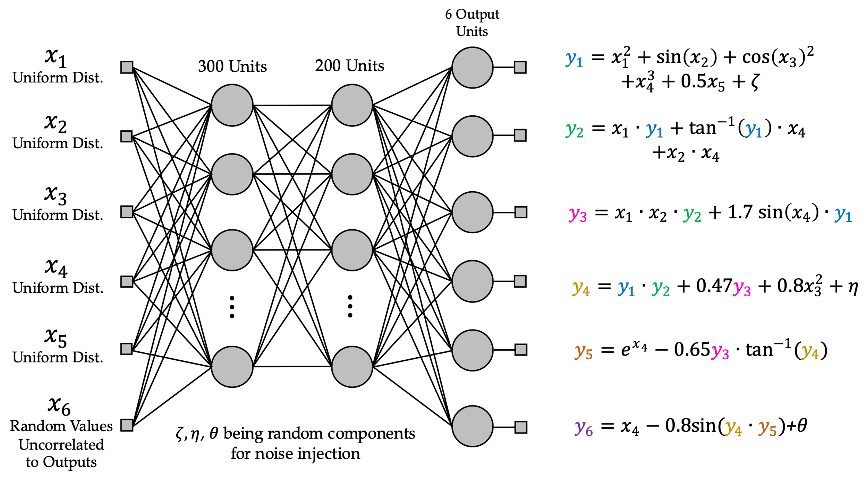
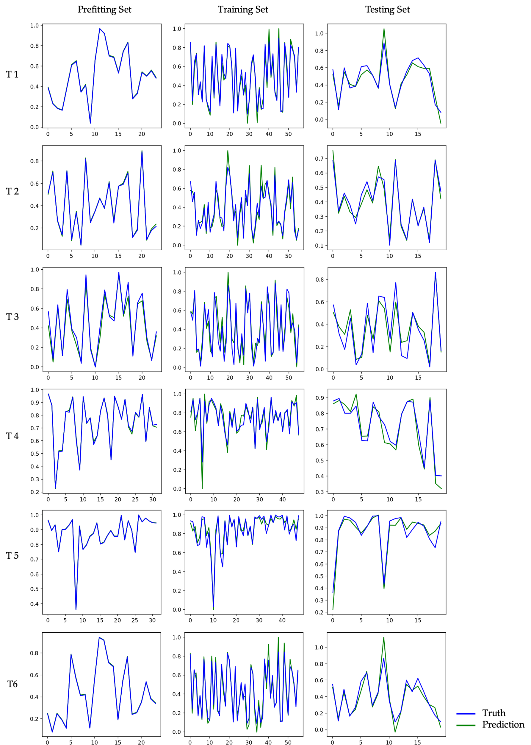
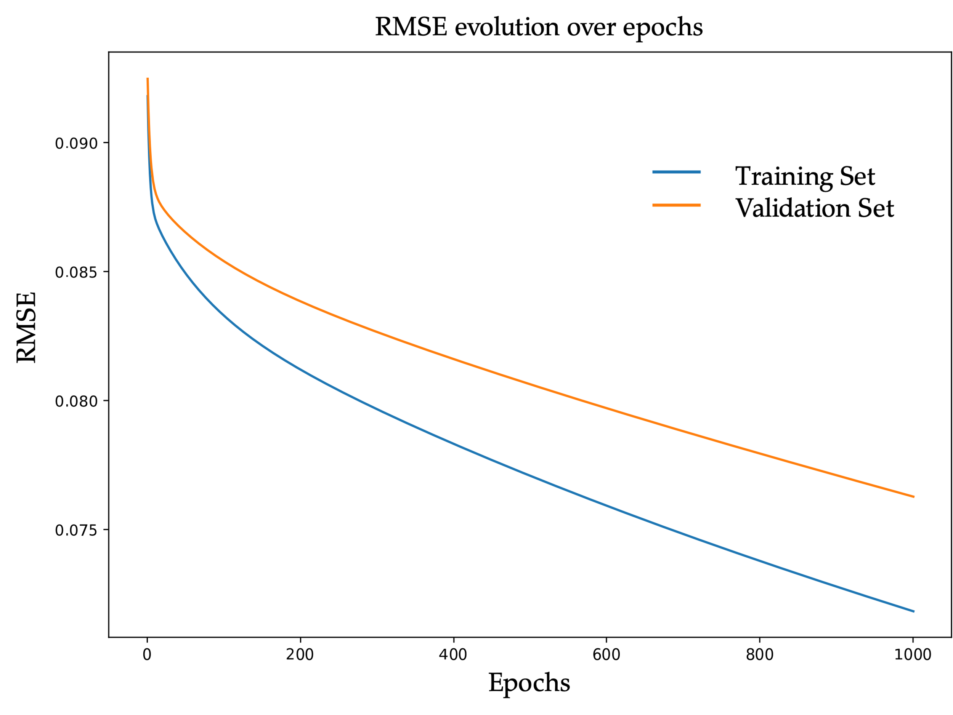
Results
We used a dataset of 200 instances, 6 input features chosen from uniform random distributions, 6 outputs, one of them unrelated to the outputs.
We choose a simple architecture of two hidden layers of 300 and 200 units respectively, where each unit had only 3 clusters. We used a learning rate of 0.001 and a short training of 1000 epochs to prove the learning behavior.

Slide 15
Results
We also studied the performance of CEFYDRA in a collection of publicly available
multidimensional datasets from the University of California Irvine Machine Learning
Repository. The results obtained are shown
Problem | System | Results
Concrete Slump Test Inputs: 7 Outputs: 3 Instances: 103 | CEFYDRA Layers: 3 Units: 300, 500, 300 Clusters: 3 | RMSE Training: 0.043 Validation: 0.051 Testing: 0.048
Forest Fires Inputs: 12 Outputs: 1 Instances: 517 | CEFYDRA Layers: 3 Units: 400, 200, 100 Clusters: 4 | RMSE Training: 0.065 Validation: 0.067 Testing: 0.064
Water Quality Inputs: 11 Outputs: 1 Instances: 705 | CEFYDRA Layers: 2 Units: 500, 100 Clusters: 4 | RMSE Training: 0.076 Validation: 0.083 Testing: 0.084
Datasets studied, system configuration and results in normalized axes. Publicly available at (I-Cheng 2007), (Cortez and Morais 2007), (Zhao et al 2019).

Slide 16
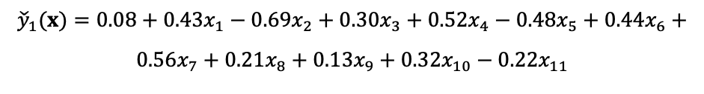
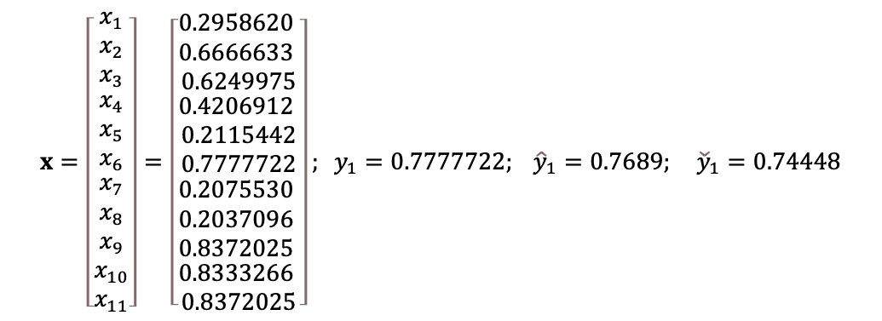
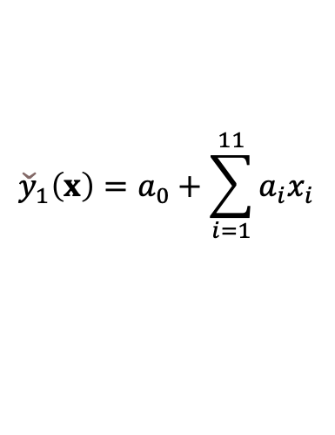
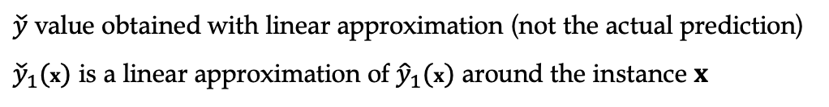
Explainability
$$x=\left[\begin{matrix}x_{1} \\ x_{2} \\ x_{3} \\ \begin{matrix}x_{4} \\ x_{5} \\ x_{6} \\ \begin{matrix}x_{7} \\ x_{8} \\ x_{9} \\ x_{10} \\ x_{11}\end{matrix}\end{matrix}\end{matrix}\right]=\left[\begin{matrix}0.2958620 \\ 0.6666633 \\ 0.6249975 \\ \begin{matrix}0.4206912 \\ 0.2115442 \\ 0.7777722 \\ \begin{matrix}0.2075530 \\ 0.2037096 \\ 0.8372025 \\ \begin{matrix}0.8333266 \\ 0.8372025\end{matrix}\end{matrix}\end{matrix}\end{matrix}\right]; y_{1}=0.7777722; {\hat{y}}_{1}=0.7689; {\check{y}}_{1}=0.74448$$
For the case of the last dataset, where there are 11 inputs and 1 output, for each instance, we would be generating a single explanation of the type
$${\check{y}}_{1}\left(x\right)=a_{0}+\sum_{i=1}^{11}{a_{i}x_{i}}$$
$${\check{y}}_{1}(x)=0.08+0.43x_{1}−0.69x_{2}+0.30x_{3}+0.52x_{4}−0.48x_{5}+0.44x_{6}+$$
$$0.56x_{7}+0.21x_{8}+0.13x_{9}+0.32x_{10}−0.22x_{11}$$
which represents a linear approximation for the prediction that would be valid within the vicinity of the instance.
$\check{y}$ value obtained with linear approximation (not the actual prediction)
${\check{y}}_{1}(x)$ is a linear approximation of ${\hat{y}}_{1}(x)$ around the instance $x$

Slide 17

Conclusions
We proposed an alternative core mathematical mechanism for the units of a neural network. The CEFYDRA is an algorithm that leverages a fuzzy Takagi-Sugeno-Kang inference to map the inputs of each unit via Cauchy membership functions and multidimensional logistic functions.
In this paper we focused our efforts on demonstrating the learning formulation for the deep hidden layers of the CEFYDRA.
We covered the three laws that make this generalization possible, i.e., Displacement, Substitution and Composition. Finally, we also propose a method to minimize the calculations (induced from the fully connected system) and reduce the complexity in the training.
Viaña, J., Cohen, K.: Fuzzy-Based, Noise-Resilient, Explainable Algorithm for Regression. In: Explainable AI and Other Applications of Fuzzy Techniques. 1st edn. Springer, Cham (2022).
Viaña, J., Ralescu, S., Cohen, K., Ralescu, A., Kreinovich, V.: Extension to multi-dimensional problems of a fuzzy-based explainable and noise-resilient algorithm”. In: Proceedings of the 14th International Workshop on Constraint Programming and Decision Making CoProd’2021, Szeged, Hungary (2021).

Slide 18
Covered in other NAFIPS papers
Self-reorganization of CEFYDRA
Initialization criteria of the parameters

Slide 19
References
Yang, Z., Zhang, A., Sudjianto, A.: GAMI-Net: An explainable neural network based on generalized additive models with structured interactions. Pattern Recognition, 120 (2021).
Lee, Y. Extraction of Competitive Factors in a Competitor Analysis Using an Explainable Neural Network. Neural Processing Letters 53, 1979–1994 (2021).
Fauvel, K., Lin, T., Masson, V., Fromont, É., Termier, A.: XCM: An Explainable Convolutional Neural Network for Multivariate Time Series Classification. Mathematics 9 (23), (2021).
Sasaki, H., Hidaka, Y., Igarashi, H.: Explainable Deep Neural Network for Design of Electric Motors. IEEE Transactions on Magnetics 57(6), 1-4 (2021).
Valizadegan, H. et al.: ExoMiner: A Highly Accurate and Explainable Deep Learning Classifier that Validates 301 New Exoplanets. arXiv:2111.10009 (2021).
Kim, M. S., Yun, J. P., Park, P.: An Explainable Convolutional Neural Network for Fault Diagnosis in Linear Motion Guide. In IEEE Transactions on Industrial Informatics, 17 (6), 4036-4045 (2021).
Gallego, V., Ríos Insua, D.: Current Advances in Neural Networks. Annual Review of Statistics and Its Application 9(1), (2022).
Samek, W., Montavon, G., Lapuschkin, S., Anders, C. J., Müller, K. -R.: Explaining Deep Neural Networks and Beyond: A Review of Methods and Applications. Proceedings of the IEEE 109(3), 247-278 (2021).
Viaña, J., Ralescu, S., Cohen, K., Ralescu, A., Kreinovich, V: Localized Learning A Possible Alternative to Current Deep Learning Techniques. In: Melin, P., Castillo, O. (eds.) Studies in Computational Intelligence (2021).
Viaña, J., Cohen, K.: Fuzzy-Based, Noise-Resilient, Explainable Algorithm for Regression. In: Explainable AI and Other Applications of Fuzzy Techniques. 1st edn. Springer, Cham (2022).
Viaña, J., Ralescu, S., Cohen, K., Ralescu, A., Kreinovich, V.: Extension to multi-dimensional problems of a fuzzy-based explainable and noise-resilient algorithm”. In: Proceedings of the 14th International Workshop on Constraint Programming and Decision Making CoProd’2021, Szeged, Hungary (2021).
Viaña, J., Ralescu, S., Cohen, K., Ralescu, A., Kreinovich, V.: Why Cauchy Membership Functions: Reliability. Advances in Artificial Intelligence and Machine Learning, (To Appear).
Viaña, J., Ralescu, S., Cohen, K., Ralescu, A., Kreinovich, V.: Why Cauchy Membership Functions: Efficiency. Advances in Artificial Intelligence and Machine Learning, 1(1), 81-88 (2021).

Slide 20
    Acknowledgements
I thank
the La Caixa Fellowship Award for financial support

Slide 21
Thank you for your attention!

