Slide 1
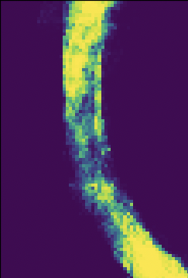

Localizing Robots using Neural Networks with Interval Data
Edwin Tomy George, Vladik Kreinovich, Christoph Lauter, Martine Ceberio, And Luc Jaulin

Slide 2
Localization through Interval Computation
The correct localization of mobile robots is necessary, even with the existence of imprecise sensors which may record geospatial data with a certain degree of uncertainty.
These mobile robots may follow heavily non-linear and not easily represented relations.
Interval Computation is a numerical tool that allows us to solve these non-linear problems in a reliable way, guaranteeing correct results and avoiding false negatives.

Slide 3
Motivation
An issue with Interval Computation is the time it takes to compute results, making real-time observations computationally expensive.
Thus, we propose using neural networks, which could supplant the role of Interval Computation and potentially reduce the time to localize mobile robots, especially in cases where a robot may follow a not easily represented relation.
computer used to run tests

Slide 4
Our Research Question
Can neural networks provide reliable decisions on situations that involve uncertainty?
Given a situation with uncertainty, explore how to best represent it with real values in such a way that the neural network will make a decision that properly accounts for the original uncertainty.

Slide 5
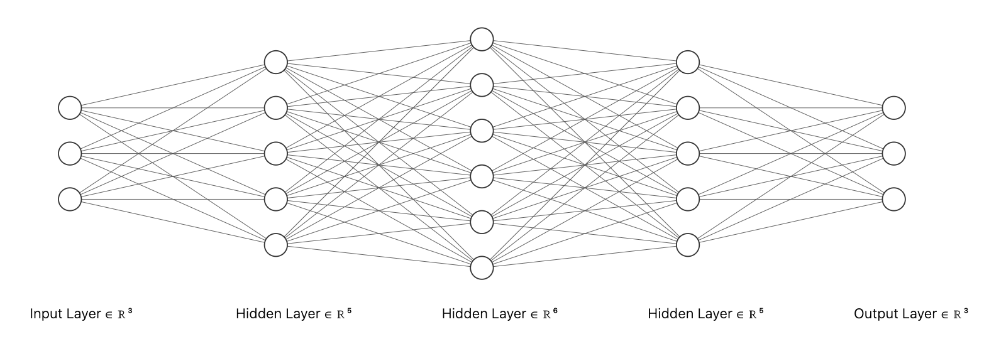
Neural Network
A neural network is a machine learning model that can make decisions given data, loosely based on how biological neural systems process information.
The neural network is composed of several layers of interconnected nodes or neurons, where each neuron performs a computation.

Slide 6
Localization Problems
We apply neural networks to solve the following situations with uncertainty
Trilateration
Time Difference of Arrival
We will explain our results with trilateration in the following slides.

Slide 7
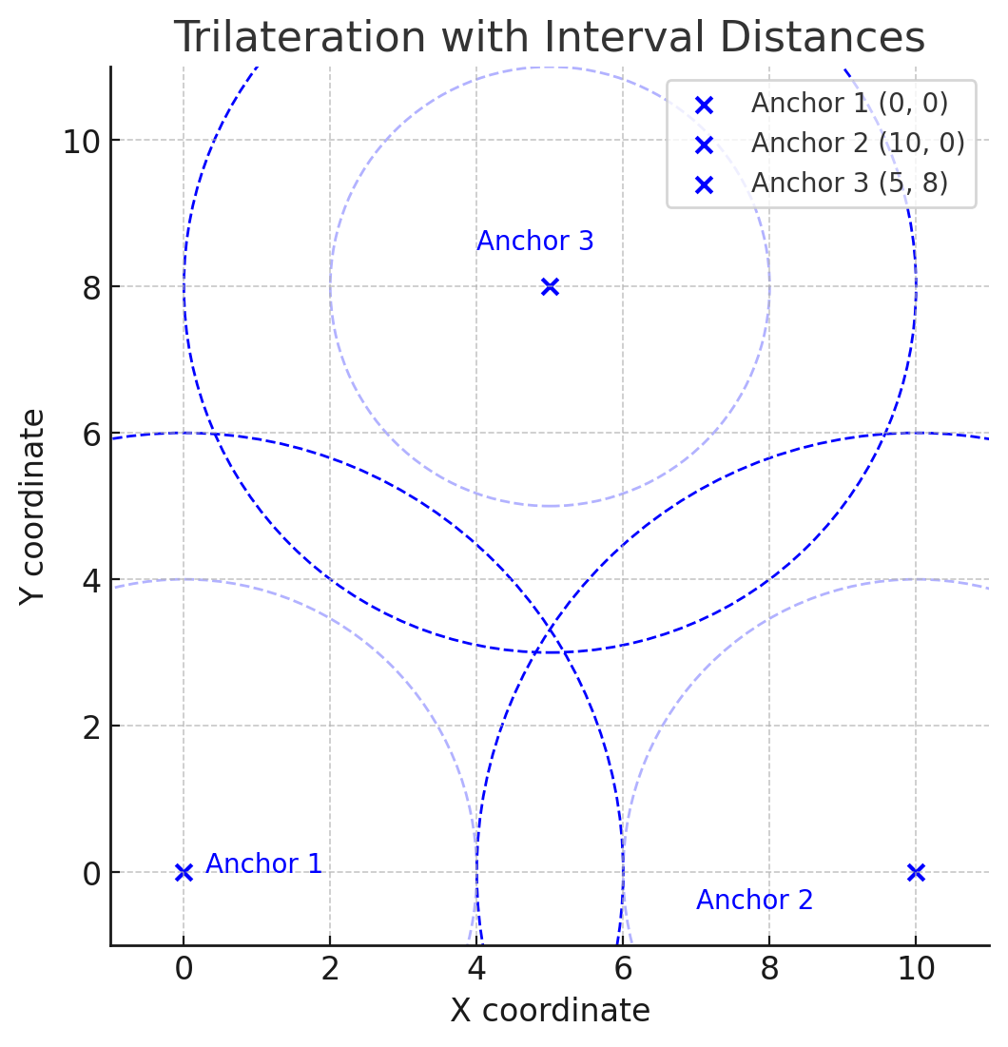
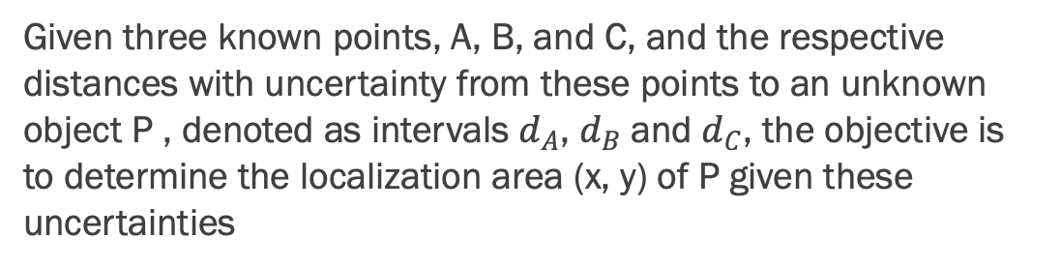
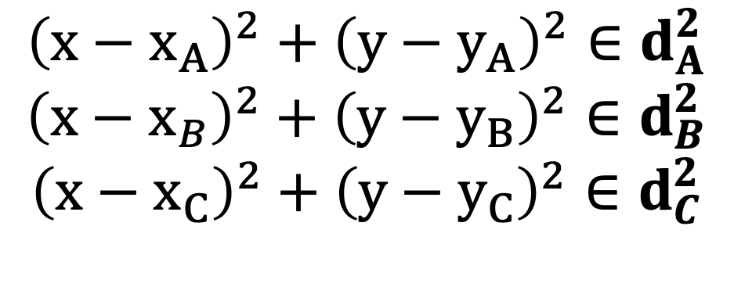
Trilateration
Given three known points, A, B, and C, and the respective distances with uncertainty from these points to an unknown object P , denoted as intervals $d_{A}$, $d_{B}$and $d_{C}$, the objective is to determine the localization area (x, y) of P given these uncertainties
$${\left(x−x_{A}\right)}^{2}+{\left(y−y_{A}\right)}^{2}∈d_{A}^{2}$$
$${\left(x−x_{B}\right)}^{2}+{\left(y−y_{B}\right)}^{2}∈d_{B}^{2}$$
$${\left(x−x_{C}\right)}^{2}+{\left(y−y_{C}\right)}^{2}∈d_{C}^{2}$$

Slide 8

Addressing Uncertainty through Real Valued Representations
We pass information as real values to the neural network.
We test with two real-valued representations
Bound representation $z→(\underline{z},\overline{z})$
Midpoint Range representation $z→(\frac{\underline{z}+\overline{z}}{2},\frac{\overline{z}−\underline{z}}{2})$

Slide 9
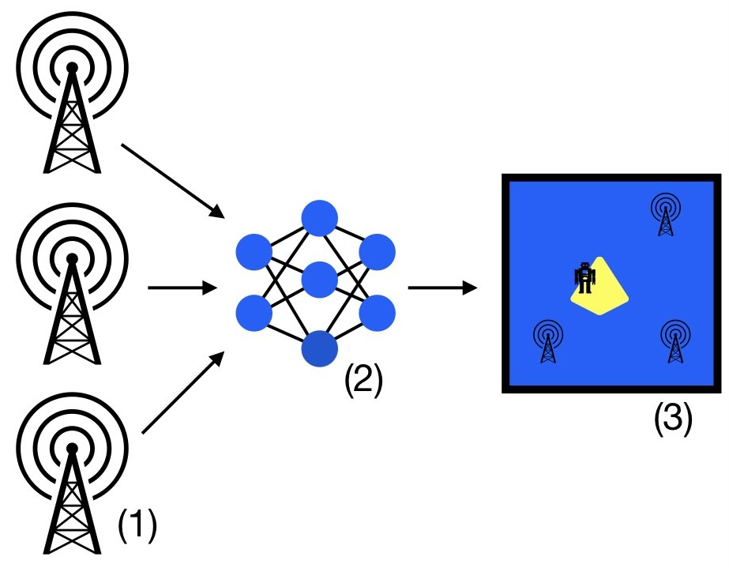
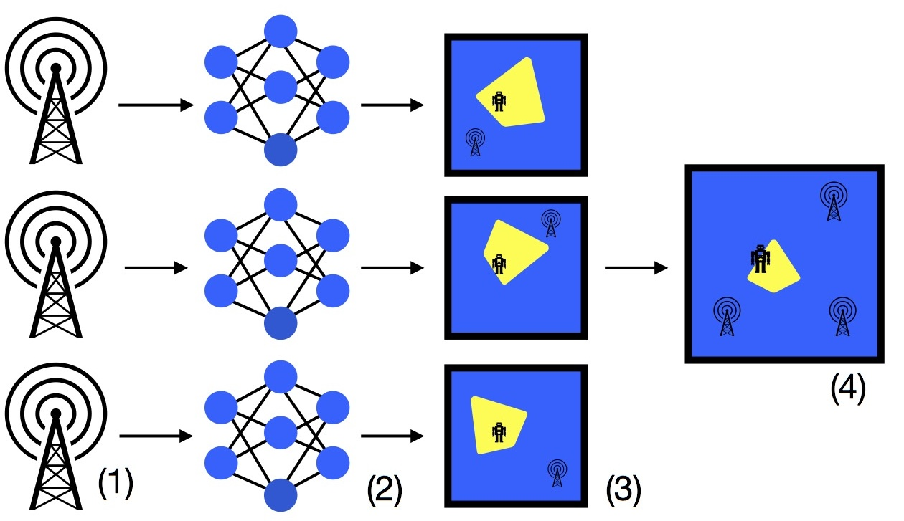
Model Input Data
Combined Input Processing: The neural network takes as inputs all the coordinates of the landmarks and their respective distance measurements and produces one final output image.
Individual Input Processing: The neural network only takes as input the coordinates and distance measurements of one landmark, and then produces an image of the possible localization of the object given the information of that landmark alone. We combined the three images obtained into one final output.

Slide 10
What metrics do we care about?
Goal: obtain high accuracy, precision, and recall
Emphasis on recall
Test two different levels for the classification threshold value
0.5
0.1
Note, we also look at the proportion of the sizes of the predicted output in comparison to the true output size.

Slide 11
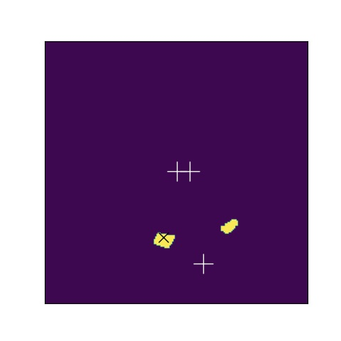
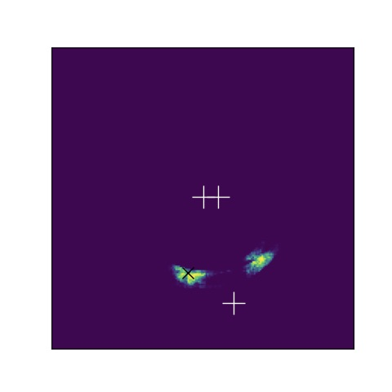
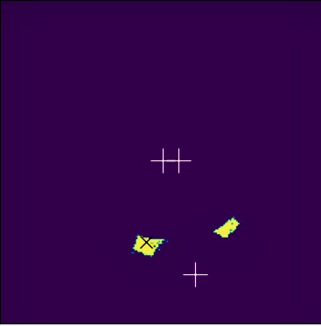
Trilateration Examples
Interval Constraint Programming
Individual Input Processing
Combined Input Processing

Slide 12
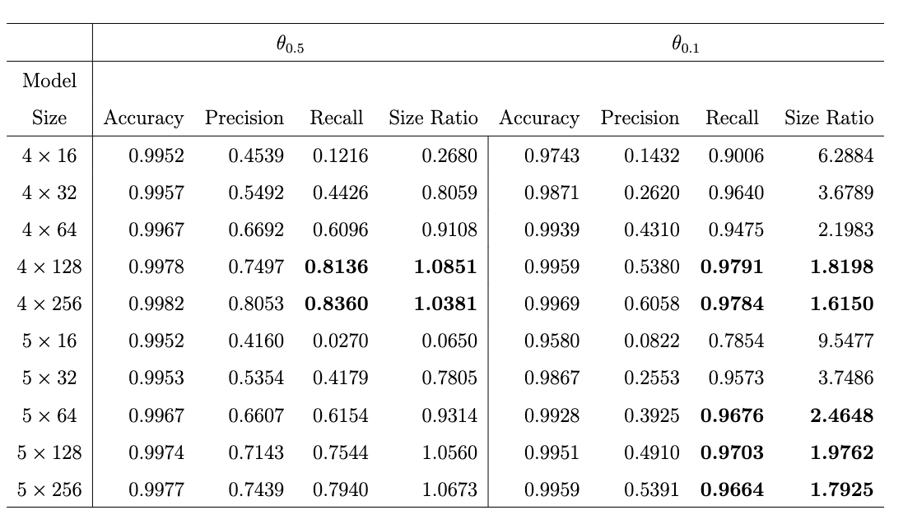
Experimental Results - Architecture
We test with different model architectures, with 4 layers containing 256 units having the best performance overall.
Individual Inputs using Bound Representation

Slide 13
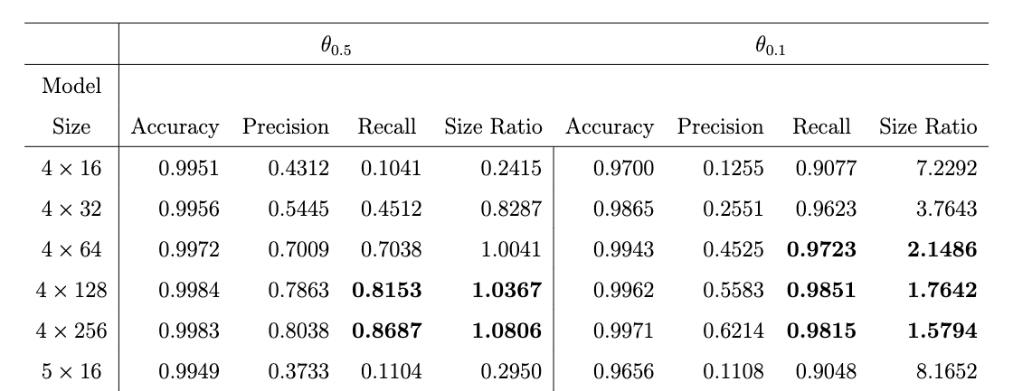
Experimental Results – Interval Representation
How intervals are represented using real values does not have a notable effect on performance.
Individual Inputs using Bound Representation
Individual Inputs using Midpoint Representation

Slide 14
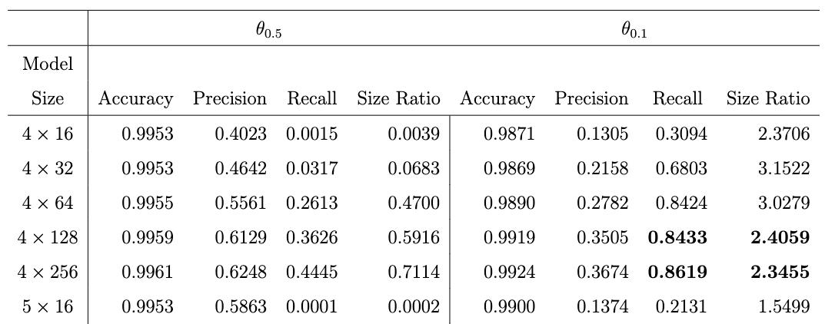
Experimental Results – Model Input Data
Individually processing the inputs of each landmark and then combining the outputted images provided a better result than using all the inputs at once.
Individual Inputs using Bound Representation
Combined Inputs using Bound Representation

Slide 15
Discussion
In individual input processing, where we reach a 0.80/0.83 in precision/recall for a threshold of 0.5 and an expected trade off between between better recall and worse precision of 0.61/0.97 for a threshold of 0.1.
In combined input processing, the pair precision / recall is lower.

Slide 16
Conclusion
In general, the best models for trilateration can predict somewhat decent localization regions which are of similar size to the region produced by interval computations.
For applications where almost certain guarantee is needed, the outputted region will be slightly larger than that of interval computations, on average 1.6 times larger.

Slide 17
Future Work
Integrate filtering mechanisms within the models to impose stricter constraints on the predicted outputs. By leveraging more constraint programming techniques, while controlling the cost, the model can ensure that the predicted localization region adheres to more precise parameters, allowing increasing the threshold for recall in the pursuit of reliable results.
Propagate the uncertainty from the input data throughout the network through replacing the variables and operations in the neural network with intervals.

Slide 18
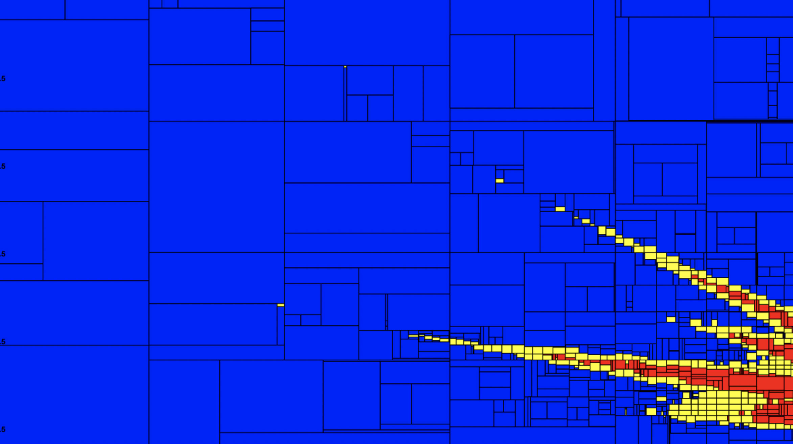
Thank you for your attention!

