Slide 1

Achieving Our Professional and Personal Goals: Asking & Helping
Charles Boehmer, Eric Smith, Kate Gannon, Kien Lim, Vladik Kreinovich
kienlim@utep.edu
Notes:
https://tinyurl.com/UTEPkindness

Slide 2
Purpose
What goals do you have for your professional career and/or helping UTEP advance in its mission?
What we seek to accomplish in this ignite session is a discussion about how to think about achieving our goals by avoiding isolation and working with others
Let us see how we can apply the video by Barbara Sher to our professional circumstances and location

Slide 3
An Ignite Session
Welcoming & Purpose
Barbara Sher’s Idea
Groups of 3 Discussion
General Audience Discussion
Future Plans
Notes:
Welcoming (welcome participants, introduce ourselves, purpose: what are we trying to ignite?) When you are connected, there are more opportunities.
Barbara Sher’s Idea (introduce Barbara Sher, summarize the earlier parts of the video, show the last part to highlight wishes & obstacles)
Questions/Thoughts (to clarify/discuss Barbara Sher’s idea - why it works?)
Option 1: Groups of 3 (Liberating Structures - 8. Troika Consulting format) Option 2: Whole group to discuss what it takes to implement Barbara Sher’s idea at UTEP (or in the community)
Next steps - invite participants to join the Kindness-at-UTEP informal faculty & staff group.
2022 CFLD Proposal - Asking-Helping - Google Docs

Slide 4

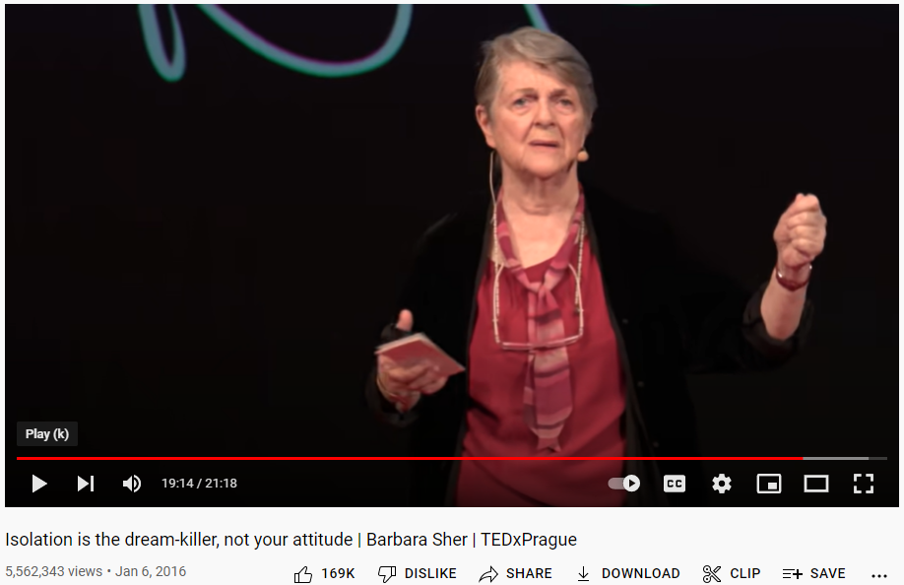
Barbara Sher’s Idea
Who is Barbara Sher?
How to get what you really what?
A short video clip
https://youtu.be/H2rG4Dg6xyI?t=1110
Notes:
a speaker, career/lifestyle coach, and author
passed away in May 2020

Slide 5
Group of 3 Discussion
1. Invitation: “What is your goal?”
“What are your obstacles?”
2. Process: One Client with 2 Consultants
A Client shares goal B Consultants ask clarifying questions & give advice C Client-consultants dialogue
3. Change roles

Slide 6
Participation and Interaction, avoiding isolation
Participating in collective activities allows for interactions that:
help Identify and remove barriers to our goals, by having others help us learn, hone, and adapt
important in finding mentors, sponsors, and networking generally
Such connections to others may lead to opportunities that are good for the collective, such as the UTEP community, helping ourselves with our own goals
This may lead to more opportunities than one would be afforded if one is isolated from others
What we often achieve is done so by standing on the shoulders of our peers, mentors, colleagues, friends, and family

Slide 7
How This Process Helps: General Audience Discussion
It feels good:
to know that others are eager to help you;
to learn that you can be of help to others;
to realize that you are not the only one struggling with your problems
How this process helps:
the very need to share your goals and obstacles makes us formulate them clearly to ourselves, and this helps to solve these problems;
it often helps to get different perspectives on your problems;
knowing how others succeeded in similar situations helps;
you also learn what did not work, so you can select and combine the most successful strategies and avoid problematic ones.

Slide 8
How This Process Helps (cont-d)
This process also helps:
an advice from someone outside your discipline is often helpful, especially for interdisciplinary problems;
to learn about how results from your research area are used in other areas -- e.g., how math is used in biology;
this knowledge can lead to new collaborations,
this knowledge also helps better motivate students in your classes;
even when you do not immediately get helpful advice, you often learn how to look for someone who can help.

Slide 9
Closing Remarks
Kindness at UTEP - an informal group of faculty and staff interested in promoting kindness on campus
An example of a statement promoting a culture of care that can be included in our syllabus.
UTEP espouses a culture of care and excellence. In this course, I strive to model kindness and do my best to support your learning while maintaining high expectations and learning outcomes.

Slide 10
THANK YOU
Notes:
https://tinyurl.com/UTEPkindness

